Slide 1
Quiz Management System
Project Proposal
Faysal Ahmad
221-15-4699
Esrat Jahan
221-15-4690
Shakibur Rahman
221-15-4714
Fatema Akter
221-15-4765

Slide 2

Quiz Management System
A Quiz Management System is a software application designed to facilitate the creation, administration, and management of quizzes for students and teachers. It allows students to take quizzes, submit answers, and view results, while enabling teachers to create, update, delete questions, and track student performance. This system aims to simplify the assessment process by automating quiz distribution and result management.

Slide 3





Motivation
Improved Efficiency
Increased Profitability
Easy Monitoring
Reduced Costs
Customizable Quizzes

Slide 4





Tools Used In Project
Java
JFrame
Netbeans
My SQL
Xampp

Slide 5





Key Features
Quiz Creation and Management
Instant Results and Feedback
User
Authentication
Student Information Management
Result
Analysis

Slide 6
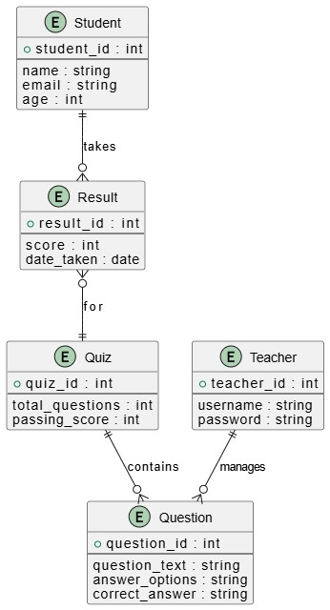
ER Diagram
Student
Quiz
Teacher
Question

Slide 7
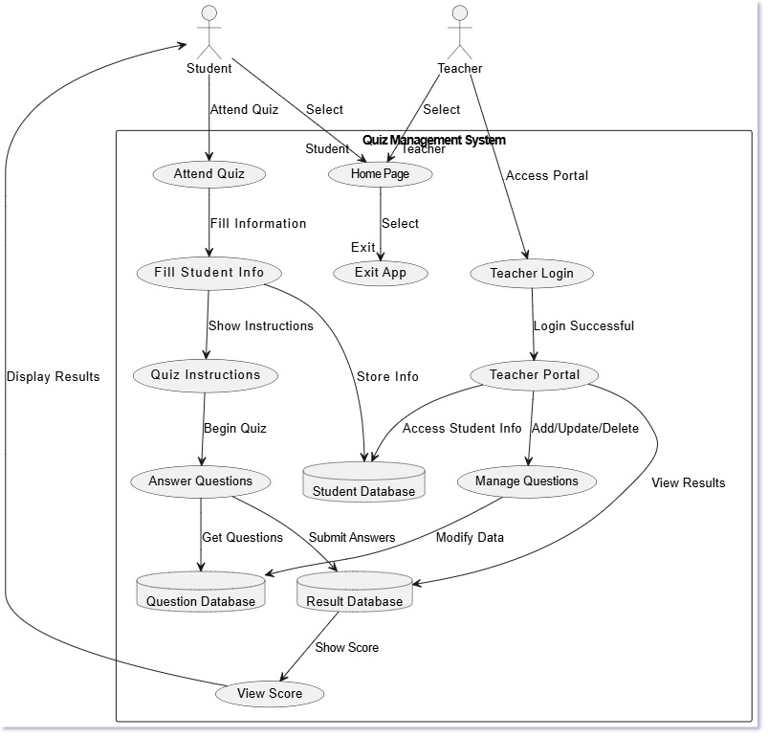
Use Case Diagram
Processes
The DFD defines the main processes in the system, such as HomePage, AttendQuiz, TeacherPortal, and ManageQuestions.
Data Stores
The system includes important data stores like StudentDatabase, QuestionDatabase, and ResultDatabase, which store student information, quiz questions, and results respectively.
Entities
The external entities include Student and Teacher, who interact with the system. Students participate in quizzes and view results, while teachers manage questions and view student information.

Slide 8
Applications
Education and E-Learning Platforms
Competitive
Exams

Slide 9
Survey
And
Polling
Corporate
Training

