Slide 1
IPv4 vs IPv6: Challenges and Solutions
OSI model, Application Layer
Faysal Ahmad
ID:221-15-4699
Esrat Jahan
ID:221-15-4690
Shakibur Rahman
ID: 221-15-4714

Slide 2
IPv4 vs. IPv6
Challenge
Solution
IPv4
Address exhaustion
Limited support for security
Increased complexity
IPv6
Balance with IPv4 systems
Higher infrastructure costs
Limited expertise and knowledge
IPv4
Subnetting
Utilize VPNs and firewalls
Implement address management systems
IPv6
Dual Stack Implementation
Phased Transition
Training IT staff

Slide 3
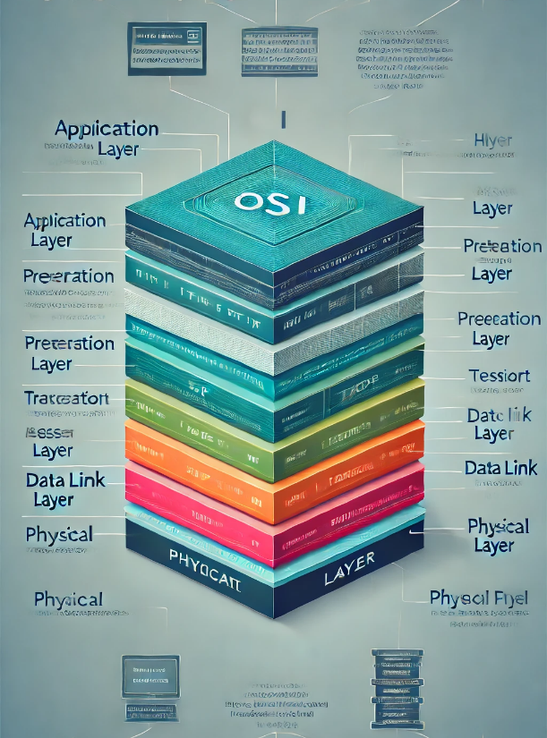
OSI Model
Layer
Physical Layer
Data Link Layer
Network Layer
Transport Layer
Session Layer
Presentation Layer
Application Layer

Slide 4
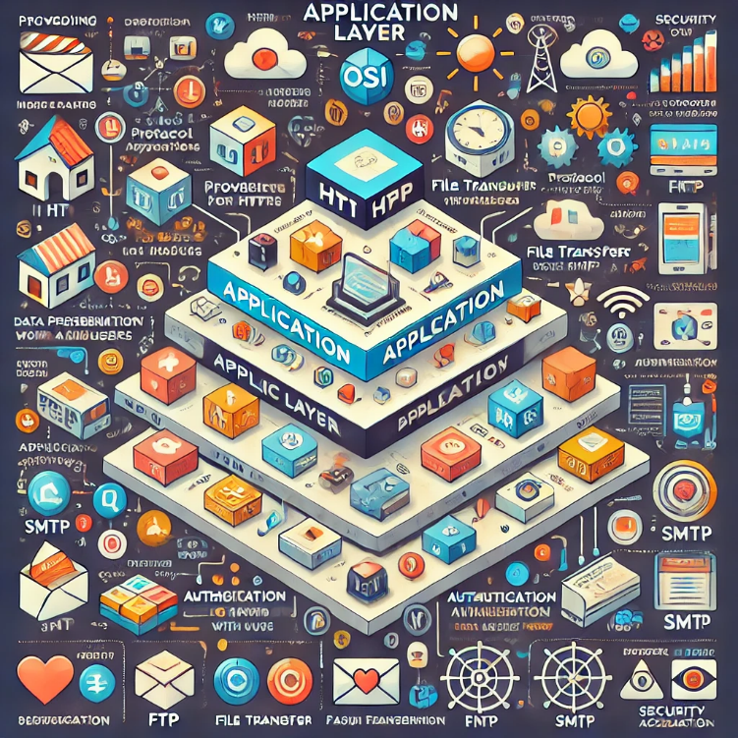
Application Layer
The Application Layer is the seventh and topmost layer of the OSI model. It provides an interface for software applications to communicate over the network, allowing end-users to interact with network services.
Provides Network Services to End-Users
Data Presentation for Applications
Protocol Support for User Applications
Session Management and Error Handling

