Slide 1
A lightweight CNN for Breast Cancer Classification Using the BI-RADS System on a Mobile Platform
Arnub Datta
ID :221-15-4726
Department of CSE
Daffodil International University
Dr. Md. Monzur Morshed
Professor
Department Of CSE
Daffodil International University

Slide 2
Outline
Introduction
Problem Statement
Motivation and Objective
Related Works
Comparison Between Existing Works
Gap Analysis
Proposed Methodology
Q & A

Slide 3
Introduction
Breast cancer is one of the leading causes of cancer-related deaths among women globally. Early and accurate diagnosis is critical for effective treatment, yet manual interpretation of mammograms is time-consuming, subjective, and error-prone.
Recent advances in deep learning, particularly Convolutional Neural Networks (CNNs), have shown remarkable success in automating medical image analysis, including BI-RADS classification.
This research aims to develop an efficient, lightweight CNN model capable of accurately classifying breast cancer from mammography images, overcoming the limitations of traditional manual methods and heavy pre-trained models.
Furthermore, to ensure real-world applicability, the system is integrated into a mobile application using TensorFlow Lite and Flutter, enabling instant, offline diagnosis at the point of care, especially useful in resource-limited settings.
This work bridges critical gaps in diagnostic accessibility, model efficiency, and mobile deployment for AI-powered breast cancer screening.

Slide 4
Problem Statement
High Mortality Rates – Breast cancer causes significant deaths among women due to delayed or missed diagnoses.
Limitations of Manual Interpretation – Mammogram analysis is time-consuming, subjective, and prone to human error.
Lack of Accessible AI Solutions – Most deep learning models are resource-heavy, making them unsuitable for real-time use in mobile devices.
Limited BI-RADS Integration – Few studies effectively integrate BI-RADS classification into lightweight, deployable AI systems.
Data Imbalance Issues – Many datasets have unequal class distributions, affecting model accuracy and generalization.
Deployment Challenges – Existing AI solutions often lack optimization for offline and low-resource environments.

Slide 5
Motivation and Objective
Motivation | Objective
Breast cancer is a leading cause of death among women worldwide. Early and accurate diagnosis significantly improves survival rates. Manual BI-RADS classification is time-consuming and prone to errors. Deep learning, especially CNNs, offers powerful tools for medical image analysis. There is a need for lightweight, mobile-friendly models for real-time diagnosis in resource-limited | Develop a lightweight CNN model for accurate BI-RADS classification of breast mammograms. Apply effective preprocessing and data augmentation techniques to improve model performance. Address class imbalance using augmentation strategies to ensure fair learning across categories. Evaluate model performance using metrics such as accuracy, precision, recall, and F1-score. Deploy the optimized model in a mobile app using TensorFlow Lite and Flutter for offline diagnosis.

Slide 6
Related Works
Gao et al. (2018) introduced SD-CNN, a hybrid shallow-deep CNN architecture for breast cancer diagnosis, improving performance over traditional CNNs.
Liu et al. (2021) combined mammography images with clinical data to predict malignancy of BI-RADS 4 microcalcifications, enhancing diagnostic precision.
Tsai et al. (2022) developed a high-performance DNN for BI-RADS classification using screening mammograms, achieving state-of-the-art accuracy.
Hejduk et al. (2022) proposed a fully automated CNN for BI-RADS classification in ABUS (ultrasound), highlighting the modality-independent potential of deep learning.
Eshun et al. (2024) tackled class imbalance in breast cancer datasets using a deep CNN, improving classification accuracy for minority BI-RADS classes.

Slide 7
Comparison Between Existing Works
Author | Model Used | Accuracy / AUC | Contribution
Hejduk et al. [16] | Deep CNN + Sliding Window | 90.9% (Acc), 0.91 (AUC) | ABUS-based BI-RADS detection with localization
Sexauer et al. [17] | Dual DCNN | 89.6% (Acc) | ACR breast density classification with strong radiologist agreement
Baccouche et al. [18] | ResNet ensemble + XGBoost | Up to 99% (Acc) | BI-RADS & shape classification with ensemble transfer learning
Valencia-Hernandez [19] | Texture Analysis + Fuzzy Logic | 84.2%, 81.3% | Breast density mapping via fuzzy classification
Eshun et al. [20] | DCGAN + ResNet50 | High Acc (not specified) | GAN-based data balancing for histopathology
Kollem et al. [21] | Hybrid CNN + RFE + ML Classifiers | 99.99% (Acc) | 4-stage hybrid pipeline with novel feature selection

Slide 8
Gap Analysis
Large Model Sizes: Existing CNN models are too heavy for efficient mobile deployment.
Lack of Real-Time Mobile Solutions: Few AI tools are optimized for real-time breast cancer classification on mobile devices.
BI-RADS Integration: Limited research directly integrates BI-RADS classification into deep learning models for mobile applications.
Class Imbalance Issues: Many datasets suffer from imbalance, reducing model accuracy for minority classes.
Limited Field Testing: Few solutions are validated in real-world, resource-limited healthcare settings.

Slide 9
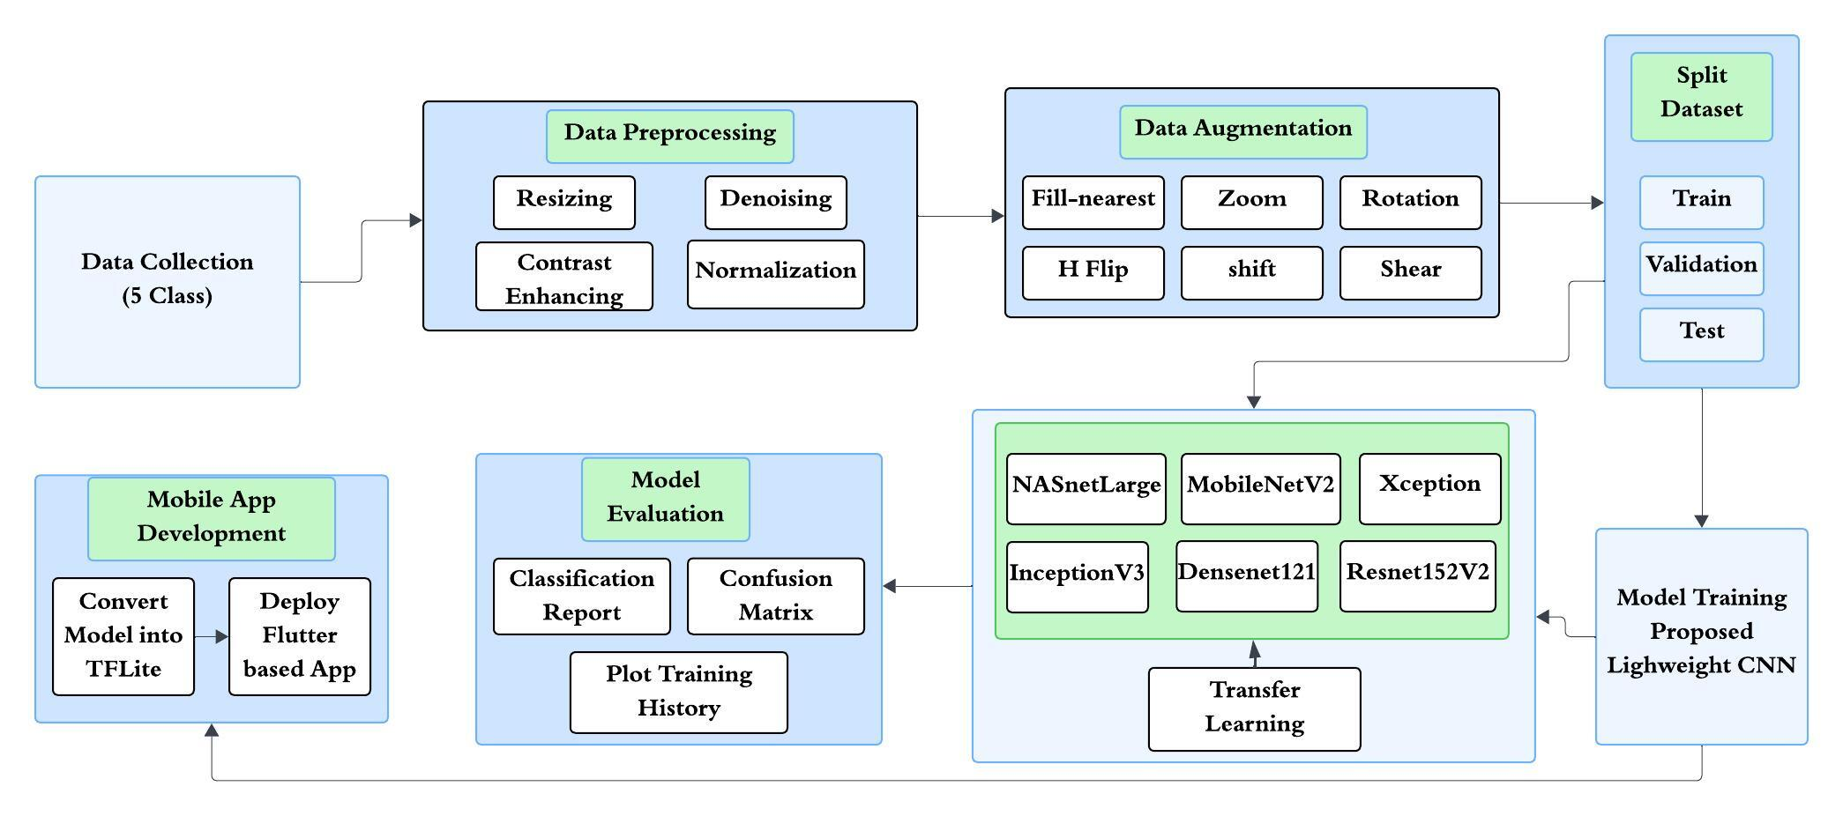
Proposed Methodology

Slide 10
THANK YOU

