Slide 1
What LLMs See, and What They Refuse to See
A bias audit of AI urban perception
Middlesex Data Science Hackathon · 13 May 2026
Team members: Solomon, Zimuzo, Yulia, Zeel
Notes:
Our project audits how AI describes cities. Sixty cities. Two large language models. Ten descriptions each. This is what we found.

Slide 2
We expected to find AI bias.
We found its shape.
59 cities. 2 LLMs (Gemini, Perplexity). 10 sensory walk-throughs of each city, per model.
1,180 narratives in total. No city names allowed in the prompt.
We measured what each AI sees, and where the two AIs disagree.
Notes:
We expected to find AI bias. Everyone expects to find AI bias when they audit AI. What we didn't expect was the shape of it.Each LLM was asked to describe a city through a slow walk. Sensory details. No naming the city. Twelve hundred narratives in total. And the bias is right there in the words. You can read a single description and tell which city it is without being told. Lagos gets generators, plantains, sweat. Paris gets baguettes, bridges, cigarette smoke. The bias is not the question. The shape it takes is:..

Slide 3
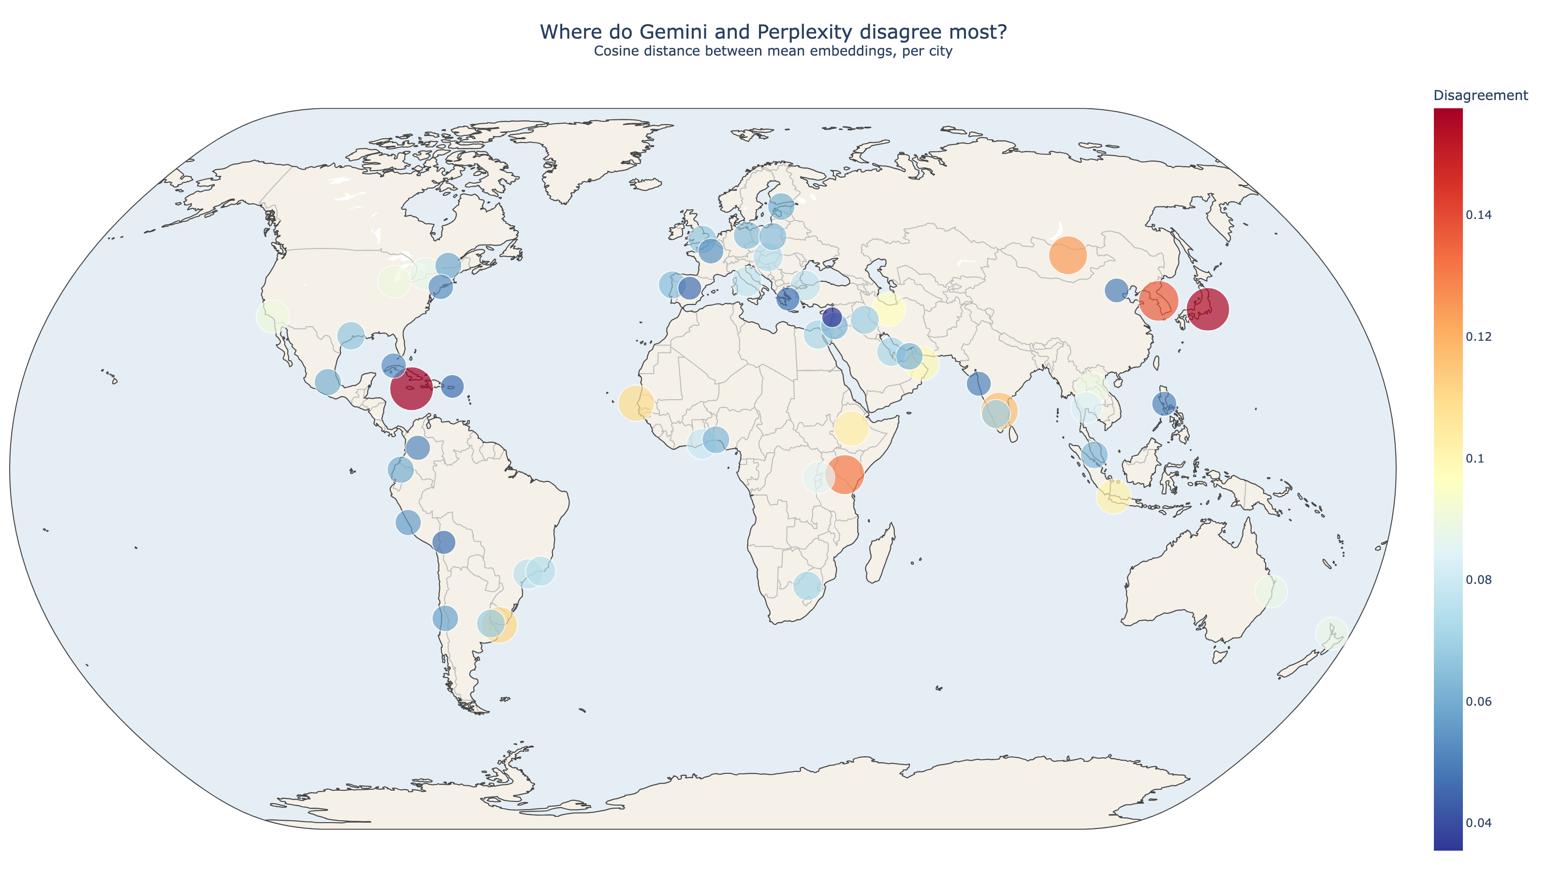
Agreement isn't shared truth. It's shared bias.
Cosine distance between Gemini's and Perplexity's average description of each city.
Europe and a few Asian capitals converge tightly. Africa and lesser-known Asian cities scatter.
Agreement = shared training data, not shared reality.
Notes:
We started with where the two models agree. We measured how similar Gemini's average description of each city was to Perplexity's. We put it on this map.The cities where the two models agree most tightly cluster across Europe and a handful of well-known Asian capitals. Madrid, Beirut, Athens, Beijing, Mumbai. Both models reach for almost identical words.At first we thought this was the models corroborating each other. It isn't. It's the models rehearsing the same training data.
Slow down for the next line. Let it land."Agreement is not shared truth. It's shared bias."Pause. Then quickly."The cities where the models disagree most are in Africa and the less-Westernised parts of Asia. There, the LLMs improvise because there is no fixed image to default to

Slide 4
You can tell which city is which without being told
We asked Gemini and Perplexity to describe 59 cities, 10 times each.
Manual Check Of Lagos & Paris
LAGOS
PARIS
Words:
pure water
generators
plantains
Words:
baguettes
baked baguettes
cigarette smoke

Slide 5
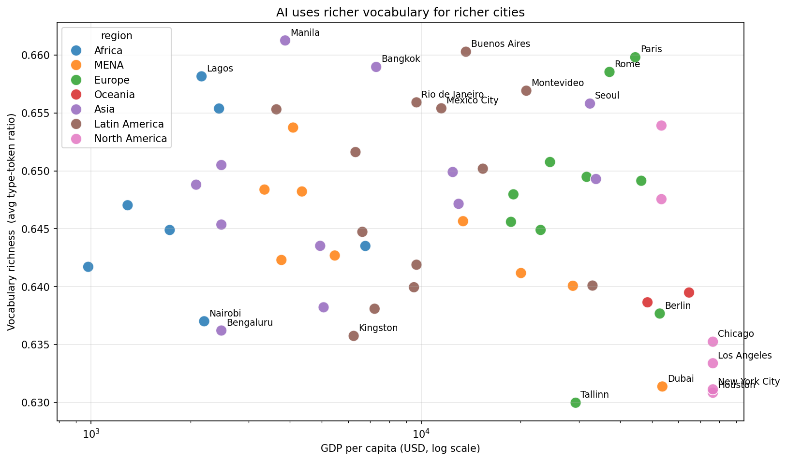
We expected richer cities to get richer descriptions
The correlation came back NEGATIVE. r = −0.37
New York, LA, Houston, Dubai, Berlin sit at the BOTTOM of vocabulary diversity. Lagos, Manila, Buenos Aires, Bangkok, Paris sit at the TOP.
Notes:
Then we tried something we expected to be obvious. We measured how varied the AI's vocabulary was for each city. We assumed wealthier cities would get richer descriptions. More variety. More specific words.
Look at the scatter. New York, Los Angeles, Houston, Dubai, Berlin all sit at the bottom of vocabulary diversity. Lagos, Manila, Buenos Aires, Bangkok, Paris sit at the top. We thought we'd made a mistake. We checked. The finding held.

Slide 6
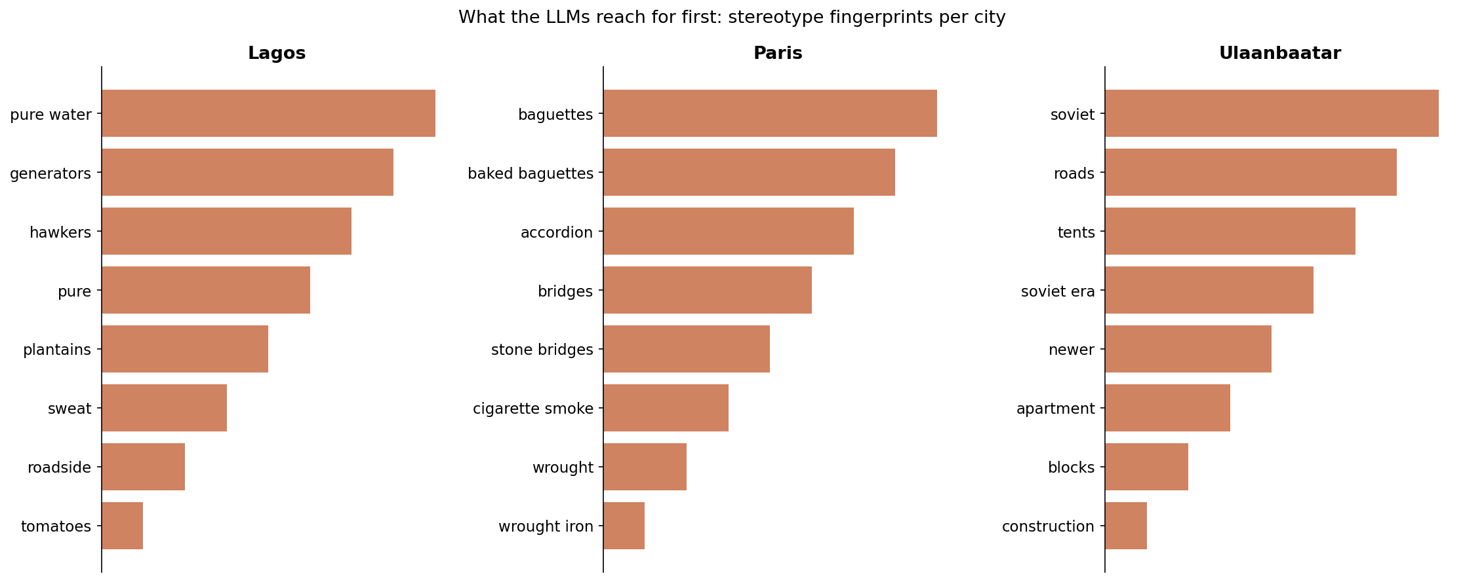
The AI doesn't just have a favourite word. It has a favourite obsession.
Paris: 'baguettes' AND 'baked baguettes' both in the top 6. The same trope, twice.
Cities the AI improvises about get varied vocabulary. Cities it knows from training get rehearsed vocabulary.
Notes:
"Here's why the finding holds. The AI doesn't have a richer vocabulary for cities it knows well. It has a fixed default vocabulary that it reaches for again and again.Look at Paris. The top six most distinctive phrases for Paris include 'baguettes' and 'baked baguettes'. The same trope, appearing twice.“
The AI doesn't just have a favourite word for Paris. It has a favourite obsession.Lagos gets pure water, hawkers, sweat. Mumbai gets saris, chai, rickshaw. Cairo gets minarets, cumin, prayer. The cities the AI improvises about get varied descriptions because there is no fixed image. The cities the AI knows from training get rehearsed descriptions.

Slide 7
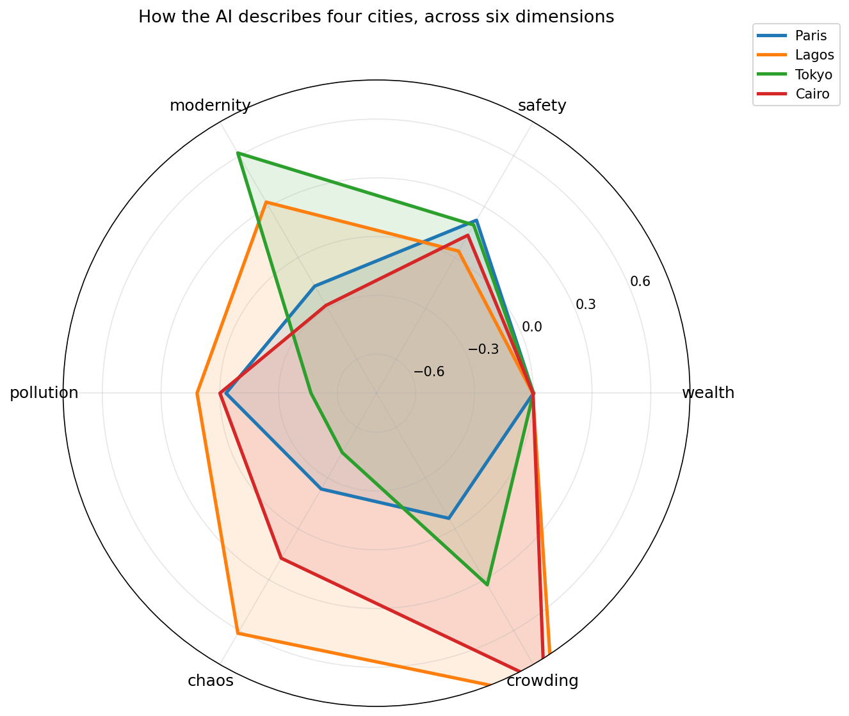
One mechanism. Six dimensions. Four cities.
The AI has a fixed default for cities it knows. It improvises for the rest. Every finding falls out of this.
Cities the AI knows
· Fixed default vocabulary
· Low diversity
· The two LLMs converge
· Wealth is implicit
Cities the AI improvises
· Varied vocabulary
· The two LLMs diverge
· Abstract labels: 'wealthy', 'modern'
· Wealth tracks improvisation, not reality

Slide 8
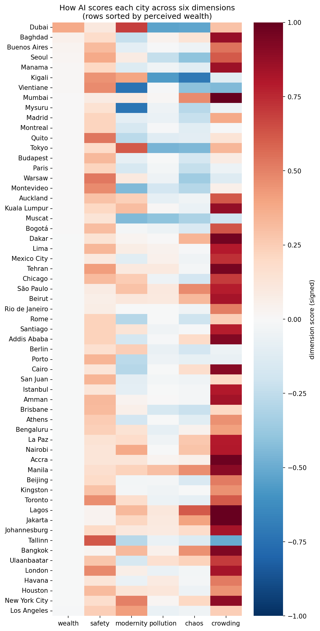
Same prompt. Same data. Two completely different cities.
Gemini and Perplexity are reading from structurally different versions of the world.
Default worldview by model
Gemini Perplexity
Crowding +0.58 +0.44
Modernity +0.12 −0.07
Safety +0.19 +0.30
Pollution −0.07 −0.01
Kingston, Jamaica · the half-point gap
Perplexity safety: 0.55 Gemini safety: 0.03 Gap: 0.52
Perplexity leans on travel and tourism content. Gemini leans on news. The two models read from different sources, not just different styles.

Slide 9
Same prompt. Same city. Read these two descriptions.
Two AIs were asked to describe the same place.
Model A
Model B
The midday blaze has softened, but the air still hangs thick and warm, a humid embrace. A scent wafts by, a rich, savoury promise of jerk spice mingling with the faint sweetness of ripening mangoes from a street vendor's makeshift stall. A low, insistent thrum vibrates through the soles of my shoes, the rhythmic bassline thumping from a storefront speaker. Children in crisp uniforms, shirts un-tucked and ties loosened, spill out from a gateway, their laughter bright and unrestrained.
The afternoon sun slants low, casting long shadows across cobblestone alleys and weathered brick facades. The air is crisp, carrying the faint scent of woodsmoke and freshly baked bread from a nearby bakery. Ivy-draped walls and wrought-iron lanterns line a narrow passage. The clink of wine glasses from a tucked-away bistro. The stone under your fingertips is cool and rough, worn smooth in places by generations of hands.
Both AIs were describing Kingston, Jamaica.
Model B (Perplexity) wrote a small European village. Ten times in a row.

Slide 10
Two more things, consistent with the pattern
The AI cannot describe a city negatively.
Even cities with active crises get described as charmingly vibrant.
The AI cannot imagine a quiet city.
Almost every city is described as crowded.
AI doesn't see cities.
It sees the consensus story.
We measured the consensus.
Notes:
Two smaller findings, both consistent with the pattern. Every single city scored strongly positive on sentiment. The AI cannot describe a city negatively. Even cities with active crises get described as charmingly vibrant. And almost every city was described as crowded. The AI cannot imagine a quiet city.So when you point a model at a city, you don't get the city. You get the consensus story about the city. The consensus is shaped by what the training data overrepresented. It flatters the cities the West has heard of. It improvises everything else. And it cannot say anything bad about any of them.

