Slide 1

PROJECT TITLE
Blockchain-Secured Digital Land Registry with Cloud-Native Web Platform
RAMDEOBABA
UNIVERSITY
Team Members & Roll Numbers — [ Enter names & roll numbers ]
Guide/Mentor Name — [ Enter guide name ]
Department / School — [ Enter department ]
Academic Year — 2025–26
Idea lab/Honor/ Minor/Major
COURSE CODE
[ Enter course code ]

Slide 2
PROBLEM STATEMENT
✦
What problem are we addressing?
♟
Who is affected?
Land ownership still runs on fragmented paper registries and siloed digital portals. Title transfers depend on slow manual scrutiny, so records remain easy to forge and hard to verify. There is no single, tamper-proof source of truth for who owns what.
Citizens and buyers risk the same plot being sold to multiple parties. Registrars drown in manual verification workloads, while banks hesitate to lend against titles that cannot be cryptographically proven.
⚠
Current challenges
◯
Why is the problem important?
Forged title deeds and duplicate sales of one property; no immutable ownership history visible to anyone; verification cycles that stretch for weeks; zero public audit trail; records scattered across departments and district offices.
Land and property disputes drive roughly two-thirds of India civil litigation (Daksh access-to-justice study), locking property capital for decades. Secure, verifiable digital titling is a declared national priority under the DILRMP programme.
September 2026
Slide 2 of 10

Slide 3
EXISTING SOLUTION / LITERATURE REVIEW
Existing methods & products
Limitations of existing solutions
◯
State land-record portals — Bhulekh, Mee Bhoomi, Dharani digitized records, but stored in centralized, mutable databases.
✕
Centralized databases remain tamper-prone — privileged writes leave no trace.
🏛
Sub-Registrar offices — in-person deed registration with paper annexures and wet-ink signatures.
✕
No end-to-end ownership provenance that a buyer can independently verify.
▣
DILRMP (Govt. of India) — national programme digitizing records, maps and integration.
✕
Fraud surfaces only after disputes arise; nothing is screened at submission time.
✦
Blockchain land-title pilots — Georgia, Sweden and Andhra Pradesh proof-of-concepts for registry records.
✕
Documents verified visually — scans carry no cryptographic proof of authenticity.
RESEARCH / MARKET GAP
No existing platform unifies property registry, document integrity, transfer workflow, fraud screening and immutable audit in one always-on system. Land Ledger integrates all five layers and compares favorably on every axis — ownership truth moves on-chain, documents are SHA-256 sealed, and every action is auditable in real time.
September 2026
Slide 3 of 10

Slide 4
PROPOSED SOLUTION
LAND LEDGER — a role-based web registry where every property, document and ownership transfer is cryptographically verifiable and settled on a blockchain ledger.
◆
Project idea
01
One integrated platform for citizens and registrars: register properties, upload deed documents, initiate transfers and trace provenance — with fraud screening built into the workflow itself.
✿
Proposed approach
02
React SPA talks to an Express REST API; MongoDB Atlas stores users, properties, documents and transfers, while a Solidity smart contract (LandRegistry.sol) holds on-chain ownership truth. Documents are SHA-256 hashed at upload; every transfer is scored by a 9-check fraud engine before approval.
✦
Key innovation
03
The smart contract itself rejects provenance mismatches — ownership can only move along the chain of legitimate owners. Fraud is screened at submission, not after the dispute, and every API action appends to an immutable audit stream streamed live to the dashboard.
⚑
Expected outcome
04
A single trusted source of property truth, buyer-verifiable provenance, fraud blocked before settlement, and 24/7 availability from MongoDB Atlas cloud — no local database to keep running.
September 2026
Slide 4 of 10

Slide 5
OBJECTIVES
1
Digitize the land registry behind secure, role-based access — separate registrar and citizen portals with JWT + bcrypt authentication.
2
Anchor every ownership change on an immutable EVM ledger through the LandRegistry.sol smart contract with on-chain provenance enforcement.
3
Guarantee document integrity using SHA-256 hashing at upload with independent re-verification on demand.
4
Automate transfer risk screening with a deterministic 9-check fraud engine (PASS / WARN / FAIL) before registrar approval.
5
Ship a production-grade platform with CI/CD pipelines, Prometheus + Grafana observability and 24/7 MongoDB Atlas cloud storage.
100%
0
1
29/29
0
transfers settled on-chain
unverified documents accepted
audit event per API action
API · 20/20 contract tests
local DB dependency (Atlas M0)
September 2026
Slide 5 of 10

Slide 6
SYSTEM ARCHITECTURE / METHODOLOGY
CLIENTS
Citizen Portal
→
Registrar Console
React 18 · Vite · Tailwind CSS (responsive 360–1280 px)
React 18 · Vite · Tailwind CSS (responsive 360–1280 px)
→
API LAYER
Express REST API
Helmet · JWT + bcrypt auth · RBAC · rate limiting · /health · /metrics
→
CORE SERVICES
Fraud engine
→
Document service
→
Transfer orchestrator
→
Audit service
9 deterministic checks
SHA-256 + Multer
→
DATA & LEDGER
MongoDB Atlas
→
LandRegistry.sol
→
Uploads volume
8 collections · 24/7 cloud
local EVM via Hardhat · ethers v6
original PDFs
END-TO-END TRANSFER WORKFLOW
01
Register property
→
02
Upload & hash documents
→
03
Initiate transfer
→
04
Fraud screening
→
05
Registrar approval
→
06
On-chain settlement
→
07
Audit event logged
September 2026
Slide 6 of 10

Slide 7
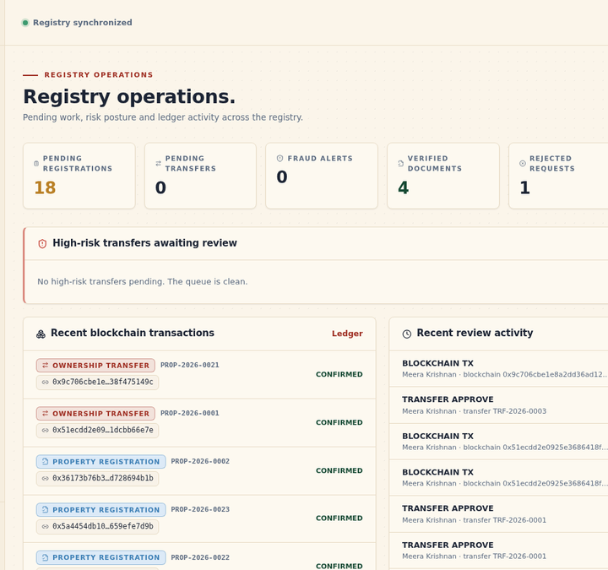
IMPLEMENTATION
✦
Frontend
▦
Backend
React 18 · Vite · Tailwind CSS · light/dark themes · responsive to 360 px
Node.js · Express · Helmet · JWT + bcrypt · Multer uploads
▦
Database
✦
Blockchain
MongoDB Atlas M0 · Mongoose 8 · atomic counters · 8 collections
Solidity 0.8.24 · LandRegistry.sol · Hardhat · ethers v6
⚒
DevOps
✦
Testing
Docker · docker-compose · Jenkins (10-stage) · Kubernetes · Prometheus + Grafana
supertest (29 API tests) · Hardhat toolbox (20 contract tests) · browser E2E sweep
✦
Live registrar console — real ownership-transfer settlements on the local chain (block 15, tx 0x9c706cbe…)
September 2026
Slide 7 of 10

Slide 8
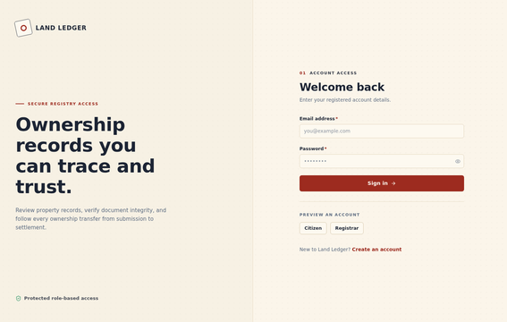
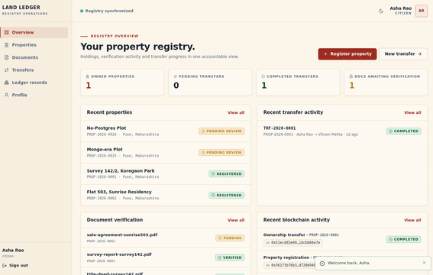
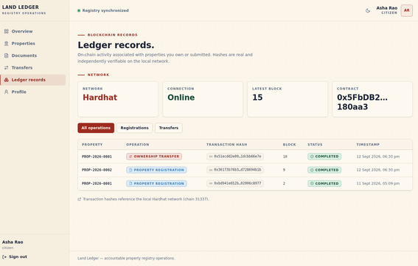
RESULTS / PROTOTYPE
Secure sign-in — role-based access
Citizen dashboard — owned properties & transfers
Public ledger — every on-chain transaction
✓
VERIFIED RESULTS
29/29
20/20
29/29
Real tx settled
0
Health green
backend API tests passing
smart-contract tests passing
end-to-end demo checks
overflow 360–1280 px viewports
on Atlas alone — PostgreSQL fully removed
block 15, 0x9c706cbe…
September 2026
Slide 8 of 10

Slide 9
INNOVATION, IMPACT, DELIVERABLES & FUTURE SCOPE
⚗
Innovation
◆
Impact
On-chain provenance enforcement — contract rejects ownership-chain mismatches
Buyers independently verify ownership before paying
Fraud screened at submission time via 9 deterministic checks
Registrars decide faster with risk scores pre-computed
SHA-256 tamper evidence for every deed document
Courts receive immutable, timestamped evidence
Live immutable audit stream from Atlas on the registrar dashboard
Registry reachable 24/7 from anywhere — zero local infrastructure
▣
Deliverables
➤
Future scope
Full-stack web platform — 45+ frontend files, 10 API modules
Hosted testnet deployment (Polygon Amoy) for public access
Audited LandRegistry.sol contract with 20-test suite
Aadhaar-based e-KYC for identity assurance
REST API verified by 29 automated tests + E2E browser sweep
GIS map layers and OCR auto-extraction of deed data
Docker / Kubernetes / Jenkins CI-CD + Grafana observability
SMS / WhatsApp alerts and AI-assisted valuation hints
September 2026
Slide 9 of 10

Slide 10
CONCLUSION & REFERENCES
CONCLUSION
References
Land Ledger proves that trustworthy digital land administration can be built end-to-end with open technology.
1
Department of Land Resources, Govt. of India — Digital India Land Records Modernization Programme (DILRMP).
2
Daksh — Access to Justice surveys on land/property share of civil litigation in India.
✓
Every record hashed, every transfer fraud-screened before approval
3
Ethereum Foundation — Solidity 0.8.x language documentation.
4
Nomic Foundation — Hardhat and ethers.js v6 developer documentation.
✓
Ownership settled on an immutable ledger with full provenance
5
MongoDB Inc. — MongoDB Atlas M0 and Mongoose ODM v8 documentation.
6
Meta Open Source — React 18, Vite and Tailwind CSS documentation.
✓
Every action audited — available 24/7 from the cloud with nothing more than a browser and an internet connection.
7
V. Lemieux — Evaluating the Use of Blockchain in Land Registries, 2019.
September 2026
Slide 10 of 10

