Slide 1
雲端運算 nginx load-balance in k8s
110年雲端運算課程使用
報告者:陳宥騰 衍生教材說明:https://0yukali0.github.io.

Slide 2
前置作業
安裝Docker-容器運行時(Container Runtime)
安裝Helm
安裝Kind-建立邏輯Kubernetes叢集
安裝Kubectl-Kubernetes客戶端操作工具
Github倉庫-git clone https://github.com/0yukali0/k8sInkind.git

Slide 3
Docker安裝(linux)
sudo apt-get update
sudo apt-get install ca-certificates curl gnupg
sudo install -m 0755 -d /etc/apt/keyrings
curl -fsSL https://download.docker.com/linux/ubuntu/gpg | sudo gpg --dearmor -o /etc/apt/keyrings/docker.gpg
sudo chmod a+r /etc/apt/keyrings/docker.gpg
echo \
"deb [arch="$(dpkg --print-architecture)" signed-by=/etc/apt/keyrings/docker.gpg] https://download.docker.com/linux/ubuntu \
"$(. /etc/os-release && echo "$VERSION_CODENAME")" stable" | \
sudo tee /etc/apt/sources.list.d/docker.list > /dev/null
更多設定在https://docs.docker.com/engine/install/ubuntu/

Slide 4
Helm 安裝
curl -fsSL -o get_helm.sh https://raw.githubusercontent.com/helm/helm/main/scripts/get-helm-3
chmod 700 get_helm.sh $ ./get_helm.sh
./get_helm.sh
更多設定https://helm.sh/docs/intro/install/#from-script

Slide 5
kind安裝
# For AMD64 / x86_64
[ $(uname -m) = x86_64 ] && curl -Lo ./kind https://kind.sigs.k8s.io/dl/v0.20.0/kind-linux-amd64
# For ARM64
[ $(uname -m) = aarch64 ] && curl -Lo ./kind https://kind.sigs.k8s.io/dl/v0.20.0/kind-linux-arm64
chmod +x ./kind
sudo mv ./kind /usr/local/bin/kind
更多設定在https://kind.sigs.k8s.io/docs/user/quick-start/#installing-from-release-binaries

Slide 6
Kubectl安裝
sudo apt-get update sudo apt-get install -y ca-certificates curl
sudo apt-get install -y apt-transport-https
curl -fsSL https://packages.cloud.google.com/apt/doc/apt-key.gpg | sudo gpg --dearmor -o /etc/apt/keyrings/kubernetes-archive-keyring.gpg
echo "deb [signed-by=/etc/apt/keyrings/kubernetes-archive-keyring.gpg] https://apt.kubernetes.io/ kubernetes-xenial main" | sudo tee /etc/apt/sources.list.d/kubernetes.list
sudo apt-get update
sudo apt-get install -y kubectl
更多設定在https://kubernetes.io/docs/tasks/tools/#kubectl

Slide 7
實作步驟
建立Kubernetes叢集
部署MetalLab
設定IP tool
Nginx部署
驗證Ningx服務

Slide 8
Cluster.yaml
kind: Cluster
name: bcs110108 # Kubernetes 叢集名稱，將其改為你的學號
apiVersion: kind.x-k8s.io/v1alpha4
nodes: # 1 主節點、5工作節點
- role: control-plane
- role: worker
- role: worker
- role: worker
- role: worker
- role: worker
networking:
podSubnet: 10.240.0.0/16 # Pod網域，Pod數量上限為2^16個的Cluster IP
serviceSubnet: 10.110.0.0/16 # Service網域，Service數量上限為2^16個的 Cluster IP

Slide 9
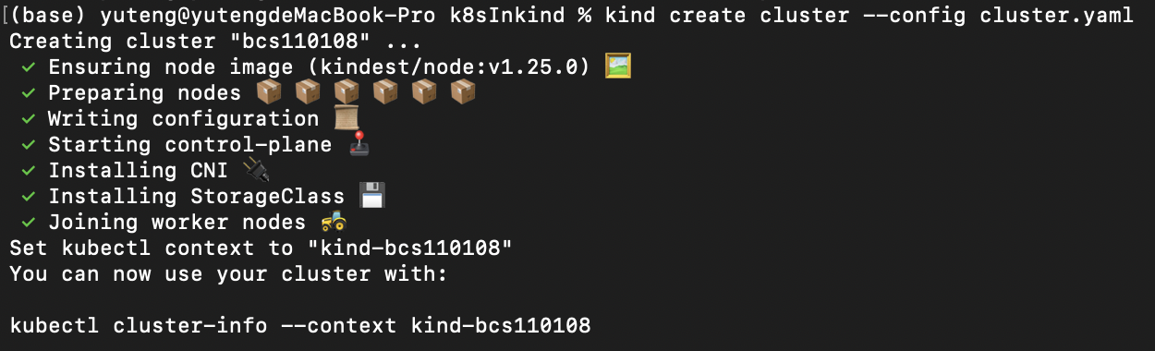
建立Kubernetes叢集
kind create cluster --config cluster.yaml

Slide 10
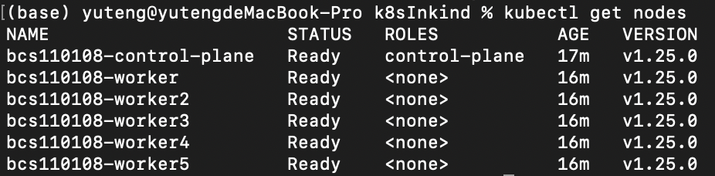
驗證Kubernetes節點資源
kubectl get nodes

Slide 11
實作步驟
建立Kubernetes叢集
部署MetalLab
設定IP tool
Nginx部署
驗證Ningx服務

Slide 12
MetalLB 介紹與作用
背景
K8s元件中是不包含內建的load-balancer
k8s提API定義使使用者或雲廠商提供load-balancer功能
功能
提供local k8s一個途徑來實現load-balance的功能

Slide 13
Metallb 介紹
Controller 負責從IP pool中分配IP給service
Speaker 負責網路連接轉接
Layer2無須外部硬體，由master負責，但會受master主機環境限制
BGP可透過外部路由器，委任其負責連接外部與k8s內部網路的轉接

Slide 14
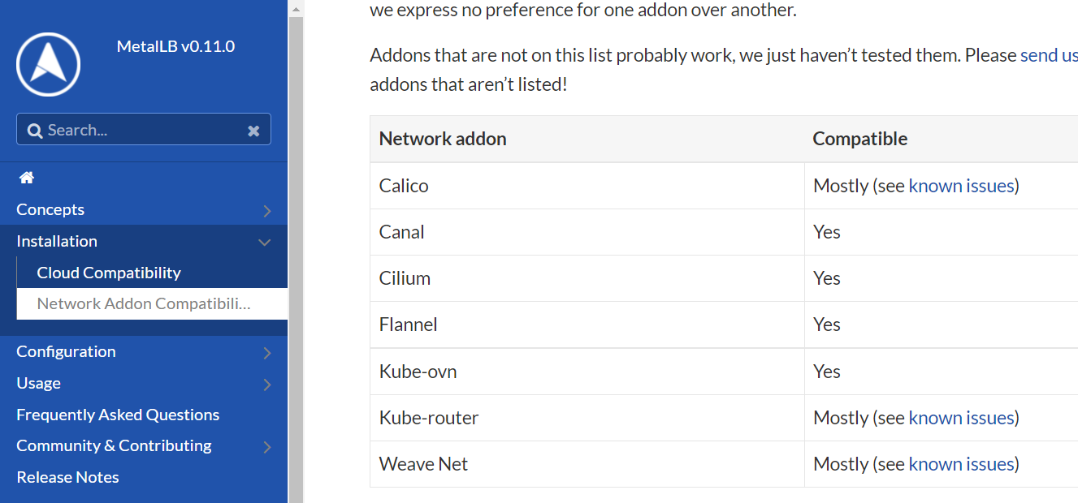
Metallb(CNI support)

Slide 15
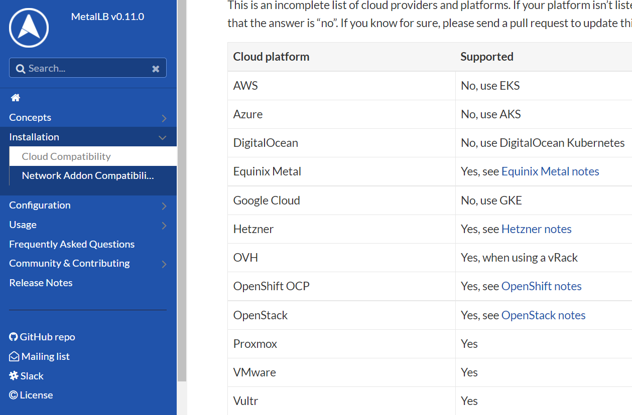
Metallb(Cloud support)

Slide 16
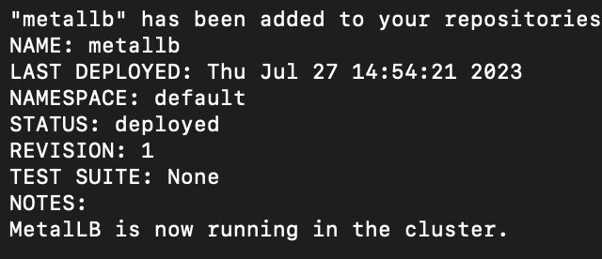
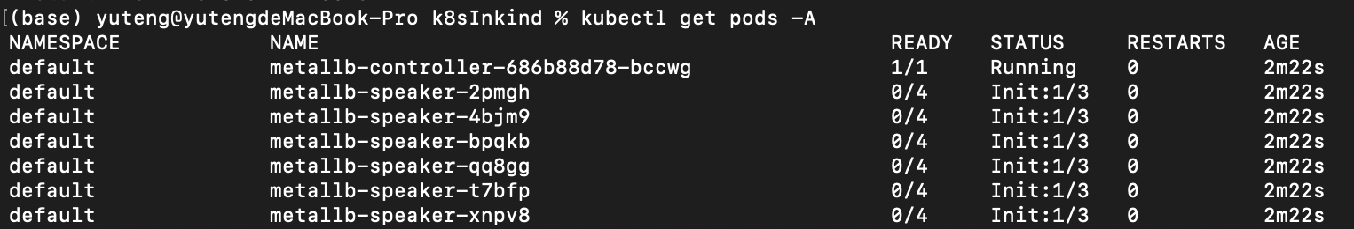
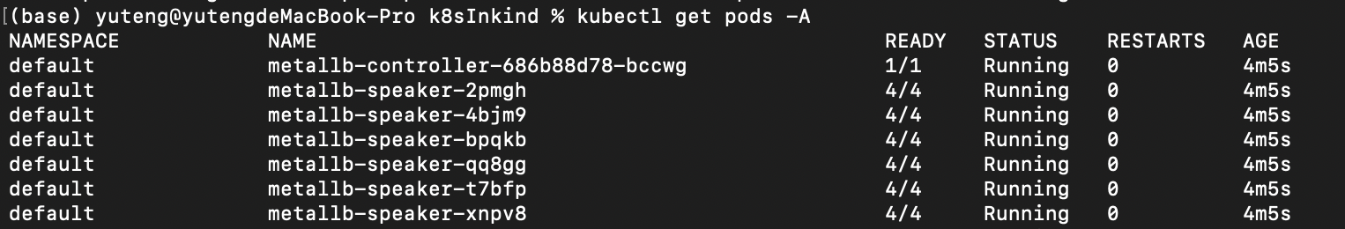
部署metalLB於Kubernetes叢集
helm repo add metallb https://metallb.github.io/metallb
helm install metallb metallb/metallb –n metalb
耐心等待

Slide 17
實作步驟
建立Kubernetes叢集
部署MetalLab
設定IP tool
Nginx部署
驗證Ningx服務

Slide 18
驗證Kubernetes節點資源
docker network inspect -f '{{.IPAM.Config}}' kind
[{172.18.0.0/16 172.18.0.1 map[]} {fc00:f853:ccd:e793::/64 map[]}]
修改IPAddressPool.yaml，IP為172.18.0.1-50
apiVersion: metallb.io/v1beta1
kind: IPAddressPool
metadata:
name: labip
namespace: default
spec:
addresses:
- 172.18.0.1-172.18.0.50

Slide 19
依Kind使用之Docker虛擬網域，更新IP池
docker network inspect -f '{{.IPAM.Config}}' kind
[{172.18.0.0/16 172.18.0.1 map[]} {fc00:f853:ccd:e793::/64 map[]}]
修改IPAddressPool.yaml，IP為172.18.0.1-50
apiVersion: metallb.io/v1beta1
kind: IPAddressPool
metadata:
name: labip
namespace: default
spec:
addresses:
- 172.18.0.1-172.18.0.50

Slide 20
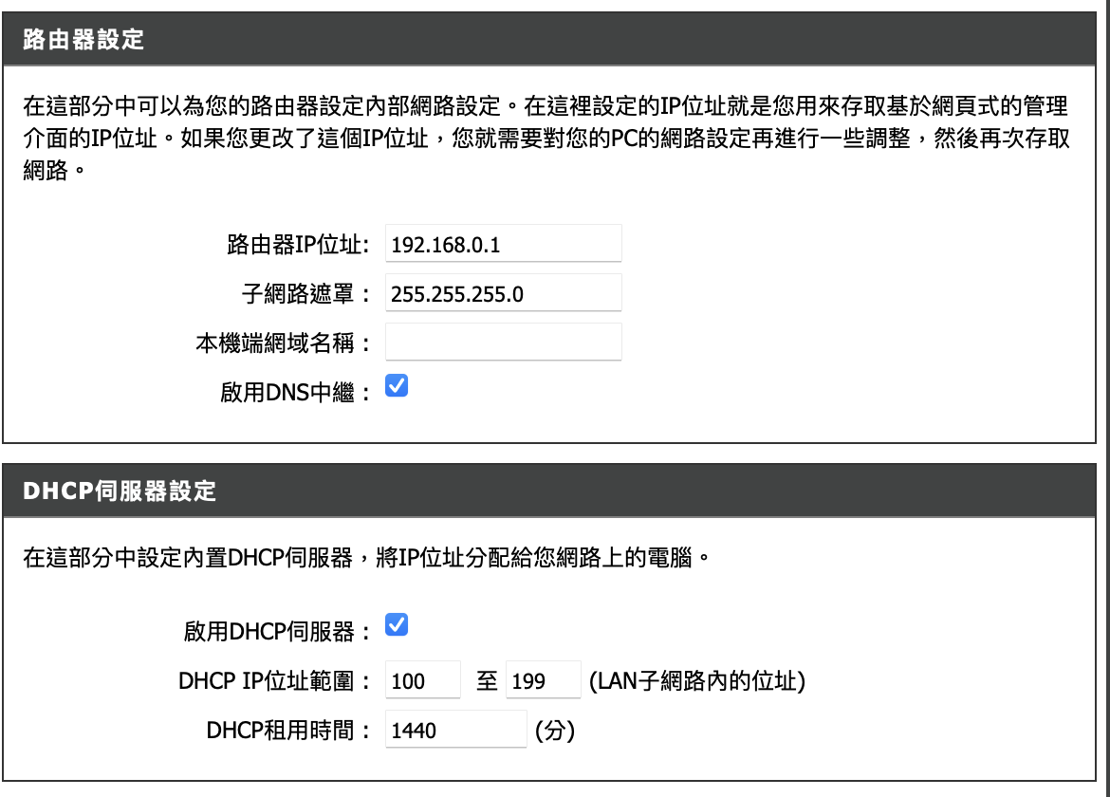
注:在實際生產環境中 依路由器配置更改IPAddressPool
apiVersion: metallb.io/v1beta1
kind: IPAddressPool
metadata:
name: labip
namespace: default
spec:
addresses:
- 192.168.0.100-192.168.0.199

Slide 21
實作步驟
建立Kubernetes叢集
部署MetalLab
設定IP tool
Nginx部署
驗證Ningx服務

Slide 22
實作步驟
建立Kubernetes叢集
部署MetalLab
設定IP tool
Nginx部署
驗證Ningx服務

Slide 23
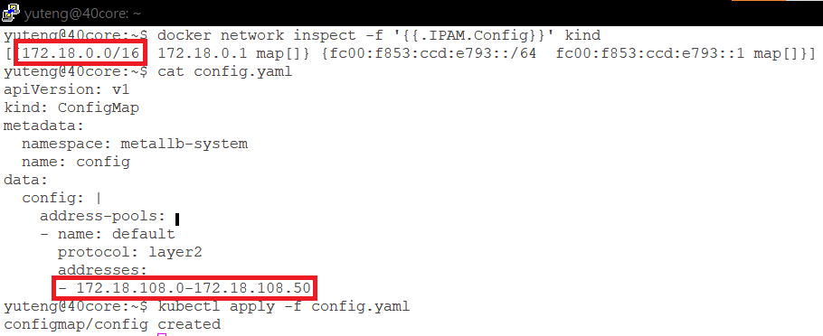
自動IP配置-設定IP池
Docker 內部網段 + 學號末三碼 + 0到50

Slide 24
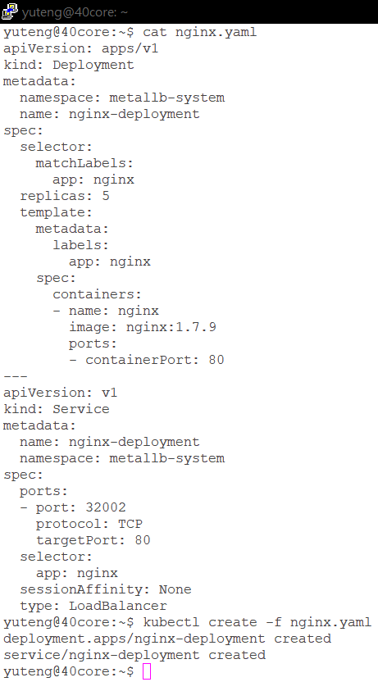
部屬nginx deployment and service
kubectl apply –f nginx.yaml

Slide 25
Nginx deployment
Nginx container port為80 nginx instances為5

Slide 26
Nginx services
將container port 80轉接到主機32002

Slide 27
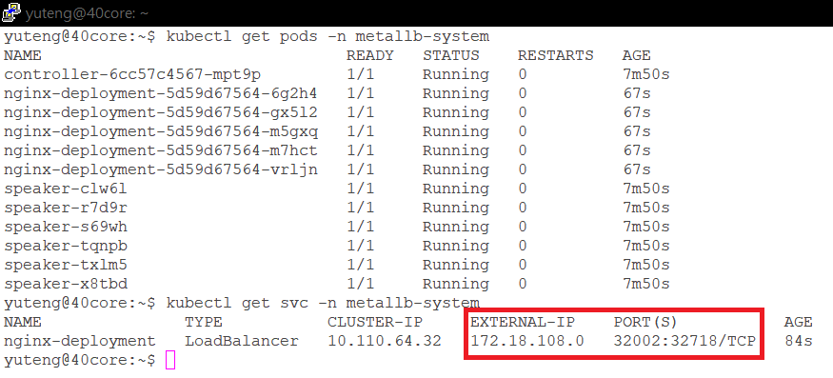
Nginx已轉接到externalIP:port
部屬nginx

Slide 28
測試nginx網頁
curl –v externalIP:port
建立cluster
部屬metallb
部屬nginx
確認網站服務
設定ip pool

Slide 29
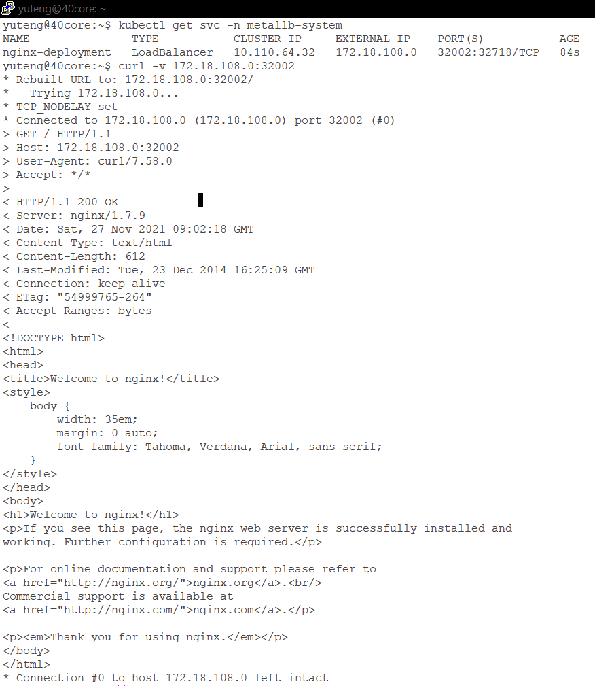

Slide 30
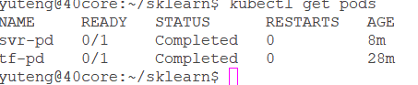
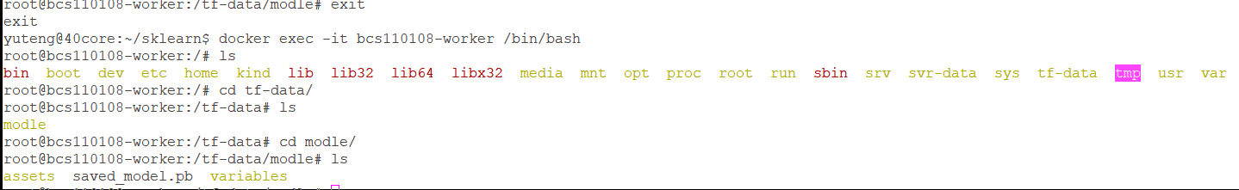
Other things(CNN, SVR model saving)

Slide 31
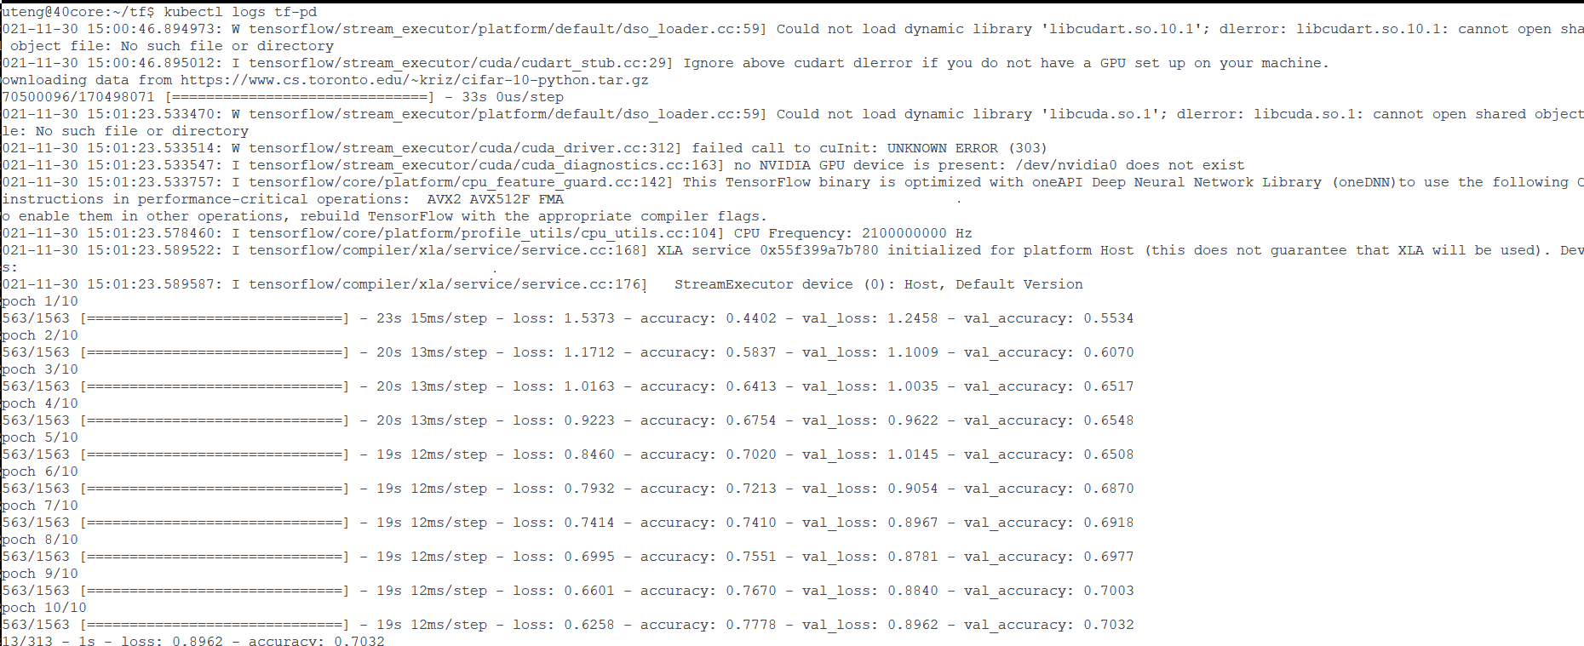
Other things(CNN, SVR log)

Slide 32
TroubleShooting-Docker Desktop沒開
1.在Window與Mac下
2.透過Docker desktop安裝Docker runtime。()
=> 啟動你的Docker Desktop
(base) yuteng@yutengdeMacBook-Pro k8sInkind % kind create cluster --config cluster.yaml
ERROR: failed to create cluster: failed to list nodes: command "docker ps -a --filter label=io.x-k8s.kind.cluster=bcs110108 --format '{{.Names}}'" failed with error: exit status 1
Command Output: Cannot connect to the Docker daemon at unix:///var/run/docker.sock. Is the docker daemon running?

