Slide 1
A TensorRT example on Kubernetes

Slide 2
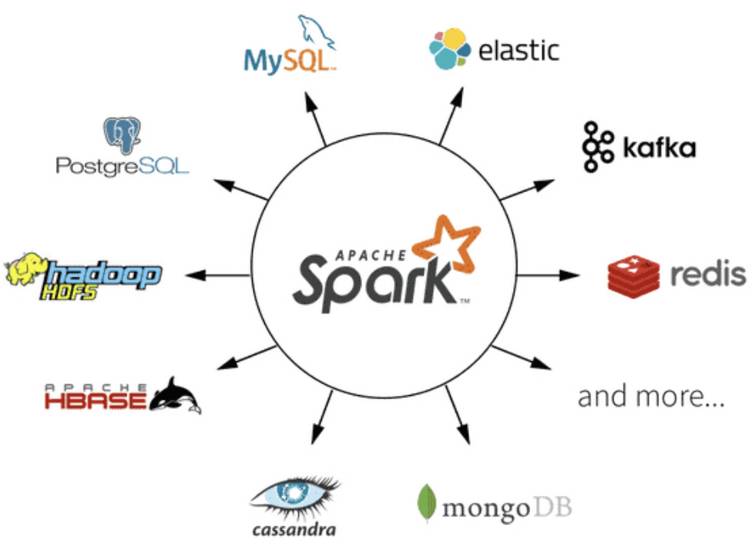

Application on Kubernetes
Software example
Apache Ozone
Apache Hadoop
Apache spark
Application example
Duolingo
WordPress
ML
TF
Pytorch

Slide 3
Relationship
Running an example on Kubernetes
imagenet-camera.py

Slide 4
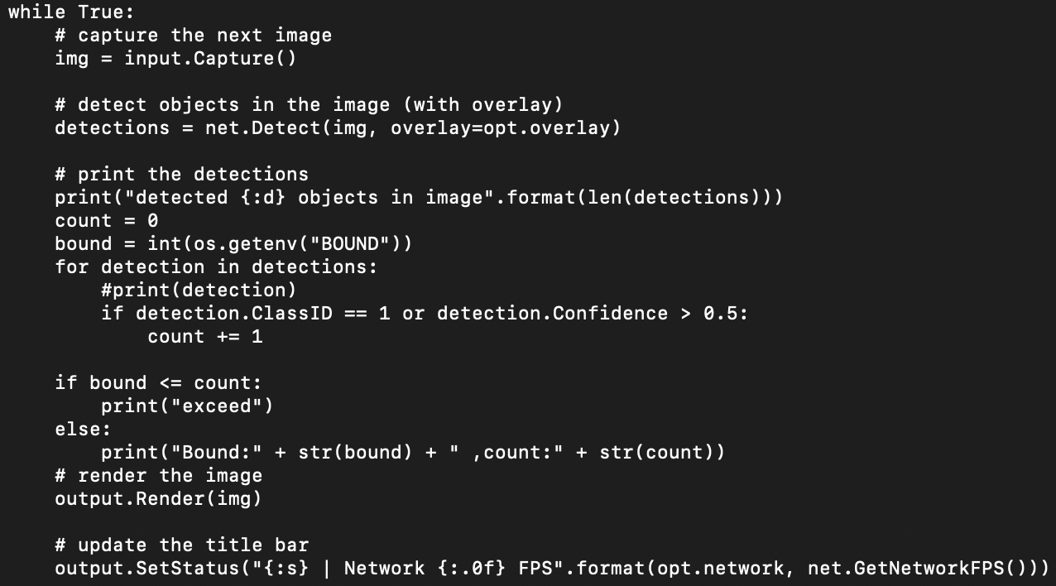
Flow
Kubernetes(k8s, lite version k3s)
Configmap.yaml
Key-value
Deployment.yaml
Volume
VolumeMount
Image
Yunikorn
Multi-Tenant
Hierarchical queue
TensorRT

Slide 5
Problem
Lack of Device plugin.
Architecture of image.
K3s parameters problem.
K3s container runtime context.

Slide 6
Feeling
Different structure of selector in yaml.
I need to learn how to implement device plugin in future to fulfill my requirements.

Slide 7
Vedio
Only devices
demo.py
Kubernetes
Env
demo.py
Imagenet-camera.py
Exe
Imagenet-camera.py

