Slide 1

Joint source selection and transfer optimization for erasure coding storage system
Han Zhang, Xingang Shi, YingYa Guo,Haijun Geng, Zhiliang Wang,Xia Yin
Notes:
Good Morning，I am XX, very happy to meet all of you here. Today my topic is Joint source selection and transfer optimization for erasure coding storage system

Slide 2
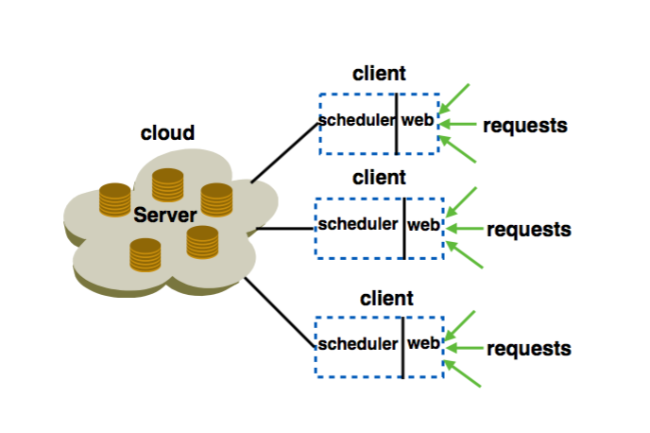
Introduction
Social networking and e-commerce activities are popular.
Erasure coding storage system has been widely used by companies.
(n,k) MDS erasure code is used to divide file into n chunks, any subset of k out of n chunks are needed to reconstruct it.
Chunks are stored at the servers in the cloud and the clients receive requests and select sources for each request.
Notes:
Social networking and e-commerce activities are popular these days and more and more data are stored in the online storage. Also, businesses are relying on big data analytics for business intelligence and are migrating their traditional IT infrastructure to the cloud. In this trend, cloud storage services like Amazon’s Cloud drive, Apple’s iCloud, DropBox, Google Drive, Microsoft’s SkyDrive, AT&T Locker stores redundant information on distributed servers to increase reliability for storage systems
Erasure coding has been widely used by companies such as Google and Facebook [23] [27], since it provides space- optimal data redundancy to protect against data loss. In erasure coding storage system, (n, k) MDS erasure code is used to divide file into n chunks. When a user fetches the file, any subset of k out of n chunks are needed to reconstruct it

Slide 3
Introduction
Two Processes can affect the latency:
Inefficient source selection can lead to flows conflict at server nodes.
random source selection will make some nodes have heavy load and this will magnify latency
TCP is not a good choice for distributed storage system.
For TCP transfer, different chunks may get different bandwidth and the last finish chunk may finish late.
Minimize average File Access Time (FAT).
Joint source selection and chunk transfer together to optimize.
Notes:
We can see two processes affect the accessing latency of the distributed erasure coding storage system. Firstly, inefficient source selection can lead to flows conflict at server nodes
random source selection will make some nodes have heavy load and this will magnify latency.
tcp is not a good choice for distributed storage system. TCP is fair transfer method, but in erasure coding storage system, a file can be reconstructed only when the client receives all the chunks.
In this paper, we try to minimize average file access time (FAT) for distributed erasure coding storage system. We joint source selection and trunk transfer together to optimize

Slide 4
Contributions
We are the first to joint source selection and chunk transfer together to optimize in distributed erasure coding storage system
We formulate Idealized File Access Time Minimization (IFATM) problem, study its hardness, and derive a non- preemptive scheduling algorithm that is 2-approximate optimal.
We further design D-Target, a scheduler to select efficient sources and allocate bandwidth to chunks
Trace-driven simulation shows that D-Target performs 2.5, 1.7, 1.8, 3.6 better than TCP, Barrat , Aalo , pFabric respectively.
Notes:
What we do in this paper:
We are the first to joint source selection and chunk transfer together to optimize in distributed erasure coding storage system
We formulate Idealized File Access Time Minimization (IFATM) problem, study its hardness, and derive a non- preemptive scheduling algorithm that is 2-approximate optimal.
We further design D-Target, a scheduler to select efficient sources and allocate bandwidth to chunks
Trace-driven simulation shows that D-Target performs D- Target performs 2.5, 1.7, 1.8, 3.6 better than TCP, Barrat , Aalo , pFabric respectively.

Slide 5
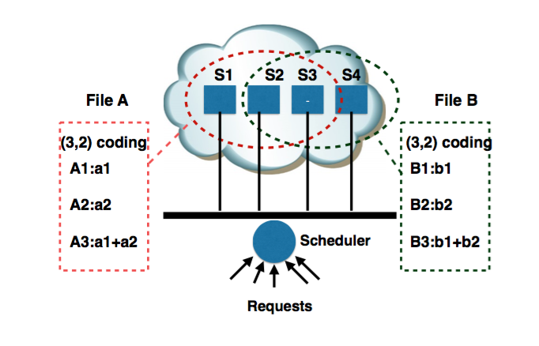
Motivation
R_{A} and R_{B} arrive at t = 0 .If A chooses (S1,S2) and B chooses (S3,S4), AFAT is 1.
Two requests arrive at t = 0 .If A chooses (S2,S3) and B chooses (S3,S4), AFAT is 2.
R_{A1} arrives at t=0,R_{A2} arrives at t=0.1. R_{A1} chooses (S1,S2), R_{A2} chooses (S2,S3). If random selection. For TCP, FAT1=1.9. FAT2=2， AFAT=1.95.
R_{A1} arrives at t=0,R_{A2} arrives at t=0.1. R_{A1} chooses (S1,S2), R_{A2} chooses (S2,S3). If random selection. If A1 has higher priority, FAT1 = 1, FAT2 = 2, AFAT = (1+2)/2=1.5.
File A’s chunks are stored at machines S1,S2,S3. File B is stored at machines S2,S3,S4. Link capacity is 1, two requests arrive at t = 0
For R_{A},3 options：(S1,S2),(S1,S3),(S2,S3), R_{B},3 options：(S2,S3),(S3,S4),(S2,S4)
Notes:
we consider two files A and B, both encoded and stored at n = 3 machines. A request to retrieve file A can be completed after it is successfully processed by 2 distinct nodes chosen from {S1, S2, S3}. It is similar for file B, which can be chosen from {S2, S3, S4}. To simplify the problem, we assume capacity of all links is 1 and chunk size of file A and file B is also 1. Firstly, we consider two requests RA and RB that arrive simultaneously at t = 0 to fetch file A and file B respectively. For RA, file A has 3 source selection options: (S1, S2), (S1, S3), (S2, S3), while file B has (S2, S3), (S2, S4), (S3, S4). If the scheduler uses random source selection, a common case maybe RA chooses (S 2, S 3) and RB chooses (S 3, S 4). If the transfer policy is TCP, then thefileaccesstimeforRA istA =2andforRB istB =2. The AFAT(average file access time) is 2. However, if RA chooses (S1, S2) and RB chooses (S3, S4), the AFAT is 1. From the simple example, we can see, for the erasure coding storage system, efficient source selection for request can reduce AFAT, thus user experience will be better.
What’s more, only tcp-fair transfer is not enough for the distributed storage system. Just think the simple case, there are two request for file A, RA1 arrives at t = 0 and RA2 arrives at t = 0.1. RA1 chooses(S1,S2) as the sources and RA2 chooses (S2,S3) as the sources. For TCP transfer, FAT( file accesstime)forRA1 ist=1.9andFATforRA2 ist=2.0,so that AFAT( average file access time) is (1.9 + 2.0)/2 = 1.95. However, if we let RA1 have higher priority than RA2 . Then FATforRA1 ist=1andFATforRA2 ist=2,sothat AFAT is (1 + 2)/2 = 1.5. We can see, incorporating task level optimization can improve much on reducing AFAT for file transfer in distributed storage system.

Slide 6
Background and Related work
Previous work mainly focus on efficient encoding and decoding, Overhead of CPU will significantly reduce.
When accessing file or one blocks that are sufficient to recover all the data. This process can add heavy burden to network.
Still now, lots of methods have been proposed to reduce applications’ transfer latency in data center. According to schedule granularity, we can divide them into two kinds: flow level optimization and task level optimization.
Notes:
Previous work mainly focus on efficient encoding and decoding, Overhead of CPU will significantly reduce.
When accessing file or one blocks that are sufficient to recover all the data. This process can add heavy burden to network.
Still now, lots of methods have been proposed to reduce applications’ transfer latency in data center. According to schedule granularity, we can divide them into two kinds: flow level optimization and task level optimization.

Slide 7
Background and Related work
DCTCP, D2TCP,L2DCT,PDQ,pFarbic,LPD and D3 are flow level methods.
DCTCP – fair sharing
D2TCP, LPD and D3 are deadline-aware methods.
Barrat, Varys,Aalo, Sunflow regard flows of applications as a whole.
Barrat schedules task in FIFO order but avoids head-of-line blocking by dynamic changing the level of multiplexing in the network
Varys and Aalo, sunflows try to minimize average coflow completion time.
In erasure coding storage system, file access will generate parallel flows. We think just flow level optimization is not enough, task level schedule methods should be considered to make the transfer efficiency
Notes:
DCTCP, D2TCP,L2DCT,PDQ,pFarbic,LPD and D3 are flow level methods.
DCTCP – fair sharing
D2TCP, LPD and D3 are deadline-aware methods.
Barrat, Varys,Aalo, Sunflow regard flows of applications as a whole.
Barrat schedules task in FIFO order but avoids head-of-line blocking by dynamic changing the level of multiplexing in the network
Varys and Aalo, sunflows try to minimize average coflow completion time.
In erasure coding storage system, file access will generate parallel flows. We think just flow level optimization is not enough, task level schedule methods should be considered to make the transfer efficiency

Slide 8

DC Fabric: Just a Giant Switch
H1
H2
H3
H4
H5
H6
H7
H8
H9
Notes:
Recent studies regard the data center as a big switch, where all ports have normalized united capacity. All flows compete for the ingress and egress bandwidth. Such abstraction is reasonable and matches with recent full bisection bandwidth topologies widely used in current production data centers. In this paper, we use this assumption and only take the contention of ingress and egress ports into consideration.

Slide 9
DC Fabric: Just a Giant Switch
H1
H1
H1
H2
H2
H2
H3
H3
H3
H4
H4
H4
H5
H5
H5
H6
H6
H6
H7
H7
H7
H8
H8
H8
H9
TX
H9
H9
RX
Notes:
Recent studies regard the data center as a big switch, where all ports have normalized united capacity. All flows compete for the ingress and egress bandwidth. Such abstraction is reasonable and matches with recent full bisection bandwidth topologies widely used in current production data centers. In this paper, we use this assumption and only take the contention of ingress and egress ports into consideration.

Slide 10
DC Fabric: Just a Giant Switch
H1
H1
H2
H2
H3
H3
H4
H4
H5
H5
H6
H6
H7
H7
H8
H8
TX
H9
H9
RX

Slide 11
DC transport = scheduling on giant switch
Ports have unit capacity
Flows contend at ports only
H1
H1
H2
H2
H3
H3
H4
H4
H5
H5
H6
H6
H7
H7
H8
H8
TX
H9
H9
RX
ingress & egress
capacity constraints

Slide 12
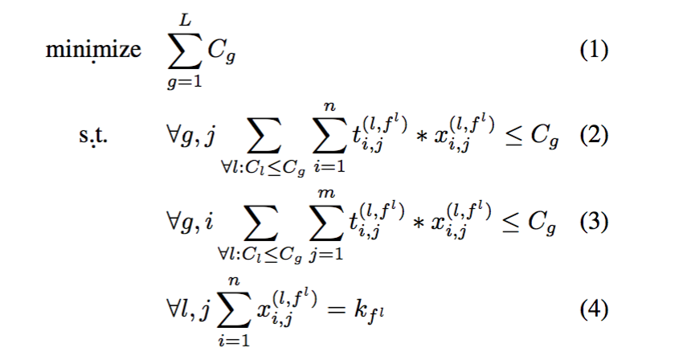
Problem Formulation
Idealized File Access Time Minimization (IFATM) Problem
We try to simplify the problem
Notes:
We consider a non-blocking data center that consists of n
storage nodes, denoted by S
Then r files, denoted by F
For each file fi, we partition it into ki fixed-size trunks and then encode it using an (ni,ki) MDS erasure code to
generate ni distinct trunks of the same size for fi
The ni distinct shares are stored at ni machines.
The m clients, denoted by C
Assume all the L requests arrive at time (k)
0 and the k − th request denoted by Tf k means requesting file fk(fk ∈ F). The k-th request T(k)consists of parallel fk subtasks, each subtask is a flow from a server to the client
As the non-blocking model’s ingress and egress ports have unit
capacity, so the transfer time for sub-task t(k,fk) is t(k,fk). i,j i,j
The problem of non-preemptive Idealized File Access Time Minimization (IFATM) Problem can be defined as

Slide 13
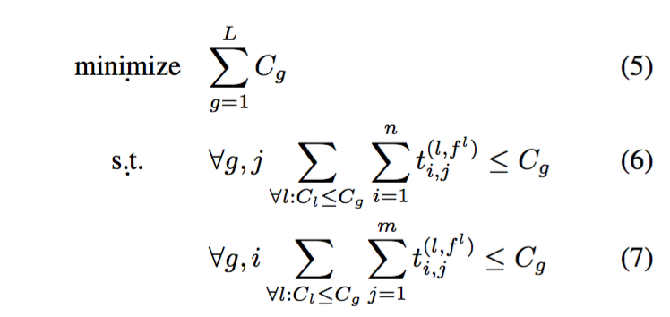
SIFATM problem
Simple idealized File Access Time Minimization (SIFATM) problem
Simple idealized File Access Time Minimization (SIFATM) problem is equivalent to the problem of minimizing the sum of job completion time in a concurrent open shop
Notes:
we firstly consider a simple case, in which ni = ki and ni equals to total number of servers. That means that every server stores one chunk and all chunks are needed when accessing the file. We further assume all the requests arrive simultaneously. As a result, the Simple idealized File Access Time Minimization (SIFATM) problem can be defined as

Slide 14
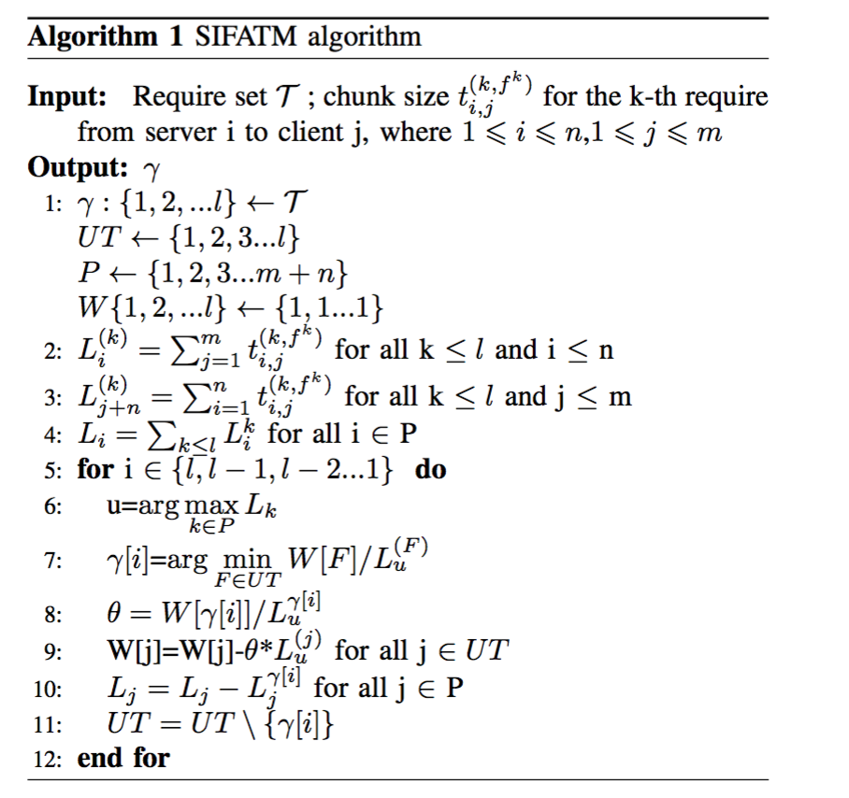
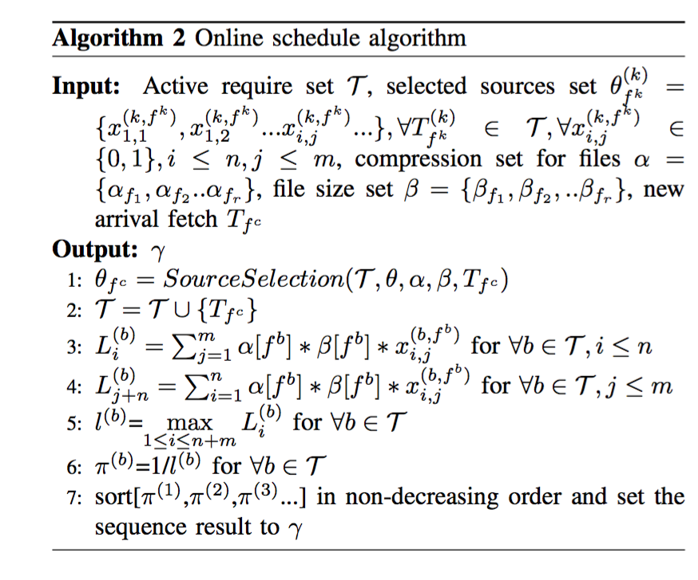
ALGORITHM AND SYSTEM DESIGN
A 2-approximate solution
Online solution
Notes:
The best solution to the problem of minimizing completion time of concurrent open shop problem is a 2-approximate solution that is proposed at [20]. According to the relationship between concurrent open shop problem and SIFATM problem, we change the algorithm to adapt to SIFATM problem just as Algorithm 1 shown
In practice, file request occurs online and the load of
each port varies with time. On average, all ports would have
the same load since today’s data centers generally assign
jobs with load balancing [14], [19], [10]. In this case, the
scheduler does not need to take the load diversity of ports into
account (relaxation 1) [19]. What’s more, for the distributed
erasure coding storage system, each client knows the chunk
information of all files. Based on this, we can compute the load
of server side (fact 1). Also, for the erasure coding storage
system, a file’s trunks have the same size (fact 2). We can
define file fb’s compress ratio as αfb = trunk size of fb and file size of fb
compute chunk size according to this. Then we get the online schedule Algorithm 2.

Slide 15
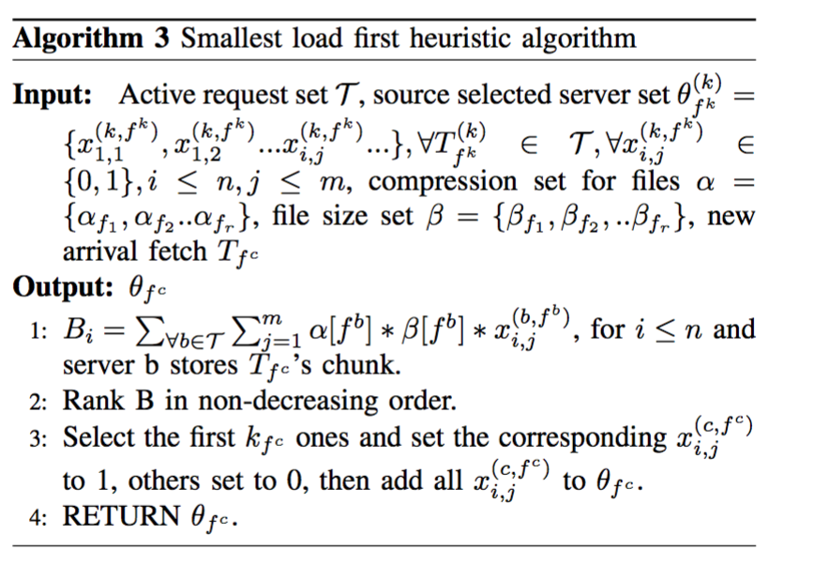
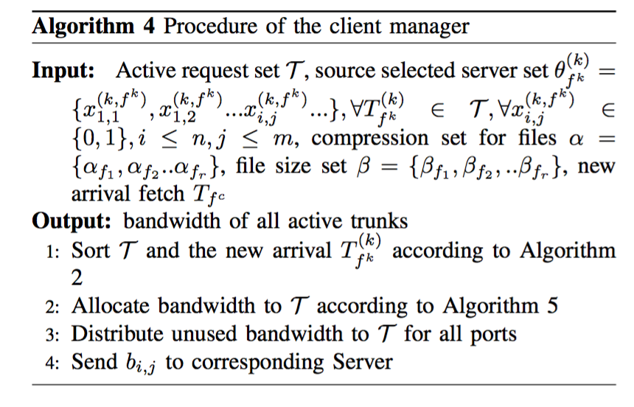
ALGORITHM AND SYSTEM DESIGN
Notes:
Algorithm 3 tries to find sources with smallest load. This
makes sense, because file access time is decided by the slowest trunk. The smallest load first heuristic indeed tries to minimize the maximum transfer time of trunks. As FAT is decided by the maximum transfer time of trunks, so that FAT reduces
In D-Target, client manager is the heart of the system. When a new file request arrives, it computes the priority (Algorithm 2) and the chooses sources (Algorithm 3) for each request. After computing the priority of each file request, it calculates the bandwidth of each trunk. Procedure of client manager is shown at Algorithm 4

Slide 16
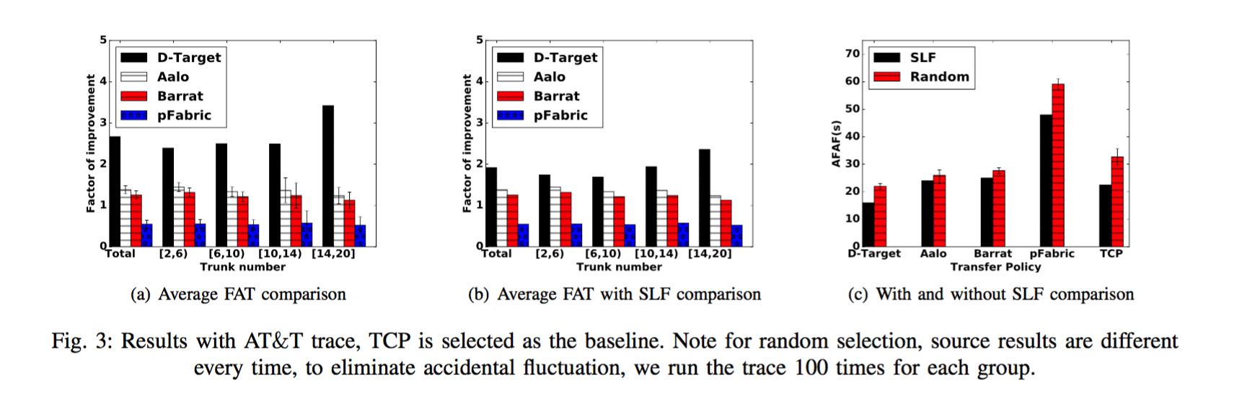
Evaluation
Notes:
we thoroughly evaluate the performance of D-Target by trace-driven simulation
Fig. 3(a) shows the result of average FAT. We can see that factor of improvement for D-Target is 2.5, while for Aalo, Barrat, pFarbric are 1.5, 1.2, 0.8, respectively. For the distributed erasure coding storage system, the response always contains parallel chunks and according to the width of the response, we divide them into four groups. We can see that factor of improvement for D-Target is 2.2, 2.4, 2.8, 3, when parallel chunk number is [2,6), [6,10), [10,14) and [14,20] respectively. Factor of improvement becomes larger with the increasing of parallel of chunks. The reason for this is that, for bigger number of parallel chunk, collision between requests become higher, so that the necessity of doing source selection and traffic control are larger.
In modern erasure coding storage system, when requests arrive, scheduler always uses random source selection to choose sources. In this paper, we purpose the smallest load first heuristic to choose sources. In this case, less collides will occur. Fig. 3(b) shows the results that all the transfer methods use smallest load first heuristic to select sources. We can see that gap between D-Target and other methods become small. D-Target performs about 1.9×, 1.7×, 2× better than TCP, Aalo, Barrat and pFabric, respectively.
Fig. 3(c) shows average file access time (FAT) comparison for different methods . We can see that with smallest load first heuristic source selection, D-Target, Aalo [8], Barrat [14], pFabric [5] and TCP perform about 30%, 30%, 27%, 33%, 20% better than random source selection respectively.

Slide 17
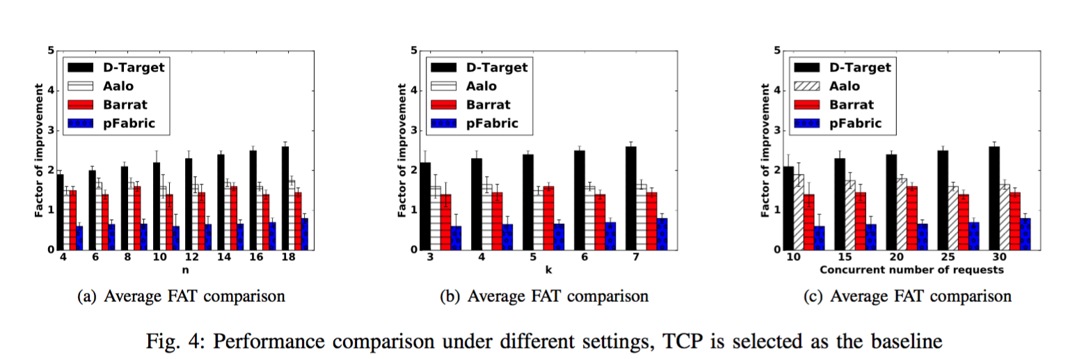
Evaluation
Notes:
Fig.4(a) shows that with the increase of n, factor of im- provement for D-Target becomes larger. When n is 4, factor of improvement is 1.8 and when n is 18, factor of improvement is 2.5. D-Target performs better for larger value of n. The reason for this is that for larger n, conflicts between nodes become higher, so that it is more necessary to optimize source selections and transfer.
Fig.4(b) shows that with the increase of k, D-Target per- forms better. When k is 3, factor of improvement is 2.2 and when k is 7, factor of improvement is 2.5, which is about 20% larger. For larger value of k, D-Target improves higher due to less collides.

Slide 18
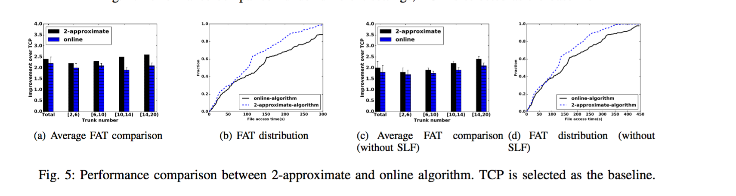
Evaluation
Notes:
From Fig. 5(a), we can see that factor of improvement for the 2-approximate method is 2.4, while for the online method is 2.1. The online method has about 15% performance loss. Fig. 5(b) demonstrates the distribution of FAT, we can see that more than 80% of the FAT is less than 300s for the 2- approximate method, while that for the online method is about 65%. Fig. 5(c) shows the performance of the two methods that are without smallest load first heuristic, we can see that performance gap between the online and 2-approximate is about 18%. Fig. 5(d) shows the distribution of FAT. We can see that about 80% of the FAT is within 350s, which is about 30% worse than the method with SLF.

Slide 19
Thanks

