Slide 1
Summary

Slide 2
Index
What I learned and did
Gained performance
Research plan in the future
Life in US

Slide 3
What I did and learned
Period 1: Read Paper and tried to fit US (Oct ~ Jan)
Period 2: Find what to do (Jan ~ Feb)
Period 3: Try to study the problem (Feb ~ now)

Slide 4
Paper and book Reading
Theory paper (30+)
Convex optimization (half)
Concurrent open shop problem (almost half)
System paper(10-)
Distribute system (3)- mainly erasure code storage system
Coflow scheduling(5)
Book Reading
Convex optimization

Slide 5
Data center and cloud bandwidth
Adjust network bandwidth with application
Single flow series (TCP-based, Flow level scheduling)
Flow set series (Coflow, Task, Job)
Particular application (Hadoop, Spark)
Virtualize
Virtual machine (instability, resource contention)
DCTCP evaluated on Vm( sigcomm 2016)
Next coflow ,task scheduling at docker container and vm?

Slide 6
What I did and learned
Period 1: Read Paper and tried to fit US (Oct ~ Jan)
Period 2: Find what to do (Jan ~ Feb)
Period 3: Try to study the problem (Feb ~ now)

Slide 7
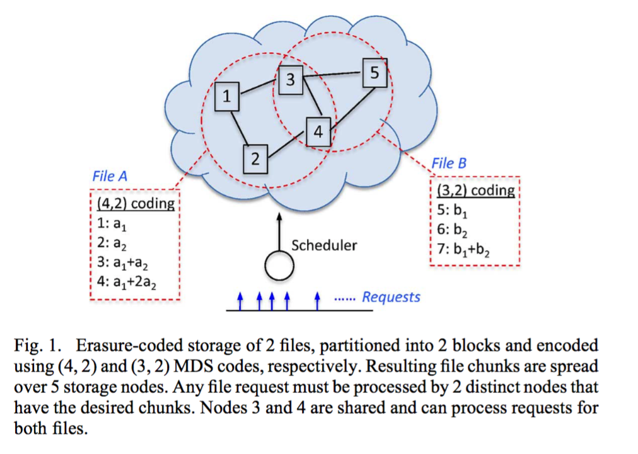
Erasure code storage system
File A (4,2): store a file into 4 segment any file request must be processed by 2 nodes.
File B (3,2); store a file into 3 segment any file request must be processed by 2 nodes.
Erasure code system is now used by ATT, google ,facebook, etc.

Slide 8
Problem description
In total, optimize file transfer time
Source selection: requiring file should select k nodes from n sources, how to select the nodes to optimize the performance
Bandwidth guarantee: after selecting the node from the node set, how to optimize the transferring time.

Slide 9
VS. Coflow Optimization
Coflow-application task.
Tasks whose semantic( for example, they belong to the same shuffle or the same file transfer) are similar belongs to the same coflow.
coflow is just an abstraction. Distribute system flows can all be seen as coflow.
Erasure code storage system
File part transfers are coflow.
Special: Known source, destination, file size and source destination
Based on these, we can design special schedule policy to optimize transfer

Slide 10
What I did and learned
Period 1: Read Paper and tried to fit US (Oct ~ Jan)
Period 2: Find what to do (Jan ~ Feb)
Period 3: Try to study the problem (Feb ~ now)

Slide 11
Theory
a network with M nodes: M=(M₁,M₂…,M_{m}) and F files, F=(F₁,F₂,F₃..F_{f}),each file with volume v_{i}
each stored using an (n, k) erasure code on a subset of the nodes, X(i,j)=1 if node M_{j} is selected for File i, t, for subtask, the chunk size is v_{ij}
if clients submit file requests R=(R₁,R₂..R_{r}) and each request is associated with a deadline D={d₁,d₂..d_{r}}.
As a cloud provider, select the source nodes serving each request and allocate enough resource to meet its deadline
Link Set={l₁,l₂..l_{l}},capacity of each link is{c₁,c₂….c_{c}}
Y={Y₁,Y₂,..Y_{r}} if request r finishes before deadline, Y_{i}=1 else 0

Slide 12
Network model
N1
N2
N3
N4
N5
C1
C2
C3
C4
C5
Data center fabric

Slide 13
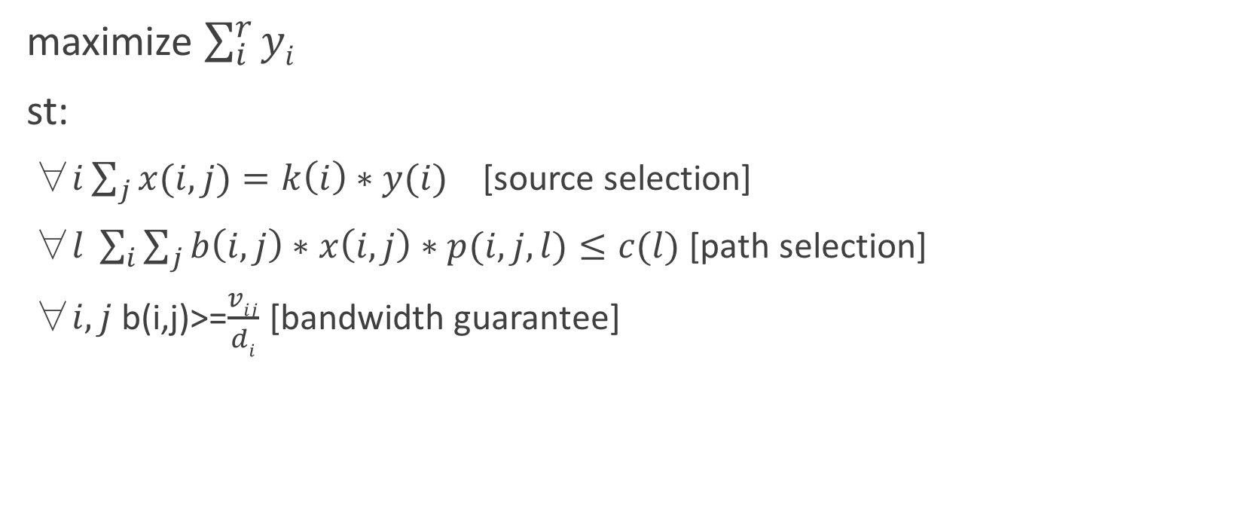
Problem formulation
maximize $\sum_{i}^{r}{yi}$
st:
$\text{∀}i\sum_{j}{x(i,j)}=k\left(i\right)∗y(i)$ [source selection]
∀$l \sum_{i}{\sum_{j}{b\left(i,j\right)∗x\left(i,j\right)∗p(i,j,l)}}≤c(l)$ [path selection]
∀$i,j$b(i,j)>=$\frac{vij}{di}$ [bandwidth guarantee]

Slide 14
Network model
N1
N2
N3
N4
N5
C1
C2
C3
C4
C5
Data center non-blocking fabric
Regarded the data center as non-blocking fabric: congestion only occurs at the ingress and egress ports

Slide 15
Solve the problem
Use convex optimization to analyze the problem
I have tried but failed to find a good theory solution
without source selection the problem equals to concurrent open shop problem which is NP-hard
heuristic solution (combine with coflow problem )
source selection according to network
file transfer according to the bottleneck of network

Slide 16
System
The project is now doing with Bob and Vaneet who are engineers from ATT
ATT is now using ceph which is distribute storage system to store information.
File transfers can cover ~40% time of the process (by Vaneet)
Try to optimize the process of file request
Perform a scheduling system to solve the problem.

Slide 17
Key idea
Give Each transfer’s information(N,k, each transfer size), use the centralized method to schedule the transfer tasks.
Under the assumption that data center is a big giant non-blocking fabric which means congestion only occurs at the source and destination.
For source selection, choose the least congestion ports as the source.
For task transfer, use the bottleneck flow as the standard of each transfer.
Joint source selection and bandwidth optimization.

Slide 18
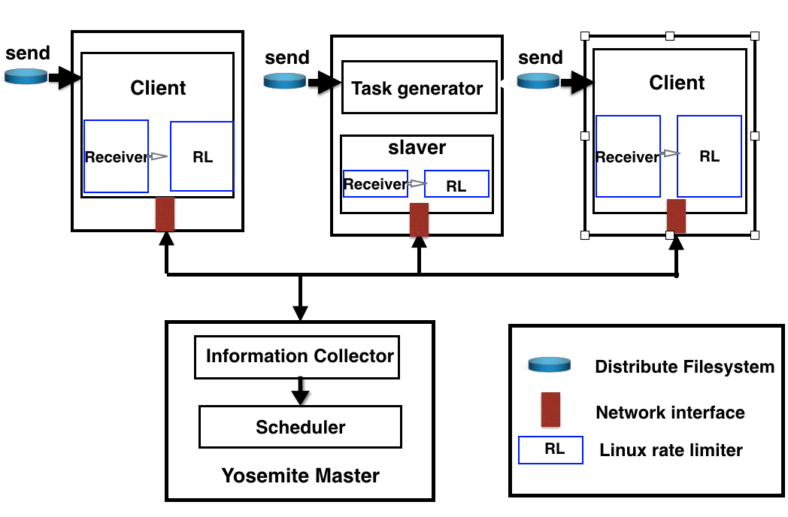
System design
3 actors:
Slave: register each file transfer to master.
Master: the brain of the system, scheduling center.
Client: do bandwidth guarantee.

Slide 19

System design
Web UI
Slave
Web UI
Register
①
Akka Actor
Register
②
⑧
Scheduler
Master
③
④
Web UI
Client
Akka Actor
⑦
⑤
Akka Actor
Rate Limiter
⑥

Slide 20
System design
(1) Users register the file transfer, the register sends it to akka Actor of the slave.
(2) The akka actor of the slave send the information to master.
(3) Master collects all the information and then gives the information to scheduler.
(4) The scheduler computes the bandwidth and gives the information to akka actor of master.
(5) The akka actor of the master sends the information to clients.
(6) The clients do rate limits.
(7) after the flows finish, it gives information to slave.

Slide 21
API
Register(TaskId,Width,filesize,description,option)
taskid:Task identifier; width: width of the task; filesize: longth of the task. description: information of the tasks. option:weight
Put(FilePath,FileName)
FilePath: the location of the File
FIleName: Name of the file
Get(FileName)
FIleName: Name of the file
Ungister(TaskId)

Slide 22
Index
What I learned and did
Gained performance
Research plan in the future
Life in US

Slide 23
Coflow weight completion time
Application in data center has different importance.
Set different weight to different coflow.
Try to solve weight coflow completion time

Slide 24
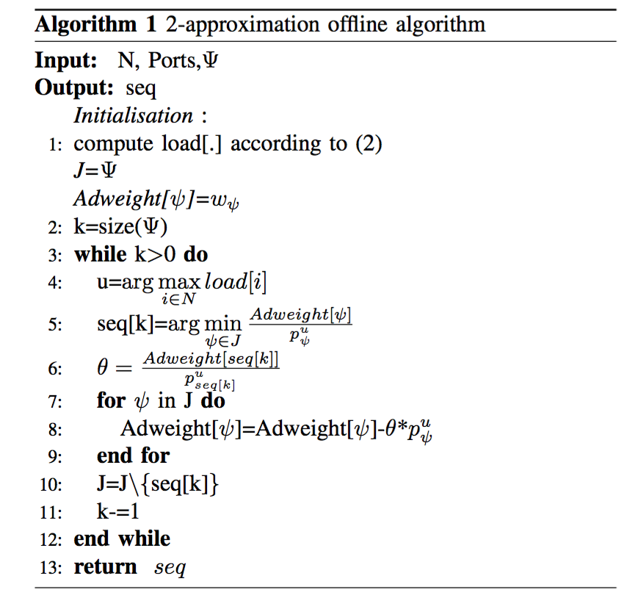
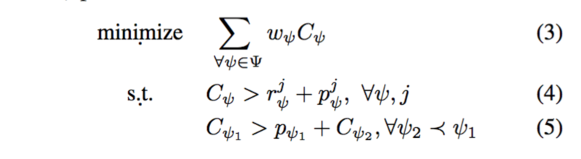
Coflow weight completion time

Slide 25
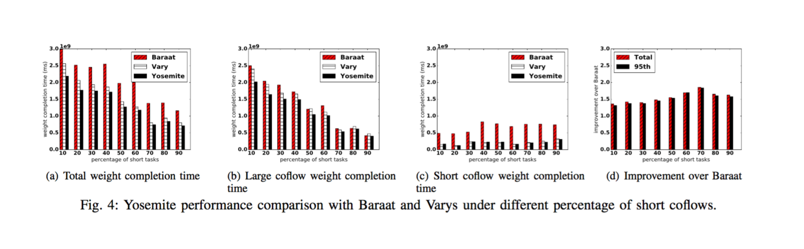
Simulation

Slide 26
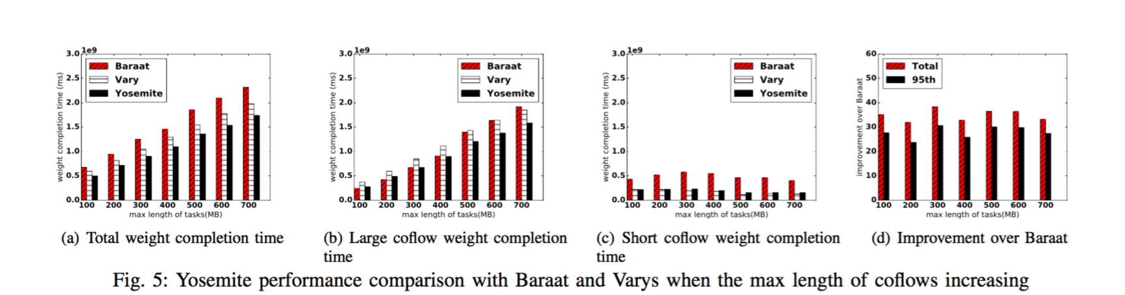
Simulation

Slide 27
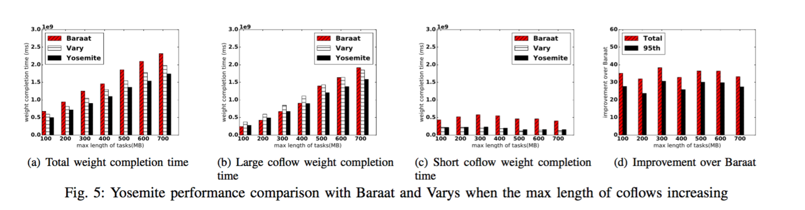
Simulation

Slide 28
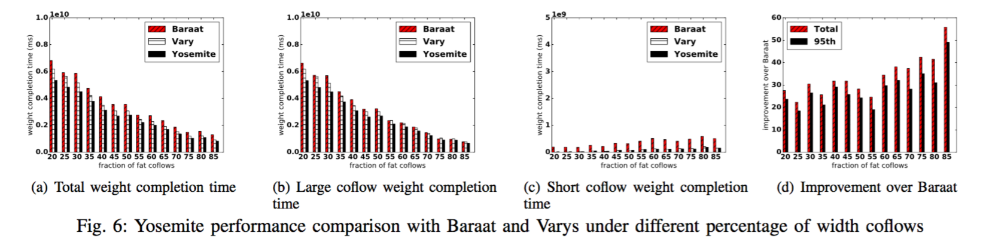
Simulation

Slide 29
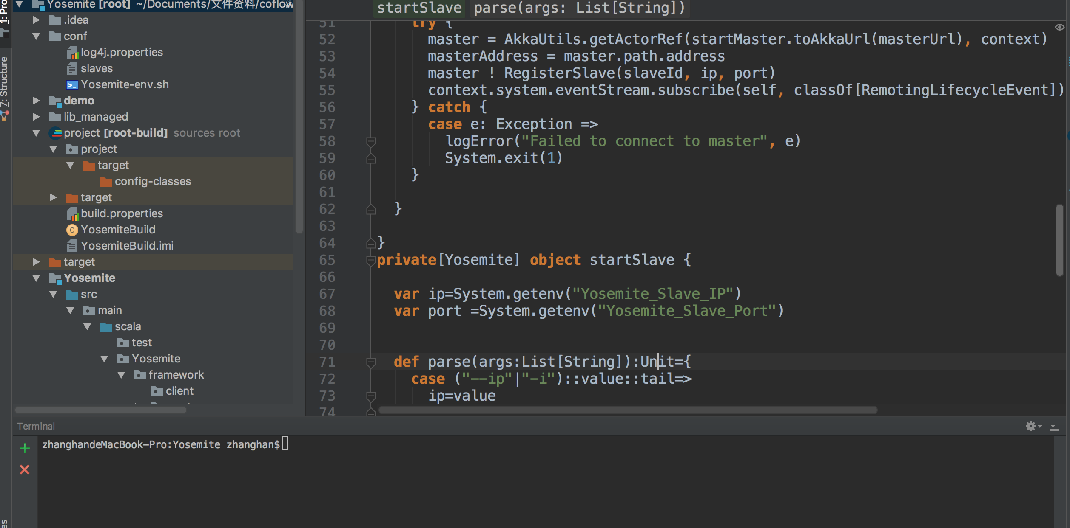
Evaluation
With Alice and Vaneet
deploy on openstack of ATT

Slide 30
Index
What I learned and did
Gained performance
Research plan in the future
Life in US

Slide 31
Plan
Yosemite: minimize coflow weight completion time ( ICNP try)
Yosemite-based File transfer optimization( Infocom or NSDI try)

Slide 32
Index
What I learned and did
Gained performance
Research plan in the future
Life in US

Slide 33
Life
Fit well.
Practice everyday.
Cook by myself.
Miss you all.

Slide 34
Thanks

