Slide 1

Testbed Topology
spine4
4 x 100G ECMP links
spine3
2 x 100G ECMP links
4 x 40G ECMP links
spine2
spine1
leaf1
leaf2
leaf3
leaf4
leaf8
leaf7
leaf6
leaf5
NCS5508
DR03
NCS5508
DR02
NCS5508
DR01
N9504
N3232
N3232
N3232
N9236
N3172
N9236
N3232
rswA5
Bell-CA
rswA6
rswA2
rswB1
rswA3
rswA4

Slide 2
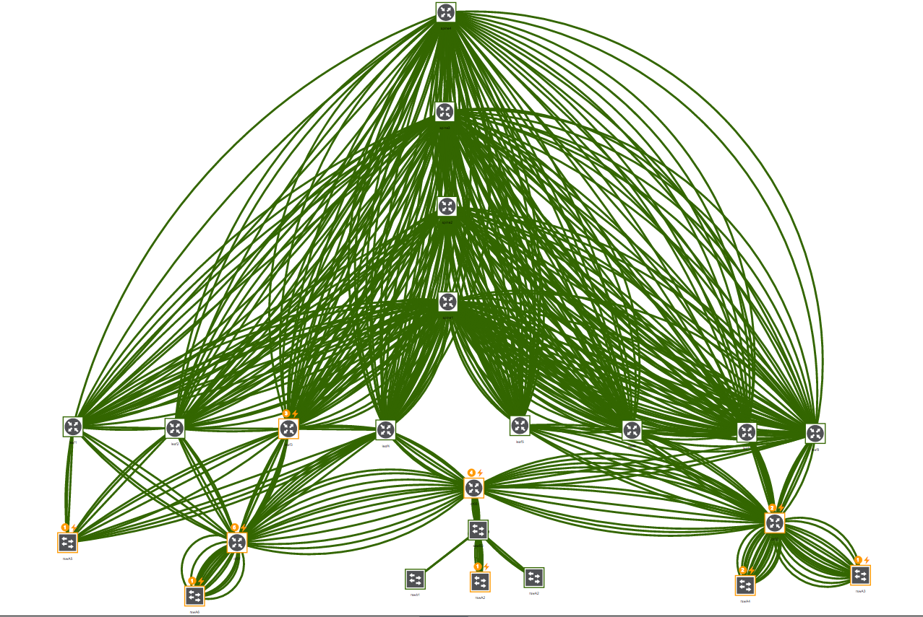
Connected Topology

Slide 3
Devices in place
Top Of Rack
Rack Switch
spine
Out of Band
leaf
spine
ssw
dr
oob
rsw
leaf
spine
Catalyst 3750
Catalyst 4948
Various IOS/XE
Nexus 3232
Nexus 9236
NXOS 7.0(3)I5(1)
NCS 5011
eXR 6.2.1
NCS 5011
eXR 6.2.1
NCS 5508
eXR 6.1.3
Nexus 9504
NXOS 7.0(3)I5(1)

