Slide 1
Simple Example
Hello World!
999
Bullet text
Line 1
Line 2
Line 3

Slide 2
Text Examples 1
Misc font/color, size = 12
999
Misc font/color, size = 18
Bullet text (int above)
Misc font/color, size = 22
Line 1
Line 2
Line 3
Misc font/color, size = 28
Misc font/color, size = 32
Misc font/color, size = 42
Misc font/color, size = 48
Misc font/color, size = 60

Slide 3
Text Examples 2
Textbox (ctr/ctr)
Textbox (top/lft)
Textbox (btm/rgt)
Hello World!
Plain x/y coords
^ (50%/50%)
Escaped chars: ' " & < >
Arial (42pt, green, bold, italic, underline), [0 inset]
Footer Bar: PptxGenJS version 1.1.5 (width:100%, valign:ctr)

Slide 4
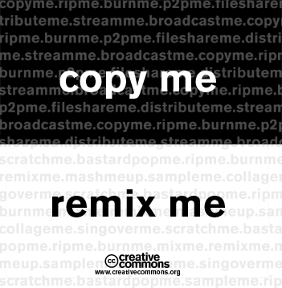

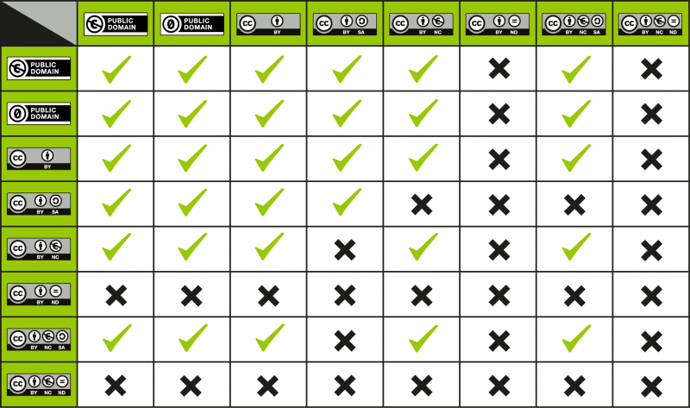


Image Examples: Misc Image Types

Slide 5
Shape Examples: Misc Shape Types (no text)

Slide 6
Shape Examples: Misc Shape Types (with text)
RECTANGLE
OVAL
ROUNDED-RECTANGLE
RIGHT-TRIANGLE
LINE
RIGHT-TRIANGLE
LINE
LINE
LINE

Slide 7
Table Examples 1
Cell Text Alignment:
Cell Styles:
Top Lft | Top Ctr | Top Rgt
Ctr Lft | Ctr Ctr | Ctr Rgt
Btm Lft | Btm Ctr | Btm Rgt
White | Yellow | Pink
12pt | 20pt | 28pt
Bold | Underline | 10pt Pad
Row/Col Heights/Widths:
1x1 | 2x1 | 2.5x1 | 3x1 | 4x1
1x2 | 2x2 | 2.5x2 | 3x2 | 4x2

Slide 8
Table Examples 2
Row/Col-spans:
A1 and A2 | B1 | C1 and D1 |  | E1 | F1/F2/F3
 | B2 | C2 | D2 | E2
A3 | B3 | C3 | D3 | E3
A1/B1 |  | C1
A2 | B2/C2
Complex Cell Border:
Borders!
Escaped Invalid Chars:
< | > | " | ' | & | plain

Slide 9


Global IT Team

Slide 10
Star Labs - Confidential

Slide 11

Thank You!

Slide 12
Star Labs - Confidential

Slide 13
Thank You!

