Slide 1
IIT-K Hackathon Solution
Team : Landscapers
Members : Akash Gupta
Haran Ravindran
Raj Richard Nunes

Slide 2
Unsupervised Machine Learning
From the outset, we realized that this was an unsupervised machine learning problem.
The solution needs to be adaptive, flexible to new situations.
Presence of partial labelling of the data.
Hence, unsupervised learning is the way to go.
The core algorithm used in our solution is Isolation Forest.

Slide 3
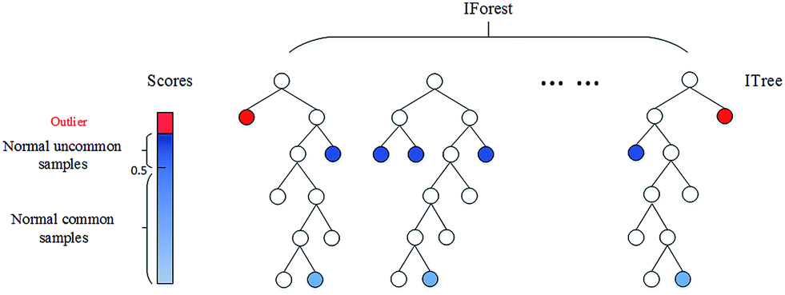
Isolation Forest

Slide 4
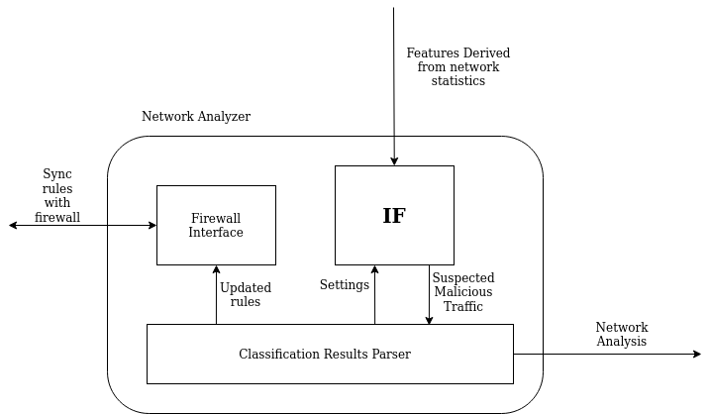
Network Analyzer

Slide 5
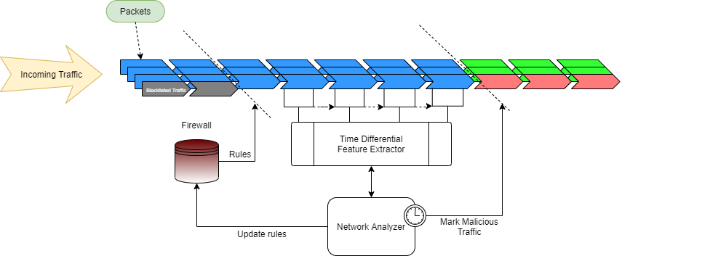
Real-Time Usage

Slide 6
Advantages of the solution
Isolation Forests were designed to be memory efficient and fast. This is a must for any algorithm hoping to analyze traffic in real time.
Isolation forests are also easy to parallelize, and the feature extraction used in our solution can also easily be parallelized, making it easier to scale the solution if needed.
The solution is extremely configurable, since every parameter can be changed and the model can be retrained quickly; This makes it highly adaptive.
It is easy to add new features to the solution, making it highly extensible.

Slide 7
Why not deep learning?
Our solution is configured to observe and extract features in one second intervals, and can be modified to work on smaller time scans.
As a network analysis problem, any algorithm we use must also be able to operate in these conditions or it will quickly accumulate a lot of backlog, especially in a DDoS attack.
Additionally, it is hard to augment models with new data in most DL models.
Hence, neural networks and other deep learning techniques were off the table for us given the requirements of the problem statement.

Slide 8
Future Improvements
The features currently being extracted were handpicked after analyzing the given dataset. To make the solution more generalized, extra features indicative of other types of DDoS attacks (e.g. SlowLoris attacks) can be added to the feature extractor.
The solution can benefit hugely from parallelization at each and every stage, which will hugely boost the performance.
Metrics can be appropriately presented to a systems engineer for further analysis.
Notes:
Our current solutions can easily be extended to All kinds of DDOS amplification attacks like NTP,SNMP, DNS

Slide 9
Thank You
Q/A

