Slide 1
Debug & Patch
——By M4x

Slide 2
Debug Tools：
Linux
gdb(peda, pwndbg, gef....)
IDA
pdb
......
Windows
Ollydbg, Windbg
IDA
IDE
......
Patch Tools:
010editor, winhex, C32Asm
IDA(keypatch), Ollydbg, Windbg
gdb
some github repo

Slide 3
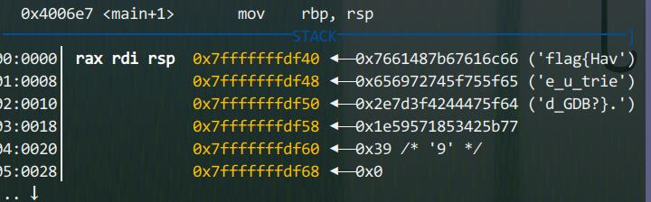
Why dynamic debugging?
watch/fix memory(stack, heap, variables and registers)
clarify/control program flow
to find bugs
for better patch
......

Slide 4
How to dynamic debugging?
Take gdb for example:
b(reak)
r(run), c(ontinue)
x/nfu(examine)
watch
b(reak) if
p(rint)
set
search/find
基本思想：静动结合
Notes:
2018.rev
1. set $rdi.....
2. jump
符号表
ccc

Slide 5

Debugging in pwn
pwn.gdb.attach()(reference)
context.log_level = "debug"
sudo gdb attach [pid]
context.terminal = ["deepin-terminal", "-x", "sh", "-c"]
No pie:
PIE enabled:
reference
Notes:
ret2libc

Slide 6
Debug Tools：
Linux
gdb(peda, pwndbg, gef....)
IDA
pdb
......
Windows
Ollydbg, Windbg
IDA
IDE
......
Patch Tools:
010editor, winhex, C32Asm
IDA(keypatch), Ollydbg, Windbg
gdb
some github repo

Slide 7
Why patch?
control program flow
to defend in AWD
for better debug
......
Notes:
去弹窗

Slide 8
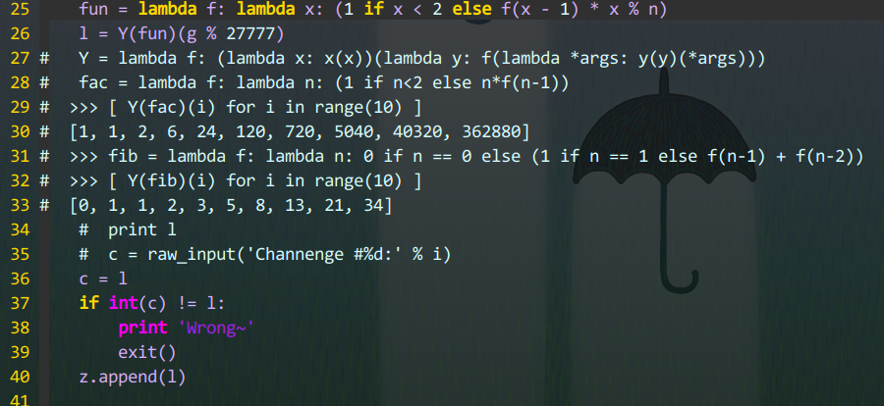
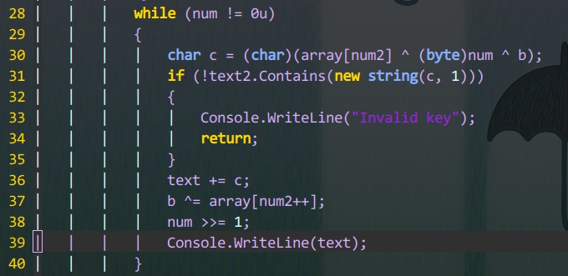
How to patch?
源码级的patch(py, C#, vb)
汇编级的patch
Take IDA for example:
jz/jnz/jge/jle改变程序流程
nop大法好(\x90)
keypatch
注意栈结构
........
Notes:
pyyy
gccc
onepunch

Slide 9
Homework
之前的所有附加题
re
babyRE
get_flag.exe
建议了解z3(求解多约束问题神奇)
pwn
调试ret2syscall,rop2
stack(10.4.21.55 9012)
inndy-leave_msg

Slide 10
References
http://blog.chinaunix.net/uid-29699406-id-5184915.html
http://brieflyx.me/2015/python-module/pwntools-advanced/
http://blog.csdn.net/niexinming/article/details/78814422
http://www.chinapyg.com/thread-86624-1-1.html

