Slide 1

Project Title - Seasonal Agriculture Performance Analysis
Student Name :- Nisha Kishorji Borse
College Name :- R.C.P.E.T's Institute of Management Research and Development, Shirpur
AICTE STU ID :- STU67650ae7b49901734675175

Slide 2

PROBLEM STATEMENT
Agricultural activities are influenced by seasonal variations in environmental conditions, farming practices, resource availability and market conditions. As a result, agricultural performance may differ from one season to another.
However, raw agricultural data does not clearly explain how agricultural performance changes across seasons or what patterns can be observed in different seasonal conditions.
The problem is to analyze the given agricultural dataset and investigate seasonal differences in agricultural performance by identifying meaningful patterns, trends, relationships and variations within the available data.

Slide 3
Project Description
This project analyzes agricultural activities across different seasons using Python, Pandas, NumPy, Matplotlib, and Seaborn.
The analysis focuses on crop production, yield, rainfall, temperature, soil conditions, resource usage, disease risk, revenue, cost, and profit.
Statistical and visualization techniques were applied to identify seasonal trends, regional variations, environmental impacts, and economic outcomes.
The project provides evidence-based insights and recommendations for improving agricultural planning.

Slide 4
WHO ARE THE END USERS?
End Users
Farmers
Agricultural Researchers
Government Agriculture Departments
Policy Makers
Agribusiness Companies
Agricultural Consultants
Students and Researchers
Benefits
Better seasonal planning
Improved resource allocation
Higher productivity
Better profit management
Data-driven decision making

Slide 5

Technology Used
Environment
Jupyter Notebook
Techniques
Data Cleaning
Exploratory Data Analysis (EDA)
Correlation Analysis
ANOVA Statistical Testing
Data Visualization
Programming Language
Python
Libraries
Pandas
NumPy
Matplotlib
Seaborn
SciPy

Slide 6
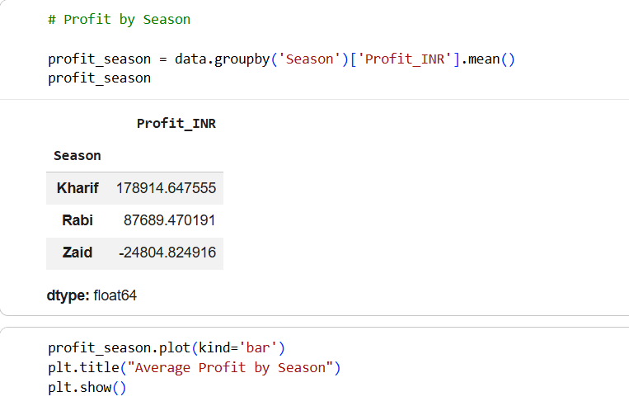
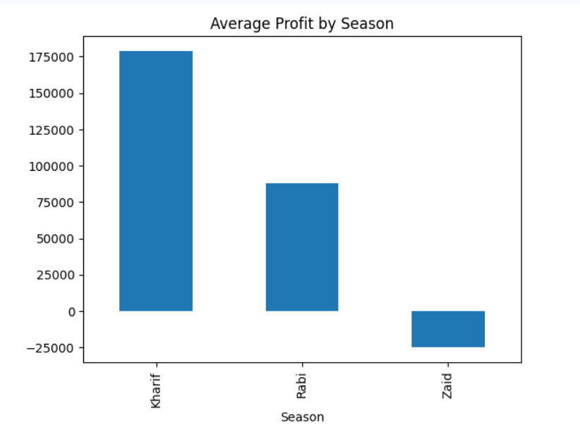
RESULTS
Agricultural Performance Across Seasons
Profit is the final business outcome.
Directly answers:
How agricultural performance varies across seasons.
Which season performs best economically.
Slide Text
Key Findings:
Agricultural profitability varies across seasons.
Some seasons generate significantly higher profits.
Seasonal conditions influence economic outcomes.
Interpretation: This analysis shows that agricultural performance is not uniform throughout the year.
Seasonal variations impact overall profitability, indicating the importance of season-specific planning and resource allocation.

Slide 7
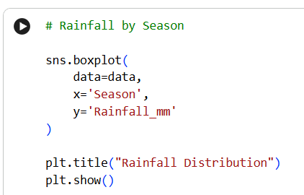
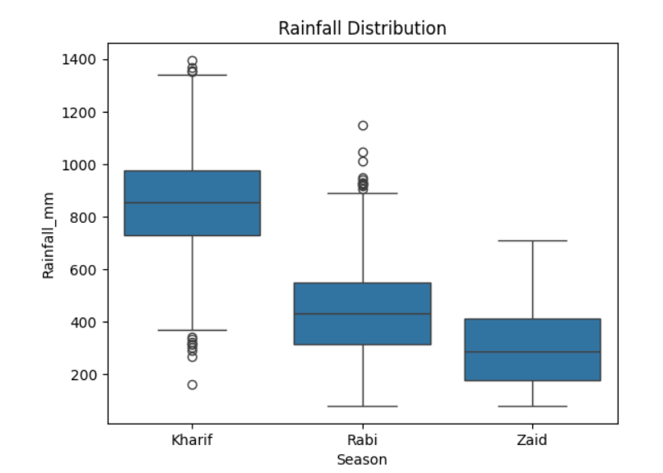
RESULTS
Environmental Conditions Analysis
Rainfall is one of the most important agricultural factors.
Directly answers:
What seasonal patterns can be observed?
How environmental conditions differ.
Slide Text
Key Findings:
Rainfall levels vary considerably across seasons.
Some seasons receive significantly higher rainfall.
Environmental conditions change throughout the agricultural cycle.
Interpretation: Rainfall plays a critical role in crop growth and agricultural productivity.
Seasonal differences in rainfall can influence yield, production, and resource requirements.

Slide 8
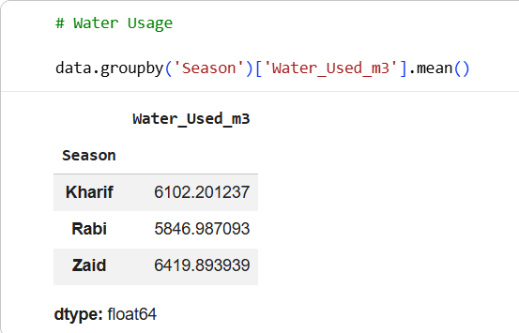
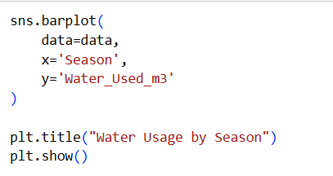
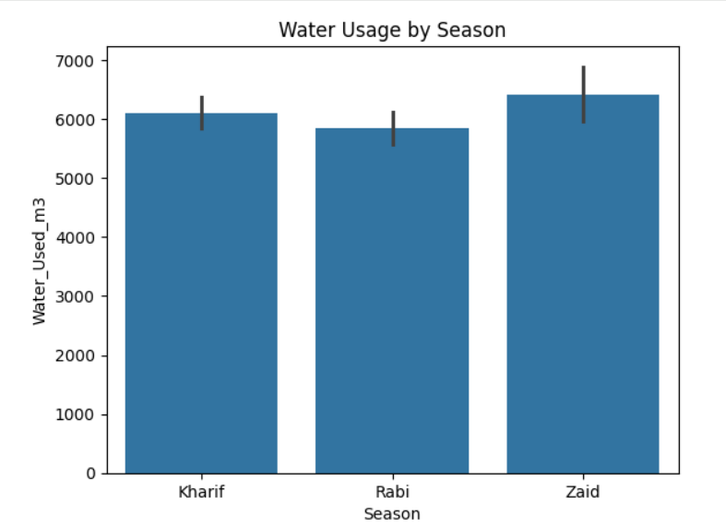
RESULTS
Resource Usage Analysis
PDF specifically asks for resource usage analysis.
Water is the most critical agricultural resource.
Slide Text
Key Findings:
Water consumption differs across seasons.
Some seasons require significantly higher irrigation.
Resource requirements are influenced by environmental conditions.
Interpretation: Understanding seasonal water demand helps improve irrigation planning and supports efficient resource utilization for sustainable farming.

Slide 9
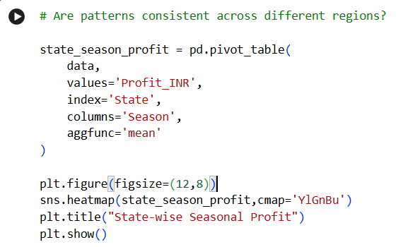
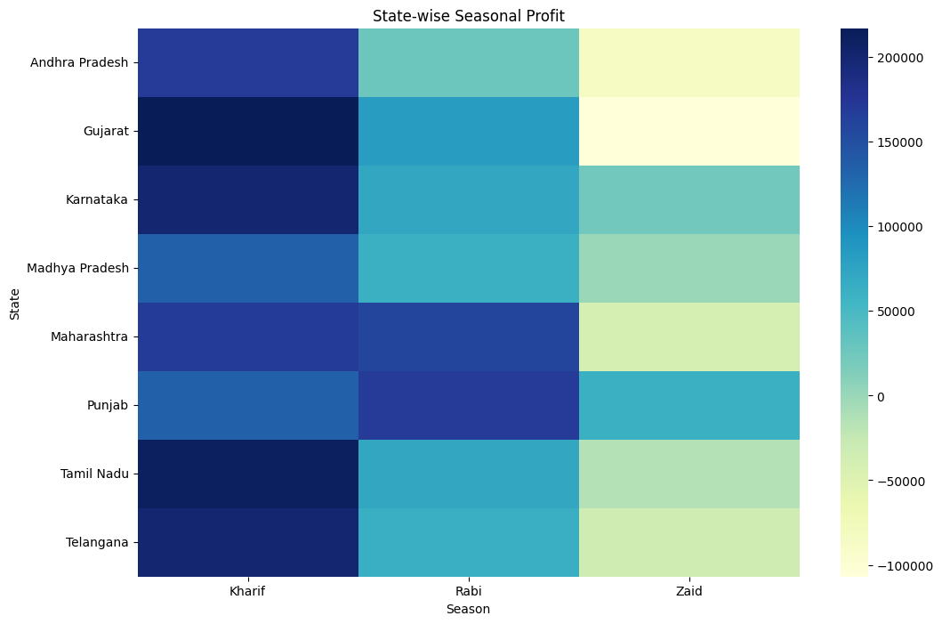
RESULTS
Regional Performance Analysis
Directly answers:
Are seasonal patterns consistent across regions?
Slide Text
Key Findings:
Agricultural profitability differs across states.
Seasonal performance is not identical across regions.
Certain regions consistently achieve better outcomes.
Interpretation:
Regional factors such as climate, farming practices, and resource availability contribute to variations in seasonal agricultural performance.

Slide 10
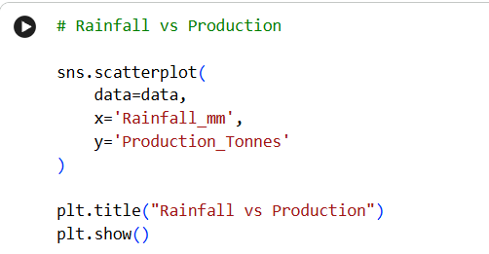
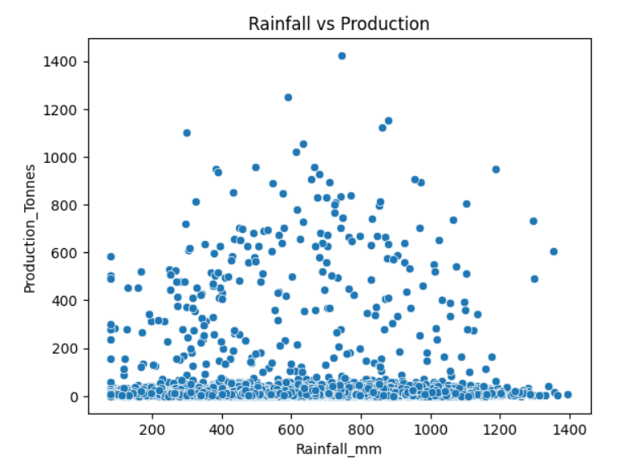
RESULTS
Relationship Analysis
Rainfall vs Production (Scatter Plot)
Directly answers:
Are environmental conditions related to agricultural performance?
Slide Text
Key Findings:
A relationship exists between rainfall and crop production.
Environmental factors influence agricultural outcomes.
Production levels tend to vary with rainfall patterns.
Interpretation: This analysis highlights the impact of environmental conditions on agricultural productivity and demonstrates the importance of monitoring climate-related factors.

Slide 11
Future scope
Integrate real-time weather data to improve seasonal agricultural analysis.
Develop machine learning models for crop yield and profit prediction.
Build an interactive Power BI dashboard for farmers and agricultural stakeholders.
Analyze multi-year agricultural data to identify long-term seasonal trends.
Incorporate satellite and IoT sensor data for precision agriculture.
Create an early warning system for disease and pest risk prediction.
Develop region-specific recommendations based on seasonal performance patterns.
Support data-driven agricultural planning and resource optimization.

Slide 12
GitHub Link
https://github.com/100-Nisha/Seasonal-Agriculture-Performance-Analysis

Slide 13

VOIS Course completion certificate - Course name- Data Visualization

Slide 14
Thank You
Seasonal Agriculture Performance Analysis
Submitted by: Nisha Kishorji Borse
MCA 2025
.
.

