Slide 1
ParcelPilot Support Agent
A customer-facing AI support chatbot — CalQuity AI Engineer Assessment
parcelpilot-support.streamlit.app
github.com/100-nal/parcelpilot-support-agent

Slide 2
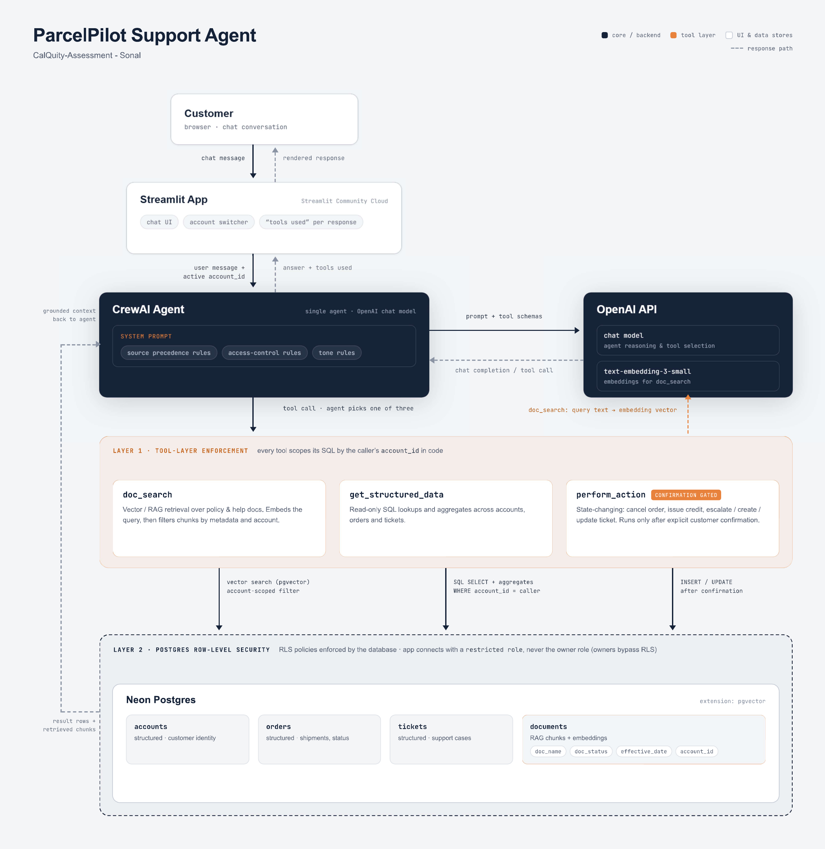
ARCHITECTURE
One agent, three tools, two data sources

Slide 3
TOOL DESIGN
Three tool families, six actions
Document retrieval
Structured data
State-changing
doc_search
get_structured_data
perform_action
Vector retrieval over policies, SOPs, product docs, and customer contracts. Filtered by account before ranking.
Lookups and account-scoped aggregates over accounts, orders, and tickets. Strips internal-only fields for customers.
cancel_order · issue_service_credit · create_followup_task · create_escalation · update_ticket · create_ticket — always gated behind explicit confirmation.

Slide 4
SECURITY
Access control — two independent layers
Layer 1 — Tool layer (primary)
Every tool scopes its own SQL by the caller's account_id. A customer-mode call cannot pass through a mismatched entity_id to reach another account's data — the code rejects it, rather than trusting the model to self-restrict.
Layer 2 — Database layer (Postgres RLS)
Row-Level Security policies on every table, keyed off session variables set on each connection — defense in depth, so even a query issued outside the app is scoped. Required creating a restricted DB role, since Neon's default owner role bypasses RLS entirely.

Slide 5
LIVE DEMO
Four scenarios that stress-test the system
1
Contract override
2
Access control
Northstar's signed agreement correctly waives a cancellation fee the default policy would otherwise charge.
Asking about another customer's account gets a flat refusal — no confirmation, no leaked details.
3
Proactive issue detection
4
Confirm, then act
Agent catches a historical ticket that wrongly blamed a plan limit, and names the real known issue instead.
A ticket escalation is proposed, confirmed by the customer, then genuinely written to the database.

Slide 6
DECISIONS
Key technical trade-offs
Single agent, not a crew
The workflow is fundamentally linear per request — simpler to reason about and debug.
Tool-layer + RLS access control
Two independent layers, so a model mistake alone can't leak cross-account data.
Sources cited by type, not filename
Fixed after testing showed raw internal filenames leaking into customer-facing answers.
Confirmation is prompt-enforced, not tokenized
A known, acknowledged gap — production would need a server-side confirmation token.

Slide 7
TESTING
Bugs found by actually using the app
Every fix in this build came from a bug I found by running the deployed app myself and checking the answer against the real documents and database — not from reading the code.
Agent fabricated another customer's account mapping and leaked a contact name
Agent claimed an action succeeded when the tool had actually returned an error
Agent answered a plan-gated question without checking the caller's actual plan
A known-issue bug's threshold was treated as a permanent plan limit
No way to open a brand-new ticket caused an infinite confirmation loop
Each fix targeted the underlying reasoning rule, not the literal test question — so it should generalize.

Slide 8
ROADMAP
What I'd build next, in priority order
1
Proactive SLA-breach escalation
Trigger automatically on breach, not only when a customer asks.
2
Server-side confirmation tokens
Close the current model-supplied confirmed=true trust gap.
3
PR-review workflow for account changes
AI drafts, a human approves, an audit trail comes free.
Full list — including privacy/DPA document handling, an internal UI, and an automated test suite — is in product-note.md.

Slide 9
Thank you
Live app
parcelpilot-support.streamlit.app
Repository
github.com/100-nal/parcelpilot-support-agent
Full write-up
architecture-note.md · product-note.md · ai-tools-note.md

