Slide 1
Benchling Buddy Chrome Extension
A simple installation and use guide for the SMI team

Slide 2
Table of Contents
Installation
Manual Installation
User Guide
Basic usage

Slide 3
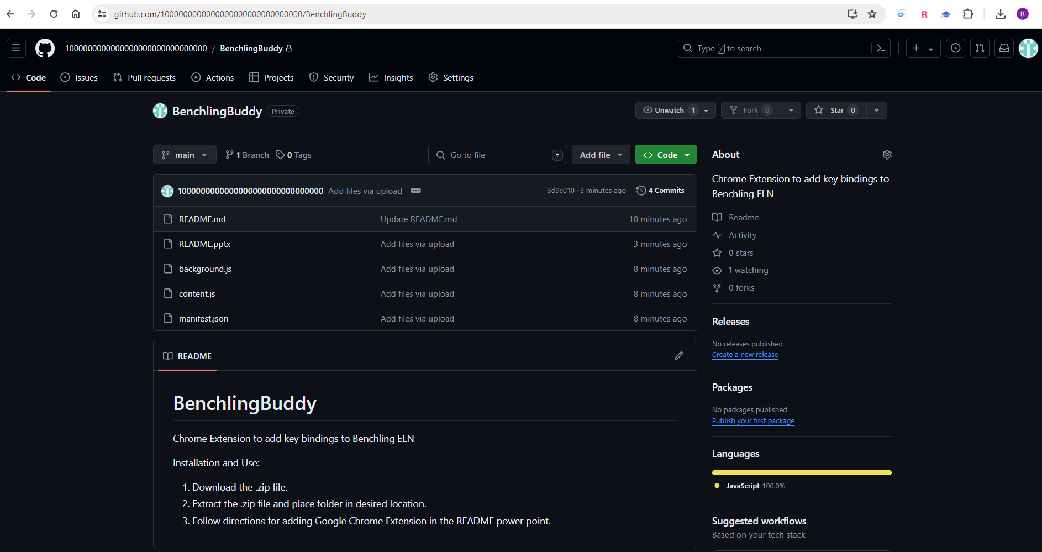
Installing the Chrome Extension Manually
Open Chrome and navigate to the Github repository

Slide 4
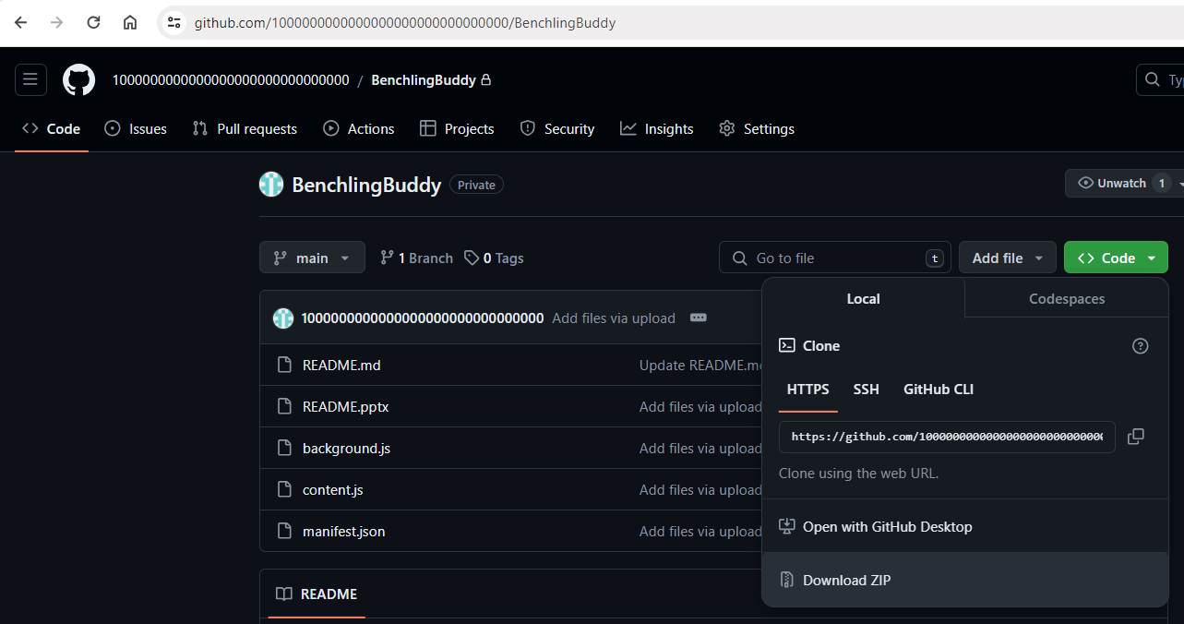
Installing the Chrome Extension Manually
Click “Code” drop-down menu and select “Download ZIP”

Slide 5
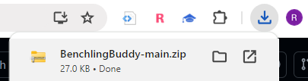
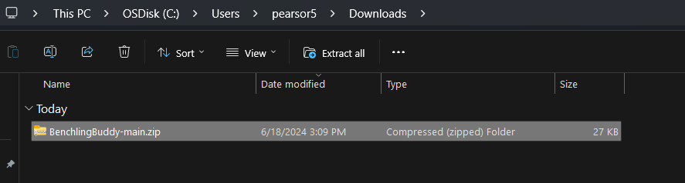
Installing the Chrome Extension Manually
When Download completes, select folder icon to open Download location.
Left-click on download, then click on “Extract all”.

Slide 6
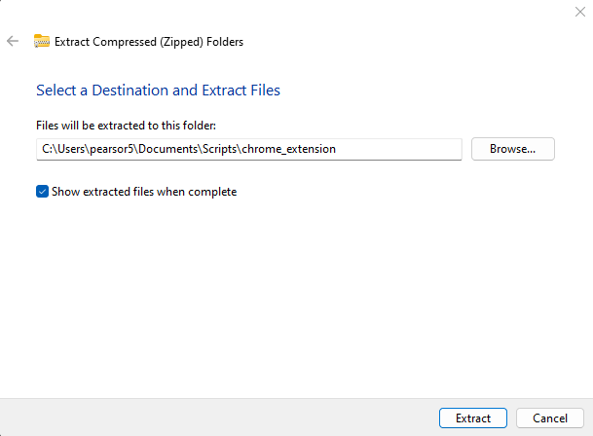
Installing the Chrome Extension Manually
Click “Browse…” and select your desired file path location. Click “Extract”.

Slide 7
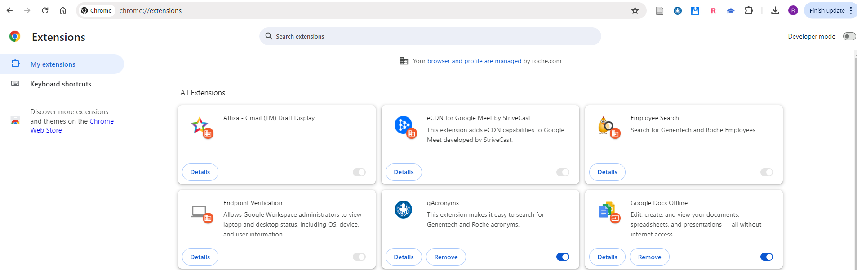
Installing the Chrome Extension Manually
In Chrome, navigate to chrome://extensions. Turn on “Developer mode” by clicking the slider button. When on, the slider turns blue.

Slide 8
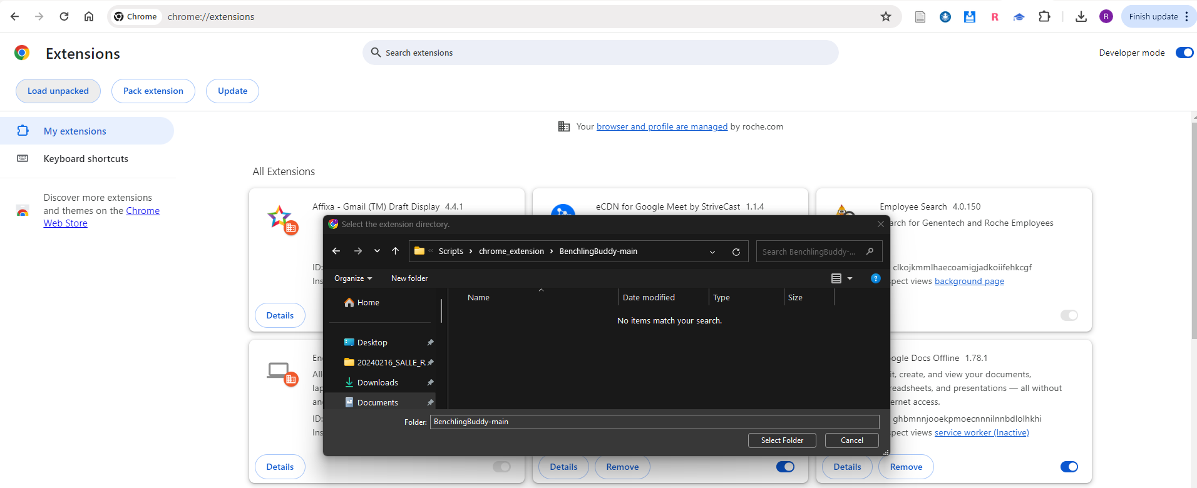
Installing the Chrome Extension Manually
Click “Load unpacked” then in the pop-up window, navigate to the extracted folder and click “Select Folder”.

Slide 9
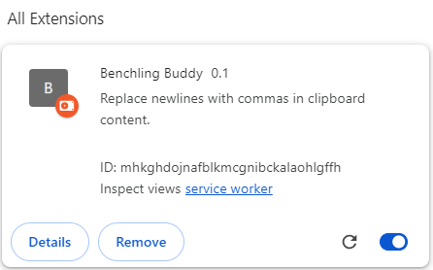
Installing the Chrome Extension Manually
Make sure that this slider button is blue like the one shown here.
Now the installation is complete.

Slide 10
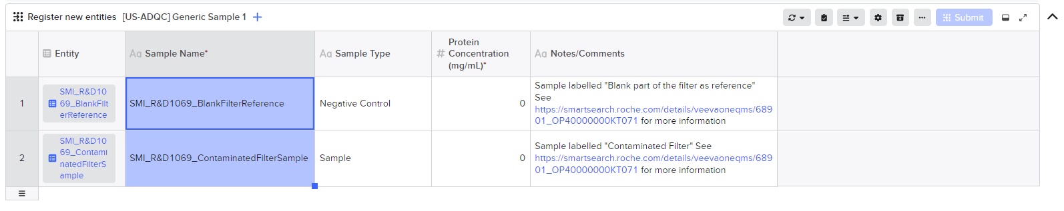
Basic Usage:
In your sample registration or lookup table, select the samples you want to link to a request. Copy the selection by pressing Ctrl+C (win) or Command+C (mac).
Now that you have copied your selection. Press Ctrl+Shift+B (win) or Command+Shift+B (mac) to reformat the copied data in a way that the request registration table accepts.

Slide 11
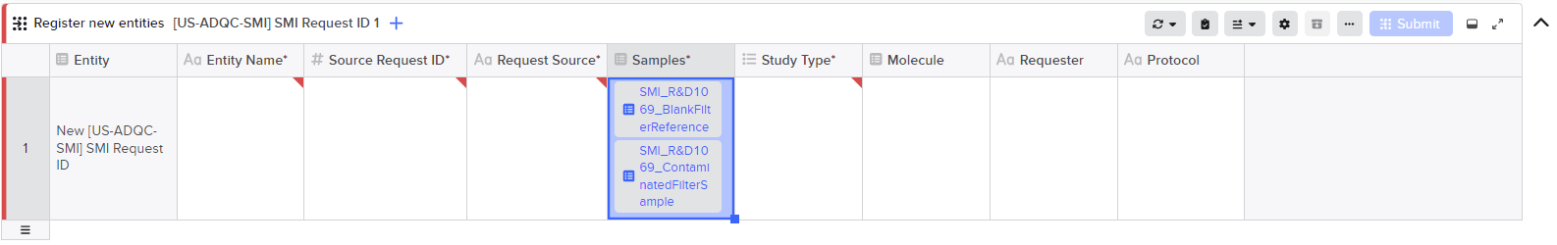
Basic Usage:
In your request registration
table, click the cell you want to past the samples into. Paste the selection by pressing Ctrl+V (win) or Command+V (mac).
You have successfully linked your samples to a request.

