Slide 1


UVA10642

Slide 2
題目
2
First take a look at the following picture. In this picture, each circle has a coordinate according to Cartesian Coordinate System. You can move from one circle to another following the path denoted by forward arrow symbols. To go from a source circle to a destination circle,
total number of step(s) needed = number of intermediate circles you pass + 1
下面這張圖，每個圓都有一個坐標，根據笛卡爾坐標系，您可以按照以下所示的箭頭路徑從一個圓圈移動到另一個圓圈。

Slide 3
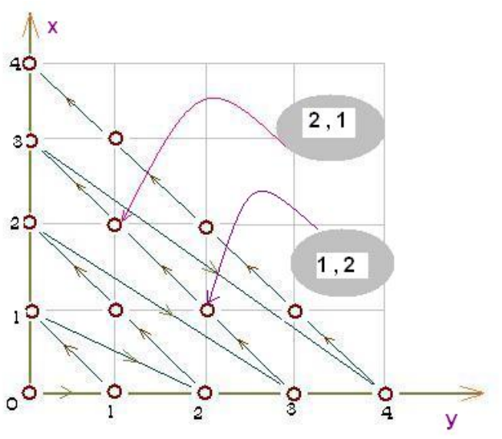
題目
3
For example, to go from (0, 3) to (3, 0) you have to pass two intermediate circles (1, 2) and (2, 1). So, in this case, total number of steps needed is 2 + 1 = 3. In this problem, you are to calculate number of step(s) needed for a given source circle and a destination circle. You can assume that, it is not possible to go back using the reverse direction of the arrows.
例如，要從 (0, 3) 到 (3, 0)，您必須經過兩個中間圓 (1, 2) 和 (2, 1)。 所以，在這種情況下，所需的總步數是 2 + 1 = 3。

Slide 4
輸入與輸出
4
Input：The first line in the input is the number of test cases n (0 < n ≤ 500) to handle. Following there are n lines each containing four integers (0 ≤ each integer ≤ 100000) the first pair of which represents the coordinates of the source circle and the other represents that of the destination circle. The coordinates are listed in a form (x, y).
Output：For each pair of integers your program should output the case number first and then the number of step(s) to reach the destination from the source. You may assume that it is always possible to reach the destination circle from the source circle.
輸入：
第一行為一個整數 n 代表測試資料數量。
接下來 n 行，每行包含 4 個整數 x1, y1, x2, y2 (0 ≤ x1, y1, x2, y2 ≤ 100000)。
(x1, y1) 代表起始座標。
(x2, y2) 代表目標座標。
輸出：
對於每筆測試資料，請照格式輸出是第幾筆，
以及要花費的最小步數。

Slide 5

範例測資
5
Input
Output
3
0 0 0 1
0 0 1 0
0 0 0 2
Case 1: 1
Case 2: 2
Case 3: 3

Slide 6

程式碼說明
6
Step 1 ：輸入測資
變數 | 備註
n | 測資數量
X1、y1、x2、y2 | 起始座標與目標座標

Slide 7

程式碼說明
7
Step 2 ：計算步數並輸出
變數 | 備註
n | 測資數量
X1、y1、x2、y2 | 起始座標與目標座標
oto1 | (0,0)到起始座標的步數
oto2 | (0,0)到目標座標的步數

Slide 8
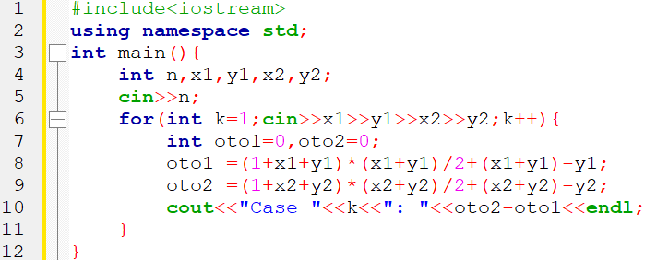
完整程式碼
8

Slide 9
資料來源
9
英文題目
:
https://vjudge.net/problem/UVA-10642
中文題目
:
https://zerojudge.tw/ShowProblem?problemid=i859

Slide 10

10
THANK YOU

