Slide 1

UVA10093

Slide 2
題目
Have you heard the fact “The base of every normal number system is 10”? Of course, I am not talking about number systems like Stern Brockot Number System. This problem has nothing to do with this fact but may have some similarity.
您聽說過“每個普通數字系統的基數都是 10”這個事實嗎？當然，我不是在談論像Stern Brockot Number System這樣的數字系統。這個問題與這個事實無關，但可能有一些相似之處。
2

Slide 3
題目
You will be given an N based integer number R and you are given the guaranty that R is divisible by (N − 1). You will have to print the smallest possible value for N. The range for N is 2 ≤ N ≤ 62 and the digit symbols for 62 based number is (0..9 and A..Z and a..z). Similarly, the digit symbols for 61 based number system is 0..9 and A..Z and a..y) and so on.
您將獲得一個基於 N 的整數 R，並保證 R 可被 (N − 1) 整除。您必須輸出 N 的最小可能值。N 的範圍是 2 ≤ N ≤ 62，基於 62 的數字的數字符號是（0..9 和 A..Z 和 a..z）。同樣，基於 61 的數字系統的數字符號是 0..9 和 A..Z 和 a..y) 等等。
3

Slide 4
輸入
Each line in the input file will contain an integer (as defined in mathematics) number of any integer base (2..62). You will have to determine what is the smallest possible base of that number for the given conditions. No invalid number will be given as input.
輸入中的每一行將包含任何整數(2..62) 的整數（如數學中定義）。您必須確定在給定條件下該數字的最小可能數是多少。不會輸入無效數字。
4

Slide 5
輸出
If number with such condition is not possible output the line ‘such number is impossible!’ For each line of input there will be only a single line of output. The output will always be in decimal number system.
如果沒有具有這種條件的數字，請輸出“such number is impossible!”，對於每一行輸入，只有一行輸出。輸出將採用十進制。
5

Slide 6
範例測資
Input：
3
5
A
Output：
4
6
11
6

Slide 7

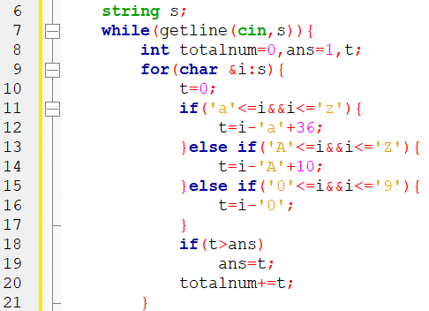
程式碼說明
Step 1 ：輸入測資並轉成十進位
變數 | 註解
s | 輸入的測資
totalnum | s的總和
ans | 所求的N
7

Slide 8
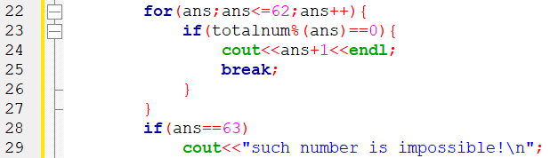
程式碼說明
Step 2 ：找到最小的N並輸出
變數 | 註解
s | 輸入的測資
totalnum | s的總和
ans | 所求的N
8

Slide 9
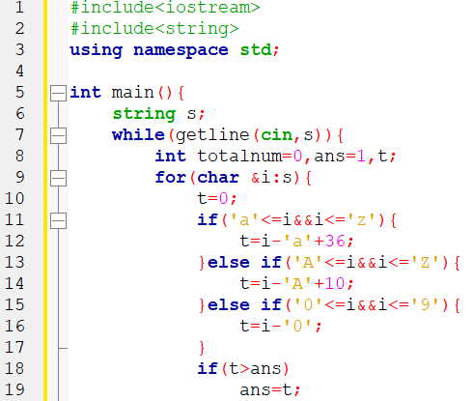
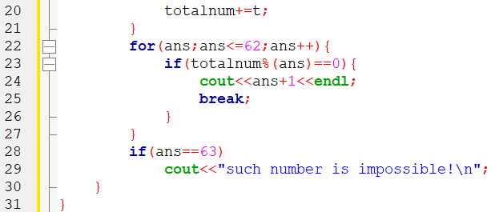
完整程式碼
9

Slide 10

資料來源
英文題目：
https://vjudge.net/problem/UVA-10093
10

Slide 11
Thank you
for listening!

