Slide 1
UVA299

Slide 2
題目
At an old railway station, you may still encounter one of the last remaining “train swappers”. A train swapper is an employee of the railroad, whose sole job it is to rearrange the carriages of trains. Once the carriages are arranged in the optimal order, all the train driver has to do, is drop the carriages off, one by one, at the stations for which the load is meant.
The title “train swapper” stems from the first person who performed this task, at a station close to a railway bridge. Instead of opening up vertically, the bridge rotated around a pillar in the center of the river. After rotating the bridge 90 degrees, boats could pass left or right.
在老舊的火車站，您也許會遇到少數僅存的"車箱置換員"。
"車箱置換員"是鐵路部門的員工，主要工作就是重新排列火車車廂。
一旦以最佳順序排列了車廂，所有火車司機要做的就是將車廂逐一卸下即可。
"車箱置換員"源自在鐵路橋附近的車站中執行此任務的第一人。
這座橋並不會垂直打開，而是繞著河中央的一根支柱旋轉。將橋旋轉90度後，船隻就能向左或向右駛過。
01

Slide 3
題目
The first train swapper had discovered that the bridge could be operated with at most two carriages on it. By rotating the bridge 180 degrees, the carriages switched place, allowing him to rearrange the carriages (as a side effect, the carriages then faced the opposite direction, but train carriages can move either way, so who cares).
Now that almost all train swappers have died out, the railway company would like to automate their operation. Part of the program to be developed, is a routine which decides for a given train the least number of swaps of two adjacent carriages necessary to order the train. Your assignment is to create that routine.
第一位"車箱置換員"發現，這座橋最多可以在其上運行兩個車廂，通過將橋旋轉180度，車廂就能切換位置。
(缺點是車廂面向相反的方向，但是火車車廂可以以任何一種方式移動，所以沒差）
現在幾乎所有的"車箱置換員"都已經淘汰了，鐵路公司希望將其操作自動化。
你的任務就是寫一個程式，該程式要計算最少需要交換幾次兩個相鄰車廂，才能將所有車廂依序排好。
02

Slide 4
輸入與輸出
Input：The input contains on the first line the number of test cases (N). Each test case consists of two input lines. The first line of a test case contains an integer L, determining the length of the train (0 ≤ L ≤ 50).
The second line of a test case contains a permutation of the numbers 1 through L, indicating the current order of the carriages. The carriages should be ordered such that carriage 1 comes first, then 2, etc. with carriage L coming last.
Output：For each test case output the sentence: ‘Optimal train swapping takes S swaps.’ where S is an integer.
輸入：輸入的第一行包含一個整數N，N代表測資數量。
每組測資的第一行包含一個整數L (0 ≤ L ≤ 50)，L代表火車的長度。
第二行包含數字1到L的排列，表示火車車廂的當前順序。
需要將火車車廂依照編號1到L的順序排好。
輸出：對於每組測資，請輸出：
"Optimal train swapping takes S swaps."，S代表最少交換次數。
03

Slide 5
範例測資
Input
Output
3
3
1 3 2
4
4 3 2 1
2
2 1
Optimal train swapping takes 1 swaps.
Optimal train swapping takes 6 swaps.
Optimal train swapping takes 1 swaps.
04

Slide 6
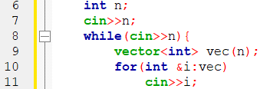
程式碼說明
Step 1：輸入測資
已宣告變數 | 註解
n | 火車長度
vec | 車廂當前順序
05

Slide 7
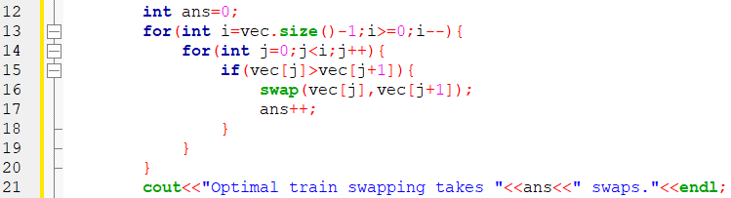
程式碼說明
Step 2：計算排列車廂所需最少交換次數並輸出
已宣告變數 | 註解
n | 火車長度
vec | 車廂當前順序
ans | 交換次數
06

Slide 8
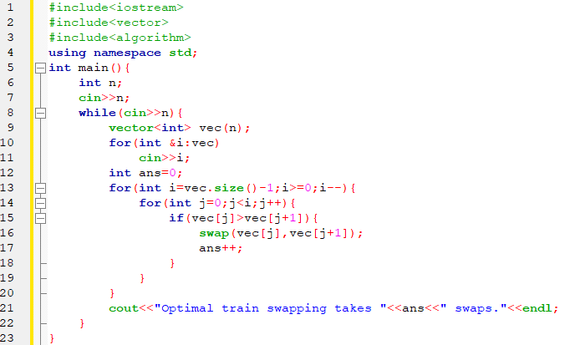
完整程式碼
07

Slide 9
資料來源
英文題目：
https://vjudge.net/problem/UVA-299
中文題目：https://zerojudge.tw/ShowProblem?problemid=e561
08

Slide 10
Thank You
reallygreatsite.com

