Slide 1
Uva100

Slide 2
題目
Problems in Computer Science are often classified as belonging to a certain class of problems (e.g., NP, Unsolvable, Recursive). In this problem you will be analyzing a property of an algorithm whose classification is not known for all possible inputs.
Consider the following algorithm:
input n
2. print n
3. if n = 1 then STOP
4. if n is odd then n ←− 3n + 1
5. else n ←− n/2
6. GOTO 2
Given the input 22, the following sequence of numbers will be printed
22 11 34 17 52 26 13 40 20 10 5 16 8 4 2 1

Slide 3
題目翻譯
It is conjectured that the algorithm above will terminate (when a 1 is printed) for any integral input value. Despite the simplicity of the algorithm, it is unknown whether this conjecture is true. It has been verified, however, for all integers n such that 0 < n < 1, 000, 000 (and, in fact, for many more numbers than this.)
Given an input n, it is possible to determine the number of numbers printed before and including the 1 is printed. For a given n this is called the cycle-length of n. In the example above, the cycle length of 22 is 16. For any two numbers i and j you are to determine the maximum cycle length over all numbers between and including both i and j

Slide 4
輸入與輸出
Input ：The input will consist of a series of pairs of integers i and j, one pair of integers per line. All integers will be less than 10,000 and greater than 0. You should process all pairs of integers and for each pair determine the maximum cycle length over all integers between and including i and j. You can assume that no operation overflows a 32-bit integer.
Output ：For each pair of input integers i and j you should output i, j, and the maximum cycle length for integers between and including i and j. These three numbers should be separated by at least one space with all three numbers on one line and with one line of output for each line of input. The integers i and j must appear in the output in the same order in which they appeared in the input and should be followed by the maximum cycle length (on the same line).

Slide 5
範例測資
輸入：
1 10
100 200
201 210
900 1000
輸出：
1 10 20
100 200 125
201 210 89
900 1000 174

Slide 6
測資解釋
EX: input 22
22 11 34 17 52 26 13 40 20 10 5 16 8 4 2 1
輸入：
輸出：
1 10 20
1 10

Slide 7
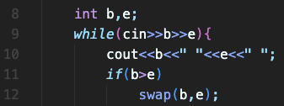
程式碼
Step 1:輸入測資
已宣告變數 | //註解
b | 開始數字
e | 結束數字

Slide 8
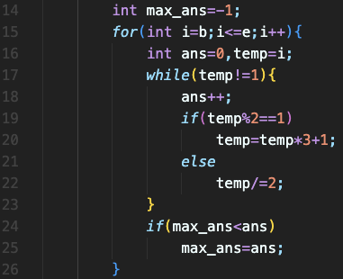
程式碼
Step 2:計算最佳解
已宣告變數 | //註解
b | 開始數字
e | 結束數字
Max_ans | 最佳答案
ans | i對應到的答案
temp | i的替身

Slide 9
程式碼
Step 3:輸出正解
已宣告變數 | //註解
b | 開始數字
e | 結束數字
Max_ans | 最佳答案
ans | i對應到的答案
temp | i的替身

Slide 10
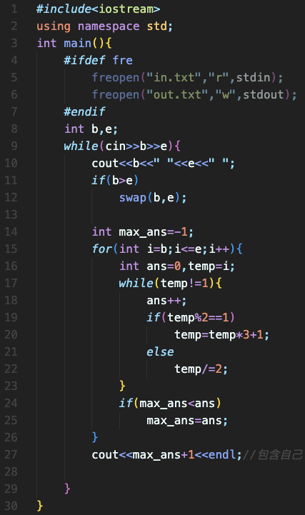
完整程式碼

Slide 11
資料來源
英文題目：https://vjudge.net/problem/UVA-100

