Slide 1
Uva10170

Slide 2
題目
The city of HaluaRuti has a strange hotel with infinite rooms. The groups that come to this hotel follow the following rules:
At the same time only members of one group can rent the hotel.
Each group comes in the morning of the check-in day and leaves the hotel in the evening of the check-out day.
HaluaRuti市有一家奇怪的酒店，房間無限。 來這家酒店的團體，請遵循以下規則： a）同時，只有能有一個旅行團可以租用酒店。 b）每個旅行團在入住日的早晨到達，並在退房日的晚上離開酒店。

Slide 3
題目
c) Another group comes in the very next morning after the previous group has left the hotel.
d) A very important property of the incoming group is that it has one more member than its previous group unless it is the starting group. You will be given the no of members of the starting group.
c）後入住的旅行團需要在前一團退房後的隔天早晨，才能入住 d）除了第一團，其他旅行團人數都比前一團多一人

Slide 4
題目
e) A group with n members stays for n days in the hotel. For example, if a group of four members comes on 1st August in the morning, it will leave the hotel on 4th August in the evening and the next group of five members will come on 5th August in the morning and stay for five days and so on.
Given the initial group size you will have to find the group size staying in the hotel on a specified day.
e）有n名成員的旅行團則會在酒店停留n天。 例如： 如果一組四個成員的旅行團在8月1日早晨到達，則它將在8月4日晚上離開酒店 下一組五個成員將在8月5日早晨入住並且停留五天，依此類推。 現在給定第一組旅行團人數，您必須回答在指定日期入住的旅行團人數。

Slide 5
輸入與輸出
Input ：The input contains round numbers S (1 ≤ S ≤ 10000) and D (1 ≤ D < 1015) in every line. S denotes the initial size of the group and D denotes that you will have to find the group size staying in the hotel on D-th day (starting from 1). All the input and output integers will be less than 1015. A group size S means that on the first day a group of S members come to the hotel and stays for S days then comes a group of S + 1 members according to the previously described rules and so on.
輸入：輸入每一行包含數字S (1 ≤ S ≤ 10000)和D (1 ≤ D < 10^15)。 S表示第一組旅行團人數，D表示必須在第D天(從1開始)查找入住酒店的旅行團人數。

Slide 6
輸入與輸出
Output ：For each integer I in the inputt you should print a line ‘The parity of B is P (mod 2).’, where B is the binary representation of I.
輸出：對於每行輸入，輸出在第D天入住的旅行團人數。

Slide 7
範例測資
輸入：
1 6
3 10
3 14
輸出：
3
5
6

Slide 8
第一筆範例測資
輸入：
1 6
輸出：
3

Slide 9
第二筆範例測資
輸入：
3 10
輸出：
5

Slide 10
第三筆範例測資
輸入：
3 14
輸出：
6

Slide 11

程式碼
Step 1:輸入測資
已宣告變數 | //註解
s | 第一組旅行團人數
d | 第D天

Slide 12

程式碼
Step 2:實際模擬
已宣告變數 | //註解
s | 第一組旅行團人數
d | 第D天
total | 第s組入住會到第幾天

Slide 13
程式碼
Step 3:輸出答案
已宣告變數 | //註解
s | 第一組旅行團人數
d | 第D天
total | 第s組入住會到第幾天

Slide 14
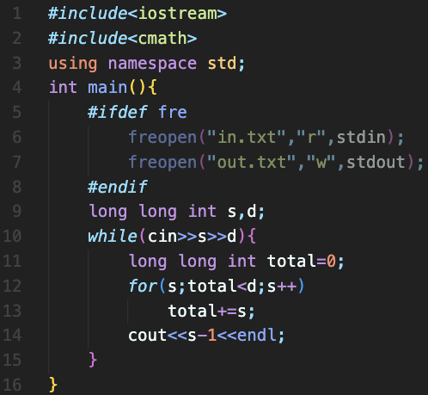
完整程式碼

Slide 15
資料來源
英文題目：https://vjudge.net/problem/UVA-10170
中文題目：https://zerojudge.tw/ShowProblem?problemid=e555

