Slide 1

UVA10226

Slide 2
題目
Hardwoods are the botanical group of trees that have broad leaves, produce a fruit or nut, and generally go dormant in the winter.
America’s temperate climates produce forests with hundreds of hardwood species —trees that share certain biological characteristics. Although oak, maple and cherry all are types of hardwood trees, for example, they are different species. Together, all the hardwood species represent 40 percent of the trees in the United States.
硬木是具有寬闊葉子、結出果實或堅果、通常在冬季休眠的植物群。
美國的溫帶氣候孕育出擁有數百種闊葉樹種的森林，這些闊葉樹種具有某些共同的生物學特徵。 例如，雖然橡樹、楓樹和櫻桃樹都是硬木樹種，但它們是不同的物種。 所有硬木樹種加起來占美國樹木的 40%。
2

Slide 3
題目
On the other hand, softwoods, or conifers, from the Latin word meaning “cone-bearing”, have needles. Widely available US softwoods include cedar, fir, hemlock, pine, redwood, spruce and cypress. In a home, the softwoods are used primarily as structural lumber such as 2×4s and 2×6s, with some limited decorative applications.
Using satellite imaging technology, the Department of Natural Resources has compiled an inventory of every tree standing on a particular day. You are to compute the total fraction of the tree population represented by each species.
另一方面，軟木或針葉樹，源自拉丁語，意思是“圓錐軸承”，有針。 廣泛使用的美國軟木包括雪松、冷杉、鐵杉、松樹、紅木、雲杉和柏樹。 在家庭中，軟木主要用作結構木材，例如 2×4 和 2×6，以及一些有限的裝飾應用。
利用衛星成像技術，自然資源部編制了特定日期每棵樹的清單。 您要計算每個物種所代表的樹木種群的總比例。
3

Slide 4
輸入
The first line is the number of test cases, followed by a blank line.
Each test case of your program consists of a list of the species of every tree observed by the satellite; one tree per line. No species name exceeds 30 characters. There are no more than 10,000 species and no more than 1,000,000 trees.
There is a blank line between each consecutive test cases.
輸入的第1列有一個正整數n，代表以下有多少組測試資料。空一列之後才是測試資料。
每組測試資料含有一或多列（不會超過1000000列），每列有一樹木的名稱（最多30個字元）。測試資料間有一空白列。
4

Slide 5
輸出
For each test case print the name of each species represented in the population, in alphabetical order, followed by the percentage of the population it represents, to 4 decimal places.
Print a blank line between 2 consecutive test cases.
對每一組測試資料，輸出各樹種名稱（樹種不會超過10000種，按數種名稱字典順序排列）及所佔的比例（到小數點後4位）。測試資料間亦請空一列。
5

Slide 6
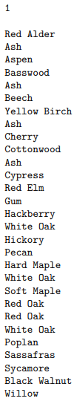
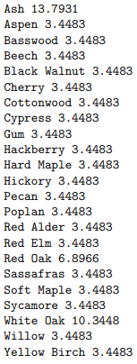
範例測資
Input：
Output：
6

Slide 7

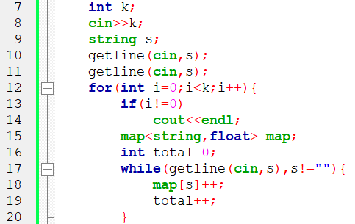
程式碼說明
Step 1 ：輸入測資
變數 | 註解
k | 幾組測資
s | 樹木名稱
map | 該測資所有樹木
total | 有多少樹木
7

Slide 8

程式碼說明
Step 2 ：輸出
變數 | 註解
k | 幾組測資
s | 樹木名稱
map | 該測資所有樹木
total | 有多少樹木
8

Slide 9
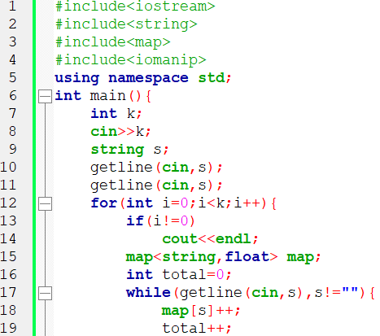
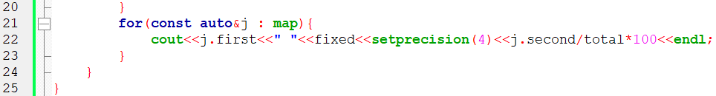
完整程式碼
9

Slide 10

資料來源
英文題目：
https://vjudge.net/problem/UVA-10226
10

Slide 11
Thank you
for listening!

