Slide 1
Uva12019

Slide 2
題目
No. Doom’s day algorithm is not a method to compute which day the world will end. It is an algorithm created by the mathematician John Horton Conway, to calculate which day of the week (Monday, Tuesday, etc.) corresponds to a certain date.
給日期，問那天星期幾

Slide 3
題目
This algorithm is based in the idea of the doomsday, a certain day of the week which always occurs in the same dates. For example, 4/4 (the 4th of April), 6/6 (the 6th of June), 8/8 (the 8th of August), 10/10 (the 10th of October) and 12/12 (the 12th of December) are dates which always occur in doomsday. All years have their own doomsday.

Slide 4
題目
In year 2011, doomsday is Monday. So all of 4/4, 6/6, 8/8, 10/10 and 12/12 are Mondays. Using that information, you can easily compute any other date. For example, the 13th of December 2011 will be Tuesday, the 14th of December 2011 will be Wednesday, etc.

Slide 5
題目
Other days which occur on doomsday are 5/9, 9/5, 7/11 and 11/7. Also, in leap years, we have the following doomsdays: 1/11 (the 11th of January) and 2/22 (the 22nd of Febrary), and in non-leap years 1/10 and 2/21.
Given a date of year 2011, you have to compute which day of the week it occurs.

Slide 6
輸入與輸出
Input ：The input can contain different test cases. The first line of the input indicates the number of test cases. For each test case, there is a line with two numbers: M D. M represents the month (from 1 to 12) and D represents the day (from 1 to 31). The date will always be valid.
Output ：For each test case, you have to output the day of the week where that date occurs in 2011. The days of the week will be: Monday, Tuesday, Wednesday, Thursday, Friday, Saturday, Sunday.
輸入：第一行有個T代表詢問的日期數(T<=100) 接下來會有T行，每行都有一組M、D分別代表月份和日期
輸出：輸出那天星期幾

Slide 7
範例測資
輸入：
9
1 6
2 28
4 5
5 26
8 1
11 1
12 25
12 31
3 9
輸出：
Thursday
Monday
Tuesday
Thursday
Monday
Tuesday
Sunday
Saturday
Wednesday

Slide 8
第一筆範例測資
輸入：
1 6
輸出：
Thursday

Slide 9
第二筆範例測資
輸入：
2 28
輸出：
Monday

Slide 10
第三筆範例測資
輸入：
4 5
輸出：
Tuesday

Slide 11
第四筆範例測資
輸入：
5 26
輸出：
Thursday

Slide 12

程式碼
Step 1:輸入測資
已宣告變數 | //註解
m | 月
n | 日
num_day | 每個月的天數

Slide 13
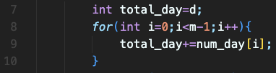
程式碼
Step 2:計算現在是第幾天
已宣告變數 | //註解
m | 月
n | 日
num_day | 每個月的天數
Total_day | 經過的天數

Slide 14
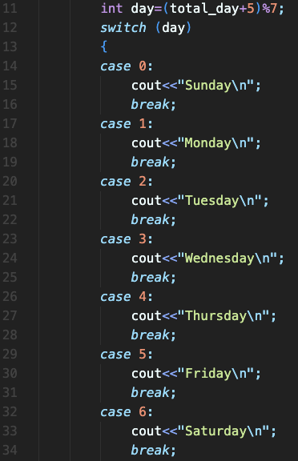
程式碼
Step 3:輸出禮拜幾
已宣告變數 | //註解
bin | 存放二進位
in | 十進位數字
num | 1的出現次數

Slide 15
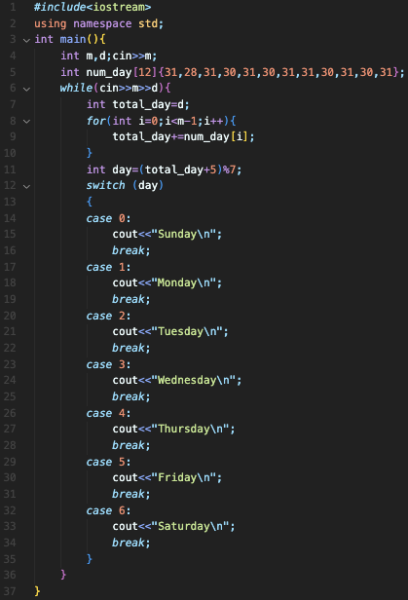
完整程式碼

Slide 16
資料來源
英文題目：https://vjudge.net/problem/UVA-11461
中文題目：https://zerojudge.tw/ShowProblem?problemid=f709

