Slide 1

UVA10019

Slide 2
題目
A student from ITESM Campus Monterrey plays with a new encryption method for numbers. These method consist of the following steps:
一位來自墨西哥蒙特瑞技術研究學院(ITESM Campus Monterrey)的學生想發表一種新的數值加密演算法。
2

Slide 3
題目
Steps : Example
Read the number N to encrypt : M = 265
2. Interpret N as a decimal number : X1 = 265 (decimal)
3. Convert the decimal interpretation of N to its binary representation : X1 = 100001001 (binary)
4. Let b1 be equal to the number of 1’s in this binary representation : b1 = 3
演算法步驟如下：
1. 讀入一個整數N，N為欲加密的數字：N = 265
2. 將N當作十進位的數值：X1 = 265(decimal)
3. 把X1由十進制轉為二進制：X1 = 100001001(binary)
4. 計算二進制的X1有幾個1：b1 = 3
3

Slide 4
題目
5. Interpret N as a Hexadecimal number : X2 = 265 (hexadecimal)
6. Convert the hexadecimal interpretation of N to its binary representation : X2 = 1001100101
7. Let b2 be equal to the number of 1’s in the last binary representation : b2 = 5
8. The encryption is the result of M xor (b1 ∗ b2) : 265 xor (3*5) = 262
5. 把N當作十六進位數值：X2 = 265(hexadecimal)
6. 把X2由十六進制轉為二進制：X2 = 1001100101(binary)
7. 計算二進制的X2有幾個1：b2 = 5
8. 最後的編碼為N xor (b1*b2)：265 xor (3*5) = 262
4

Slide 5
題目
This student failed Computational Organization, thats why this student asked the judges of ITESM Campus Monterrey internal ACM programming Contest to ask for the numbers of 1’s bits of this two representations so that he can continue playing.
You have to write a program that read a Number and give as output the number b1 and b2.
這位學生並未通過這次的計算機組識考試，所以他請求校方在ACM的試題上出一題計算共有幾個位元1的題目，好讓他能順利發表他的數值加密演算法。
你必須寫一個程式能讀入一個整數，然後輸出該整數的b1, b2值。
5

Slide 6
輸入
The first line will contain a number N which is the number of cases that you have to process. Each of the following N Lines (0 < N ≤ 1000) will contain the number M (0 < M ≤ 9999, in decimal representation) which is the number the student wants to encrypt.
第一行包含一個數字T (0 < T ≤ 1000)，代表有幾組測資。
接下來的T行，每行包含一個數字N (decimal)(0 < N ≤ 9999)，N代表學生要加密的數字。
6

Slide 7
輸出
You will have to output N lines, each containing the number b1 and b2 in that order, separated by one space corresponding to that lines number to crypt.
對於每組測資，輸出數字b1和b2，b1和b2請用空白分隔。
4

Slide 8
範例測資
Input：
3
265
111
1234
Output：
3 5
6 3
5 5
8

Slide 9

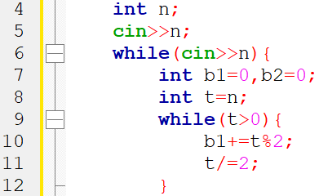
程式碼說明
Step 1 ：輸入測資並計算b1
變數 | 註解
n | 要加密的數字
b1、b2 | b1、b2
t | temp n
9

Slide 10
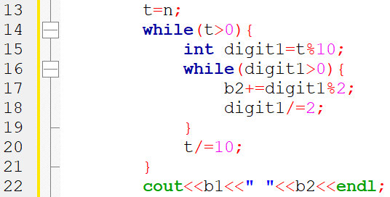
程式碼說明
Step 2 ：計算b2並輸出
變數 | 註解
n | 要加密的數字
b1、b2 | b1、b2
t | temp n
10

Slide 11
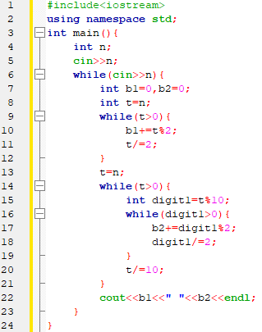
完整程式碼
11

Slide 12

資料來源
英文題目：
https://vjudge.net/problem/UVA-10019
中文題目：
https://zerojudge.tw/ShowProblem?problemid=e545
12

Slide 13
Thank you
for listening!

