Slide 1
UVA10062

Slide 2
題目
Given a line of text you will have to find out the frequencies of the ASCII characters present in it. The given lines will contain none of the first 32 or last 128 ASCII characters. Of course lines may end with \n and \r but always keep those out of consideration.
給你一列文字，請你找出各字元出現的次數。
01

Slide 3
輸入與輸出
Input：Several lines of text are given as input. Each line of text is considered as a single input. Maximum length of each line is 1000.
Output：Print the ASCII value of the ASCII characters which are present and their frequency according to the given format below. A blank line should separate each set of output. Print the ASCII characters in the ascending order of their frequencies. If two characters are present the same time print the information of the ASCII character with higher ASCII value first. Input is terminated by end of file.
輸入：每筆測試資料一列。每列最大長度為1000。
輸出：對每一列輸入，請輸出各字元的ASCII值及其出現的次數。請根據出現的次數由小到大輸出。如果有2個以上的字元有相同的次數，則ASCII值較大的先輸出。
02

Slide 4
範例測資
Input
Output
AAABBC
122333
67 1
66 2
65 3
49 1
50 2
51 3
03

Slide 5

程式碼說明
Step 1：輸入測資
已宣告變數 | 註解
s | 輸入的文字
b | 判斷換行
04

Slide 6
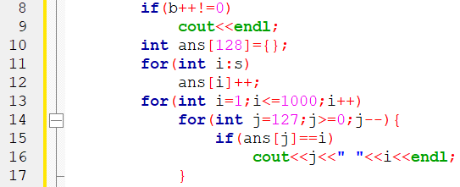
程式碼說明
Step 2：計算字母出現次數並輸出
已宣告變數 | 註解
s | 輸入的文字
b | 判斷換行
ans | 字母出現次數
05

Slide 7
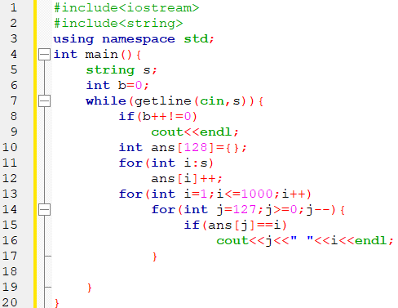
完整程式碼
06

Slide 8
資料來源
英文題目：
https://vjudge.net/problem/UVA-10062
中文題目：https://zerojudge.tw/ShowProblem?problemid=c012
07

Slide 9
Thank You
reallygreatsite.com

