Slide 1
UVA10189

Slide 2
題目
Have you ever played Minesweeper? It’s a cute little game which comes within a certain Operating System which name we can’t really remember. Well, the goal of the game is to find where are all the mines within a M × N field. To help you, the game shows a number in a square which tells you how many mines there are adjacent to that square. For instance, supose the following 4 × 4 field with 2 mines (which are represented by an ‘*’ character):
* . . .
. . . .
. * . .
. . . .
您玩過《踩地雷》嗎？這是一款可愛的小遊戲，遊戲的目標是找到所有M×N地圖內的地雷。
為了幫助您，遊戲在一個正方形中顯示一個數字，告訴您該正方形附近有多少個地雷。
例如，假設下面的4×4的地圖內帶有2個地雷(以"*"字元表示)。
01

Slide 3
題目
If we would represent the same field placing the hint numbers described above, we would end up
with:
* 1 0 0
2 2 1 0
1 * 1 0
1 1 1 0
As you may have already noticed, each square may have at most 8 adjacent squares.
如果我們根據上述作法，將遊戲提示數字填入，則結果將為：
* 1 0 0
2 2 1 0
1 * 1 0
1 1 1 0
當然，您可能已經注意到，每個正方形內的數字最多為8(因為最多有8個正方形相鄰)。
02

Slide 4
輸入與輸出
Input：The input will consist of an arbitrary number of fields. The first line of each field contains two integers n and m (0 < n, m ≤ 100) which stands for the number of lines and columns of the field respectively.
The next n lines contains exactly m characters and represent the field.
Each safe square is represented by an ‘.’ character (without the quotes) and each mine square is represented by an ‘*’ character (also without the quotes). The first field line where n = m = 0 represents the end of input and should not be processed.
Output：For each field, you must print the following message in a line alone:
Field #x:
Where x stands for the number of the field (starting from 1). The next n lines should contain the field with the ‘.’ characters replaced by the number of adjacent mines to that square. There must be an empty line between field outputs.
輸入：輸入將包含多組測資。
每組測資第一行包含兩個整數n和m (0 < n, m ≤ 100)，代表地圖大小。如果n = m = 0代表輸入結束。接下來的n行，每行m個字元，代表整張地圖。每個安全方塊用"."字元表示，每個地雷方塊用"*"字元表示。
輸出：對於每組測資。輸出第一行為"Field #k:"，k代表測資編號。接下來輸出題示後的遊戲地圖。每筆測資間請用空白行分隔。
03

Slide 5
範例測資
Input
Output
4 4
*...
....
.*..
....
3 5
**...
.....
.*...
0 0
Field #1:
*100
2210
1*10
1110
Field #2:
**100
33200
1*100
04

Slide 6
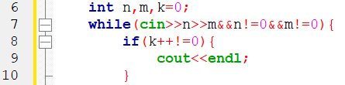
程式碼說明
Step 1：輸入測資
已宣告變數 | 註解
n、m | 地圖大小
k | 第幾個測資
05

Slide 7
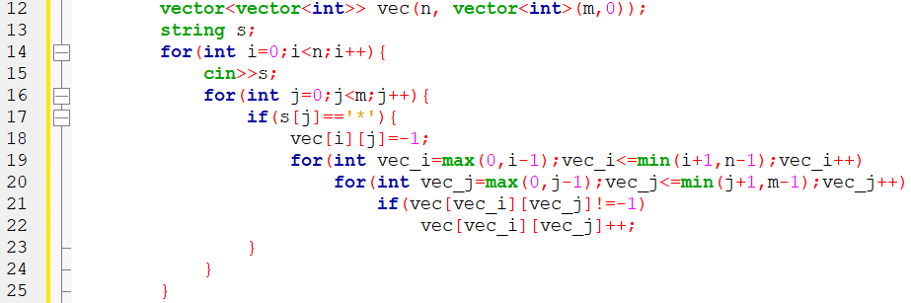
程式碼說明
Step 2：輸入每行並將周圍的格子加一
已宣告變數 | 註解
n、m | 地圖大小
k | 第幾個測資
s | 地圖每行
vec | 處理後的地圖
06

Slide 8
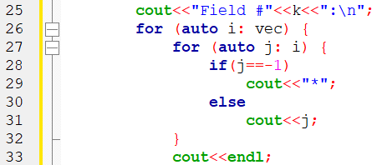
程式碼說明
Step 3：輸出
已宣告變數 | 註解
n、m | 地圖大小
k | 第幾個測資
s | 地圖每行
vec | 處理後的地圖
07

Slide 9
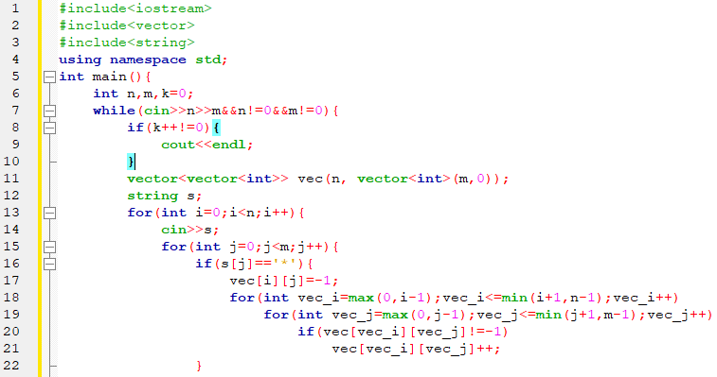
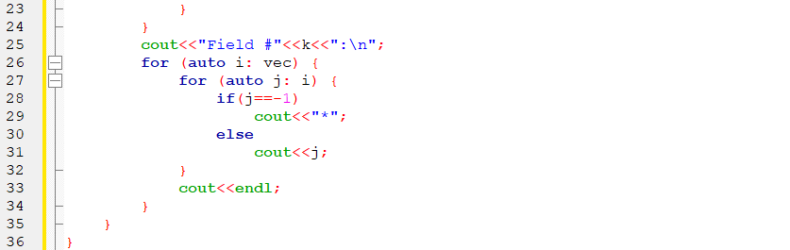
完整程式碼
08

Slide 10
資料來源
英文題目：
https://vjudge.net/problem/UVA-10189
中文題目：https://zerojudge.tw/ShowProblem?problemid=e605
09

Slide 11
Thank You
reallygreatsite.com

