Slide 1
Uva10190

Slide 2
題目翻譯
Your goal in this problem is to divide a certain integer n by another integer m until n = 1, obtaining a sequence of numbers. Lets call a[i] each number of this sequence, and let’s say it has k numbers (i.e. you must do k − 1 succesive divisions to reach n = 1). You can only have this sequence if the following restrictions are met:
此問題的目標是將某個整數n除以另一個整數m直到 n = 1，這方法將會獲得一個數字序列。 我們假設該序列的每個數字為a[i]，假設它有k個數字(即必須進行 k−1 個連續除法才能達到 n = 1)。

Slide 3
題目翻譯
• a[1] = n, a[i] = a[i − 1] ÷ m, for all 1 < i ≤ k
• a[i] is divisible by m (that is, a[i] mod m = 0) for all 1 ≤ i < k
• a[1] > a[2] > a[3] > . . . > a[k]
根據以下限制，此序列必唯一： 1. a[1] = n, a[i] = a[i − 1] ÷ m, for all 1 < i ≤ k
2. a[i] 被 m 整除(a[i] mod m = 0) for all 1 ≤ i < k
3. a[1] > a[2] > a[3] > ... > a[k]

Slide 4
題目翻譯
For instance, if n = 125 and m = 5, you have 125, 25, 5 and 1 (you did 3 divisions: 125/5, 25/5 and 5/5). So, k = 4, a[1] = 125, a[2] = 25, a[3] = 5 and a[4] = 1.
If n = 30 and m = 3, you have 30, 10, 3 and 1. But a[2] = 10, and 10 mod 3 = 1, so there is no sequence because it violates restriction 2. When the sequence doesn’t exist we think it’s not fun and, thus, very boring!
以下為舉例： 如果n = 125且m = 5，則根據上述過程會得到125、25、5、1(做了3次除法：125/5、25/5、5/5)。 因此，k = 4，a[1] = 125、a[2] = 25、a[3] = 5、a[4] = 1。
如果n = 30且m = 3，則根據上述過程會得到30、10、3、1。 但是a[2] = 10 且 10 mod 3 = 1，違反了限制2，所以此序列不存在。 如果序列不存在，我們認為這不好玩，因此非常"Boring!"

Slide 5
輸入與輸出
Input ：The input will consist on an arbitrary number of lines. Each line will consist of two non-negative integers n, m which are both less than 2000000000. You must read until you reach the end of file.
Output ：For each pair n, m you must print the correspondent sequence a (as defined above) in a single line, with each adjacent numbers of the sequence separated by a single space. In the case the sequence doesn’t exist because it violates some restriction, just print the phrase ‘Boring!’ in a single line (without the quotes).
輸入：輸入包含多行。 每行有兩個非負整數n和m，n和m皆小於2000000000。
輸出：對於每行，輸出序列a(如題目定義)，序列的每個相鄰數字之間用一個空格隔開。 如果序列不存在，則輸出"Boring!"

Slide 6
範例測資
輸入：125 5
30 3
80 2
81 3
輸出：
125 25 5 1
Boring!
Boring!
81 27 9 3 1

Slide 7
第一筆測資
輸入：
輸出：
125 25 5 1
125 5

Slide 8
第二筆測資
輸入：
輸出：
Boring!
30 3

Slide 9
第三筆測資
輸入：
輸出：
Boring!
80 2

Slide 10
第四筆測資
輸入：
輸出：
81 27 9 3 1
81 3

Slide 11

程式碼
Step 1:輸入測資
已宣告變數 | //註解
in | 目標數字
base | 底數

Slide 12
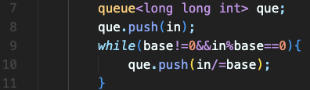
程式碼
Step 2:把答案放入queue
已宣告變數 | //註解
in | 目標數字
base | 底數
que | 答案

Slide 13
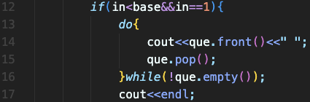
程式碼
Step 3:輸出正解
已宣告變數 | //註解
in | 目標數字
base | 底數
que | ans

Slide 14

程式碼
Step 3:輸出另解
已宣告變數 | //註解
in | 目標數字
base | 底數
que | ans

Slide 15
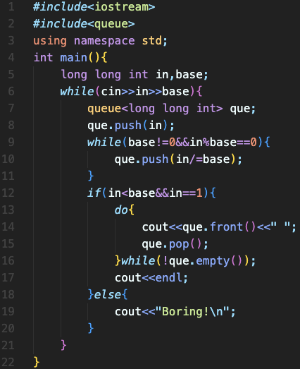
完整程式碼

Slide 16
資料來源
英文題目：https://vjudge.net/problem/UVA-10190
中文翻譯：
https://zerojudge.tw/ShowProblem?problemid=e566

