Slide 1
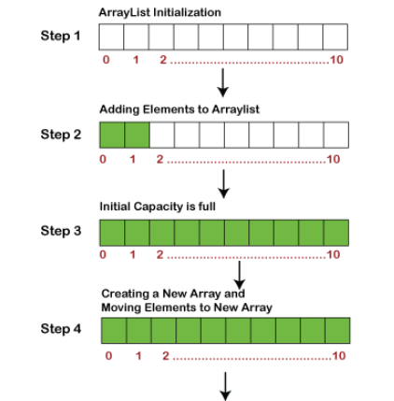

ArrayList Implementation
20

Slide 2
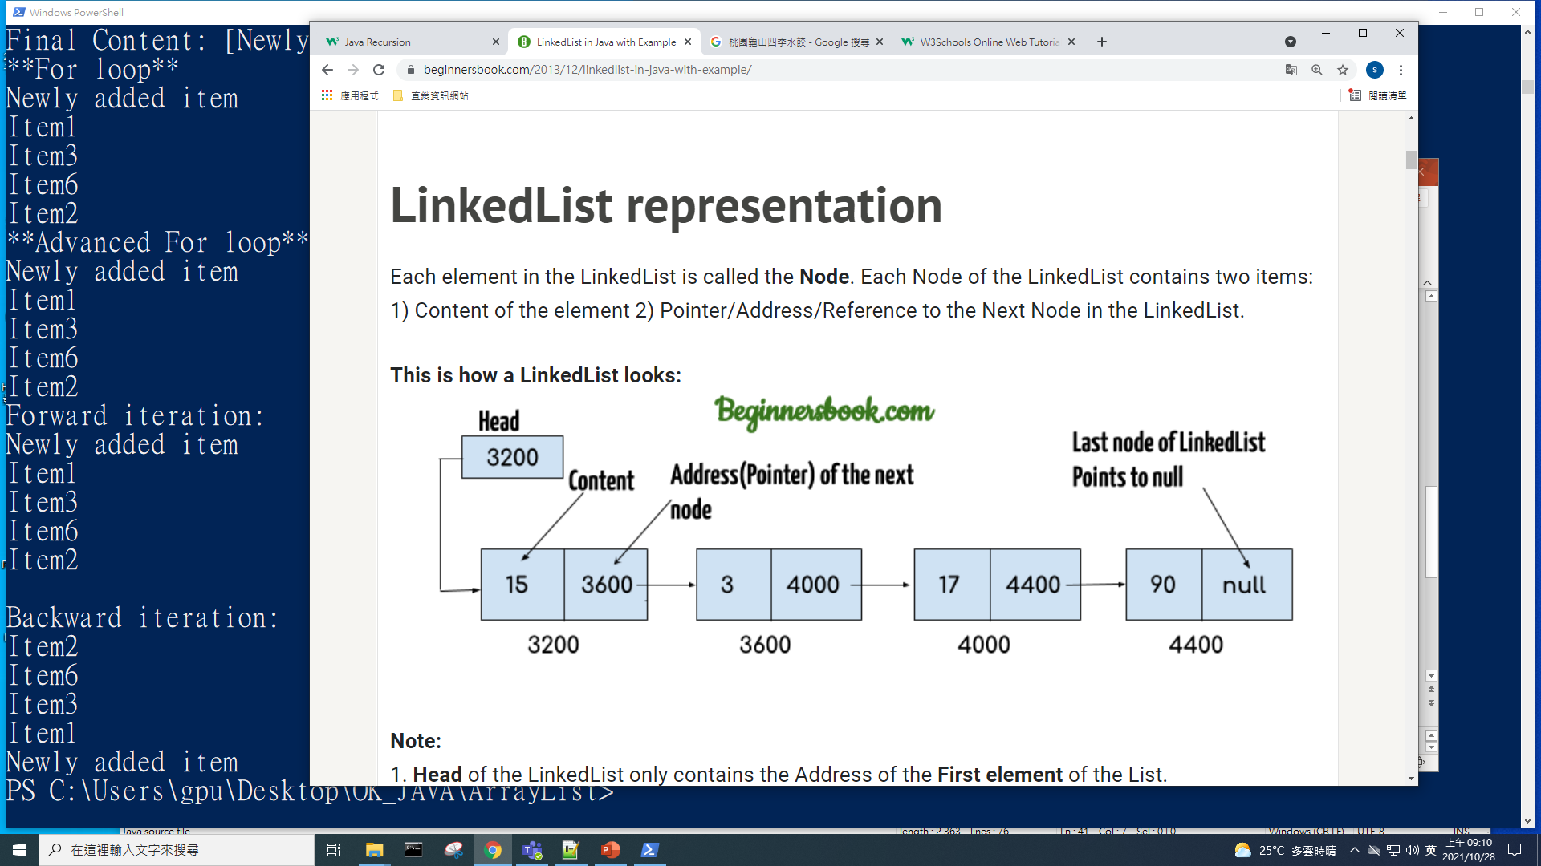
LinkedList

Slide 3
Why ArrayList is better than Array?
The limitation with array is that it has a fixed length so if it is full you cannot add any more elements to it, likewise if there are number of elements gets removed from it the memory consumption would be the same as it doesn’t shrink.
On the other ArrayList can dynamically grow and shrink after addition and removal of elements (See the images below). Apart from these benefits ArrayList class enables us to use predefined methods of it which makes our task easy. Let’s see the diagrams to understand the addition and removal of elements from ArrayList and then we will see the programs.

Slide 4
https://beginnersbook.com/2013/12/difference-between-arraylist-and-linkedlist-in-java/

Slide 5
HashMap is a Map based collection class that is used for storing Key & value pairs, it is denoted as HashMap<Key, Value> or HashMap<K, V>.

Slide 6
TreeMap is a Map based collection class that is used for storing Key & value pairs, it is denoted as TreeMap<Key, Value> or TreeMap<K, V>.
TreeMap is a sorted Map by Keys.

Slide 7
ArrayList
LinkedList
使用HashMap計算test.txt檔案內每個字的Histogram
使用HashMap計算test03.txt檔案內每個分數的Histogram(每10分)

Slide 8
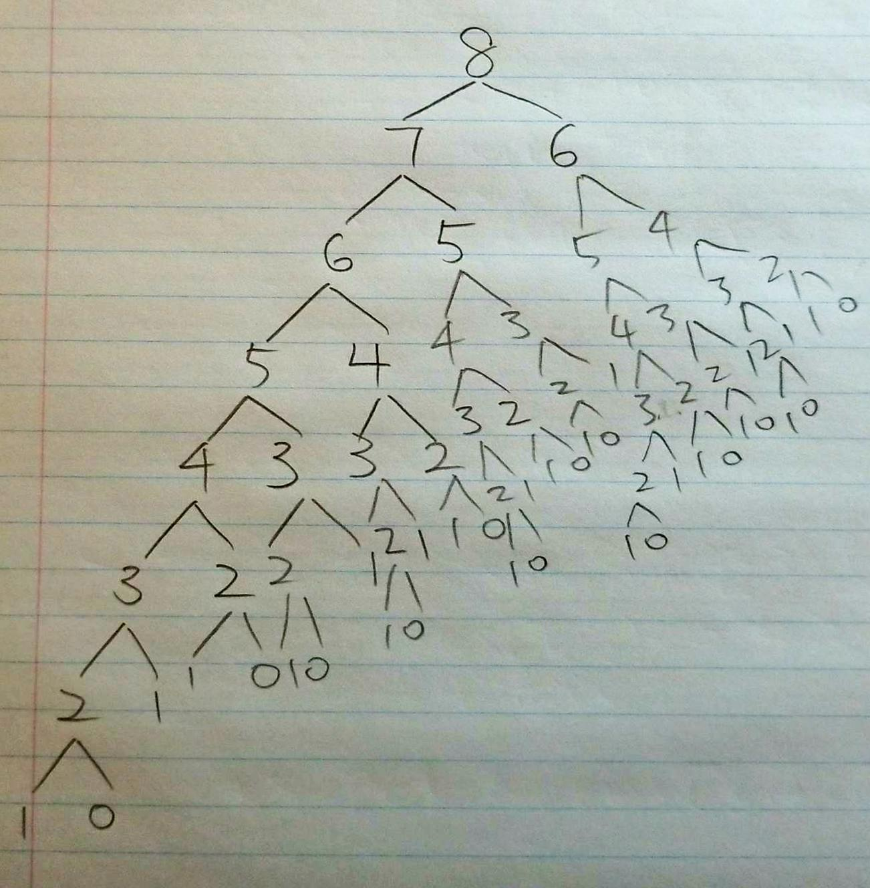
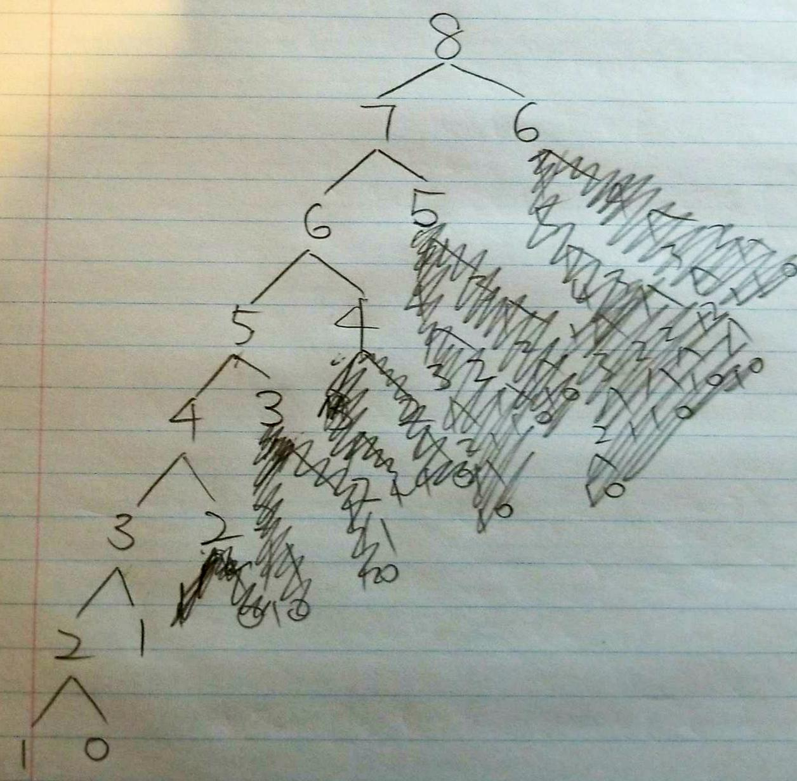
Fibonacci number by HashMap

