Slide 1

Spring 2026 · Douglas College · CSIS 3275-001
LocalGuide Connect
Final Presentation
Group 3 · Zhi Kang · Aarti Pandya · Sehjalpreet · Dong Zhang
Spring Boot 3.3.2
Vue.js 3
MySQL 8.0
AWS EC2
C2C Tour Guide Booking Platform · 15 MVP Features · 12-Week Agile Cycle · 480 Development Hours

Slide 2
The Problem We Solve
Local guides lose income. Tourists lose trust. We fix both.
The Problem
Our Solution
20–30%
Guides lose 20–30% of every booking to OTA middlemen
12%
Guides keep 88% — vs 70–80% on OTAs
3-Step
Booking flow confirmed in < 10 minutes
Informal
No contracts, no reviews, no protection — tourists can’t verify guides
Verified
Identity-verified guides build tourist confidence
No visibility
Skilled local guides have zero online discoverability
15 Features
15 features across Tourist, Guide & Admin roles
📌 Key Takeaway: Tourists need trust. Guides need visibility. LocalGuide Connect delivers both.

Slide 3
Team & Development Process
4 Parallel Modules · 6 Sprints · 12 Weeks
Team Members
Sprint Timeline
Zhi Kang
Backend Lead
Auth, JWT, tourist profile
Sprint 1–2
Wk 1–4
Auth, JWT, DB schema
Sehjalpreet
Frontend Lead
Guide profiles, search, calendar
Sprint 3–4
Wk 5–8
Guide profiles, search, calendar
Dong Zhang
Full Stack
Booking flow, payment stub
Sprint 5
Wk 9–10
Admin panel, reviews, mobile
Aarti Pandya
DevOps / Reviews
Reviews, admin, CI pipeline
Sprint 6
Wk 11–12
Testing, CI pipeline, docs
📌 Key Takeaway: Each engineer owned one end-to-end module — parallel delivery with zero blocking dependencies.

Slide 4
Current Status
What is complete · What is running · What is Phase 2
✅ 15 Core Features Implemented Tourist, Guide & Admin flows — all built and functional
DONE
✅ Runs in Local Dev Environment Spring Boot + Vue.js + H2 in-memory — runnable on any dev machine
RUNNING
✅ 29/29 Test Cases Passed Manual end-to-end testing in local dev — 21 user story + 8 edge cases
DONE
✅ GitHub Actions CI Pipeline Active Auto build + test on every push — CI checks reduce broken code risk
DONE
⏳ AWS EC2 Production Deployment Architecture designed for EC2 — not yet deployed to live server
PHASE 2
⏳ Real Stripe Payment Integration PaymentGatewayPort stub is Stripe-ready — real SDK is Phase 2
PHASE 2
⏳ SendGrid Email Notifications NotificationPort stub implemented — SendGrid wiring is Phase 2
PHASE 2
✔ Key Takeaway: Core MVP is complete and running locally. Production deployment and real third-party integrations are Phase 2.

Slide 5



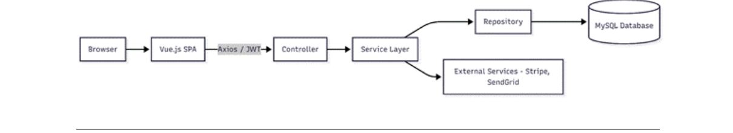
System Architecture
Implemented and running locally · deployed architecture designed for AWS EC2
Frontend
Backend
Data Layer
Vue.js 3 SPA
Spring Boot 3.3.2
H2 (dev) / MySQL 8.0
18 UI pages
REST API · Java 17
8-table schema
Axios + JWT interceptor
JWT AuthFilter
JPA Repository
Pinia state mgmt
Controller → Service → Repo
H2 in-memory (dev)
Responsive / Mobile
OpenAPI YAML
MySQL 8.0 (prod)
Cross-cutting concerns:
PaymentGatewayPort stub → Stripe SDK in Phase 2
NotificationPort stub → SendGrid in Phase 2
GitHub Actions CI on every push
✔ Status: All 3 tiers implemented and functional in local dev environment. AWS EC2 deployment is Phase 2.

Slide 6



MVP Features Delivered
Core user journeys completed within MVP scope (payment & email use stubs)
Tourist
Guide
Admin
✓
Register & login (JWT)
✓
Register + submit docs
✓
Approve guide verifications
✓
Search by city / category
✓
Create tour listings & pricing
✓
User account management
✓
View profiles & reviews
✓
Manage availability calendar
✓
Analytics dashboard
✓
Create booking request
✓
Accept or decline bookings
✓
Suspend / reactivate accounts
✓
Payment simulation (stub)
✓
Earnings dashboard
✓
Tour listing moderation
✓
Booking history
✓
View upcoming bookings
✓
Platform-wide oversight
5-star post-tour review
Respond to tourist reviews
✓
✓
✔ Key Takeaway: 15 features across 3 roles delivered in 12 weeks — core user journeys complete within MVP scope.

Slide 7
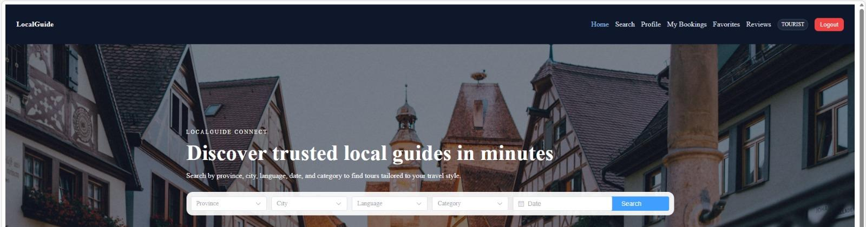
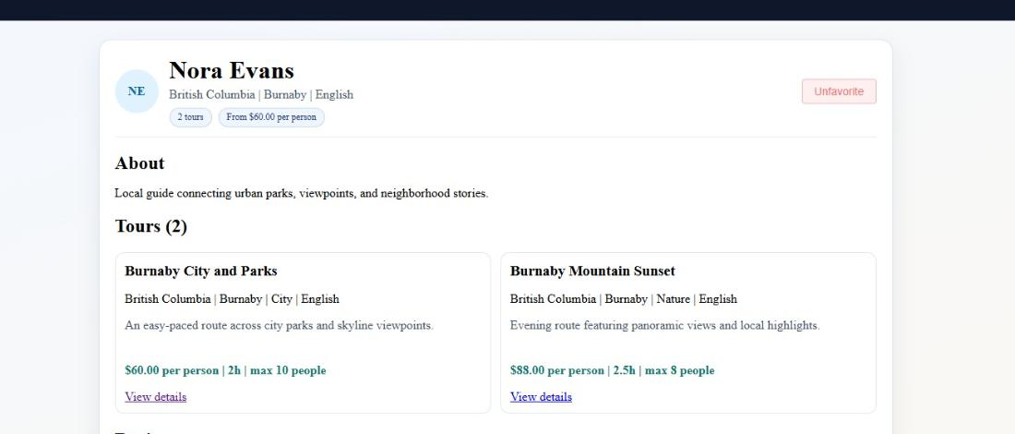
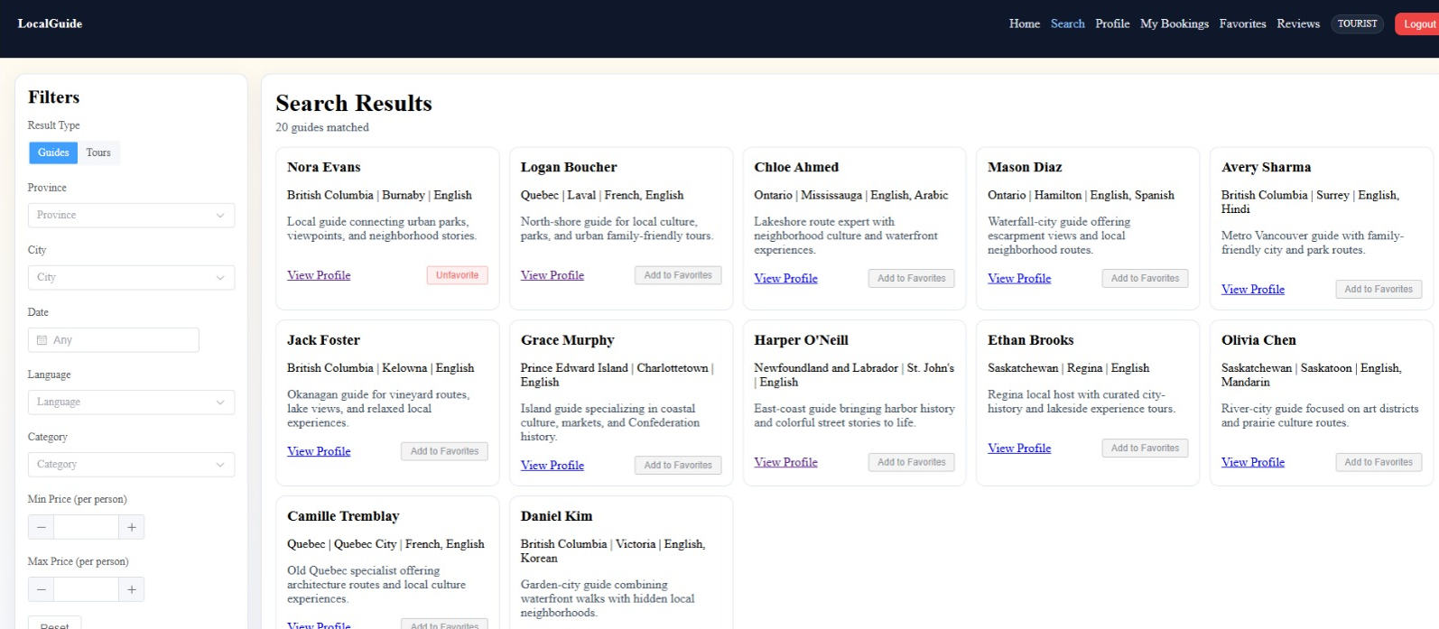
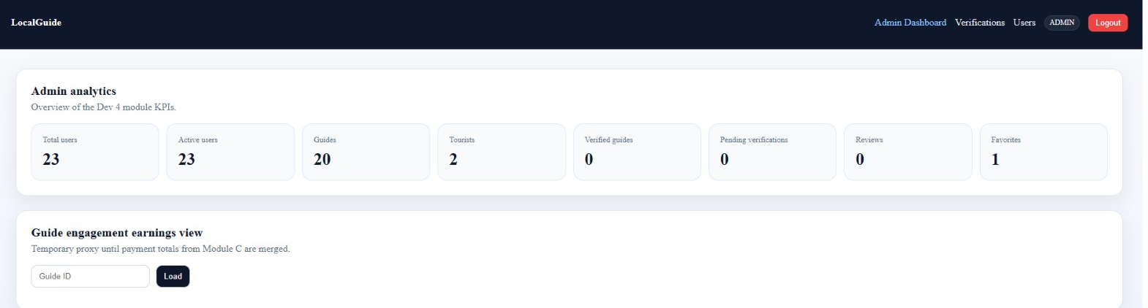
UI Showcase
All screens built and running — no mocks, no placeholders
Homepage
Guide Profile
Search Results
Admin Analytics Dashboard
✔ Key Takeaway: Every screen shown here is live — fully functional in the browser, not a wireframe.

Slide 8
Demo Flow
Scenario: A tourist discovers, books, and pays a verified local guide
Step
Action
What to show
Time
Step 1
Tourist searches for a guide
Open homepage → select Province/City/Category → click Search
~30s
Step 2
Tourist views guide profile & selects tour
Click guide card → view tours, price, availability → click Book
~30s
Step 3
Tourist submits booking request
Select date/time/people → confirm → "Booking request submitted" toast
~20s
Step 4
Guide accepts booking & tourist pays
Guide dashboard → Accept → Tourist My Bookings → Pay → payment confirmed
~40s
Step 5
Booking confirmed — status machine fires
Status: PENDING → CONFIRMED → Payment Intent ID visible on booking detail
~15s
✔ Total demo time ~2.5 minutes. All 5 steps run on localhost — no external dependencies required.

Slide 9
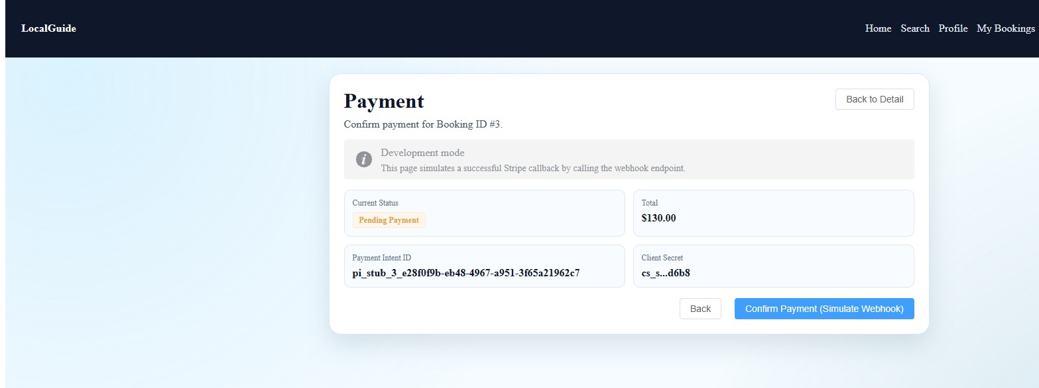
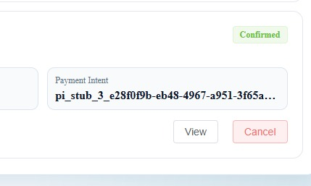
Core Booking Flow
Tourist → Booking Request → Guide Accepts → Payment Simulation → Confirmed
1
2
3
4
5
6
Tourist
Searches
Select Guide
& Date
Booking
Request
Guide
Accepts
Payment
Simulation
Booking
Confirmed
→
→
→
→
→
City · category
price filter
Pick from
availability calendar
Status: CREATED
CREATED → PENDING_PAYMENT
Status:
CONFIRMED
Ready for tour
Booking Status Machine
PENDING
→
CONFIRMED
→
IN_PROGRESS
→
COMPLETED
→
CANCELLED
Key Technical Choices
BCrypt + JWT auth · role-based guards on all endpoints
Clean layered separation: Controller → Service → Repository
PaymentGatewayPort: stub now, Stripe SDK in Phase 2
✔ Key Takeaway: A tourist can go from search to confirmed booking in under 3 steps，payment layer is already Stripe-ready.

Slide 10
Testing & Quality Assurance
Manual end-to-end testing in local/dev environment · 29/29 test cases passed
29
21
8
7
Total Test Cases
User Story Tests
Edge Case Tests
Backend Test Classes
Test Scenario
Result
Verification Note
Tourist Register / Login
PASS
JWT issued · TOURIST role assigned
Guide Search (city + category)
PASS
Results filtered, paginated correctly
Booking + Payment Stub
PASS
Webhook fires · status → CONFIRMED
Guide Accept / Decline
PASS
All status transitions validated
Admin Approve / Reject Guide
PASS
verificationStatus field updated
Invalid Webhook Payload
PASS
400 error · no state mutation
✔ Key Takeaway: 29/29 passed in local dev. Scope: full user journey from registration to post-tour review.

Slide 11
Performance & Security NFRs
Observed in local dev test environment — production performance may vary
Performance KPIs
Security & Reliability NFRs
Metric
Target
Achieved
NFR
Value
Page Load Time
< 2s
~1.2s ✓ (local dev)
Password hashing
BCrypt
Access token
1 hour expiry
Search Response
< 500ms
~300ms ✓ (local dev)
Refresh token
30 days
Payment Flow
< 3s
~1.8s ✓ (local dev)
Uptime SLA
≥ 99.5%/month
MTTR
< 30 minutes
Payment Success
> 98%
100% ✓ (dev stub)
HTTPS
Production target
PIPEDA compliance
CA privacy standard
Role-based access
3 roles enforced
✔ Key Takeaway: All targets met in local dev test environment. Page ~1.2s, search ~300ms, payment ~1.8s. Payment stub: 100% success.

Slide 12
Security & Reliability NFRs
Security hardened from day one · Canadian privacy compliance · Reliability targets defined
AUTH
BCrypt Passwords
Industry-standard hashing — no plain-text passwords ever stored or transmitted.
AUTH
JWT Token Lifecycle
Access: 1h expiry. Refresh: 30 days. Short-lived access minimises breach window.
COMPLIANCE
PIPEDA (Canada)
Privacy by design. Minimal data collection. User consent enforced at registration.
AVAILABILITY
99.5% Uptime SLA
Monthly uptime target. AWS EC2 deployment with defined restart procedures.
RELIABILITY
MTTR < 30 min
Mean time to recovery target. CI pipeline catches regressions before production.
ACCESS CONTROL
Role-Based Guards
Tourist / Guide / Admin roles enforced on every single API endpoint.
✔ Key Takeaway: Security is not an afterthought — auth, access control, and PIPEDA compliance are built in from day one.

Slide 13
Deployment & Next Steps
Current deployment state · Phase 2 backlog · Production roadmap
💻 Current State (Local Dev)
🚀 Phase 2 — Production Deployment
Spring Boot on localhost:8080
H2 in-memory DB — resets on restart
AWS EC2 deployment
Ubuntu server, Nginx reverse proxy, HTTPS
Vue.js frontend on localhost:5173
Axios/JWT auth — all API calls work
MySQL 8.0 on RDS
Replace H2 — persistent production data
GitHub Actions CI
Build + test runs on every push to main
Stripe SDK integration
Swap stub — real card processing live
PaymentGatewayPort stub
Simulates Stripe webhook — no real charges
SendGrid email
Swap stub — booking confirmation emails
NotificationPort stub
Logs email events — no real delivery
Docker + CI/CD pipeline (planned)
Target state: auto-deploy on merge to main
GPS map integration
Guide location display on search results
✔ Key Takeaway: The system is deployment-ready — AWS EC2 target is defined. Phase 2 is a config change, not a rewrite.

Slide 14
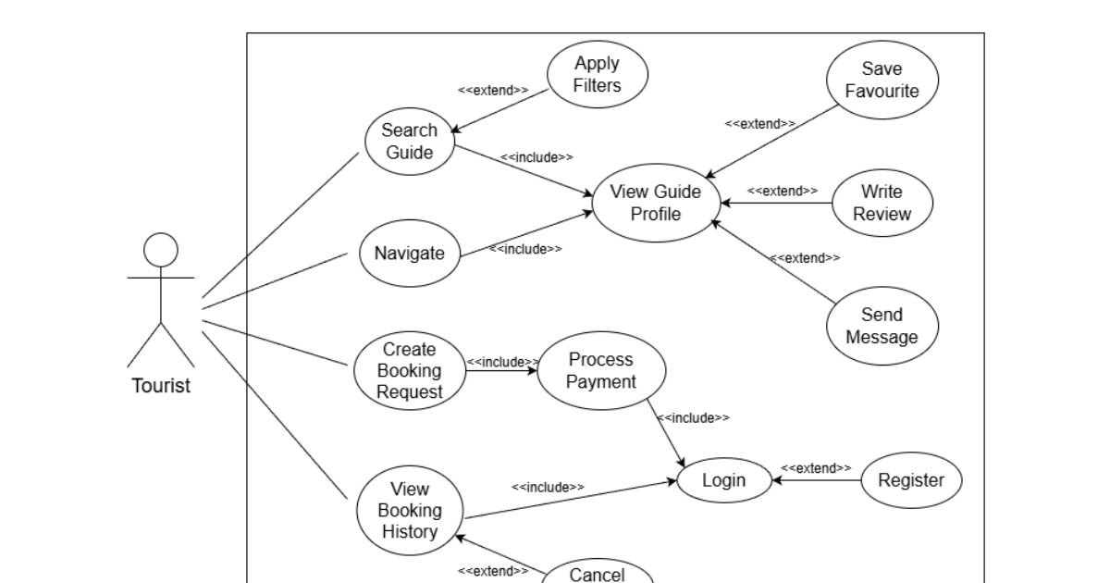
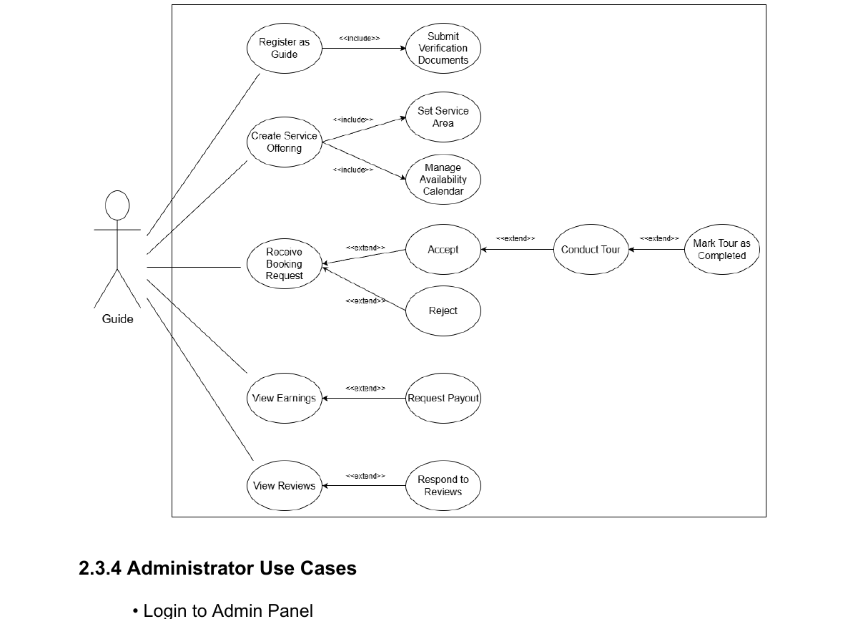
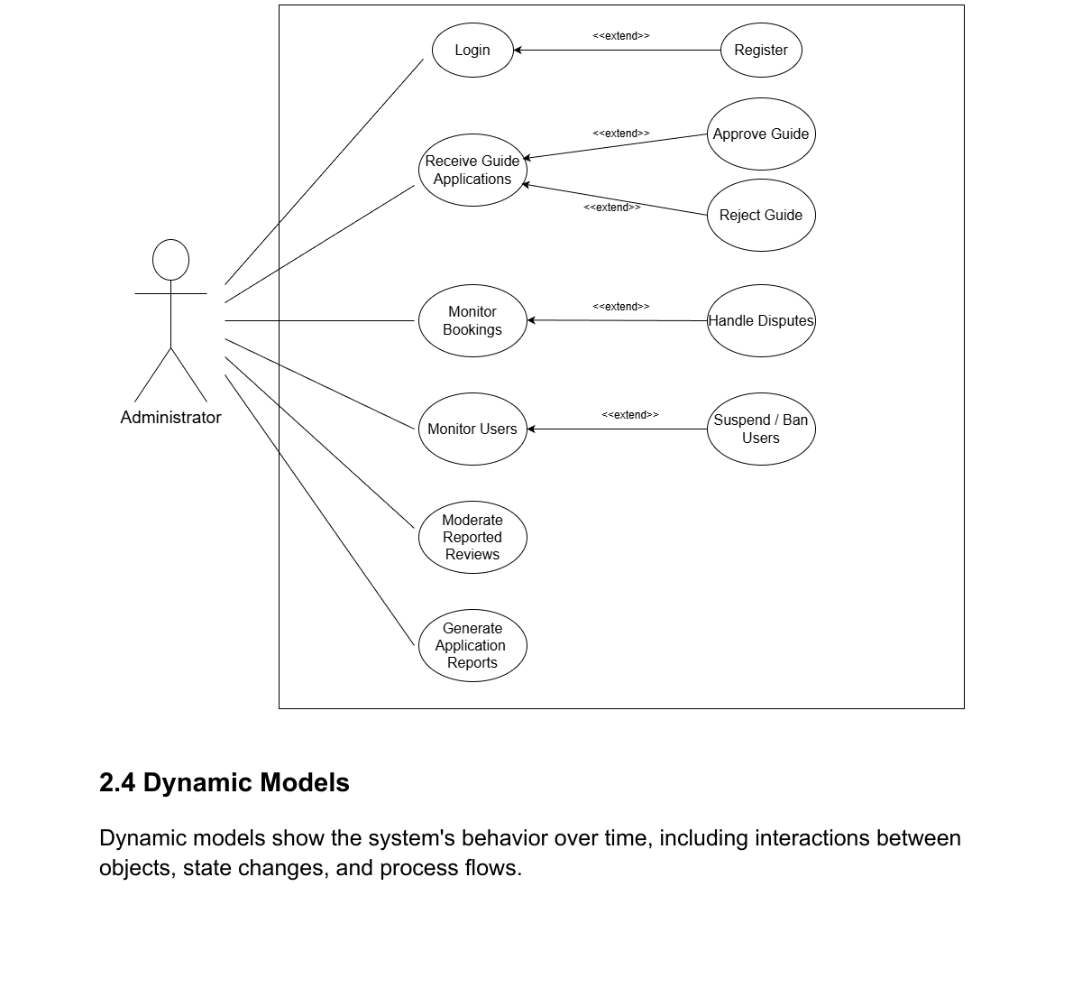
Use Case Diagrams
Tourist · Guide · Administrator
Tourist
Guide
Administrator

Slide 15
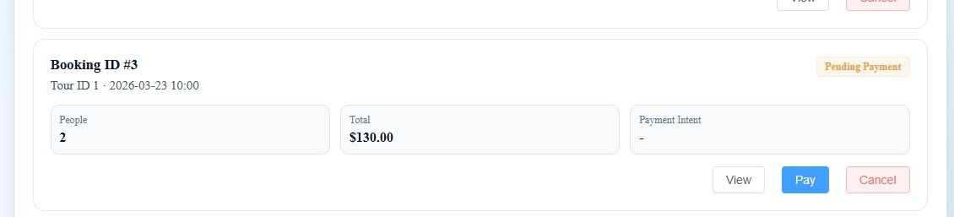
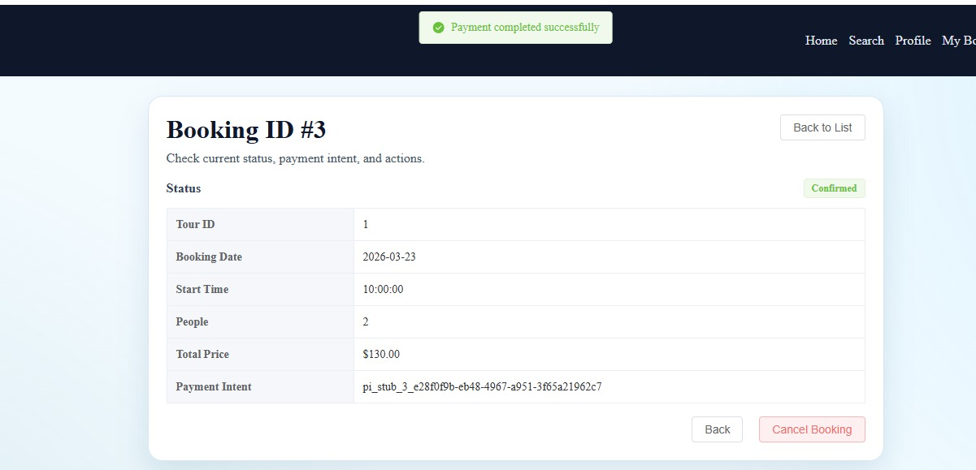
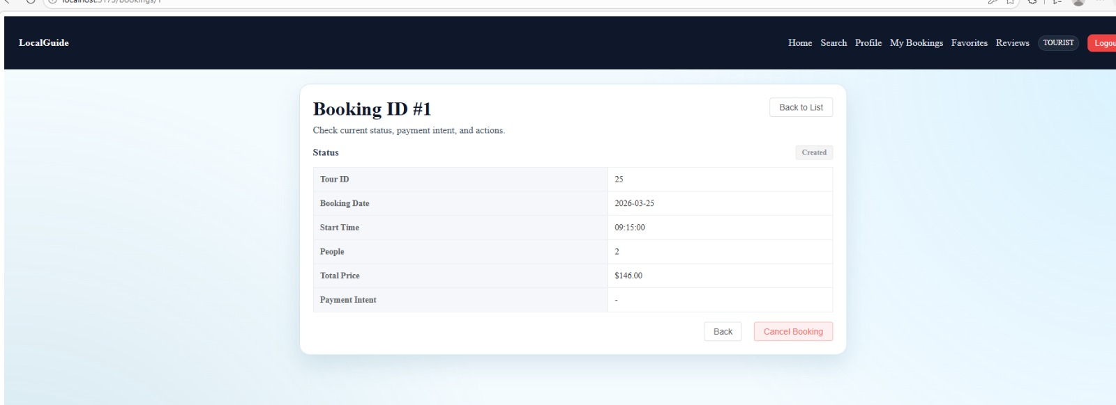
Booking Flow — Live Screenshots
My Bookings → Pending → Payment → Confirmed
1 My Bookings (Pending Payment)
2 Payment Page (Stripe Stub)
3 Payment Completed
4 Booking Confirmed

Slide 16
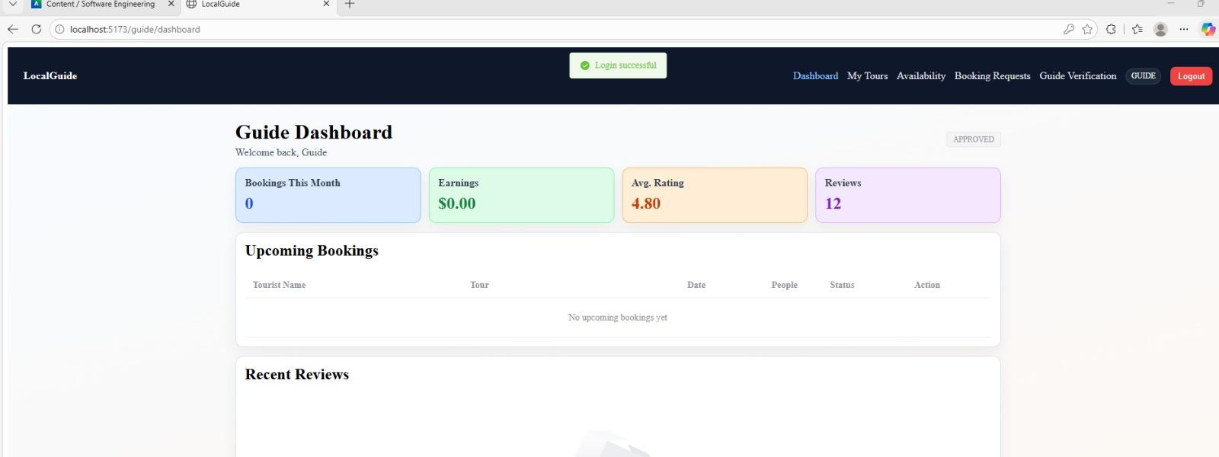
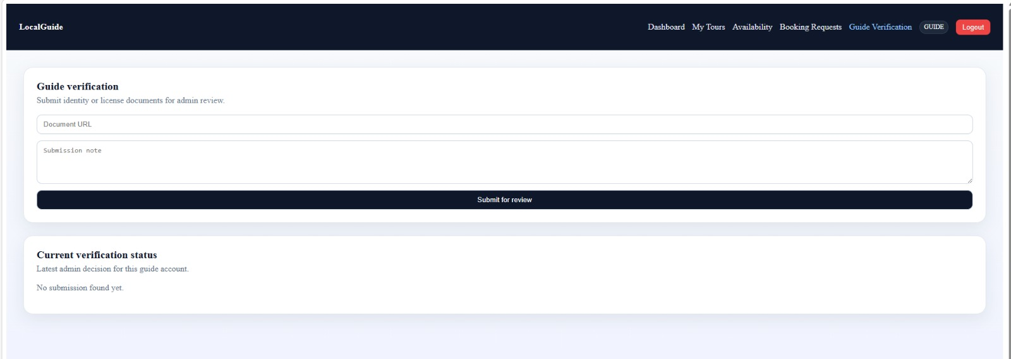
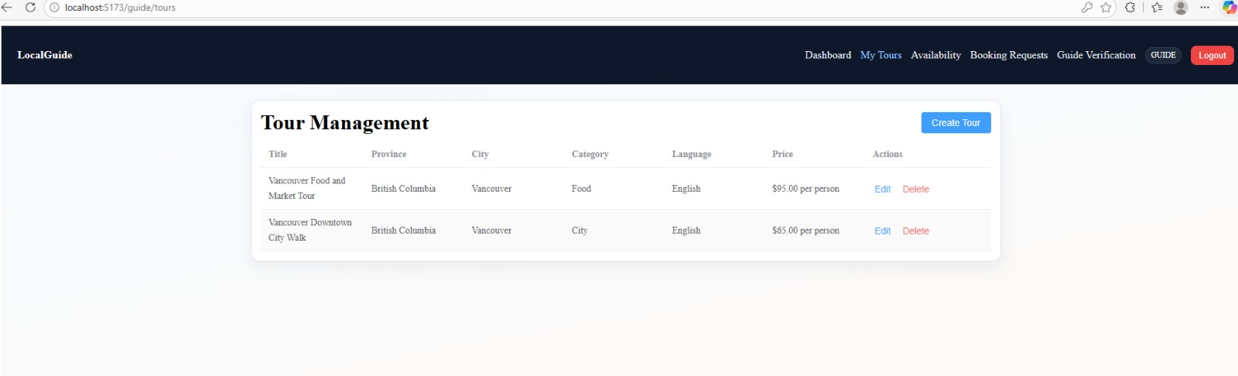
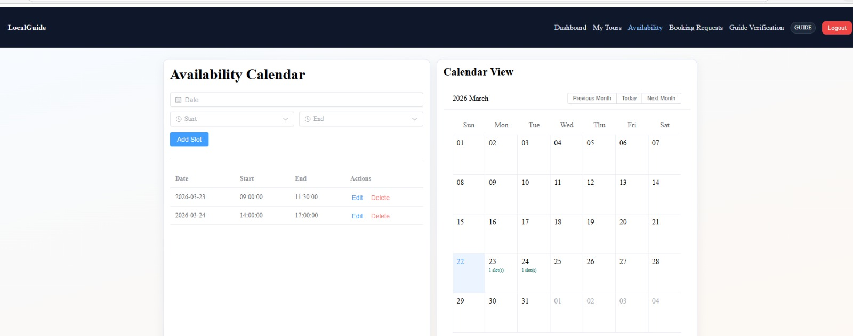
Guide Portal
Dashboard · Verification · Tour Management · Availability
Dashboard
Guide Verification Submission
Tour Management
Availability Calendar

Slide 17
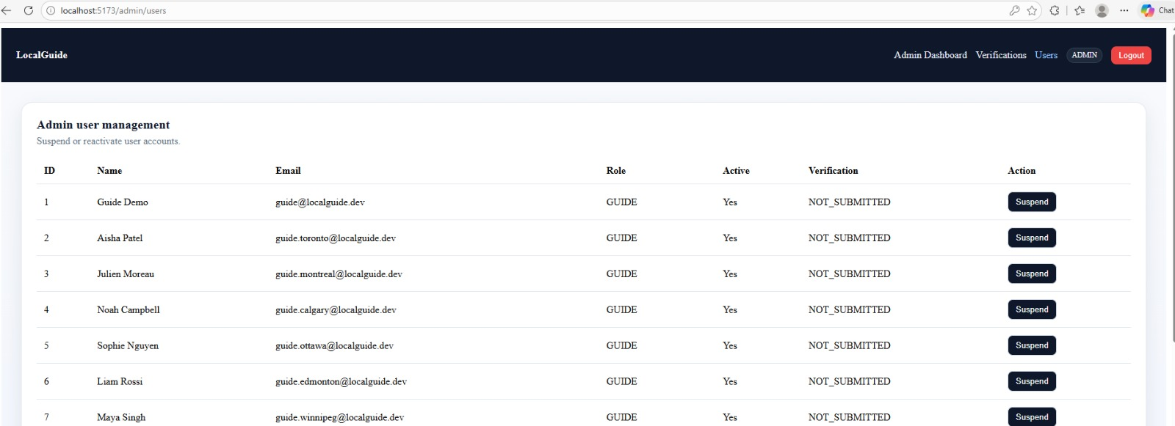
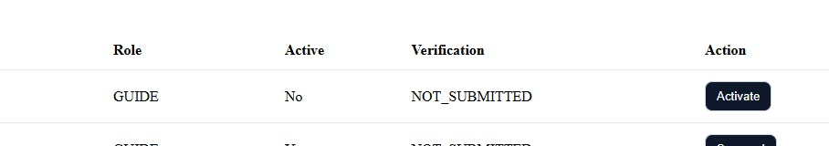
Admin Panel
User Management · Account Suspension · Platform Oversight
User Management Table
Account Suspended — Row Detail

Slide 18
LocalGuide Connect — MVP Delivered
LocalGuide Connect · CSIS 3275-003 · Group 3 · Spring 2026
15
480h
Features Shipped
Hours Invested
Full C2C platform — Tourist, Guide & Admin roles
4 engineers × 12 weeks × Agile/Scrum
29/29
12%
Tests Passed
vs OTA Standard
21 user story + 8 edge cases — zero failures
OTAs charge 20–30%. We charge 12%. Guides keep 88%.
Core MVP validated in local dev. Production deployment is Phase 2. Thank you.
System runs end-to-end in local environment. Stripe, email & GPS are Phase 2 targets.
github.com/10000Katherine/LocalGuide_Software-Engineering

Slide 19
Let’s do the web presentation!!

Slide 20
Thank you!
-Question time

