Slide 1
Zorow Overview
Notes:
‹#›

Slide 2
What is a z/OSMF Workflow?
The z/OSMF Workflow is a framework that supports z/OS System Programmers (Workflow provider) to define a guided flow (workflow) through steps to accomplish a system management or configuration task.
The z/OSMF Workflow is useful to:
Assist people unfamiliar with how to perform a given task, or a task that they perform rarely
Ensure that all tasks are performed in the right order and only when their dependencies have been met
Ensure that all steps are completed
Even if many of the tasks have been delegated to a number of different colleagues
Monitor and track progress toward the completion of the task
Provide a history (audit trail) of the steps performed for a task
Perform the same tasks on multiple systems
Enabling a function (e.g. zEDC)
Upgrading a new release of software (e.g., z/OS)
The z/OSMF Workflow also provides RESTful APIs that allow user to run workflows programmatically

Slide 3
Current challenges with z/OSMF Workflow adoption
z/OS System Programmers have historically built their own home grown processes to perform common system management tasks
Organizations are wanting to reduce the complexity of their organization’s z/OS management processes so they can transfer their knowledge to the early tenure staff
Additional skills are needed to create z/OSMF Workflows
How can early tenure and more experienced z/OS System Programmers share best practices and common workflow patterns?

Slide 4

Z Open Repository Of Workflows (zorow)
Provides a repository for z/OS systems programmers and product vendors to contribute and share z/OSMF workflows
All workflows made available under an Apache 2 license
IBM and Rabobank have made initial contributions of z/OSMF workflows to this community
Community is led by both vendors along with customers, and open to anyone to participate.
Vendor-neutral open source governance established with the guidance of the Open Mainframe Project.

Slide 5



How to get involved in Zorow
Sign up to the Zorow email lists
User List:
https://lists.openmainframeproject.org/g/zorow-user/
Developer List:
https://lists.openmainframeproject.org/g/zorow-dev/
Find other users and developers on Slack
https://slack.openmainframeproject.org
Channel: #zorow
View the code and contribute workflows
https://github.com/openmainframeproject/zorow
Contribution Guidelines at
https://github.com/openmainframeproject/zorow/blob/master/CONTRIBUTING.md

Slide 6
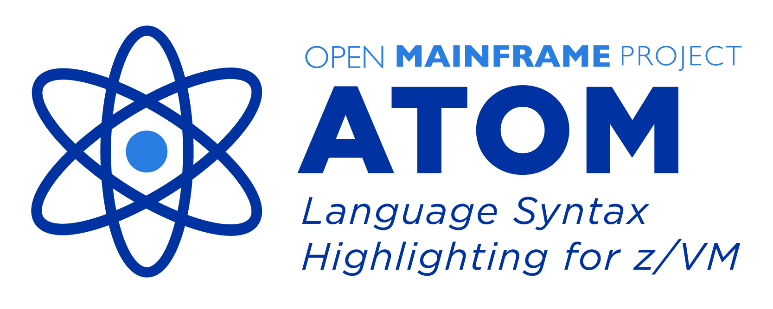







Zorow is part of the Open Mainframe Project hosted projects ecosystem
Learn about all Open Mainframe projects at https://www.openmainframeproject.org/projects

Slide 7









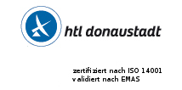





















Sustainability in open source on mainframe happens thanks to Open Mainframe Project member support
Zoss Team, LLC

Slide 8


Learn more about the Open Mainframe Project
Find out more and subscribe to our newsletter at www.openmainframeproject.org
Check out our projects at https://www.openmainframeproject.org/projects
See the full landscape of open source on the mainframe at https://l.openmainframeproject.org
Organizational membership opportunities at https://www.openmainframeproject.org/about/join or email at membership@openmainframeproject.com

