Slide 1

NotRealCorp: Quarterly financial planning meeting, Q3 2023

Slide 2
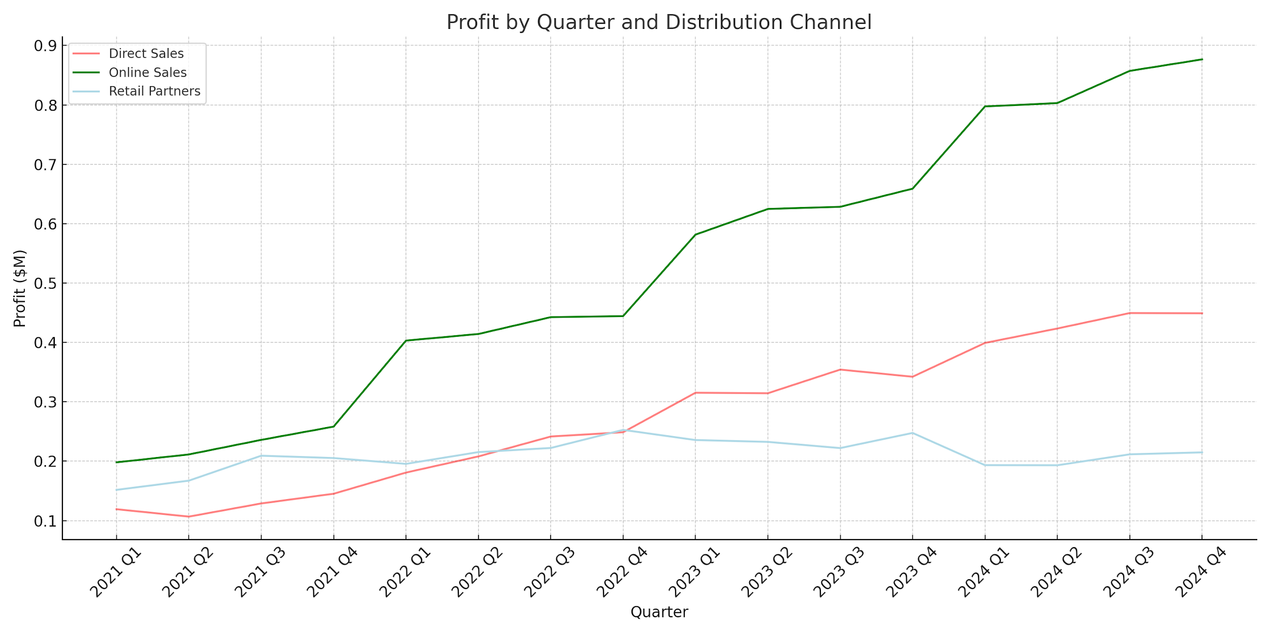
Maximizing Profits: The Dominance of Online Sales & Direct Sales Optimization
Key Insights:
Online Sales consistently lead in profitability across quarters, indicating a strong digital market presence.
Direct Sales show fluctuations, suggesting variable performance and the need for targeted improvements in that channel.

