Slide 1
COVID Data Analysis and Visualization

Slide 2
Introduction
There is a constant need to collect covid-19 data frequently and continuously to check the trend and the rate at which the virus is spreading.
As such data is collected daily from the four focused countries such as United Kingdom (UK), Sweden, Georgia and South Korea.
Different range of visualization and analysis tools are being used to represent the data being collected, such as:
Plotly
Gap-minder
Streamlit

Slide 3
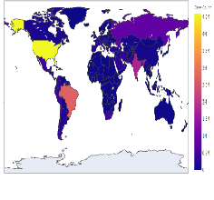
Background
The spread of Covid-19 is one of the biggest challenges of modern history. The data being collected relevant to this place a major role in stopping the spread of virus
Employ Python Programing Language, it’s respective packages {Streamlit & Plotly} to visualize the effect of virus through the available data. In addition Gap-minder tool was used to achieve the Bubble effect.
Making use of various visual and analysis trends to understand the best lockdown measure

Slide 4
Features
Real time Data collected from Oxford
Scrap the Raw data and Extract the data in CSV format
Analysis and visualizations of UK data
Clustering of the data
Streamlit to Create a visual dashboard
Gap Minder tool for Bubble and Line Graphs

Slide 5
Technologies/Tools
Technique: Real time data analysis
Language: Python
Libraries:
Platform: Anaconda Navigator and Jupyter Notebook
Pandas
Numpy
Streamlit and Gapminder tool
plotly.graph_objs
plotly.express
matplotlib.pyplot
sqlite3
streamlit
datetime
hashlib

Slide 6
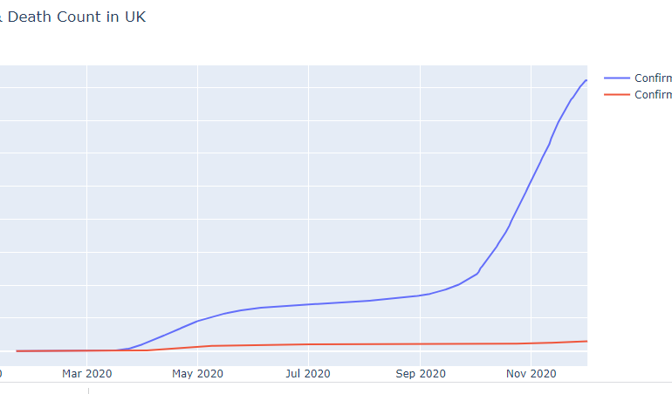
Results
Confirmed number of death count in United Kingdom

Slide 7
Measure of success:
CONCLUSION | Measure of success
Visualize the day by day spread of COVID-19. | Up-to date data available is taken into consideration and the visualized metrics are provided.
Make use of animated bubbles over maps to represent the evolution of the magnitude of the spread day by day. | The Gap-minder shows the animated bubbles over maps of the four countries with available data.
Compare strategies of different nations to determine the most successful in order to combat the second wave. | By using the tools like plotly , streamlit and gap-minder the data is analyzed and visualized comparing the four countries. It can be helpful for United Kingdom to adopt one of strategies to reduce the infection rate.

Slide 8
THANK YOU

