Slide 1
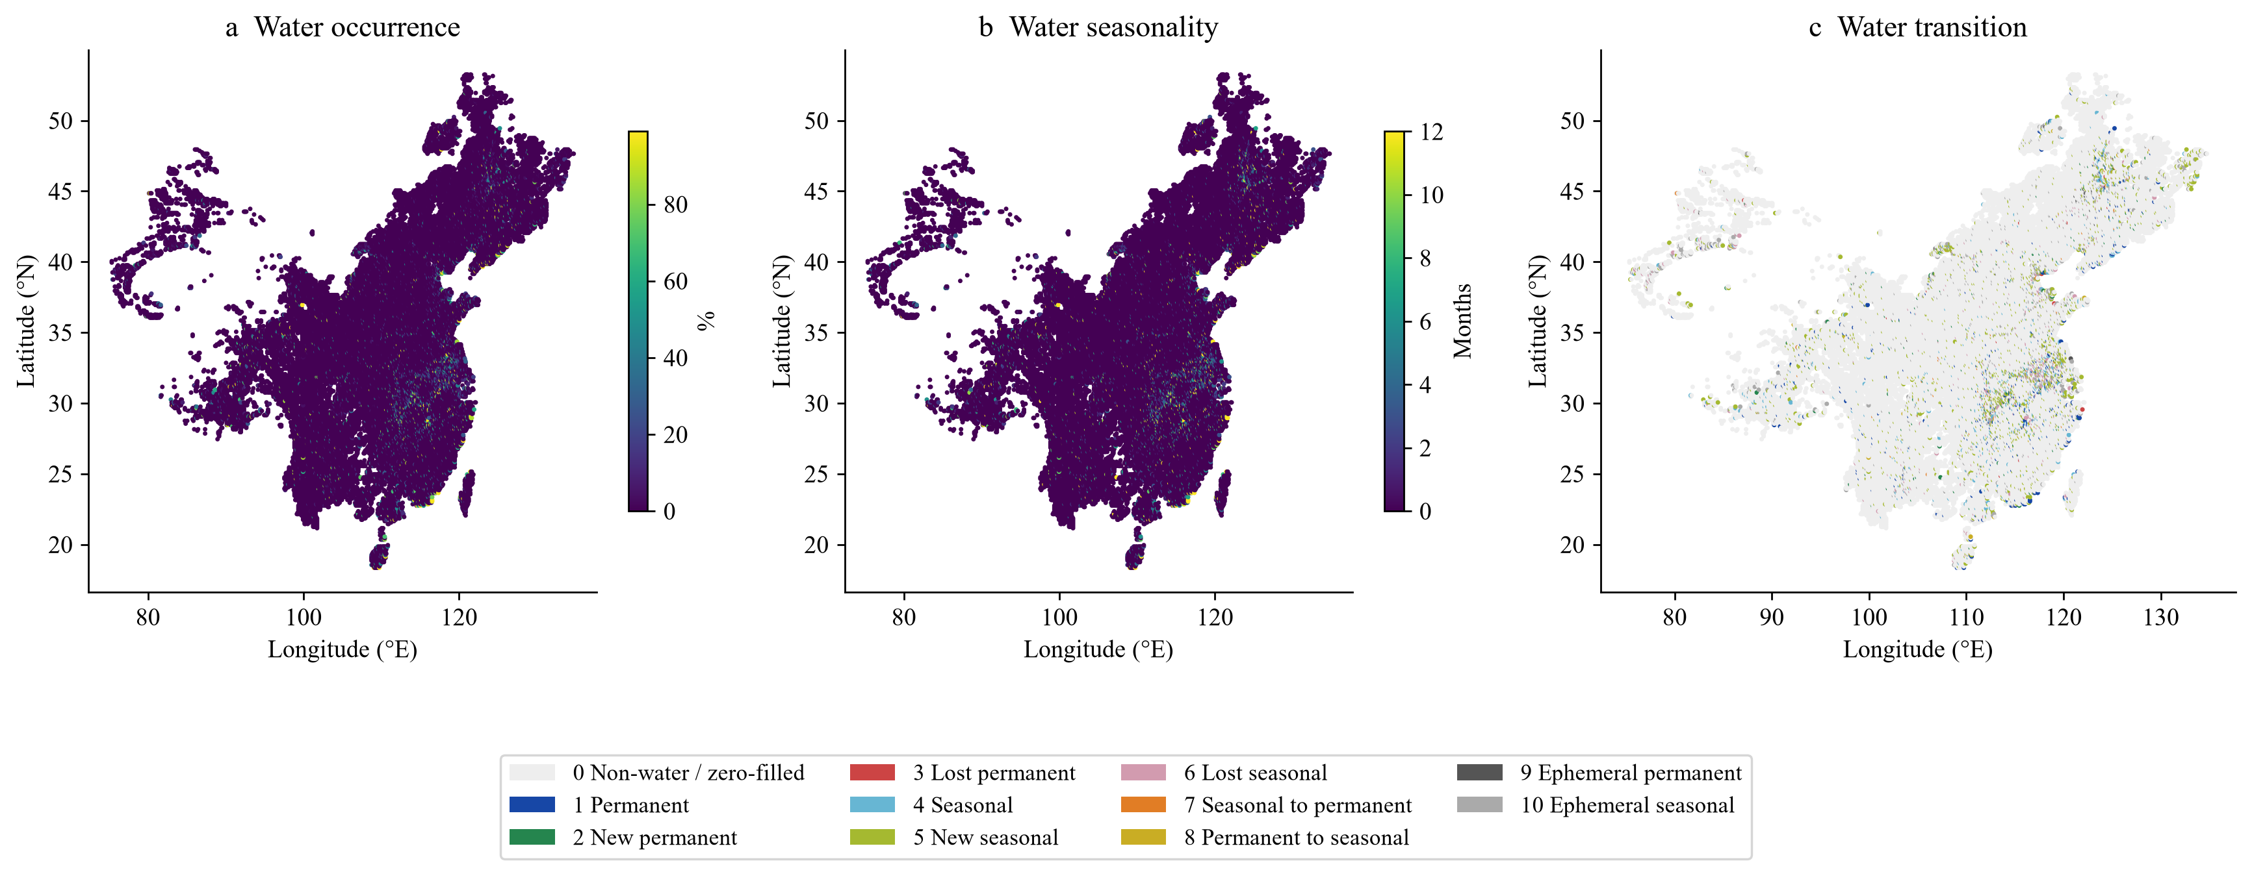
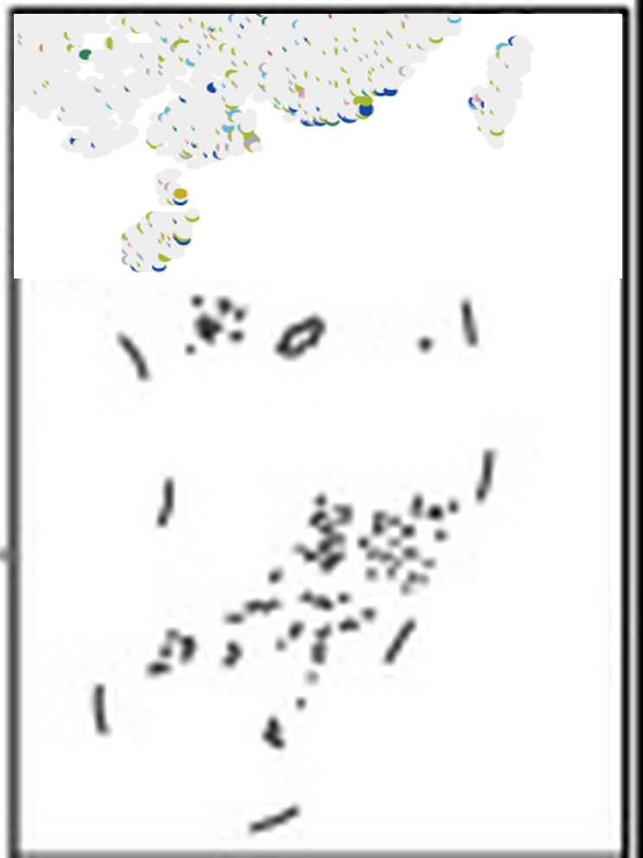
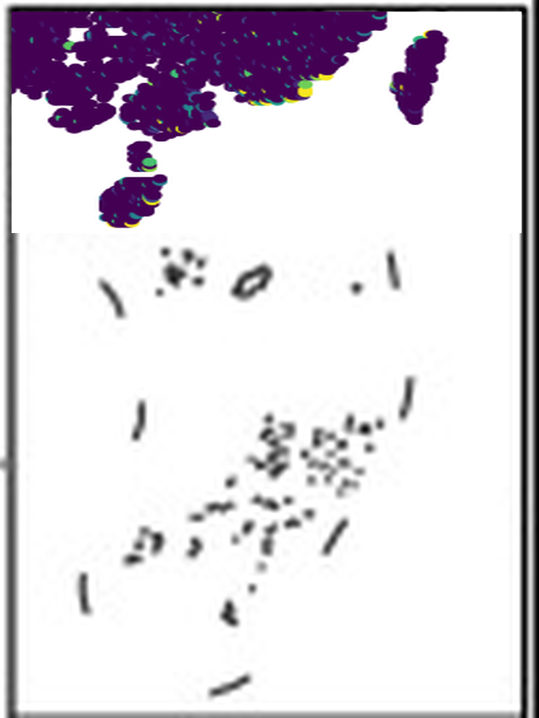

Notes:
Fig2. Each inset combines the southern crop from its own map panel with reference island outlines from the supplied PowerPoint. Move or resize the inset independently of the background.

Slide 2
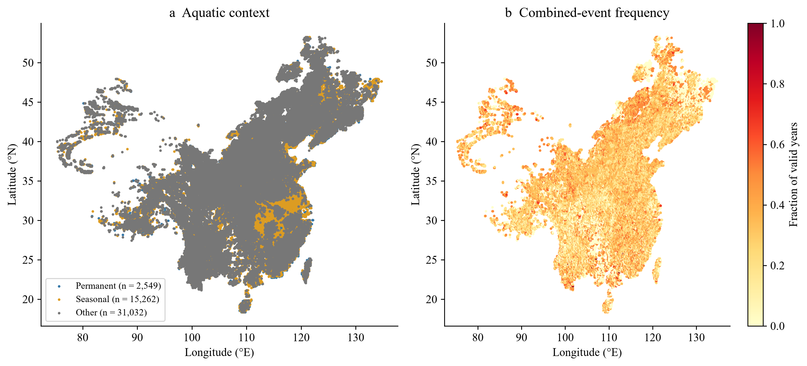
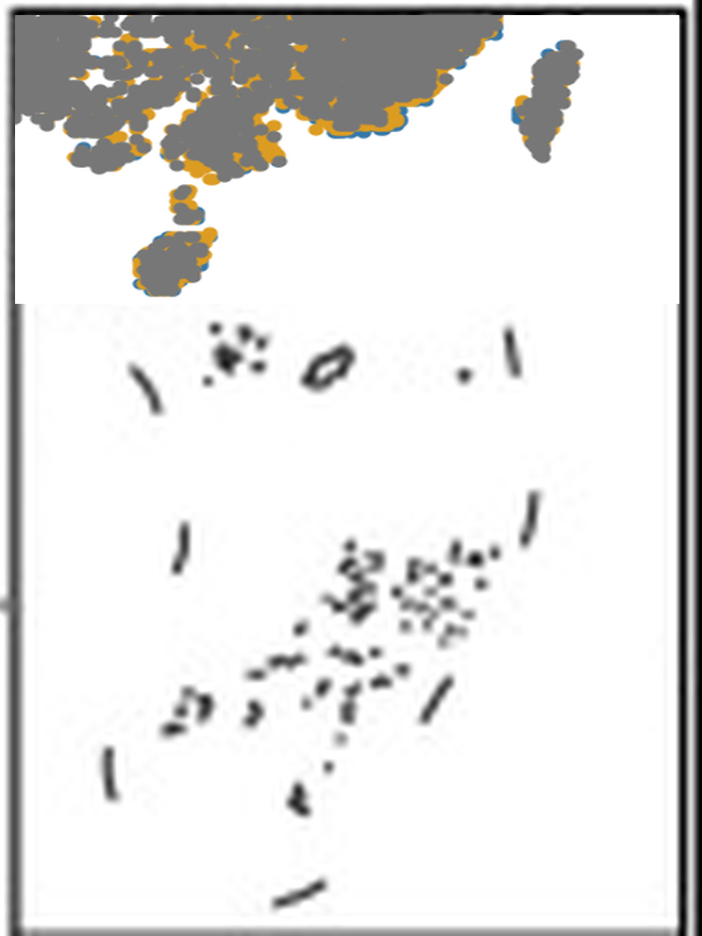
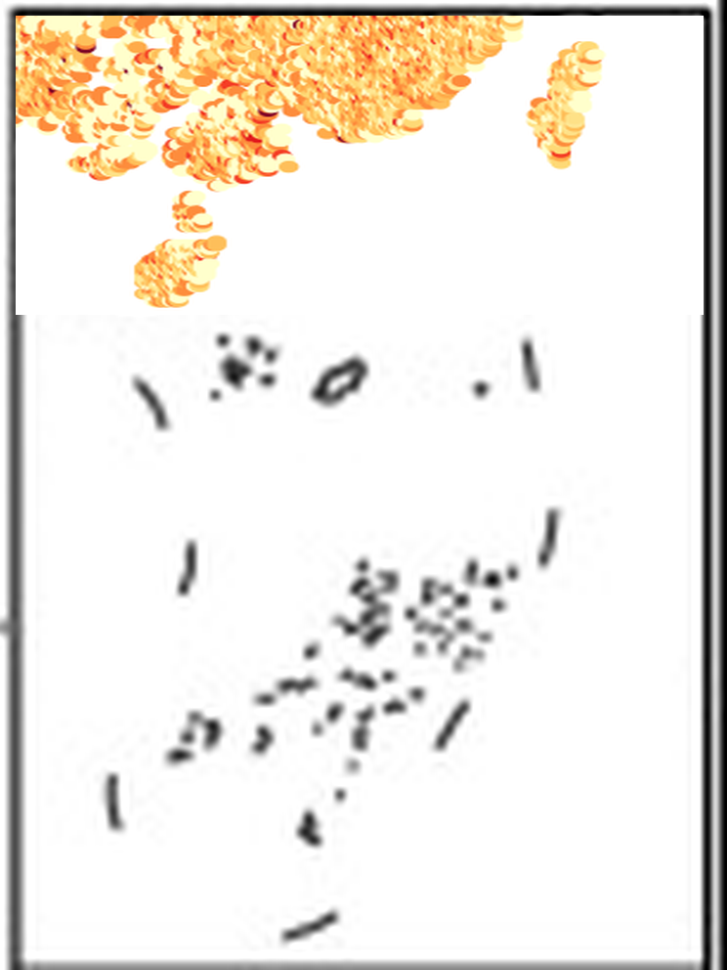
Notes:
Fig3. Each inset combines the southern crop from its own map panel with reference island outlines from the supplied PowerPoint. Move or resize the inset independently of the background.

Slide 3
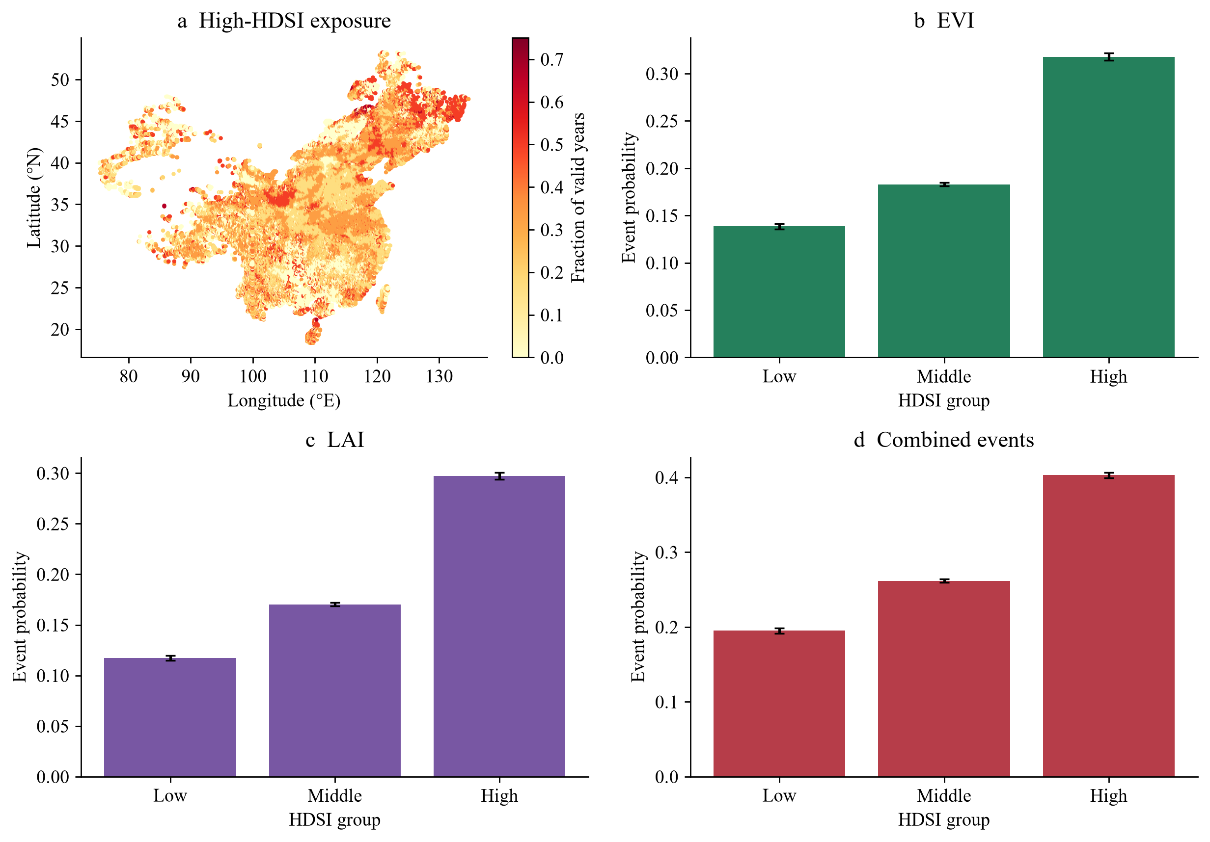

Notes:
Fig4. Each inset combines the southern crop from its own map panel with reference island outlines from the supplied PowerPoint. Move or resize the inset independently of the background.

Slide 4
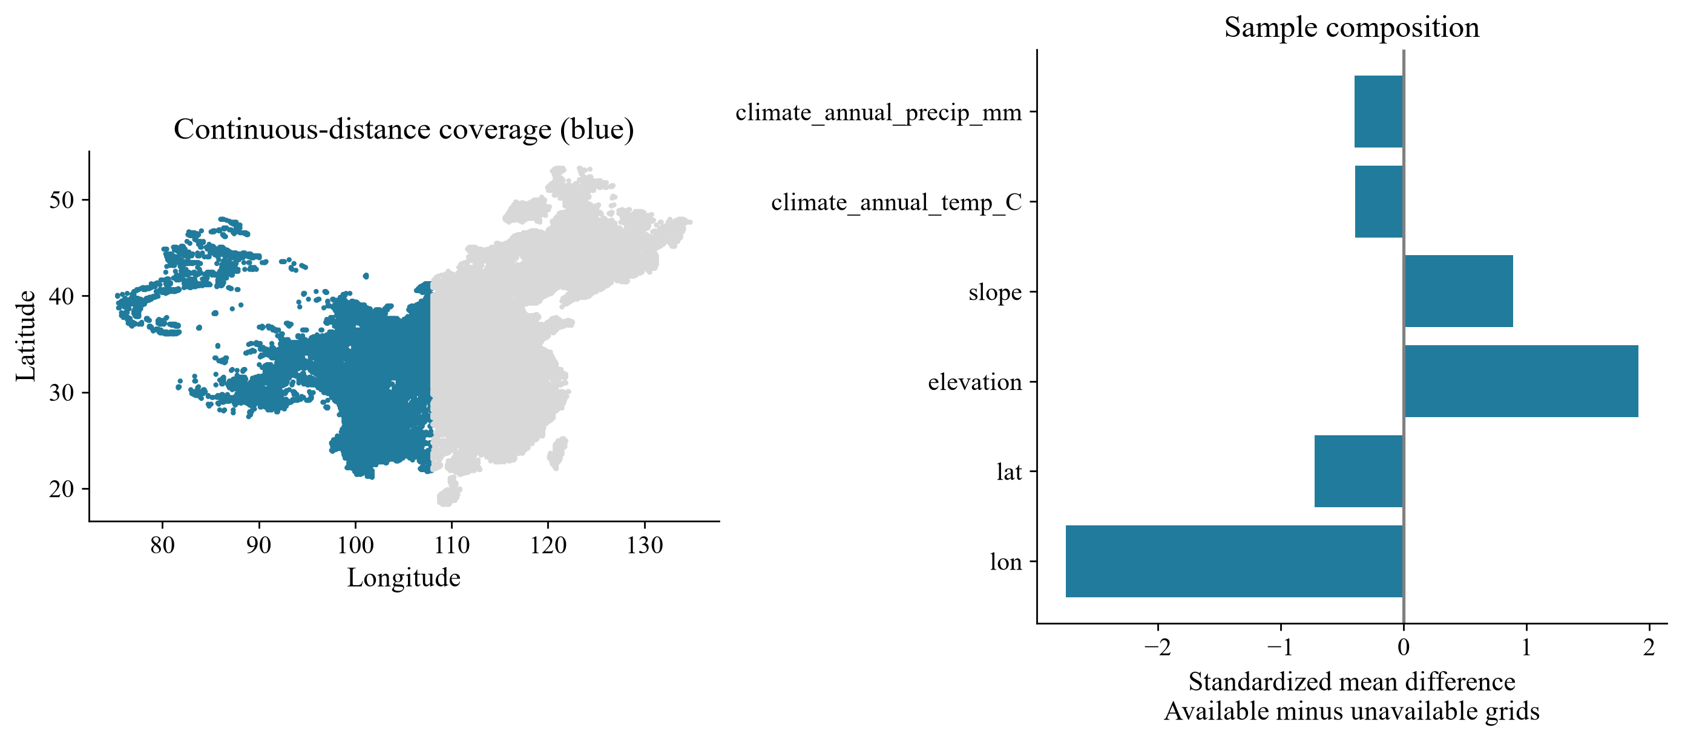
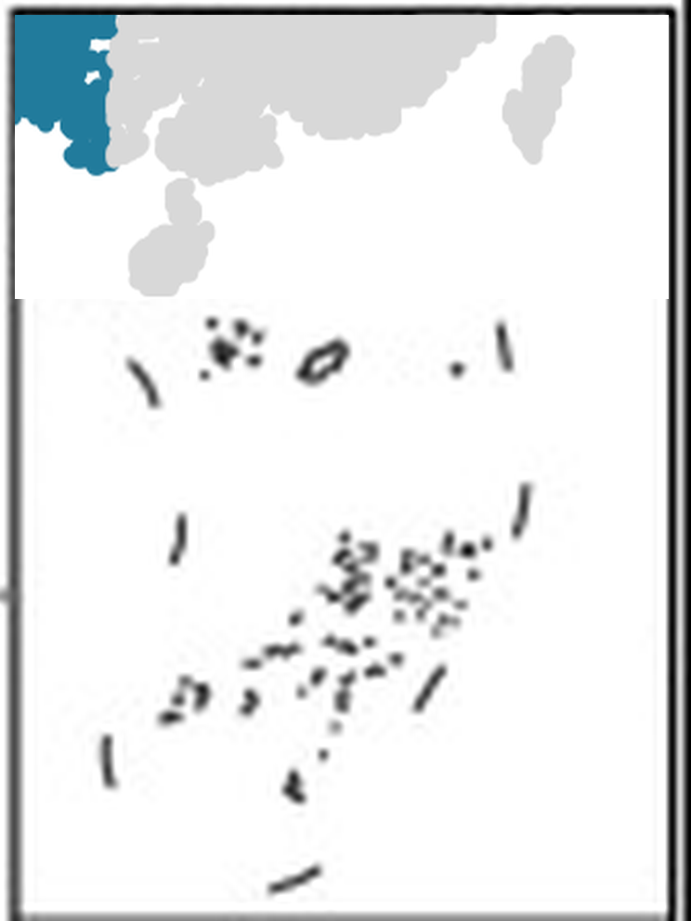
Notes:
Fig_S1. Each inset combines the southern crop from its own map panel with reference island outlines from the supplied PowerPoint. Move or resize the inset independently of the background.

