Slide 1
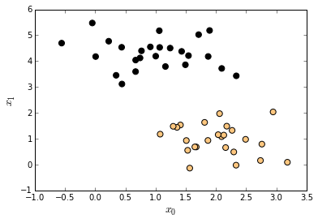
w^{T}x + b = 1
w^{T}x + b = −1
x₁ – x₂

