Slide 1


Slide 2
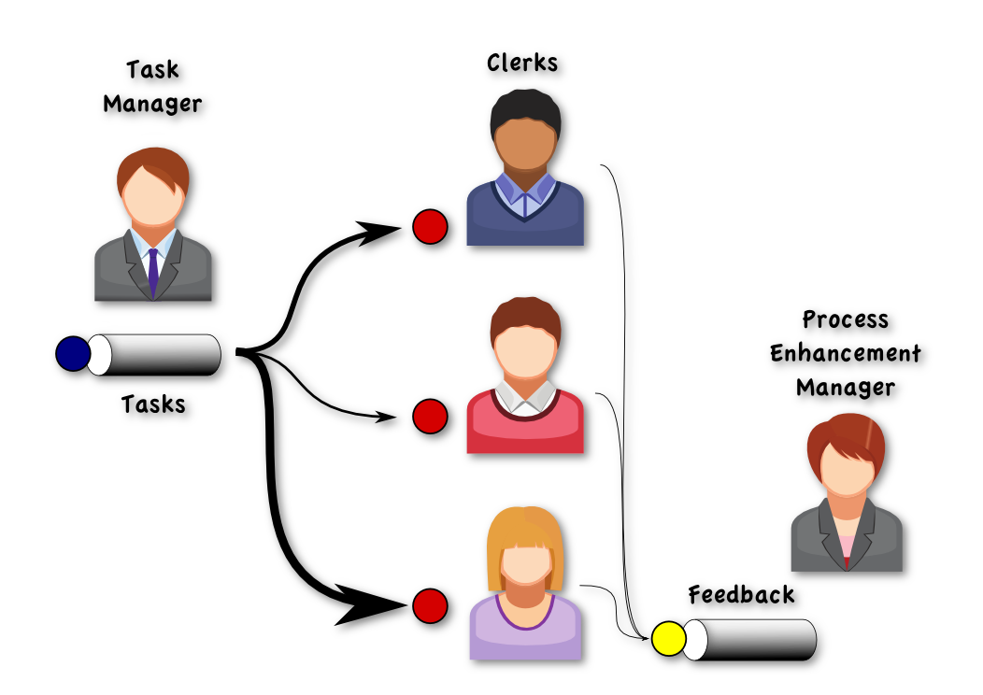
Task-manager

Slide 3


Slide 4
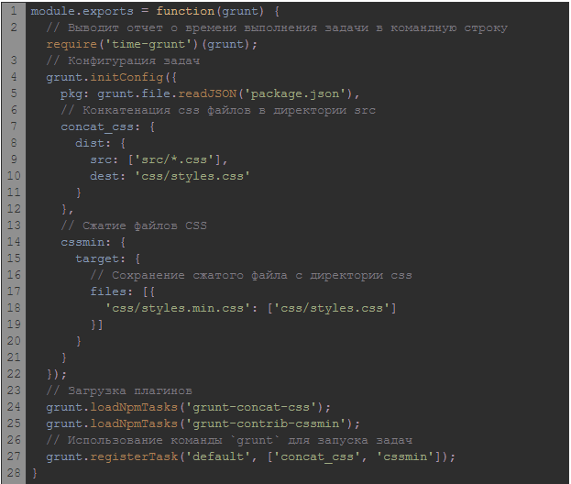

Slide 5
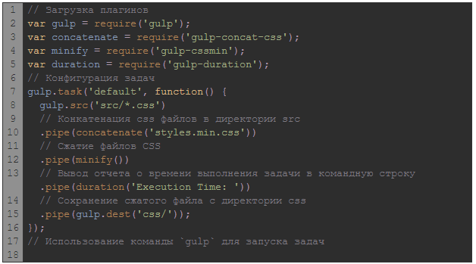

Slide 6
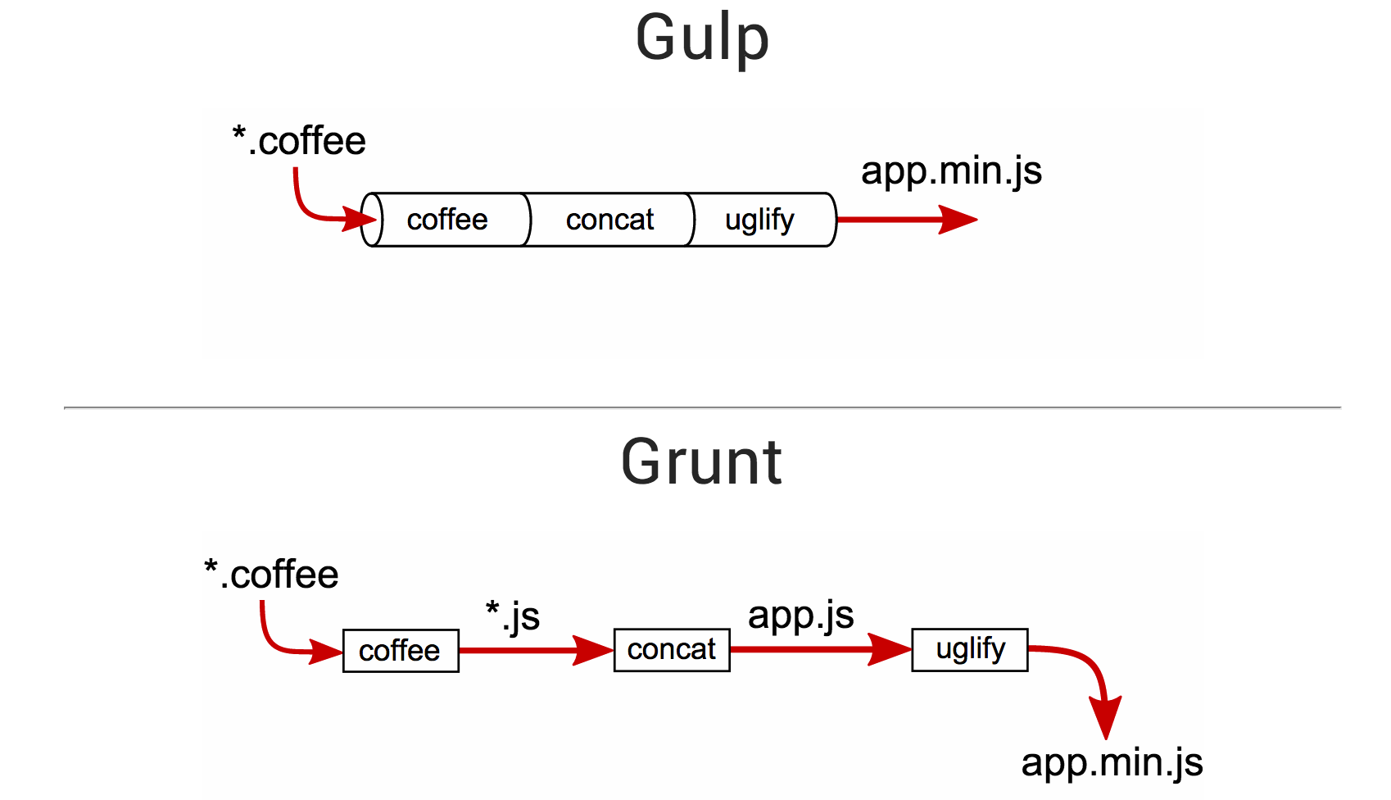

Slide 7
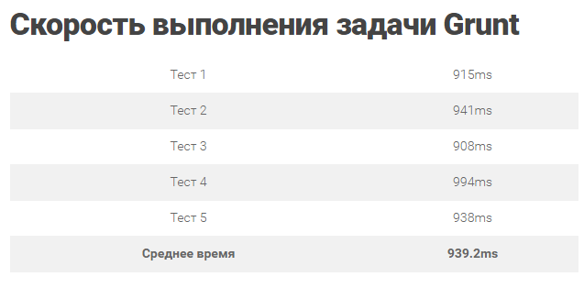

Slide 8
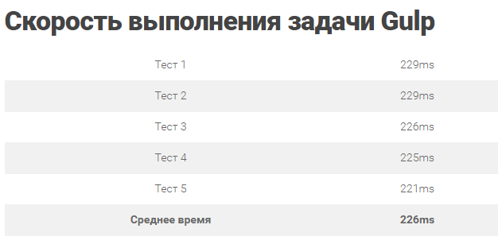

Slide 9
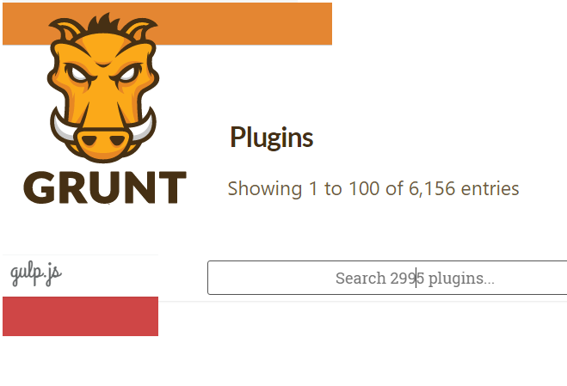

Slide 10
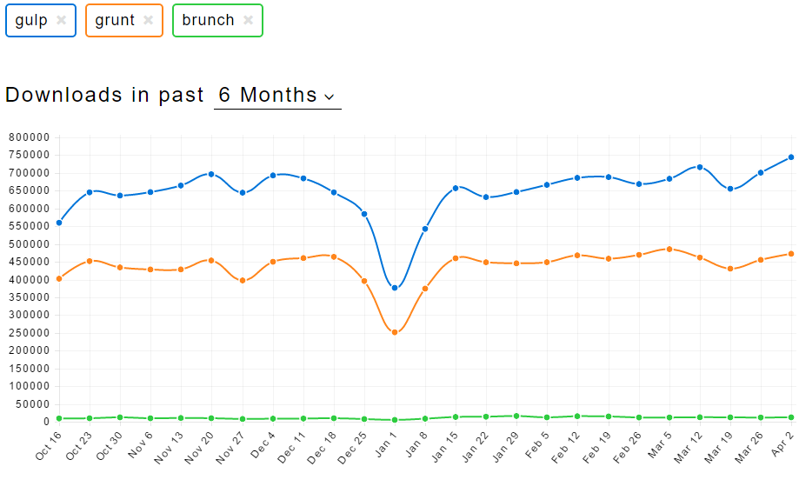

Slide 11
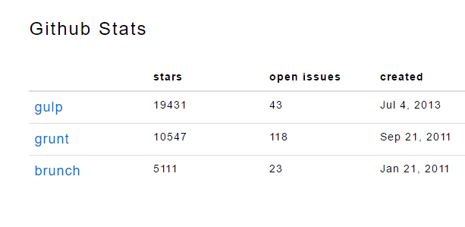

Slide 12
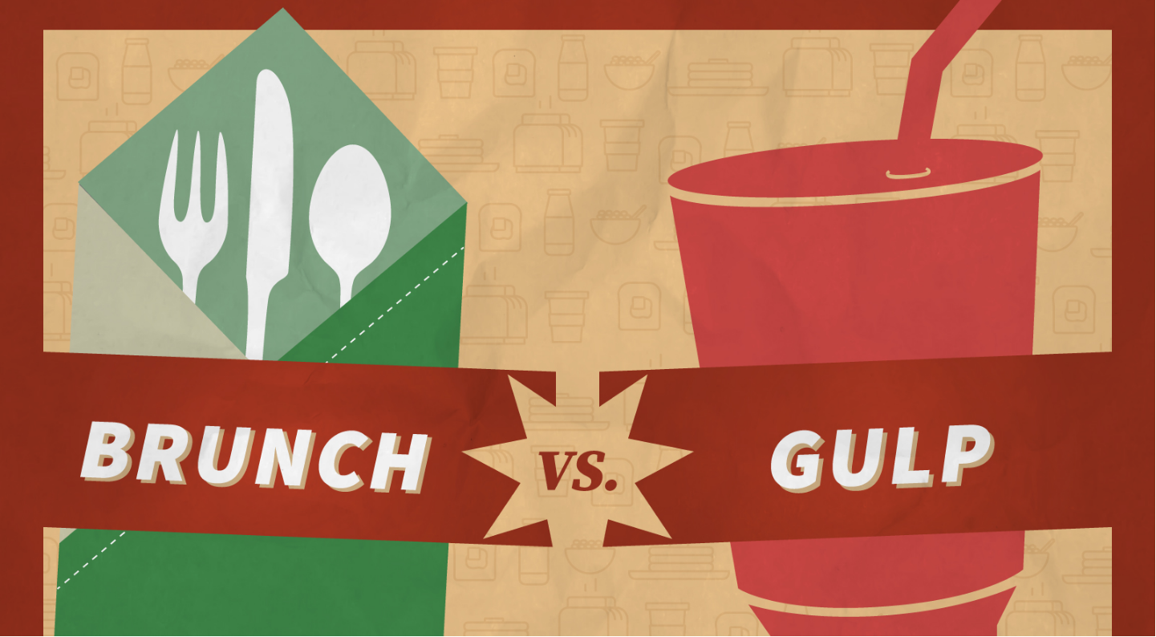

Slide 13
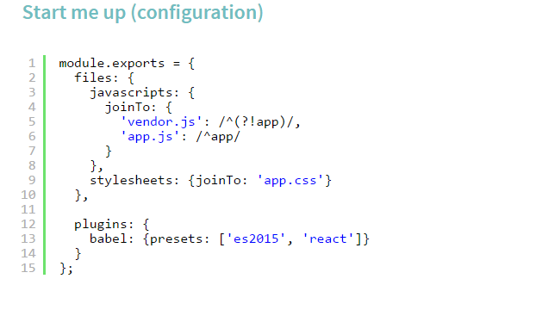

Slide 14
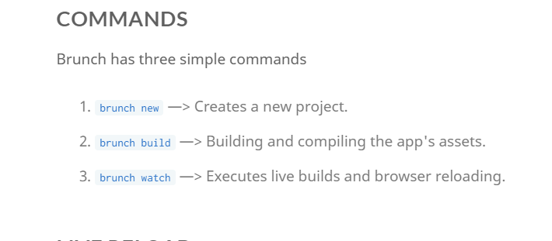

Slide 15
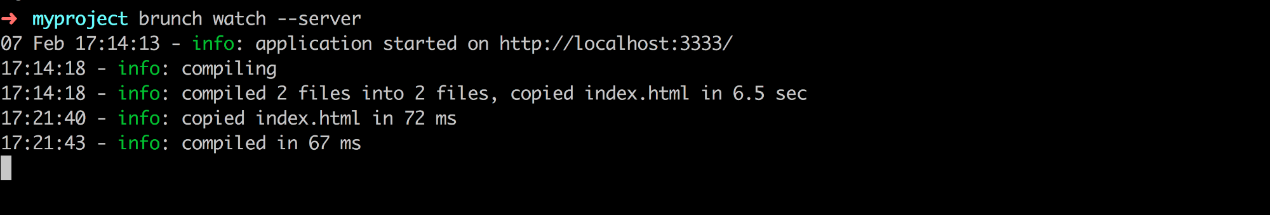

Slide 16
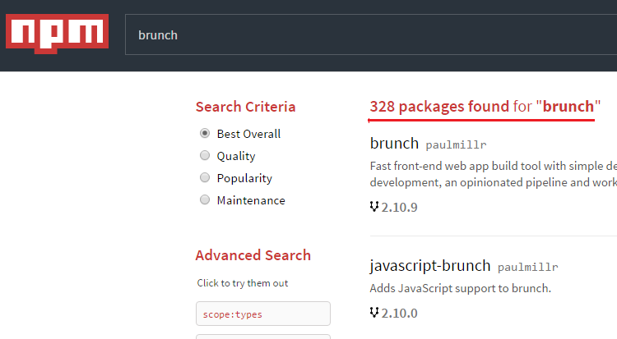

Slide 17
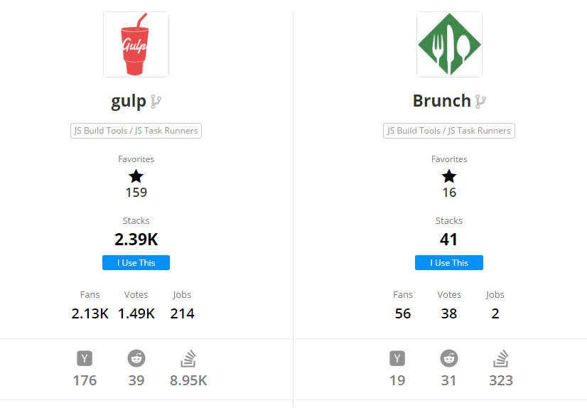

Slide 18

links
https://www.npmjs.com/search?q=&page=0&ranking=optimal
http://brunch.io/docs/why-brunch
https://npmcompare.com/compare/brunch,grunt,gulp,npm,webpack
https://blog.toggl.com/2014/03/grunt-vs-gulp-vs-brunch/
http://frontender.info/no-need-to-grunt-take-a-gulp-of-fresh-air/
https://stackshare.io/stackups/brunch-vs-grunt-vs-gulp

Slide 19


Slide 20


