Slide 1

Personalized dementia prediction
Empowering the Future of Care: Predicting Dementia with Precision Through Machine Learning

Slide 2

Hello!
I am Kumaran Hariharan

Slide 3

Introduction
Global Prevalence: Over 55 million people worldwide are currently living with dementia, and this number is expected to nearly triple to 139 million by 2050 due to aging populations and increased life expectancy. The greatest increases will be seen in low and middle-income countries​
Nearly 80% of the general public is concerned about developing dementia at some point in their lives
New Cases: A new case of dementia is diagnosed every 3 seconds globally​

Slide 4

Our Goal
Machine Learning for personalized Detection: Using advanced ML techniques to predict the onset of dementia earlier using genetic data and more accurately.
Impact: Enable earlier interventions and improve individual patient outcomes by identifying risk factors before symptoms appear.

Slide 5

Objectives
Personalized Dementia Risk Prediction
Goal: Leverage machine learning to predict individual risk levels for developing dementia based on personalized data (e.g., genetic factors, lifestyle, and medical history).
Impact: Provides a tailored approach to understanding each person's unique risk profile, enabling customized care plans and preventive strategies.

Slide 6

Business and revenue models
Business Model
Potential Users: Healthcare providers, researchers, patients at risk of dementia.
Use Cases: Early-stage diagnosis, personalized treatment planning, tracking patient progress over time.
Revenue Model:
Subscription Service for healthcare providers.
Data Analytics Platform for researchers.
Licensing to health tech companies for integration with wearable devices.
Value Proposition: Enhances dementia risk assessments, leading to timely interventions and improved patient outcomes.

Slide 7
Dataset collection and integration
The dataset used in this study was obtained from the Kaggle platform and UK biobank, which was integrated to 1,000 individuals health data. The individuals were categorized into two groups: the dementia group and the control group.
The dataset includes 500 dementia patients and 500 control subjects, providing a balanced sample for model training and evaluation. This balance helps in avoiding the pitfalls of overfitting and underfitting, ensuring the model generalizes well to unseen data.

Slide 8
Features of the dataset
Feature Name
Diabetic
Alcohol Level
Heartrate
BloodOxygenLevel
BodyTemperature
Weight
MRI_Delay
Prescription
Dosage in mg
Age
Education_Level
Dominant_Hand
Gender
Family_History
Smoking_Status
APOE_ε4
Physical_Activity
Depression_Status
Cognitive_Test_Scores
Medication_History
Nutrition_Diet
Sleep_Quality
Chronic_Health_Conditions

Slide 9
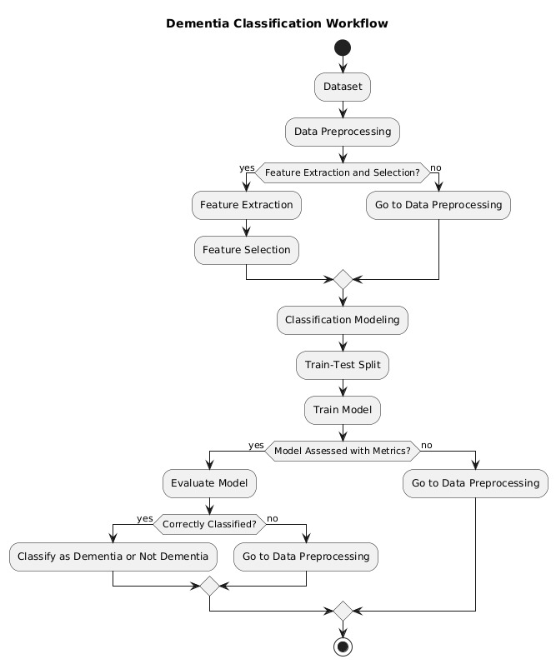
The workflow of the project

Slide 10

THE PIPELINE FOR DEMENTIA PREDICTION
Dementia classification pipeline:
Dataset: It begins with data collection and proceeds to the preprocessing phase, where initial cleaning is performed.
Feature Extraction and Selection: Features are extracted and selected for modelling, and if necessary, the process loops back for more preprocessing.
Classification Modelling: Data is split into training and testing sets, followed by model training.
Evaluation: The model's performance is assessed with appropriate metrics. If unsatisfactory, preprocessing is repeated.
Classification: The model classifies whether the subject has dementia or not, with feedback loops for incorrect classification.

Slide 11
RESULTS OF DIFFERENT ML ALGORITHMS
Classifier | Accuracy | Precision | Recall | F1-score
Random Forest | 98.75% | 98.75% | 98.75% | 98.73%
Logistic regression | 81% | 81% | 81% | 80%
SVM | 47% | 47% | 47% | 48%

Slide 12

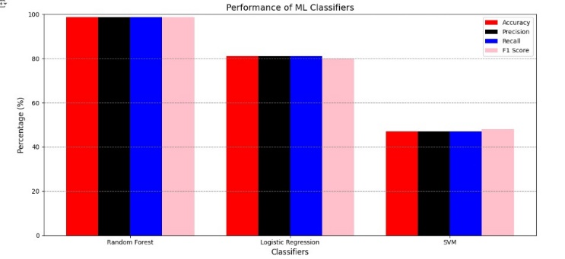

Slide 13

CONCLUSION
In this study, we applied several machine learning algorithms to predict individualized dementia risk, utilizing a dataset comprising 1000 individuals. While this perfect accuracy may seem promising at first glance, it raises concerns regarding potential overfitting, where the model may be tailoring itself too closely to the training data rather than generalizing to unseen data. Overfitting can lead to models that perform exceptionally well in controlled testing environments but fail when exposed to real-world or more diverse datasets. This is particularly concerning in medical applications like dementia prediction, where real-world applicability is critical for reliable diagnostics and treatment planning.

