Slide 1
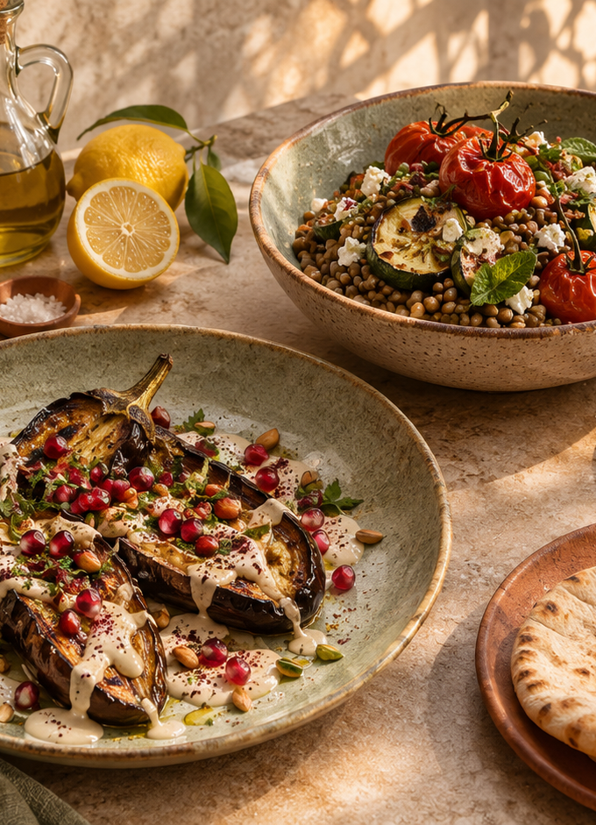
CNSCC324 Natural Language Processing
Olive Table
A restaurant enquiry assistant
Coursework task 1
Lab class ______ Team ______
Yu Zixuan Tian Yuhan Li Haoran
Qin Yingzhi Huang Xiaoyu
Sixth member __________________
01
Notes:
Suggested presenter 1. Duration 45 seconds. Introduce coursework task 1 and the group. Confirm the missing sixth member, lab class and team number before presenting. Sources: cnscc324-2026-coursework.pdf pages 1-3, docs/TEAM_DETAILS.json. Hero: AI-generated fictional Mediterranean restaurant image bundled in static/mediterranean-table.png.

Slide 2
Customer functions and menu
Customers can ask about a visit, explore dishes and refine suggestions through conversation.
Course | Items
Starters | 5
Mains | 16
Sides | 4
Desserts | 5
Drinks | 6
Diet and ingredient exclusions
A budget that persists across turns
Named dish details and follow-up questions
Answers linked to menu or FAQ sources
36 items with prices, ingredients and declared allergens
02
Notes:
Suggested presenter 1. Duration 75 seconds. Explain what a customer can do, then show the actual menu categories. The restaurant and its contact details are fictional. Sources: data/restaurant.json and data/faq.json.

Slide 3
Application architecture
Stage | Component | Purpose
1 | Browser and Flask API | Text input, validation and isolated session
2 | Dialogue state and entity rules | Preferences, exclusions and dish references
3 | Local intent classifier | Select an intent or reject weak evidence
4 | FAQ and structured menu | Ground an answer or filter dishes
5 | Response and evidence | Reply, sources, method and current context
The web interface and command line share one dialogue engine.
03
Notes:
Suggested presenter 1. Duration 90 seconds. Follow the order of a customer turn. Rules manage explicit preferences and dish references. The trained classifier routes FAQ questions when available. The grounding layer retrieves a fixed FAQ answer or filters menu records. Sources: app.py, restaurant_bot/engine.py and restaurant_bot/classifier.py. Framework reference: https://flask.palletsprojects.com/en/stable/

Slide 4
NLP methods and their purpose
Text normalisation
Slot extraction and negation
Case, punctuation and selected spelling variants
Diet, exclusions, price limit, course and spice
Word and character TF-IDF
Entity and reference resolution
Sparse features for phrasing and spelling variation
Dish names plus first, second and selected dish
Supervised intent classification
Grounding and rejection
A local model chooses among 19 intent labels
Known sources and a fallback for weak evidence
04
Notes:
Suggested presenter 2. Duration 120 seconds. Explain why each method exists rather than just listing library names. Word n-grams represent local wording. Character n-grams help with spelling and inflection. Rules preserve explicit restrictions. Sources: restaurant_bot/engine.py, restaurant_bot/classifier.py, training/train.py. References: https://scikit-learn.org/stable/modules/generated/sklearn.feature_extraction.text.TfidfVectorizer.html and https://scikit-learn.org/stable/modules/generated/sklearn.linear_model.LogisticRegression.html

Slide 5
Local model training and selection
380 authored utterances across 19 labels
304 training families with 912 variants and 76 development families
Best candidate per family | Development accuracy | Macro F1
Linear support vector classifier | 71.05% | 0.708
Logistic regression | 68.42% | 0.688
Multinomial naive Bayes | 61.84% | 0.596
Selected LinearSVC: C = 2, character weight = 0.8, rejection threshold = 0.08
All selection used development data. Model scores remain uncalibrated.
05
Notes:
Suggested presenter 2. Duration 120 seconds. The corpus contains 380 self-authored English utterances across 19 labels. Split 304 training families and 76 development families before augmentation. Three prefix variants produce 912 training examples. Fit features only on training variants. Compare 15 candidates and choose the model and rejection threshold using development macro F1. The table shows the best development result in each model family after rejection. Selected model: LinearSVC, C=2, word feature weight 1.0, character weight 0.8, threshold 0.08. No refit on development data and no access to the frozen evaluation queries during selection. Softmax-normalised SVC margins are uncalibrated scores. Sources: training/train.py, training/data/intents.json, models/training_metrics.json. References: https://scikit-learn.org/stable/modules/generated/sklearn.svm.LinearSVC.html and https://scikit-learn.org/stable/modules/generated/sklearn.feature_extraction.text.TfidfVectorizer.html

Slide 6
Dialogue state across follow-up turns
Customer message | State after the turn | System action
I am vegan, under 15 pounds | diet = vegan max price = 15 | Filter vegan mains at or below £15
Actually, vegetarian instead | diet = vegetarian max price = 15 | Update the diet and retain the budget
Which is cheapest? | Keep diet and price select lowest priced match | Explain the cheapest current match
Tell me about the first one | Resolve the first recommended ID | Show price, ingredients and allergens
A new session or reset clears the stored preferences.
06
Notes:
Suggested presenter 2. Duration 90 seconds. These are demonstration utterances authored for explaining state, not the frozen evaluation queries. The vegetarian correction keeps the existing budget. An ordinal follow-up selects a dish from the current recommendation list. Sources: restaurant_bot/engine.py and data/restaurant.json.

Slide 7
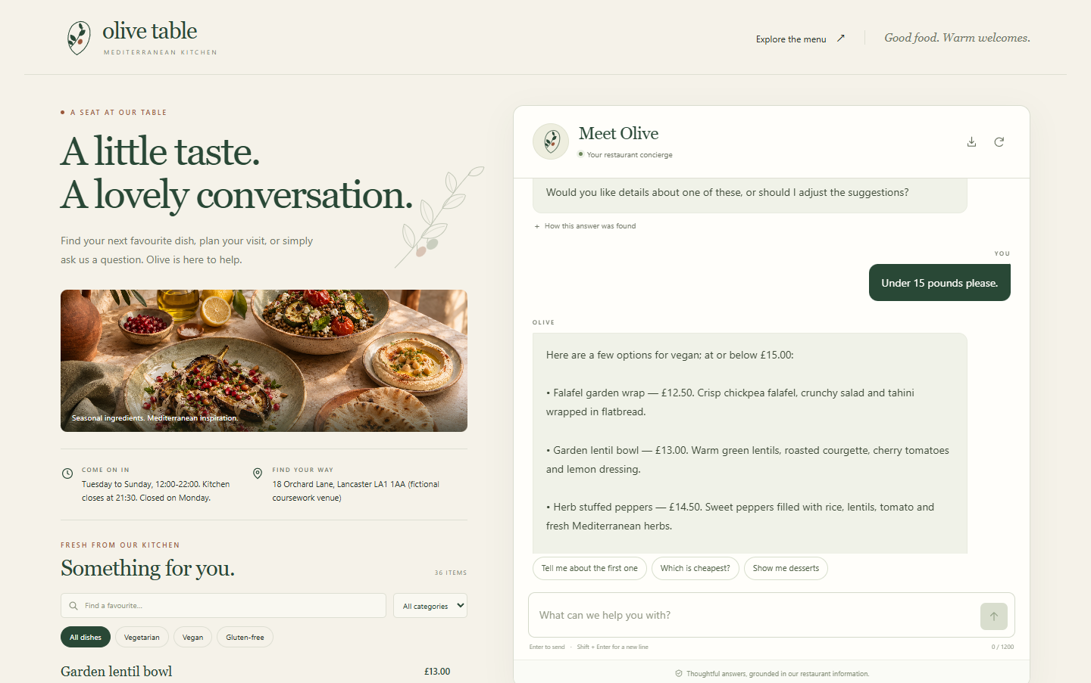
Live demonstration
Menu and dish details
FAQ answer and source
Diet and budget follow-ups
Unknown question and reset
Live app at localhost:8765
07
Notes:
Suggested presenter 3. Duration 4 minutes. Launch python app.py and open http://127.0.0.1:8765. Demonstrate the menu category selector and ingredient dialog. Ask an opening-hours question and inspect the method and source. Then ask for vegan options under 15 pounds, change to vegetarian, ask for the cheapest option and open dish details. Finally demonstrate an unrelated question, reset, and the CLI if time permits. Screenshot source: actual local app captured during UI QA in work/ui-desktop.png. No user feedback study is implied.

Slide 8
Measured performance
72 authored English queries covering 14 FAQ labels and rejection
A fixed diagnostic set, with no user study or benchmark claim
Full application | Correct | Accuracy | Macro F1
Word TF-IDF baseline | 44 / 72 | 61.11% | 0.637
Trained enhanced mode | 59 / 72 | 81.94% | 0.848
Unrelated-topic rejection improved from 4/8 to 7/8.
Raw retrieval alone scored 63.89% and 65.28%, respectively.
08
Notes:
Suggested presenter 3. Duration 120 seconds. The fixed diagnostic set has 72 authored English queries: 56 paraphrases, 8 typos and 8 unrelated topics. Its author knew the supported labels, so this is not an independent user benchmark. No exact normalised query overlap with training or FAQ examples. Full-system baseline obtains 44/72 correct, enhanced obtains 59/72 correct. Macro F1 includes the rejection label. Unknown-topic rejection: 4/8 versus 7/8. Raw-retrieval-only ablation obtains 46/72 versus 47/72 correct, showing that the full-system comparison also includes classifier/dialogue routing. Median and p95 local reply times: baseline 1.075/1.354 ms, enhanced 3.217/4.028 ms. Timing excludes startup, HTTP and browser work and depends on the machine. Fifteen functional/API tests pass with the model loaded. No model changes followed this run. Sources: evaluation/README.md, evaluation/results/results.json and tests/test_system.py.

Slide 9
Limitations and next improvements
13 of 72 intent predictions remain incorrect, including cancellation and unrelated-topic confusion.
Current limitation | Next improvement
Authored English examples cover a small domain | Collect consented paraphrases from new speakers
Rules miss complex or contradictory preferences | Clarify conflicting constraints explicitly
Model scores remain uncalibrated | Study calibration on larger validation data
Fictional data and allergen cross-contact limits | Verify live data and retain staff confirmation
No live reservations or payment processing | Integrate verified booking availability
09
Notes:
Suggested presenter 3. Duration 90 seconds. Thirteen of 72 final intent predictions remain incorrect. Observed errors include a cancellation enquiry classified as reservations and one unrelated coding request classified as menu. Typographical variation can still trigger an incorrect social intent. Do not claim human-level language understanding or production restaurant capability. The limited synthetic corpus and deterministic rule coverage constrain generalisation. These findings are error analysis only, with no model changes after evaluation. Sources: models/training_metrics.json limitations, evaluation/results/results.json, app.py and restaurant_bot/engine.py.

Slide 10
Responsibility allocation
Proposed responsibilities for verification and completion
Member | Proposed responsibility
Yu Zixuan | Knowledge data and restaurant FAQ review
Tian Yuhan | TF-IDF retrieval and method comparison review
Li Haoran | Dialogue state and recommendation scenario validation
Qin Yingzhi | Web interaction and accessibility validation
Huang Xiaoyu | Evaluation, error analysis and reproducibility review
Sixth member ______ | Report integration, user manual and demonstration rehearsal
Record actual work before submitting the team and individual reports.
10
Notes:
Suggested presenter 1 or team lead. Duration 90 seconds, followed by 2 minutes for questions. This allocation is proposed work for each member to verify and complete. It must not be presented as evidence that the named members have already performed these tasks. Replace proposed responsibilities with actual verified contributions before submission. Source: docs/TEAM_DETAILS.json. Suggested total: approximately 20 minutes, including a four-minute live demo and two minutes for questions. At least three members must present under the coursework rules.

