Slide 2
ColumnStore Index: Microsoft SQL Server 2014 and Beyond
BRK4556
Sunil Agarwal
sunila@Microsoft.com
Principal Program Manager
SQL Server Engine

Slide 3
Agenda
Overview
Compression and Query Performance
Supportability
Concurrency and High Availability
Changes in SQL Server 2016

Slide 4
Overview

Slide 5
Trends in the Data Warehousing Space
Scale:
DW systems continue to grow at a fast pace, scalability is a key concern, growing a system from 10s of TBs, to 100s of TB, to PBs.
Performance at scale:
Ability to analyze massive amounts of data while offering interactive query response.
Data Warehouse for masses:
Drive down price per TB.
Source: TDWI Report – Next Generation DW

Slide 6

Columnstore Index: Why?
Data stored as rows
Data stored as columns
C1
C2
C3
C4
C5
rowgroup
…
Ideal for OLTP
Efficient operation on small set of rows
segment
Improved compression:
Data from same domain compress better
Reduced I/O:
Fetch only columns needed
Improved Performance:
More data fits in memory
Optimized for CPU utilization
Ideal for DW Workload

Slide 7
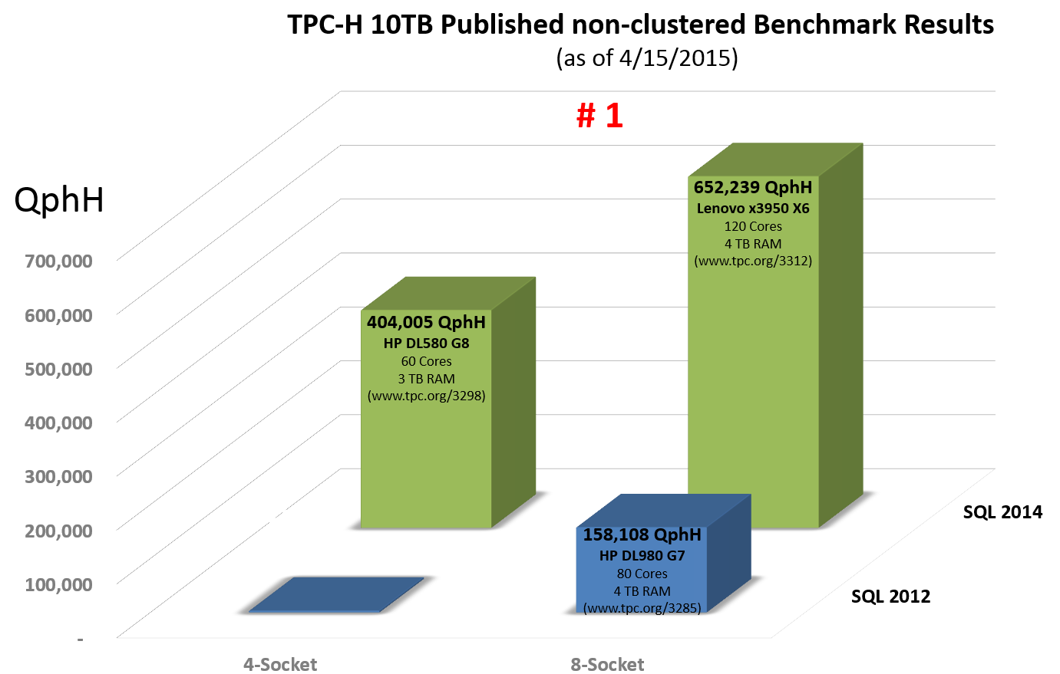
SQL 2014: World Record Breaking Performance (TPC-H)
Source: tpc.org
QphH= Queries Per Hour.

Slide 8
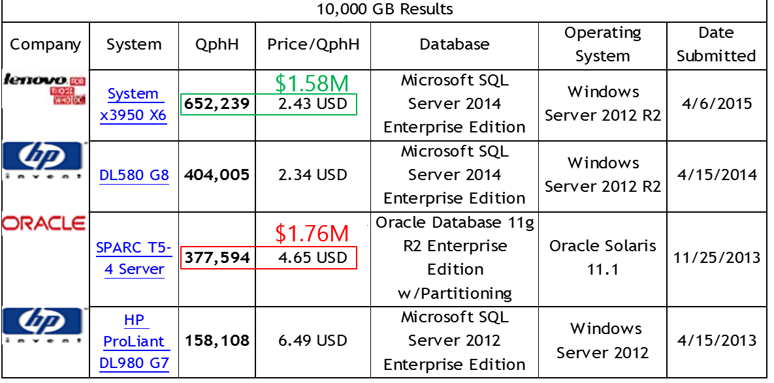
SQL 2014: Outperforming Competition
Source: http://www.tpc.org/tpch/results/tpch_perf_results.asp

Slide 9
Compression and Data Load

Slide 10
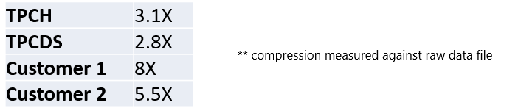
Competitive Data Compression
Table compression options:
DATA_COMPRESSION = { NONE | ROW | PAGE | COLUMNSTORE | COLUMNSTORE_ARCHIVE }
Clustered Columnstore Index: Compression
Default compression when creating a table with Clustered Columnstore Index
Typical customer workloads gets 5-8x compression ratios
ARCHIVAL Compression
Enables additional 20% compression for whole table and/or chosen partitions, with CPU overhead.

Slide 11
Updatable Columnstore Index
Table consists of column store and row store
DML (update, delete, insert) operations leverage delta store
INSERT Values
Always lands into delta store
DELETE
Logical operation. Row is marked deleted in delete bitmap
Data physically remove after REBUILD/REORG operation is performed.
UPDATE
DELETE followed by INSERT.
BULK INSERT
if batch < 100k, inserts go into delta store, otherwise Columnstore
SELECT
Unifies data from Column and Row stores - internal UNION operation.
Delta (row)
store
C1
C2
C3
C4
C5
C6
C1
C2
C3
C4
C5
C6
tuple mover
Column
Store
Delete Bitmap

Slide 12
Data Loading into Columnstore : Trickle Insert
Trickle Insert
Insert into <columnstore>
values (<>)
X rowlock
Trickle Insert
Delete bitmap
X rowlock
X rowlock
Trickle Insert
Compressed RGs
Delta RGs
Key Points:
The rows are inserted into existing delta rowgroup (RG).
New delta RG is created if needed
If multiple delta RG, SQL Server picks one
Multiple transactions can insert concurrently into same delta RG
Common load pattern with nonclustered columnstore index

Slide 13

Data Loading into Columnstore: Bulk Import
X rowgroup lock
Bulk Import (batchsize < 100k)
Delete bitmap
X rowgroup lock
Bulk Import (batchsize < 100k)
Compressed RGs
Delta RGs
Bulk Import (batchsize >= 100k)
X rowgroup lock
Key Points
Import from External Files (BCP, Bulk Insert, SSIS)
Each Bulk Import thread takes X lock on the RG.
If batchsize < 100k, the rows are inserted into a delta RG otherwise a new compressed RG is generated
Minimal Logging
Common data load pattern for Data Warehouse Workload

Slide 14
Data Loading into Columnstore: Staging Table
Load data from External Files from staging table
Delete bitmap
X rowgroup lock
Rows < 100k
Insert into <columnstore>
select * from <rowstore-staging>
Compressed RGs
Delta RGs
X rowgroup lock
Rows >= 100k
Key Points:
Similar to Bulk Import but with single BATCH
Residual rows < 100k are inserted into delta store
SQL 2016: Parallel Insert into Columnstore index

Slide 15
New Columnstore Structures in SQL Server 2016

Slide 16
Columnstore Index: Clustered (CCI)
BTREE (NCI)
Mapping Index(internal)
Delete bitmap
Delete bitmap
Compressed RGs
Delta RGs
Compressed RGs
Delta RGs
SQL 2014
SQL 2016
Master copy of the data (10 x compression)
Only index supported. Simplified analytics
No PK/FK constraints. Uniqueness can be enforced through Materialized Views
Locking granularity for Update/Delete at rowgroup level
DDL – ALTER, REBUILD, REORGANIZE
Master copy of the data (10x compression)
Additional Btree indexes for efficient equality and short-range searches and PK/FK constraints.
Locking granularity at row level using NCI index path
DDL – ALTER, REBUILD, REORGANIZE

Slide 17
Columnstore Index: Updateable NonClustered Index
Btree Index
Btree Index
Relational Table
(Clustered Index/Heap)
Relational Table
(Clustered Index/Heap)
Delete bitmap
Nonclustered columnstore index
SQL 2014
Nonclustered columnstore index
SQL 2016
Introduced in SQL Server 2012
NCCI is read-only. So no delete bitmap and no delta store
Optimizer will choose between NCCI and NCI(s)/CI or Heap based on the cost based model
Partitioning Supported
It is updateable!
You can mix OLTP and Analytics workload
You can create Filtered NCCI
Partitioning is Supported

Slide 18
Demo: Basic Columnstore
Sunil Agarwal

Slide 19
Query Performance

Slide 20
Query Processing - Read The Data Needed
SELECT ProductKey, SUM (SalesAmount)
FROM SalesTable
WHERE OrderDateKey < 20101108
OrderDateKey
20101107
20101107
20101107
20101107
20101107
20101108
ProductKey
106
103
109
103
106
106
StoreKey
01
04
04
03
05
02
RegionKey
1
2
2
2
3
1
Quantity
6
1
2
1
4
5
SalesAmount
30.00
17.00
20.00
17.00
20.00
25.00
OrderDateKey
20101108
20101108
20101108
20101109
20101109
20101109
ProductKey
102
106
109
106
106
103
RegionKey
1
2
1
2
2
1
Quantity
1
5
1
4
5
1
StoreKey
02
03
01
04
04
01
SalesAmount
14.00
25.00
10.00
20.00
25.00
17.00
Rowgroup
Elimination
Column Elimination

Slide 21
Query Processing: Rowgroup Elimination
Can significantly reduce the number of rows to be processed
Worst case – need to scan the full column store
Methodology
Predicate Pushdown
Query engine pushes down simple predicates (e.g. DateKey > 20140601)
Metadata for each column (sys.column_store_segments)
min_data_id and max_data_id
Only segments meeting the criteria are fetched or processed
Challenges
CCI: No implicit ordering. Create CCI on clustered btree index with DROP_EXISTING = ON

Slide 22

Multi-Row Batch – Batch Mode Processing
Batch object
Filtered Batch
Process multiple rows together for efficiency
Significant reduction in instructions
No copying of data
Buffer size 64K
Rows 64 to 900
Column vectors
Predicate
X
X
Get Batch
X
C1
C10
C14
Scan
X
New in SQL 2016
Single Thread Batch Mode Execution
Batch Anti-Semi-Join
Multiple count DISTINCT
Window Aggregates
Sort

Slide 23
Performance: Equality and Short Range Queries
SELECT <>
FROM <columnstore>
Where C1 = <value>
SELECT <>
FROM <columnstore>
Where C1 between <value1> and <value2>
BTREE (NCI)
Delete bitmap
Mapping Index(internal)
Compressed RGs
Delta RGs
Delete bitmap
SQL 2014
Delta RGs
Compressed RGs
SQL 2016
Execution Strategy
Rowgroup Elimination (when possible)
Partition level Scan (somewhat expensive)
Full index scan (expensive)
Execution Strategy
Optimizer can choose NCI on column C1. Index points directly to rowgroup
No full index scan
Covering NCI index

Slide 24
Performance: Aggregate Pushdown (SQL2016)
Select sum (sales) from <columnstore>
Performance gains using Fast Path
Opportunistic evaluation of aggregation in storage layer
Efficient Aggregation on compressed/encoded data in cache-friendly execution (column at a time)
Leverage SIMD
Datatype <= 8 bytes no strings
Aggregates – MIN, MAX, SUM, COUNT, AVG
SQL 2014
SQL 2016
1 row
1 row
Aggregate
Aggregate
10 million rows
0 row
Scan
Scan

Slide 25
Performance: String Predicate Pushdown (SQL 2016)
SQL 2014
SQL 2016
50 rows
50 rows
Filter
Filter
String Predicate:
name like ‘%foo%’
10 million rows
100k rows
Scan
Scan
Execution Strategy
Retrieve 10 million rows by converting dictionary encoded value to string
Apply string predicate on 10 million rows
Execution Strategy
Apply Filter on Dictionary entries
Find rows that refer to dictionary entries that quality (R1)
Find rows not eligible for this optimization (R2)
Scan returns (R1 + R2) rows
Filter node applies string predicate on (R2)
Row returned by Filter node = (R1 + R2’)

Slide 26
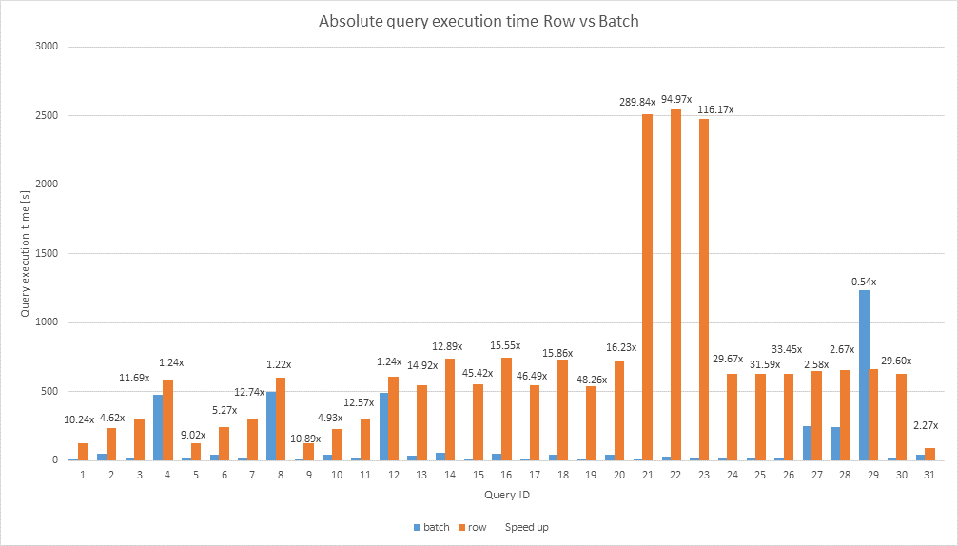
Analytics with Window Aggregates (SQL 2016)

Slide 27
Demo: Performance
Sunil Agarwal

Slide 28
Supportability

Slide 29
Supportability: Index Maintenance
Operation | SQL 2014 | SQL 2016
Removing Deleted Rows | Requires Index REBUILD | Index REORGANIZE Remove deleted from single compressed RG Merge one or more compressed RGs with deleted rows Done ONLINE
Smaller RG size resulting from Smaller BATCHSIZE Memory Pressure Index build Residual | Index REBUILD | Index REORGANIZE
Ordering Rows | Create clustered index Create columnstore index by dropping clustered Index | No Changes in CTP2

Slide 30
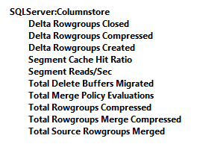
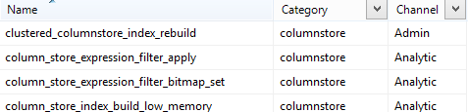
Supportability: DMVs, Perfmon, XEvents
PerfMon Counters (SQL2016)
New DMVs
sys.dm_column_store_object_pool
sys.dm_db_column_store_row_group_operational_stats
sys.dm_db_column_store_row_group_physical_stats
sys.dm_db_index_physical_stats
sys.dm_db_index_operational_stats
New XEvents
Under new columnstore category
State transition of rowgroups
Merging of compressed rowgroups

Slide 31
Concurrency and High Availability

Slide 32
Clustered Columnstore Index: Concurrency
Operation | SQL 2014 | SQL 2016
Query | Rowgroup granularity No support of RCSI or SI Recommendation: use Read Uncommitted | Support of SI and RCSI (non blocking)
Insert | Lock at row level (trickle insert) Rowgroup level for set of rows | No changes
Delete | Lock at Rowgroup level | Row level lock in conjunction with NCI
Update | Lock at Rowgroup level Implemented as Delete/Insert | Row level lock in conjunction with NCI

Slide 33
Clustered Columnstore Index: High Availability
Operation | SQL 2014 | SQL 2016
Backup/Restore | Just like any other index. Each SEGMENT is persisted using LOB datatype | No changes
AlwaysOn Failover Clustering (FCI) | Fully Supported | Fully Supported
AlwaysON Availability Groups | Fully supported except Readable Secondary | Fully Supported with Readable Secondary
Index Create/Rebuild | Offline | Offline

Slide 34
Agenda
Overview
Compression and Query Performance
Supportability
Concurrency and High Availability
Changes in SQL Server 2016

Slide 35
Other Relevant Sessions:
BRK2563: In-Memory Technologies Overview for Microsoft SQL Server and Microsoft Azure; Tuesday 10:45-12:00
BRK4552: Operational Analytics in SQL Server; Tuesday 3:15-4:30
BRK3576: In-Memory OLTP – The Road Ahead; Tuesday 5:00-6:15
Lab: In-Memory OLTP Monitoring & Troubleshooting; Thursday 9-10:15
BRK3554 Microsoft SQL Server 2014 In-Memory OLTP and Columnstore Customer Deployments; Thursday 1:30-2:45
BRK2563: Microsoft SQL Server Unplugged; Thursday 3:15-4:30
*Other In-Memory OLTP Labs are available as well throughout the conference

Slide 36
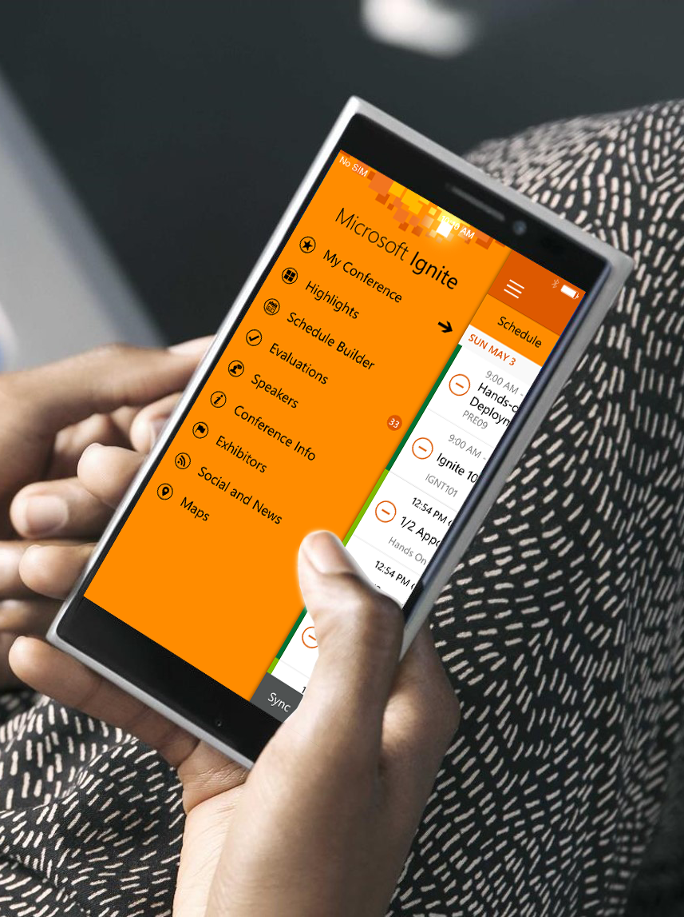

Please evaluate this session
Your feedback is important to us!
Visit Myignite at http://myignite.microsoft.com or download and use the Ignite Mobile App with the QR code above.

