Slide 1
FDS 1주차
2021-04-26
백주엽

Slide 2
Possible ways
1. Anomaly detection
검토 대상
2. Binary classification (with up-sampling method)
+) graph model

Slide 3
Review of anomaly model

Slide 4
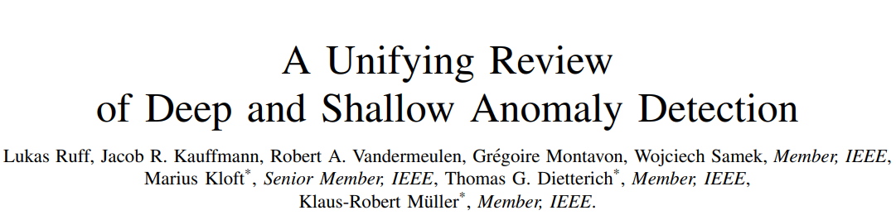
Anomaly based
https://arxiv.org/pdf/2009.11732.pdf

Slide 5
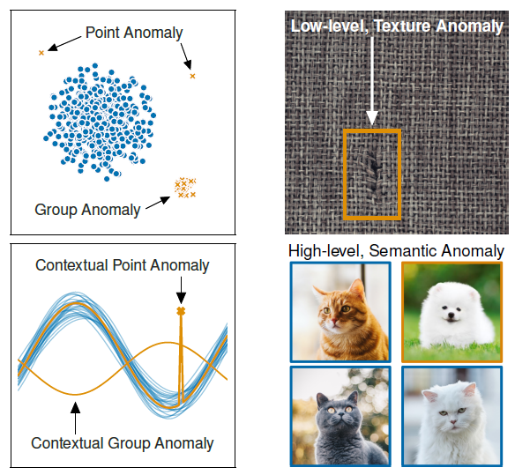
Anomaly based
Definition
Anomaly(= novelty, outlier)
- An anomaly is an observation that deviates considerably from some concept of normality

Slide 6
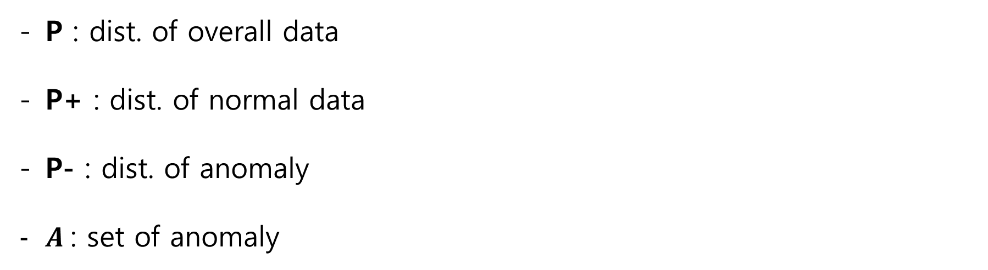
Anomaly based
Notation
P : dist. of overall data
P+ : dist. of normal data
P- : dist. of anomaly
$Α$: set of anomaly

Slide 7
Anomaly based
Main concept of AD
Main idea : model learns normal cases and deviations from it as anomaly
Assumption1) Data is stationary(but claim pattern may changes rapidly)
Assumption2) P- is uniform dist. (anomaly occurs uniformly in feature space)

Slide 8
Dataset settings

Slide 9
Anomaly based
Unsupervised
Most common way
Assumption
: X ~ P, where P=P+
Robust assumption (ex. Robust AE)
: X ~ n*P+ + (1-n)*P- , where P = [P+, P-]

Slide 10
Anomaly based
Semi-supervised
데이터 중 일부의 label이 제공되는 경우
명확한 anomaly의 경우에만 라벨을 제공
Outlier exposure, Deep SAD

Slide 11
Anomaly based
Supervised
자료의 모든 label이 제공되는 경우
Binary classification 문제로 환원됨

Slide 12
Types of AD

Slide 13
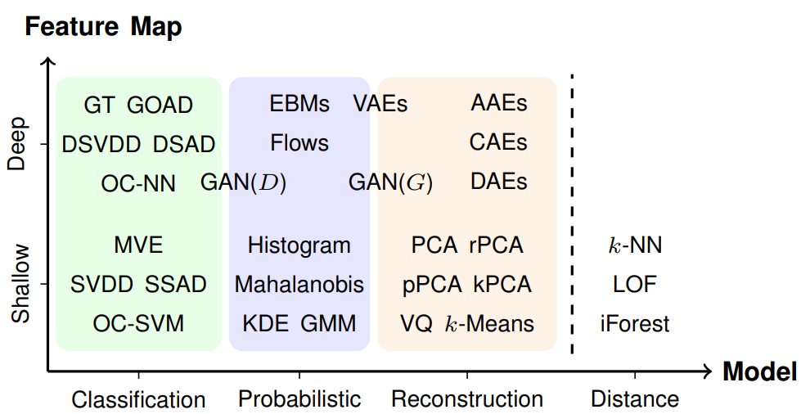
Anomaly based
Types of AD
Which one is the best??
(장담x)

Slide 14
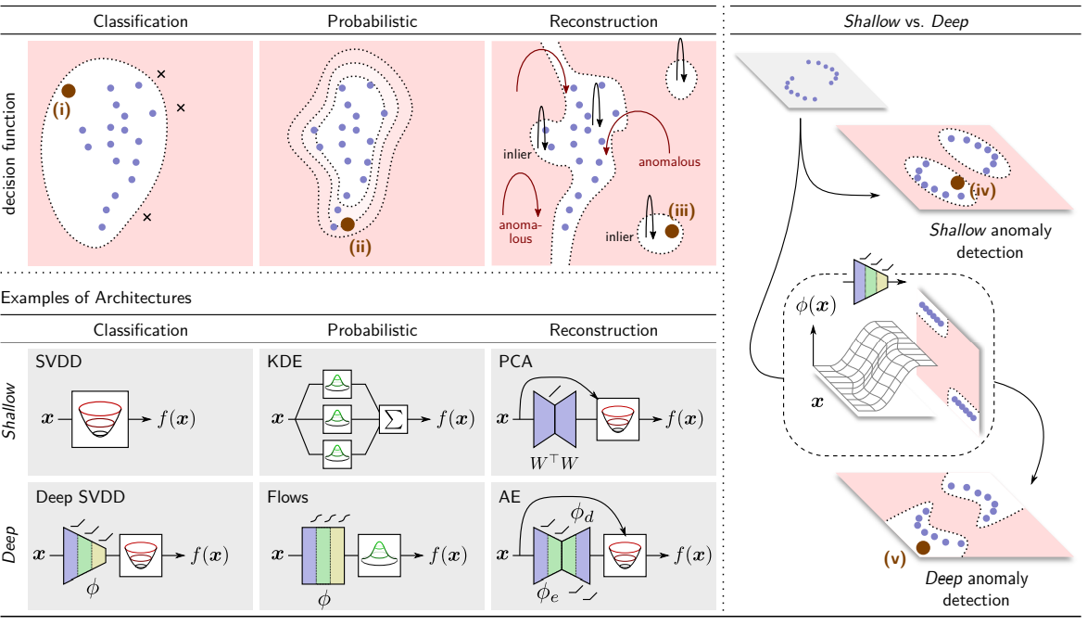
Anomaly based
Failure Detection

Slide 15
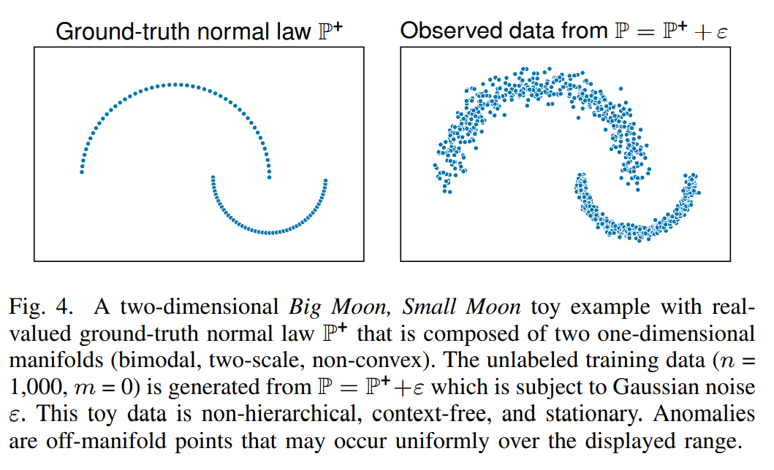
Anomaly based
Full moon, small moon toy data
anomaly

Slide 16
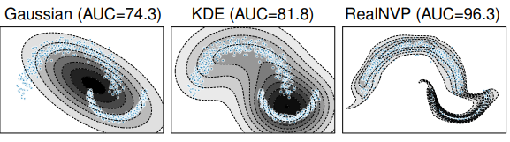
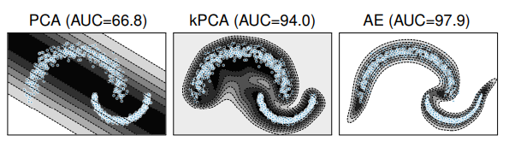
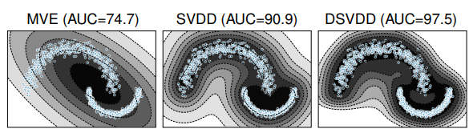
Anomaly based
Result (참고용)
세가지 방식 모두 NN 기반(deep)이 좋은 성능 보임

Slide 17
Classification model

Slide 18
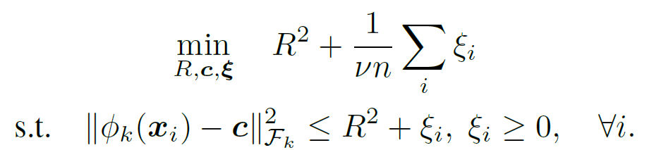
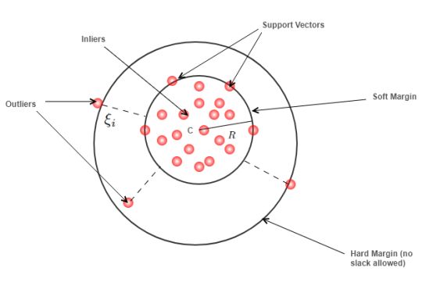
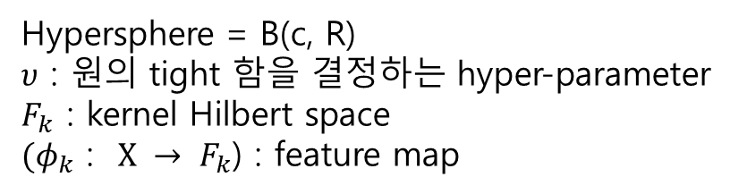
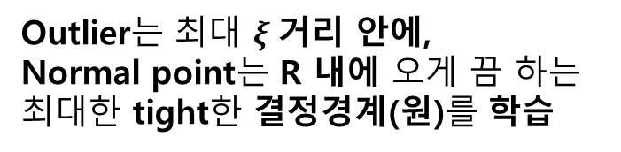
Anomaly based
One class SVM 원리
Outlier는 최대 $ξ$거리 안에,
Normal point는 R 내에 오게 끔 하는
최대한 tight한 결정경계(원)를 학습
Hypersphere = B(c, R)
$υ$ : 원의 tight 함을 결정하는 hyper-parameter
$F_{k}$ : kernel Hilbert space
${(φ}_{k}$ : $X → F_{k}$) : feature map

Slide 19
Anomaly based
Classification models
One class SVM (or SVDD) with feature selected by human
Deep SVDD
Deep SAD (Deep SVDD with semi-supervised manner)
One class Neural Net
Shallow
Deep

Slide 20


Anomaly based
One class SVM (or SVDD) with feature selected by human
Objective :
X : 880 features
(only normal cases)
Selected 42 features
(by human expert)
전문가에 의한 변수 선택!
$σ$()
OC SVM(or SVDD)
score $∈$(0,1)

Slide 21
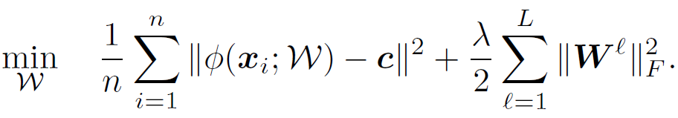


Anomaly based
모든 점이 Center에 가까워지도록
단순화 해서 생각
-> 모든 점이 center에 몰리면 안되므로
W에 대한 restriction term을 둔다
Deep SVDD
Objective :
X : 880 features
(only normal cases)
Embedded features
(by NN)
Model에 의한 변수 선택!
$σ$()
OC SVM(or SVDD)
score $∈$(0,1)
Paper
- http://data.bit.uni-bonn.de/publications/ICML2018.pdf
Jointly trained
PyTorch Implementation
-https://github.com/lukasruff/Deep-SVDD-PyTorch

Slide 22
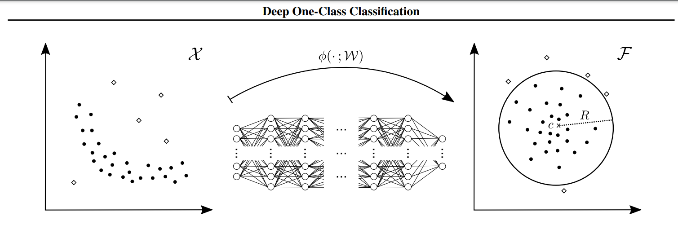
Anomaly based
Deep SVDD
뷴류가 수월한 Latent space로 mapping 해주는 함수를 NN 이용하여 찾는다

Slide 23
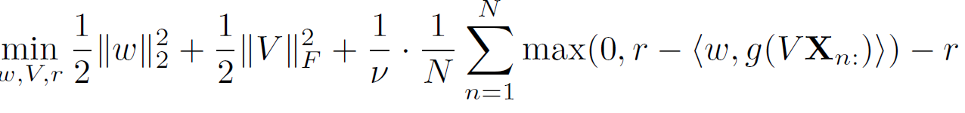


Anomaly based
One class Neural Net
Objective :
X : 880 features
(only normal cases)
Embedded features
(by AE)
Pre-trained
Embedding에
AE 이용
$σ$()
Feed-forward NN
score $∈$(0,1)
Paper
- https://arxiv.org/pdf/1802.06360.pdf
Separately trained
Keras Implementation
- https://github.com/raghavchalapathy/oc-nn

Slide 24
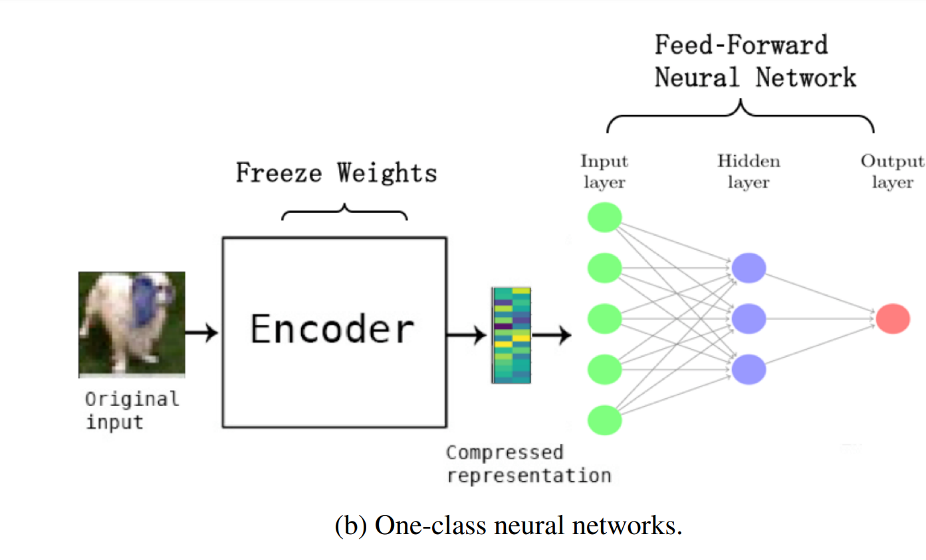
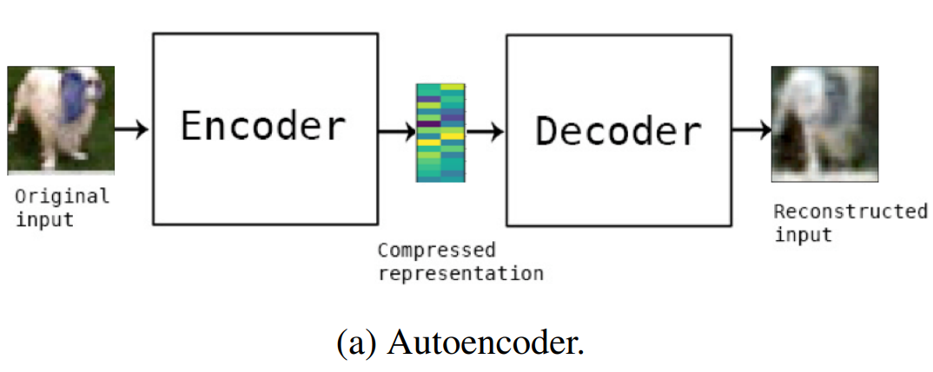
Anomaly based
One class Neural Net
AE 모델
Pre-training
AE 학습 후, encoder 딴을 전이학습 하여 AD에 이용

Slide 25
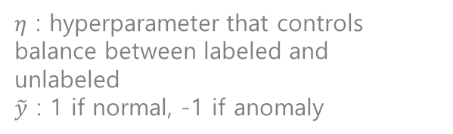
Anomaly based
If outlier is close to C, loss gets large
If normal point is far from C, loss gets also large
Deep SAD
Objective :
$η$ : hyperparameter that controls balance between labeled and unlabeled
$\tilde{y}$ : 1 if normal, -1 if anomaly
X : 880 features
Y : available label
Embedded features
(by AE)
Embedding에
AE 이용
$σ$()
OC SVM(or SVDD)
score $∈$(0,1)
라벨 이용하는 것이 특징
Paper
- http://data.bit.uni-bonn.de/publications/ICML2018.pdf
Separately trained
PyTorch Implementation
- https://github.com/lukasruff/Deep-SAD-PyTorch

Slide 26
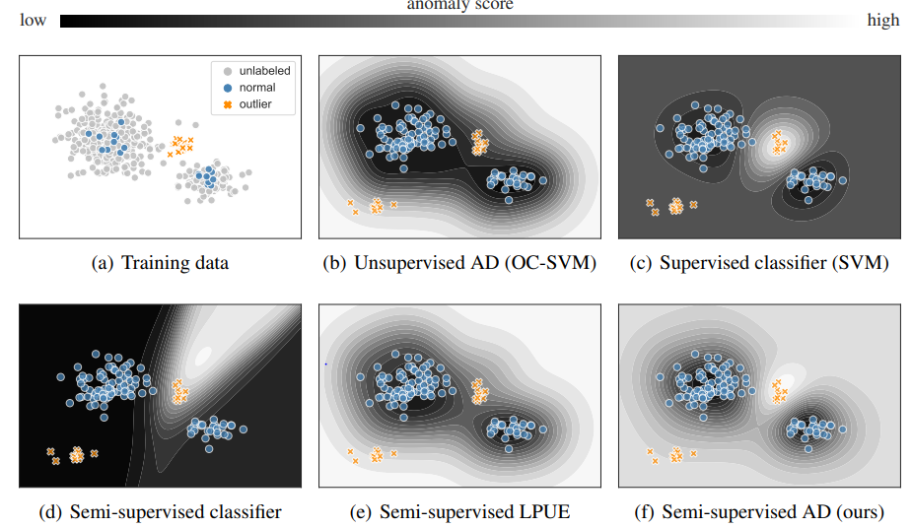
Anomaly based
Deep SAD
unseen에도
좋은 성능

Slide 27
Anomaly based
Deep SAD + AE
Objective : -
X : 880 features
Y : available label
Embedded features
(by AE)
Pre-trained
AE와 SAD를 결합
$σ$()
OC SVM(or SVDD)
score $∈$(0,1)
Paper
- http://data.bit.uni-bonn.de/publications/ICML2018.pdf
Separately trained
PyTorch Implementation
- https://github.com/lukasruff/Deep-SAD-PyTorch

Slide 28
Anomaly based
summary
 | Deep/shallow | Use label | Main idea
OC-SVM | Shallow | N | -
Deep SVDD | Deep | N | NN feature extractor + SVM
Deep SAD | Deep | Y | Deep SVDD + Use available label
Deep SAD +AE | Deep | Y | Deep SAD + AE
OC-neural net | Deep | N | Fully NN Use AE

Slide 29
Anomaly based
Conclusion
OC – SVM 기반의 Deep한 방법, shallow한 방법 성능 평가 후 적용 검토
후에 GAN 이용한 Over-sampling 방법도 검토

Slide 30
Next step

Slide 31
전처리 pipeline 구축
Scikit learn 이용 baseline 설정
GPU 서버 확보 후 deep한 방식 test
성능비교
최종 선정 모델 parameter 최적화

