Slide 1
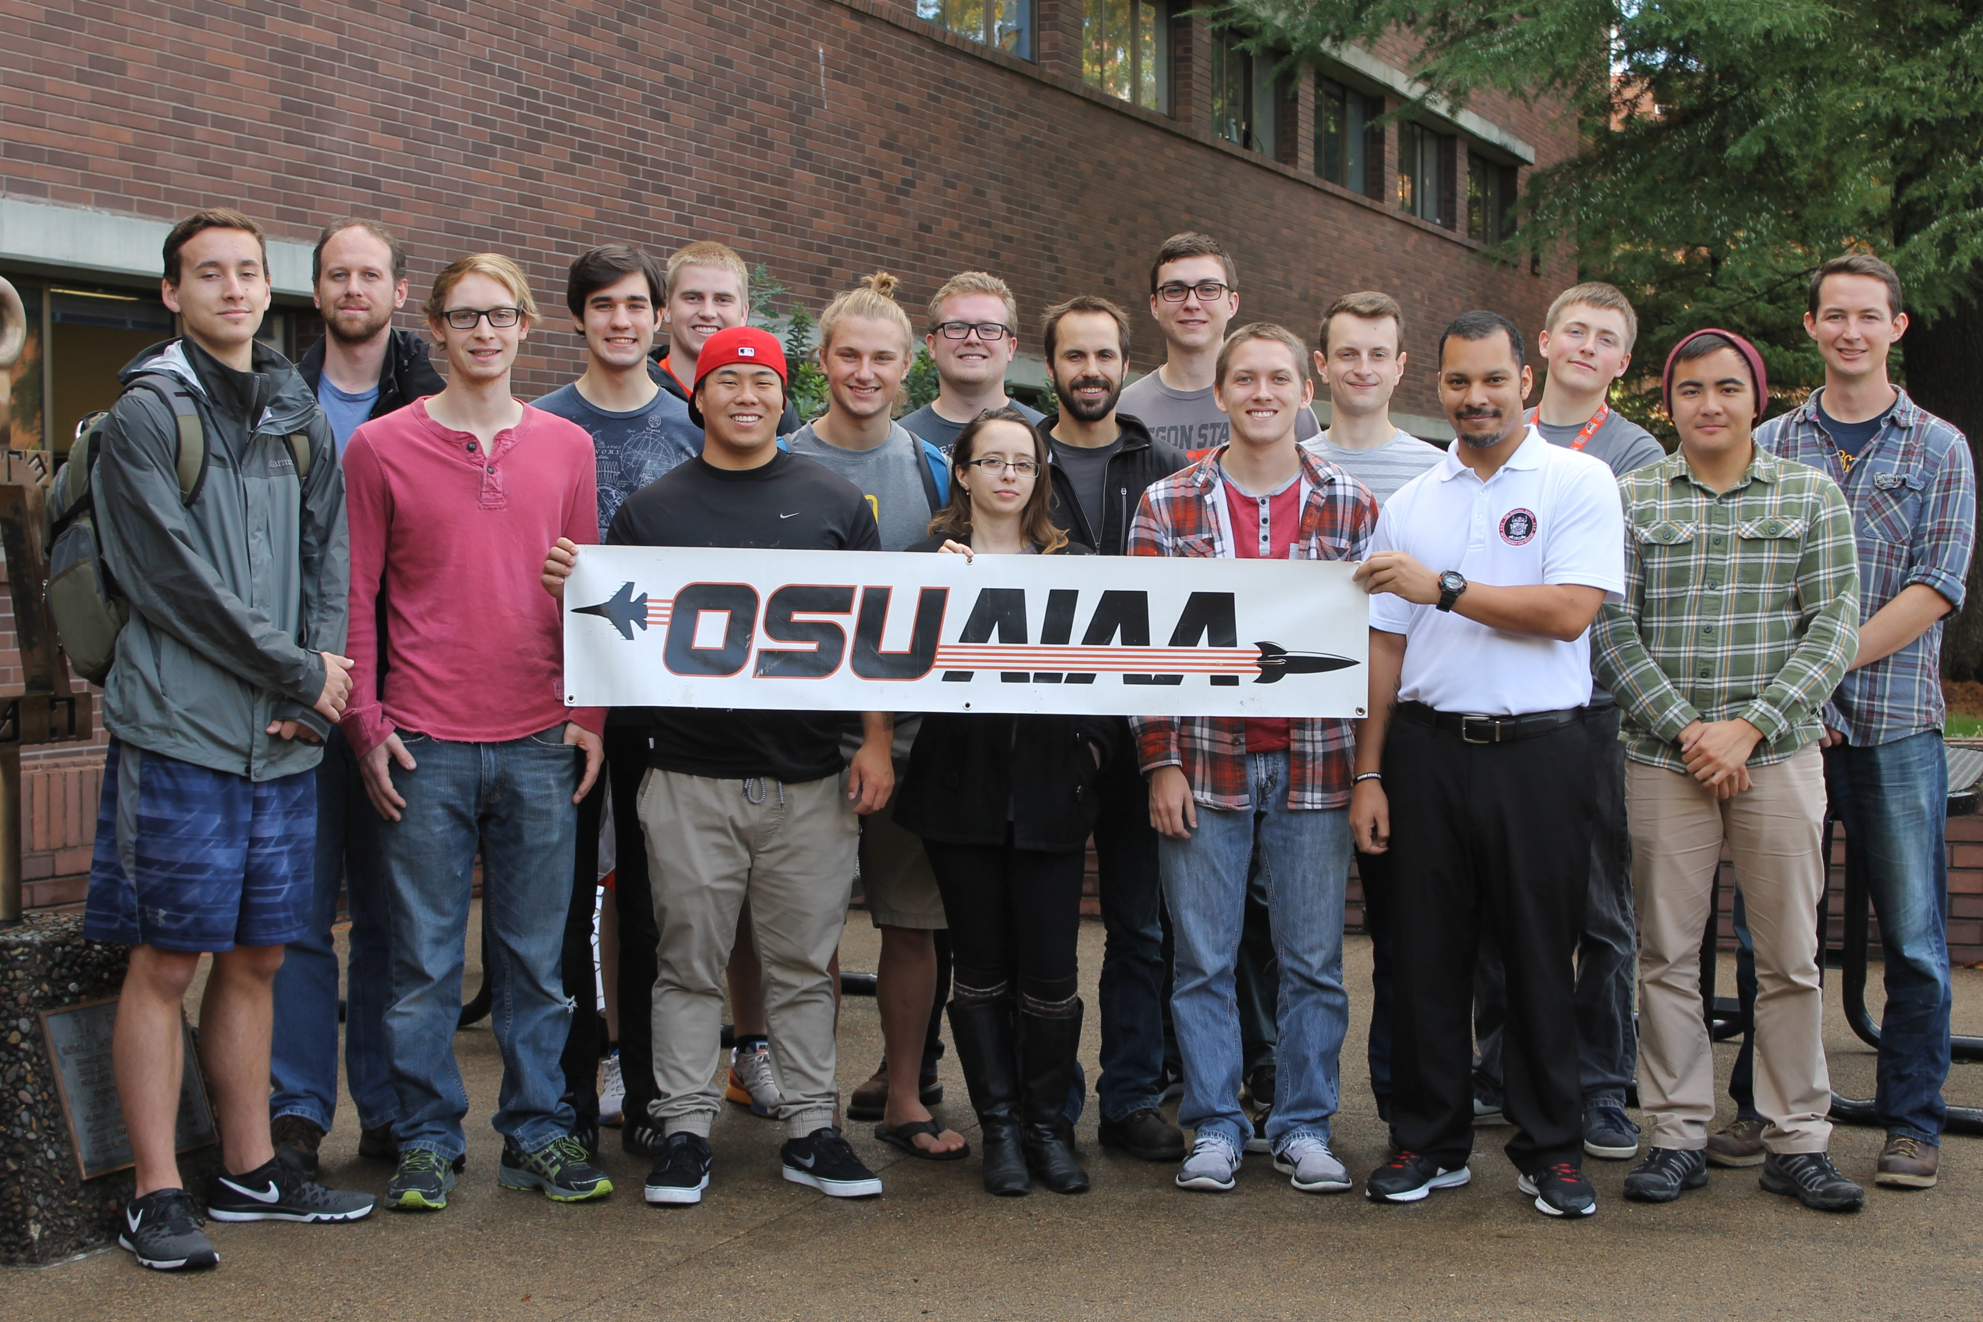
Fall Progress Report
Team #25
Natasha Anisimova, Terrance Lee, Albert Morgan

Slide 2
Week 1 - 3
Got assigned to the High-Altitude Rocketry Challenge!

Slide 3
Week 4

Slide 4
Week 5

Slide 5
Week 6

Slide 6
Week 7

Slide 7
Week 8

Slide 8
Week 9

Slide 9
Week 10

Slide 10
Thank you for listening!

