Slide 1
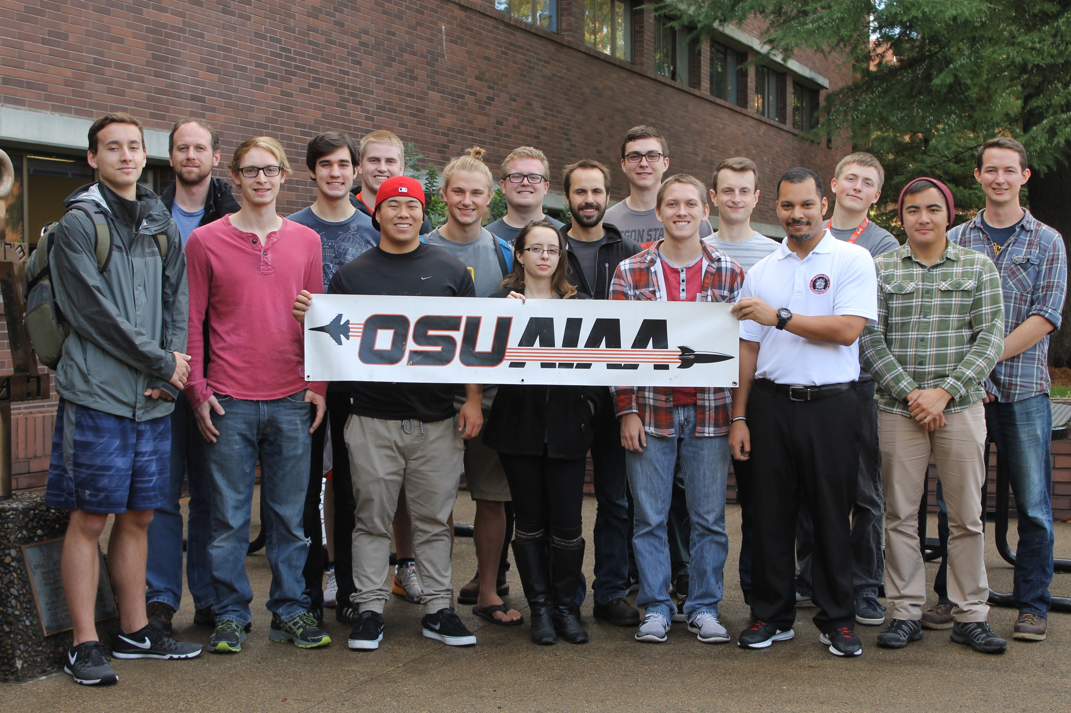
Fall Progress Report
Team #25
Natasha Anisimova, Terrance Lee, Albert Morgan

Slide 2
Introduction: The Problem
Got assigned to the High-Altitude Rocketry Challenge!
Project Purpose
Create software that will track the location of the rocket
Pretty much go over the problem statement

Slide 3
Project Goals
We can each talk about the goals of the project..
This will be pulling information from the Requirements Document

Slide 4
Problems
Any problems that we have run into
GPS signal (cutting out)
Enough Battery Power
No Wi-Fi connection

Slide 5
Proposed Solutions
Creating a local web page with local Wi-Fi
Cover kind of what we went over in the technical document

Slide 6
WebGL Demo
Include GIF of what is happening

Slide 7
Retrospective of the past 10 weeks
Each person can go over what they have thought of the past 10 weeks
Any highlights

Slide 8
Thank you for listening!

