Slide 1
DSN AI BOOTCAMP PRE QUALIFICATION PROJECT 2026
Mapping Pathways for Health, Environment, and Climate Change
Multi-Indicator Environmental Exposure Hotspot Analysis of Kano State using satellite observations from August 2026 with Google Earth Engine & QGIS: “Where heat and atmospheric pollution indicators overlap”
PARTICIPANT NAME
COMMUNITY ID
EMAIL ADDRESS
Geospatial Track
ABDULBASIT SULAYMAN
DSN/AIPlus/2025/45616
abdulbasitolokuta@gmail.com

Slide 2



1. Problem Statement
Environmental Stressors & Population Vulnerability in Kano State
Kano State experiences environmental conditions that can affect human wellbeing, including elevated land surface temperatures and exposure to atmospheric pollutants such as carbon monoxide (CO) and nitrogen dioxide (NO₂). However, these environmental indicators are not uniformly distributed across the state, making spatial mapping useful for identifying areas where multiple environmental stressors overlap.
Thermal Heat Stress
Atmospheric Pollutants
Compound Overlap Gap
Elevated Land Surface Temperature (LST) creates acute localized urban heat islands across Kano State.
Toxic trace gas concentrations including Carbon Monoxide (CO) and Nitrogen Dioxide (NO₂) impact air quality.
Indicators are non-uniformly distributed; isolated analysis misses compounding environmental exposure risks.

Slide 3

2. Project Objective
Core Research Question Guiding the Spatial Framework
"To identify and visualize areas of Kano State where elevated heat and atmospheric pollution indicators overlap, providing a spatial evidence base for environmental monitoring and health-related planning."
SPATIAL EVIDENCE BASE • MULTI-INDICATOR SCREENING • ENVIRONMENTAL DECISION SUPPORT

Slide 4
3. Data Sources
Multi-Sensor Satellite Remote Sensing & Open Data Portals
Dataset | Source Platform | Temporal Period | Analytical Purpose
Land Surface Temp (LST) | MODIS Terra & Aqua Daily | August 2026 | Thermal & Heat Environmental Stress
CO Column Density | Sentinel-5P / TROPOMI | August 2026 | Atmospheric Carbon Monoxide Pollution
NO₂ Column Density | Sentinel-5P / TROPOMI | August 2026 | Tropospheric Nitrogen Dioxide Pollution
Population Density | GRID3 Nigeria v3.0 | 2025 | Human Exposure & Population Context
Administrative Boundaries | FAO GAUL | 2025 | Kano State & LGA Reference Units

Slide 5
4. Methodology & Analytical Workflow
Sequential Workflow
End-to-End Google Earth Engine & QGIS Analytical Pipeline
STAGE 1
STAGE 2
STAGE 3
STAGE 4
Data Acquisition & Scope
GEE Preprocessing
Grid & Percentiles
Compound Index & Maps
2025 FAO GAUL boundary for Kano State.
Aug 2026 MODIS LST & Sentinel-5P (CO, NO₂) imagery in GEE.
Average Terra/Aqua daily LST and convert K to °C. Then generate spatial mean column density rasters for NO₂ & CO.
Export rasters to QGIS on a 1-km grid (20,802 cells)
Classify values ≥75th percentile as elevated binary (1 vs 0).
Sum binary layers into 0–3 Compound Score
Overlay GRID3 population & finalize cartographic layouts.
PRIMARY PLATFORMS:
Google Earth Engine
QGIS 3.x
STATISTICAL RULE:
≥75th Percentile = Elevated Stressor

Slide 6
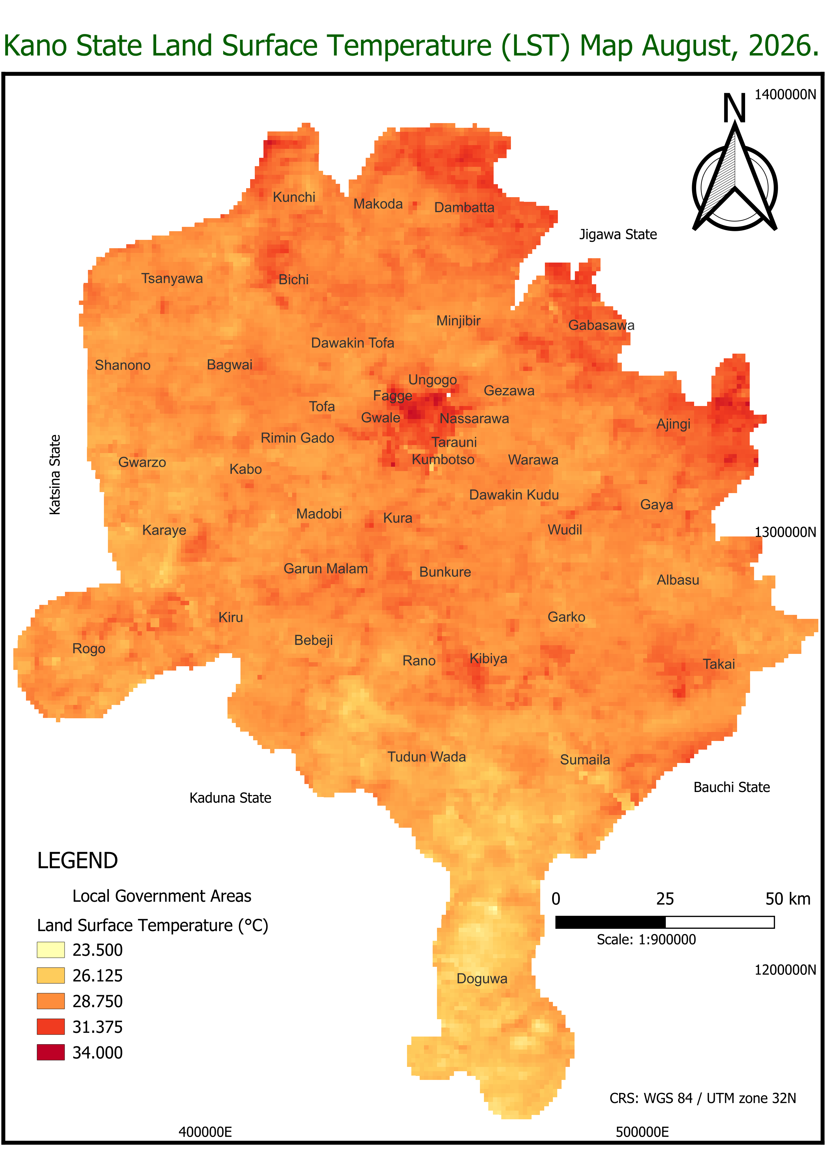
5. Storytelling & Maps: Land Surface Temp (LST)
MODIS Terra & Aqua Daily Observations (August 2026)
Thermal Variability & Heat Stress
LST shows widespread spatial variation across Kano State, with elevated thermal patches occurring in built-up urban centers and sparsely vegetated rural zones.
Cartographic Insight & Storytelling Caption
Thermal Footprint: August daytime temperatures reflect distinct microclimates, where dense built structures trap surface heat compared to irrigated agrarian belts.
Indicator Map 1 of 5

Slide 7
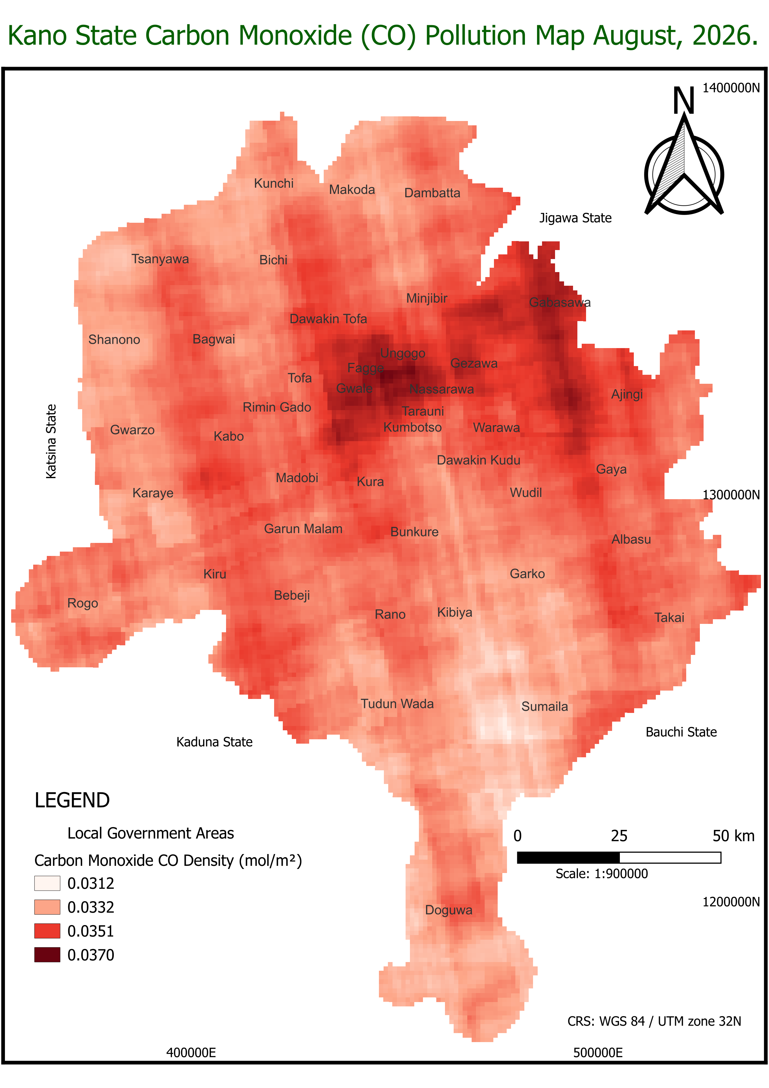
... Storytelling & Maps: Carbon Monoxide (CO)
Sentinel-5P / TROPOMI Satellite Observations (August 2026)
Broad Atmospheric Dispersion
CO displays broader, continuous geographic areas of elevated values. Notable spatial concentrations span central Kano and extend along major transportation corridors.
Cartographic Insight & Storytelling Caption
Atmospheric Residence: Longer atmospheric lifespan causes carbon monoxide to spread regional pollution plumes across central and neighboring local government areas.
Indicator Map 2 of 5

Slide 8
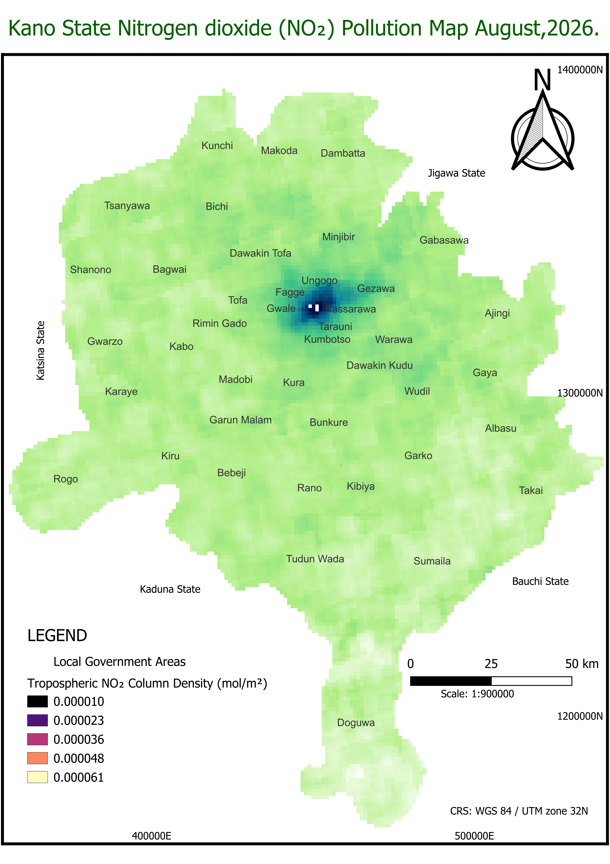
... Storytelling & Maps: Nitrogen Dioxide (NO₂)
Sentinel-5P / TROPOMI Tropospheric Column Density (August 2026)
Localized Urban Hotspot Pattern
Unlike LST or CO, tropospheric NO₂ displays a strictly localized hotspot centered over highly urbanized metropolitan Kano (Fagge, Dala, Gwale, Nassarawa, Tarauni).
Cartographic Insight & Storytelling Caption
Anthropogenic Driver: Sharp spatial concentration gradient directly reflects intense vehicular combustion, industrial emissions, and commercial activity in the urban core.
Indicator Map 3 of 5

Slide 9
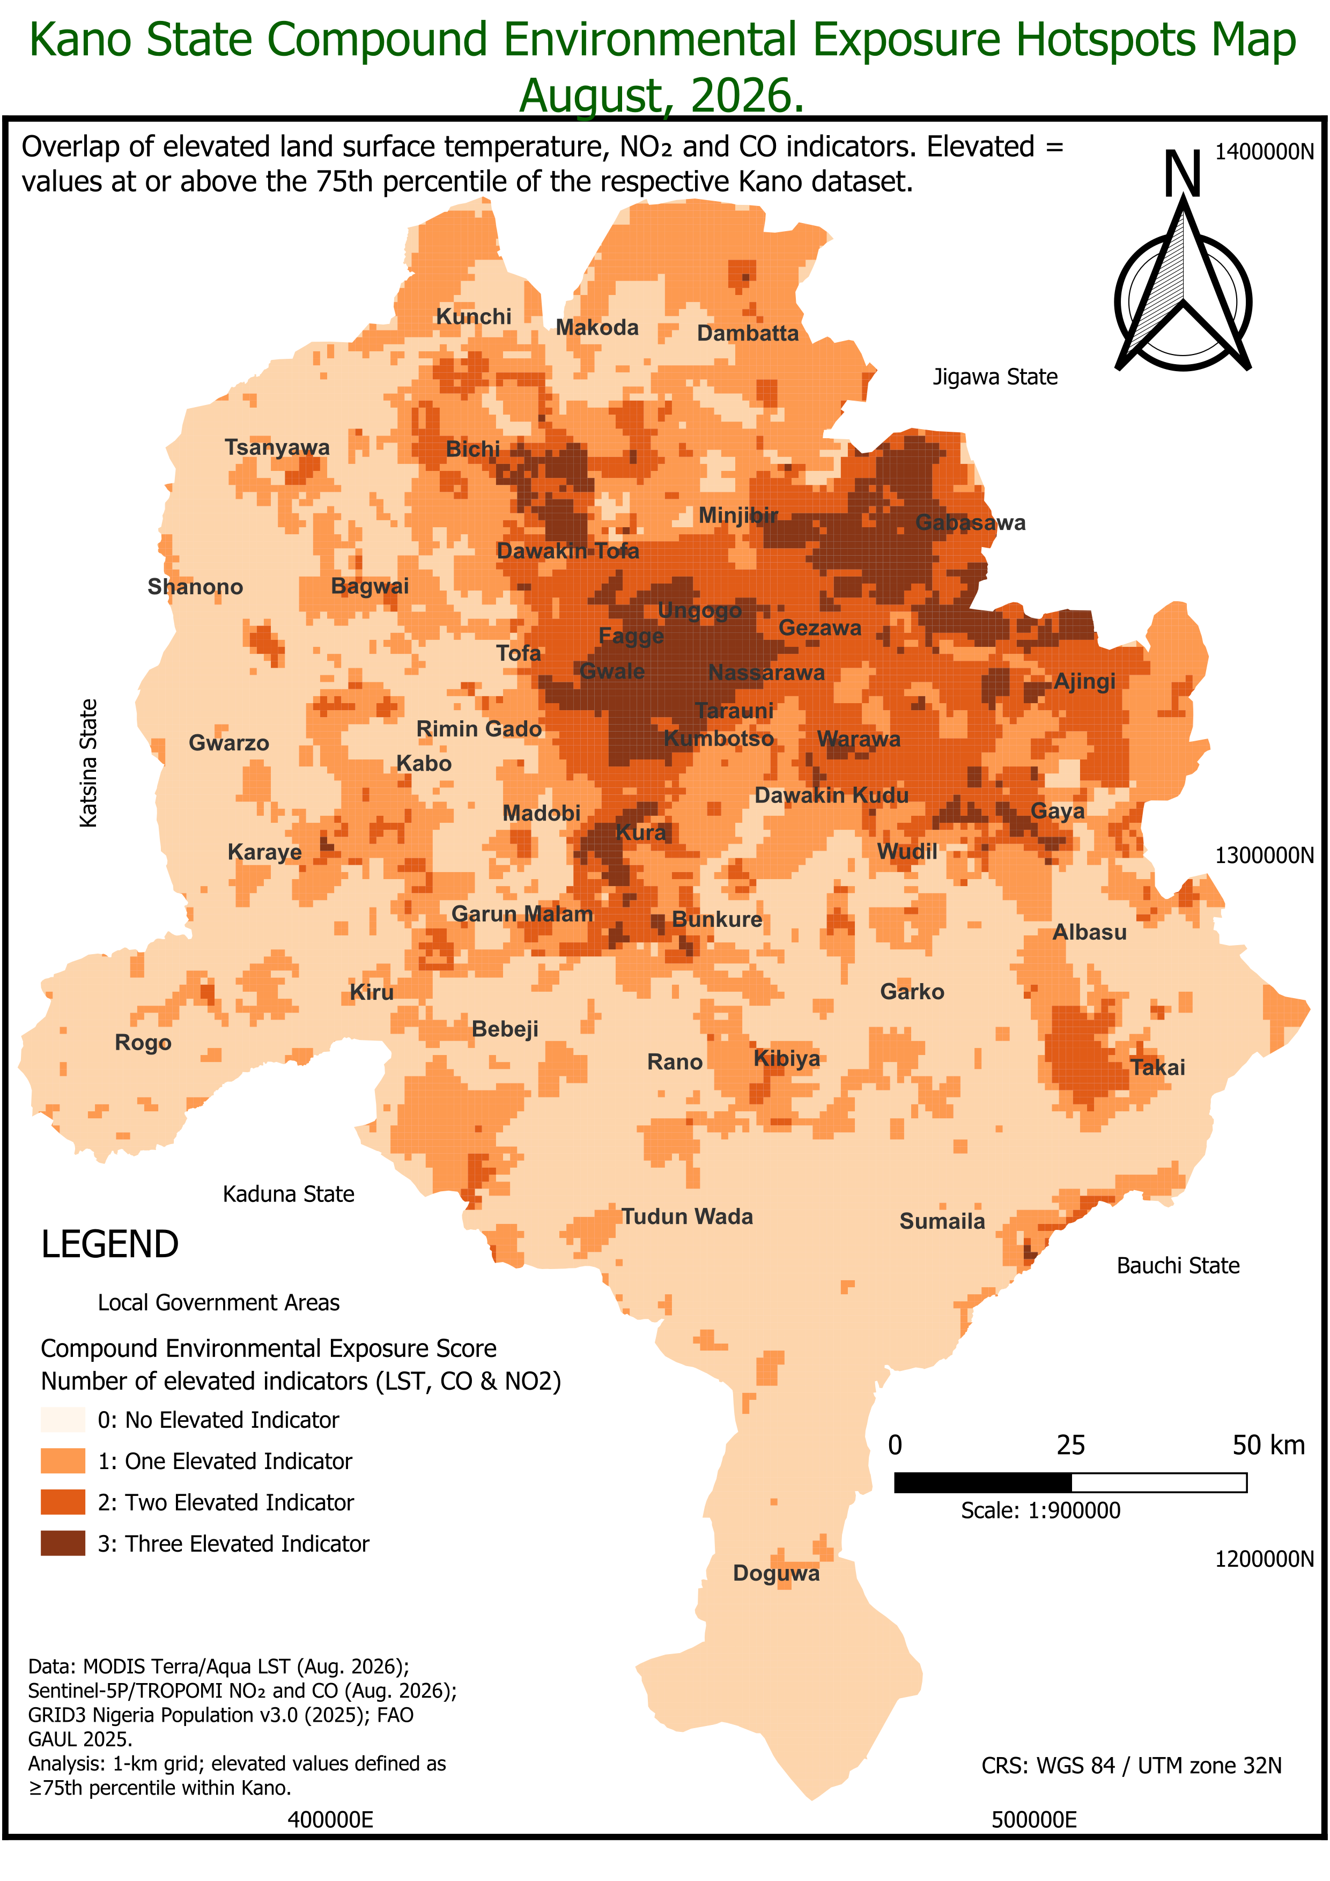
... Storytelling & Maps: Compound Exposure Score
Multi-Indicator Overlap Score (0 to 3 Elevated Stressors)
Compound Score | Grid Cells | Share
0 — No Elevated Indicator | 10,843 | 52.1%
1 — One Elevated Indicator | 5,776 | 27.8%
2 — Two Elevated Indicators | 2,912 | 14.0%
3 — Three Elevated Indicators | 1,271 | 6.1%
Key Finding: 47.9% of analyzed grid cells experience at least one elevated stressor, while 20.1% (4,183 km²) suffer compounding dual or triple environmental exposure.
Compound Map 4 of 5

Slide 10
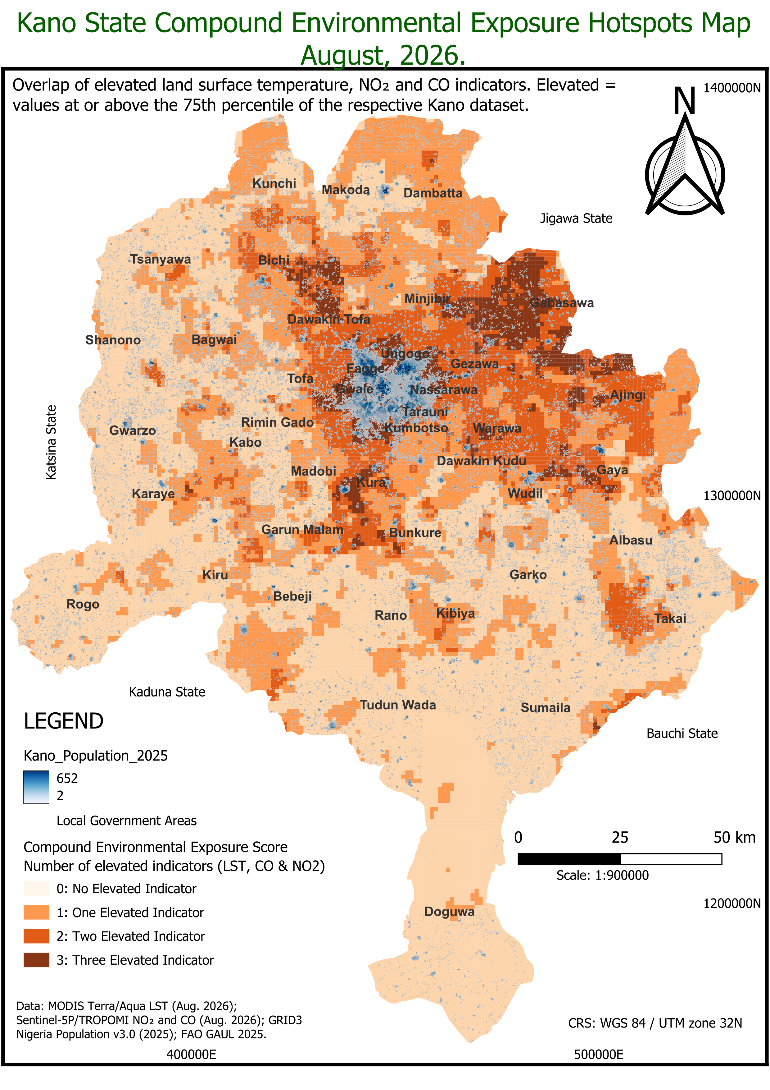
... Storytelling & Maps: Hotspots & Population
GRID3 Nigeria Population v3.0 (2025) Integration
Human Exposure Intersection
Integrating GRID3 population grid reveals that high compound exposure scores (2–3) directly coincide with the highest population densities in central Kano LGAs.
Actionable Intelligence
Priority Intervention: Densely populated urban centers face disproportionate burden, guiding targeted public health resource allocation and urban greening.
Population Map 5 of 5

Slide 11
... Storytelling & Strategic Takeaways
Synthesizing Spatial Overlap Analysis into Technical & Policy Guidance
Strategic Action Point
Methodological Note
These locations warrant attention for further environmental and health assessment because multiple environmental exposure indicators are simultaneously elevated.
The compound score represents spatial overlap of satellite indicators — not a direct medical risk index. Ground monitoring is recommended for clinical validation.

Slide 12


Thank You
Spatial Evidence Base for Environmental & Public Health Decision-Making
Community ID: DSN/AIPlus/2025/45616
•
•
Track: Geospatial Track

