Slide 1
Personalized Recommendation Systems for Content Discovery
TECHNICAL PRESENTATION
Predicting taste from 100 million ratings — the Netflix Prize dataset
100.5M
ratings learned
0.9093
best RMSE (beats Cinematch)
17,770
movies ranked
7
models compared
Collaborative Filtering | Matrix Factorization | SVD++ | BPR | Stacked Ensemble | Hybrid Ranker

Slide 2
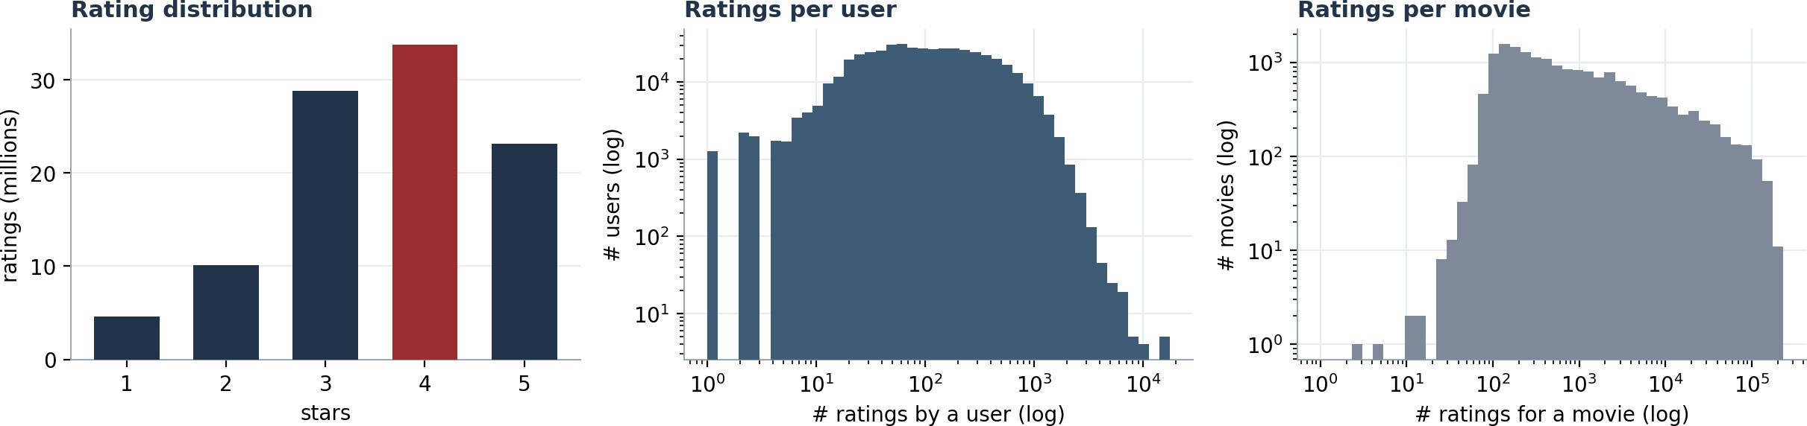
The Challenge: 100M Ratings, 99% Empty
01 · PROBLEM & DATA
The Netflix Prize asks us to learn user taste from historical ratings, predict scores for unseen films, and build personalized Top-10 lists. The data is vast and overwhelmingly sparse — which shapes every modelling choice that follows.
100.5M
ratings
480,189
users
17,770
movies
1.18%
density (98.8% empty)
Figure — ratings skew positive (4 stars is the mode) and both user activity and movie popularity follow steep long tails. Sparsity, skew and the long tail drive the entire design.

Slide 3
A Ladder of Five Models
02 · APPROACH
Rather than bet on one algorithm, we built a progression where each rung adds one idea — and a measurable gain.
1 Bias baseline | Global mean + learned user/movie biases. Cheap, strong, and our cold-start fallback.
2 Funk SVD | SGD matrix factorization on observed ratings only — the technique that defined the Prize era.
3 SVD++ | Adds implicit feedback (which films were rated at all). A pillar of the winning solution.
4 BPR | Bayesian Personalized Ranking — optimizes item ordering directly; the right objective for Top-10.
5 Ensemble & Hybrid | Linear stacking for accuracy; a BPR×SVD++ rank-blend for ranking. Blending = the winners' lesson.
The decisive upgrade
Switching from a zero-imputed SVD to SGD-based Funk SVD — which learns only from ratings that actually exist — was the single largest accuracy gain of the project. numba JIT makes a full epoch over 99M ratings run in under a minute.

Slide 4
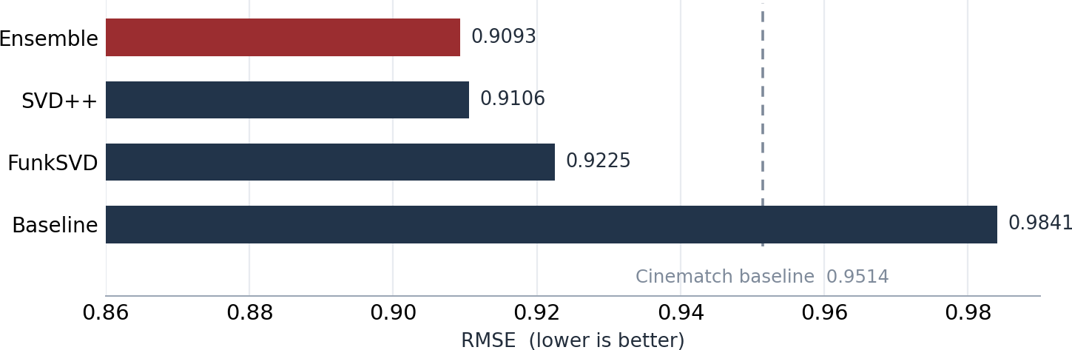
We Beat the System Netflix Shipped
03 · RESULTS — ACCURACY
0.9093
Ensemble RMSE — our best model
vs. Cinematch 0.9514 (Netflix's own 2006 system)
SGD factorization trains on observed ratings only — no zero-imputation bias.
Linear stacking is guaranteed to match or beat its best single component.
The 0.8567 grand prize took hundreds of blended models over two years.

Slide 5
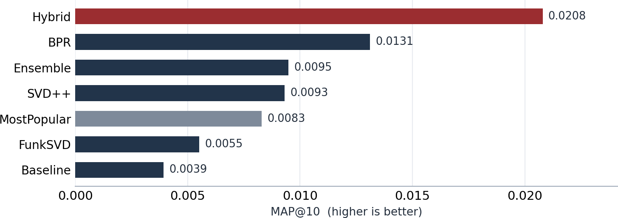
Ranking: Personalization Wins
04 · RESULTS — RANKING
+59%
Hybrid's MAP@10 lift over BPR
BPR and the Hybrid optimize ordering, not star ratings.
Both clearly beat the MostPopular baseline — personalization earns its keep.
Rating-accuracy models rank only by accident; the loss must match the goal.

Slide 6
Every Model, Side by Side
05 · THE SCOREBOARD
Model | RMSE | MAE | MAP@10 | Prec@10 | Recall@10 | NDCG@10 | HitRate@10 | Coverage
MostPopular | — | — | 0.0083 | 0.0041 | 0.0224 | 0.0133 | 0.0393 | 0.0102
Baseline | 0.9841 | 0.7744 | 0.0039 | 0.0018 | 0.0098 | 0.0059 | 0.0170 | 0.0351
FunkSVD | 0.9225 | 0.7153 | 0.0055 | 0.0034 | 0.0172 | 0.0099 | 0.0317 | 0.0998
SVD++ | 0.9106 | 0.7033 | 0.0093 | 0.0052 | 0.0257 | 0.0156 | 0.0487 | 0.1718
Ensemble | 0.9093 | 0.7018 | 0.0095 | 0.0049 | 0.0242 | 0.0154 | 0.0457 | 0.1246
BPR | — | — | 0.0131 | 0.0067 | 0.0355 | 0.0214 | 0.0637 | 0.0627
Hybrid | — | — | 0.0208 | 0.0113 | 0.0591 | 0.0349 | 0.1063 | 0.0790
The headline insight — accuracy is not ranking
The best rating model (Ensemble) and the best recommender (Hybrid) are different models. We serve the ensemble for prediction and the hybrid for discovery. Evaluation: probe set held out, split into a 25% blend slice (weights only) and a leakage-free 75% slice for all reported numbers; relevance = true rating of 3.5 or higher.

Slide 7
Does It Actually Work?
06 · RECOMMENDATIONS
No genre labels are used — taste is inferred purely from behaviour.
USER 963054 — an action fan
Loved: Batman Begins (5)
Pirates of the Caribbean (4)
Indiana Jones: Last Crusade (4)
→ Lost: Season 1 (like Batman 0.51)
→ Battlestar Galactica (0.50)
→ LOTR: Return of the King
'Miss Congeniality' → also liked
Two Weeks Notice (0.83)
The Wedding Planner (0.82)
The Princess Diaries (0.82)
Sweet Home Alabama (0.81)
Legally Blonde (0.79)
Runaway Bride (0.77)
New user (cold-start fallback)
LOTR: The Return of the King
LOTR: The Fellowship of the Ring
The Shawshank Redemption
Star Wars V: Empire Strikes Back
The Simpsons: Season 6
The Sopranos: Season 5
Genre emerges from behaviour
The model groups Batman, Pirates and Indiana Jones into a coherent action-adventure taste, and returns a clean rom-com cluster around Miss Congeniality — all without ever seeing a genre tag.

Slide 8
What We Learned
07 · KEY INSIGHTS
Sparsity dictates the architecture
At 1.18% density, latent-factor models that generalize from the observed 1% are a necessity, not a choice.
Train on what you can see
Replacing zero-imputed SVD with SGD over observed ratings was the highest-leverage change in the study.
To rank well, optimize ranking
Pairwise and hybrid rankers beat every rating-optimized model on MAP@10 — the loss must match the objective.
Blend diverse models
Leakage-free linear stacking beats any single rating model — the core lesson of the Prize-winning entry.
The bottom line
On the full 100-million-rating dataset we surpassed Netflix's own Cinematch on accuracy and decisively beat a popularity baseline on ranking — and, just as importantly, we can explain why. One reproducible notebook regenerates every figure and metric from a single scale switch.

