Slide 1





Air Quality Index Prediction In Guwahati
Guided by- Gunajit Kalita
Co-guide- Prasenjit Saha
By- Randwip Ghosh(17/049)
Sangramjit Dutta (17/314)
Aicheng Jaohai(17/376)

Slide 2
Introduction
Examining and protecting air quality has become one of the most essential activities for the government in many industrial and urban areas today. The meteorological and traffic factors, burning of fossil fuels and industrial parameters play significant roles in air pollution. With this increasing air pollution, We are in need of implementing models which will record information about concentrations of air pollutants (so2,no2,etc) .
An air quality index (AQI) can be defined as a communication tool and a standardized summary measure of ambient air quality used to express the level of health risk related to particulate and gaseous air pollution .
1

Slide 3
Flow of Work Approach
Gathering data
Cleaning and dealing with missing data
Training the data with different ML algorithms
Error comparison
Choosing best model
Prediction
1

Slide 4
Choosing Appropriate Algorithm
The different algorithms that were tested are:
Linear regression
Random forest
Decision tree
Support vector machine
1

Slide 5
Methodology
Decision tree has been used
A decision tree classifies data items by posing a series of questions about the features associated with the items. Each question is contained in a node, and every internal node points to one child node for each possible answer to its question. The questions thereby form a hierarchy, encoded as a tree. In the simplest form we ask yes-or-no questions, and each internal node has a ‘yes’ child and a ‘no’ child. An item is sorted into a class by following the path from the topmost node, the root, to a node without children, a leaf, according to the answers that apply to the item under consideration. An item is assigned to the class that has been associated with the leaf it reaches.
1

Slide 6
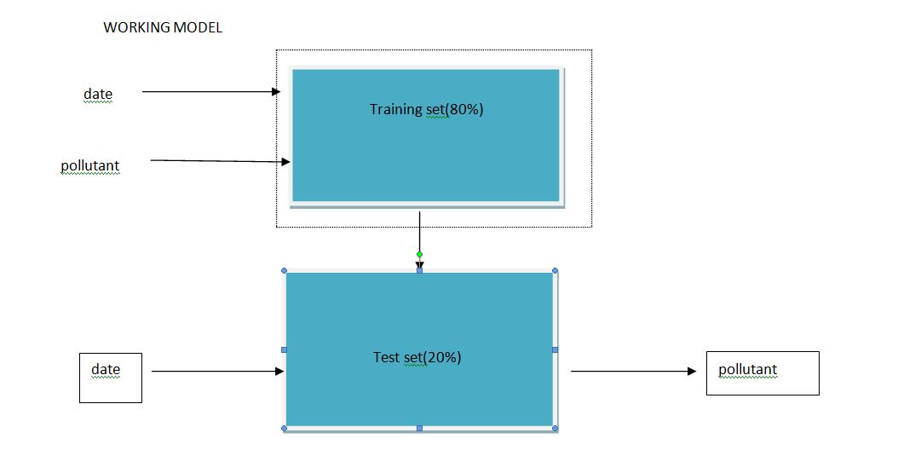
Working model
80% of data has been taken as training set and rest 20% as test set
1

Slide 7
Result analysis
Two types of graph has been plotted
1. The AQI value of a single pollutant for all locations in one graph
2. The AQI value of all the pollutants in one location
Comparison has been done between actual and predicted value
1

Slide 8
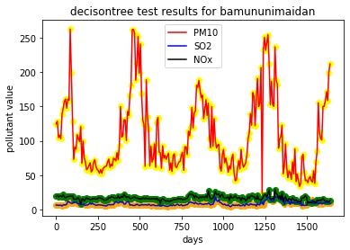
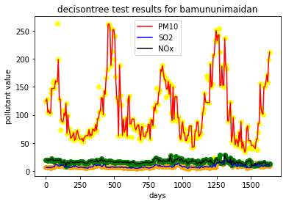
Variation of the AQI parameters at: Bamunimaidam
1

Slide 9
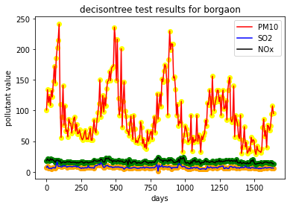
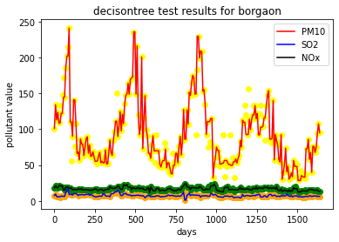
Bargaon
1

Slide 10
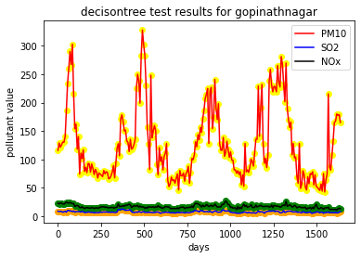
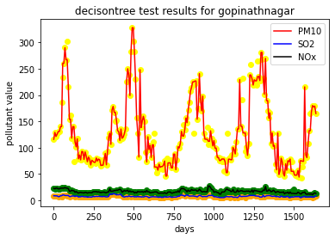
Gopinathnagar
1

Slide 11
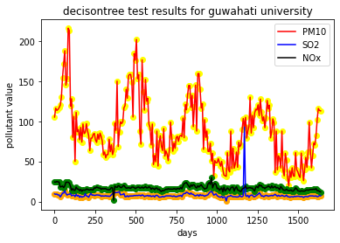
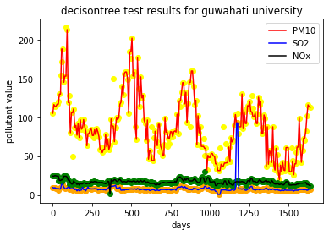
Guwahati University
1

Slide 12
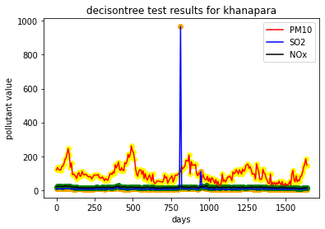
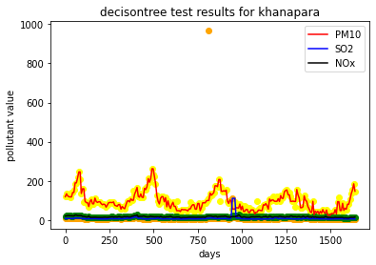
Khanapara
1

Slide 13
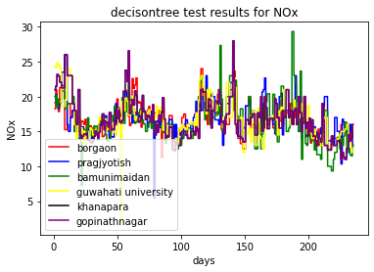
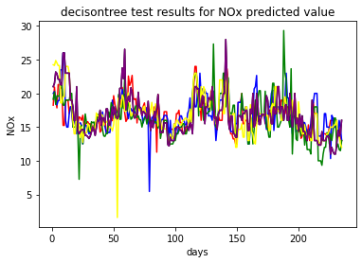
Comparison of values actual vs. predicted of Guwahati
1

Slide 14
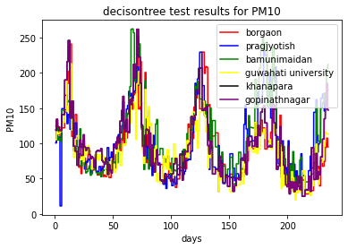
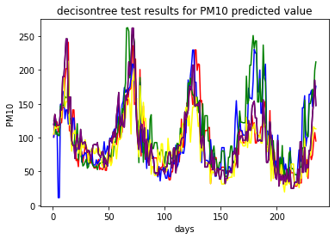
1

Slide 15
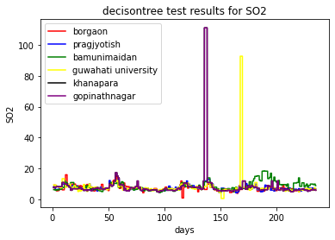
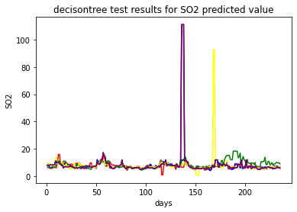
1

Slide 16
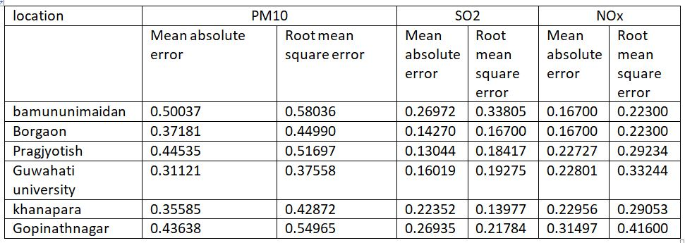
Accuracy Analysis
The mean absolute error and root mean square error were found
1

Slide 17
Conclusion
From the results obtained we can see that out of all the considered algorithms, the Decision Tree algorithm gives the highest accuracy, hence is most precise in predicting the AQI values of different locations of Guwahati.
SO2 & Nox varies almost in the same manner,while PM10 varies a bit randomly.
From the comparison of actual and predicted values ,we can see that the predicted values of SO2,Nox & PM10 almost varies linearly w.r.t the actual values.
<number>

Slide 18
references
1. Title: Air Quality Prediction using Machine Learning Algorithms
International Journal of Computer Applications Technology and Research Volume 8–Issue 09, 367-370, 2019, ISSN:-2319–8656 Pooja Bhalgat , Sejal Pitale , Sachin Bhoite
2. WHO (2009) Global health risks: mortality and burden of diseases attributable to selected major risks. World Health Organization, Geneva, Available online at http://www.who.int/healthinfo/global_burden_ disease/GlobalHealthRisks_report_full.pdf
3. NIH Public Access Author Manuscript
Nat Biotechnol. Author manuscript; available in PMC 2009 June 24 Published in final edited form as:
Nat Biotechnol. 2008 September ; 26(9): 1011–1013. doi:10.1038/nbt0908-1011.
<number>

Slide 19
THANK YOU
<number>

