Slide 1
Category review: Chips
November 2020
Retail Analytics
Brand note: If client logo is not required, use alternate title page layout right click slide thumbnail > Layout > Title

Slide 2
Notes:
To view Privacy video explaining how important data privacy is to Quantium, please click here: https://www.youtube.com/watch?v=Zq1QDAkoRzU
or here Q:\Company Reference\Brand & Design\Brand videos\Q Privacy.mp4
At Quantium, we believe that data is the behavioural footprint of humanity and that it has to be treated with the utmost care and responsibility.
Histories, attitudes, indeed lives are stored within it in ways that aren’t always apparent – and that’s what makes its potential so powerful.
To work with it responsibly, sensitively, we set ourselves the highest data privacy protection and governance standards.
We have spent 17 years perfecting privacy-by-design and secure-by-design principles. Central to this is not holding any personally identifiable information about people –
we neither receive it, and put the necessary protections in place to be unable to decipher it.
Every aspect of handling data is safeguarded: from its de-identification, to its encryption – data security is paramount and of the highest grade.
We pride ourselves on gaining the trust of iconic organisations around the world through years of securely working with their data,
and in turn the trust that builds with their stakeholders.

Slide 3
Executive summary
01
Task 1
Customer Analytics
The sales of chips increased substantially prior to Christmas. But there is no transaction on Christmas Day.
Mainstream Retirees and older singles/couples are the most common customers and also contribute 25% of sales revenue.
Kettle is the most popular brand followed by Doritos and Smiths.
Consumers seems to buy more chips which ranges from $4.0 to $5.5.
The store must focus on Mainstream and budget consumers.
02
Task 2
Trial Store Analysis
Store 77, 86 and 88 were considered as trial store. We found out 233, 237 and 155 as control stores respectively.
There was rise in sales for all the trial stores during trial period.
The results for trial stores 77 and 88 during the trial period show a significant difference in at least two of the three trial months but this is not the case for trial store 86.
The trial store 88 also saw a increase in sales in trial period but insignificant to it’s control store.

Slide 4
01
Customer Analytics

Slide 5
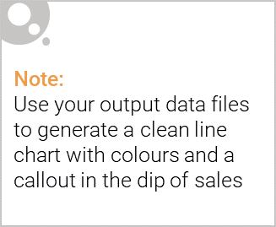
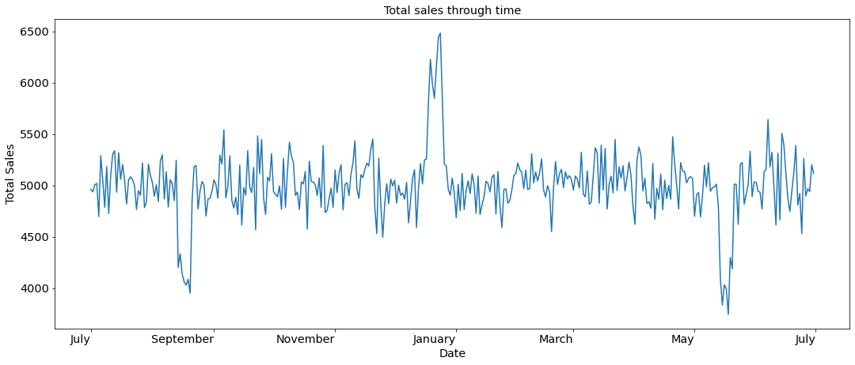
There is hike in sales of chips in December.

Slide 6

Commentary on affluence and its effect on consumer buying for the category of chips
Mainstream Retirees and Mainstream older singles/couples are the most common customers and also contribute 25% of
sales revenue.
Kettle is the most popular brand followed by Doritos and Smiths. They must be in stock everytime. Also make sure to have
175grams packets, as they are the most sold. Try to have even number of packets, since consumers love to buy 2 packets at
once.
Consumers buy chips which ranges from $4.0 to $5.5. Make sure to have them in surplus quantity.
The store must focus on Mainstream/Budget consumers rather than Premium consumers.

Slide 7
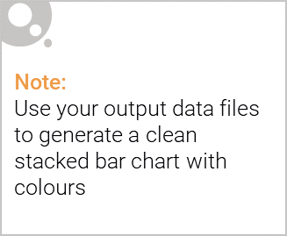
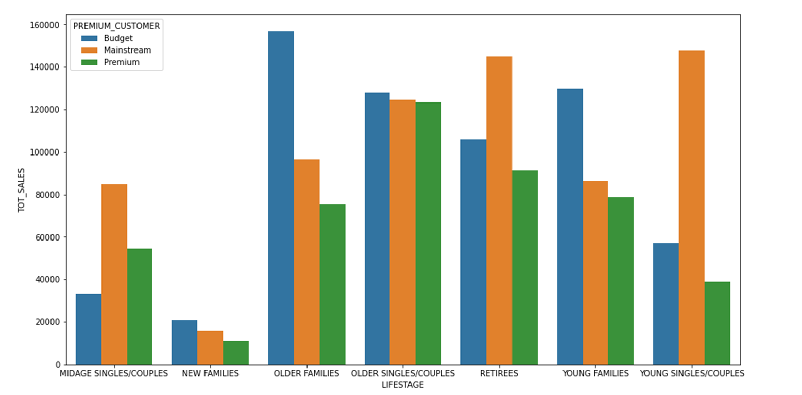
Editable (delete this)
Proportion of customers by affluence and life stage.
Mainstream Retirees and Young Singles/Couples outlast other customers in the store.

Slide 8
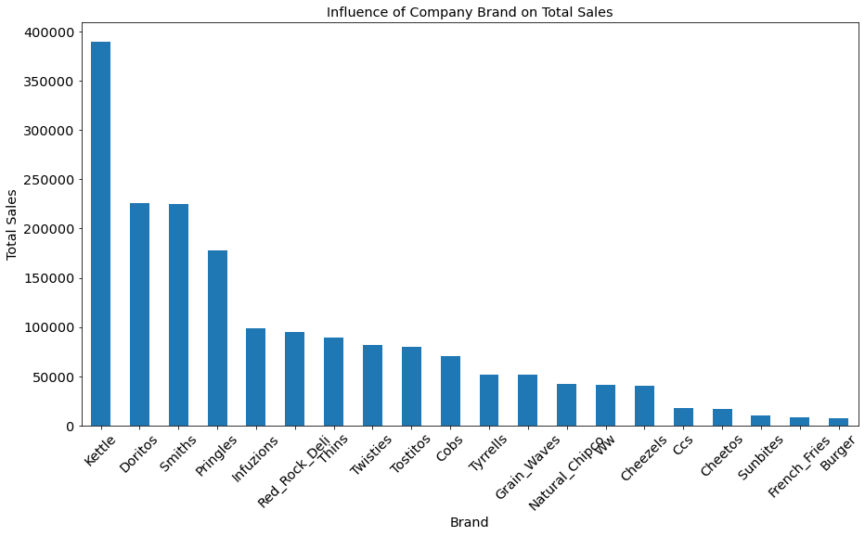
Editable (delete this)
Influence of product brand on sales

Slide 9
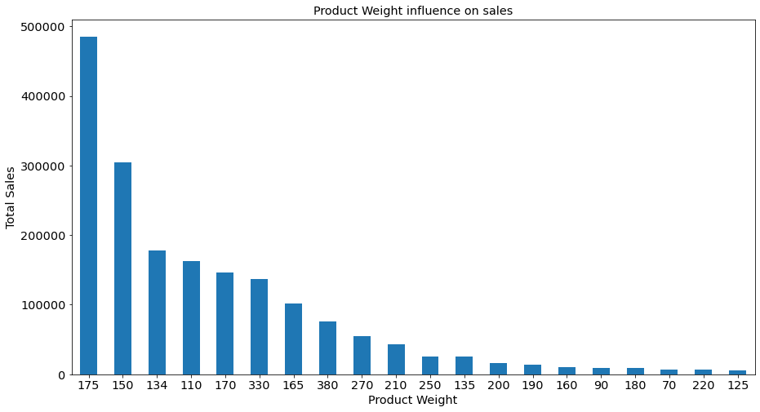
Editable (delete this)
Influence of product weight on sales

Slide 10
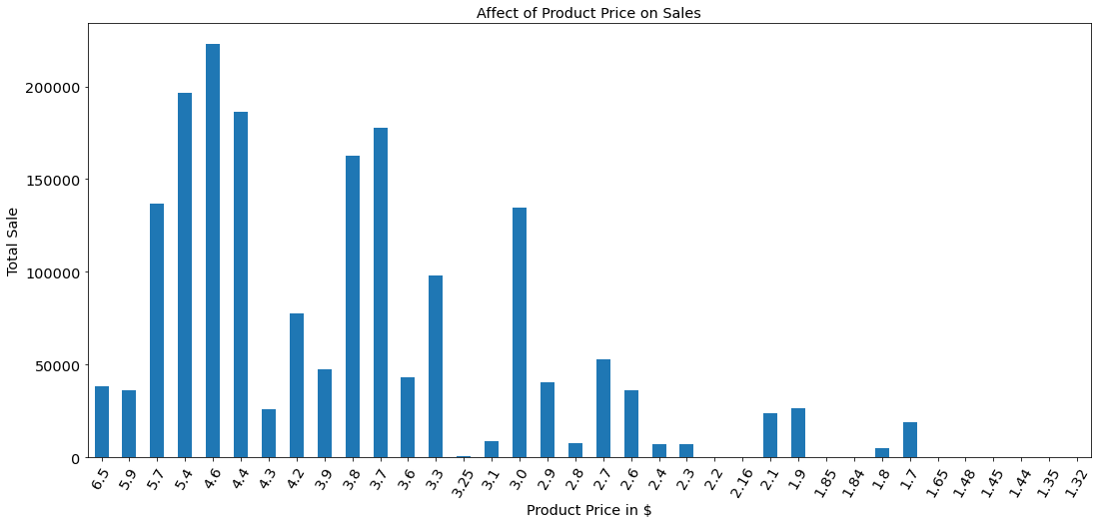
Editable (delete this)
Influence of product price on sales

Slide 11
02
Trial Store Performance

Slide 12
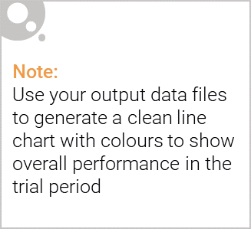
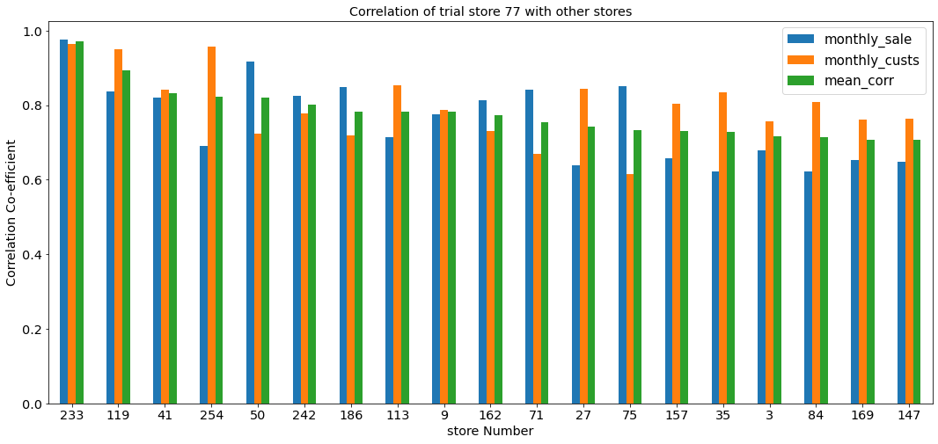
Correlation of trial store 77 with other stores

Slide 13
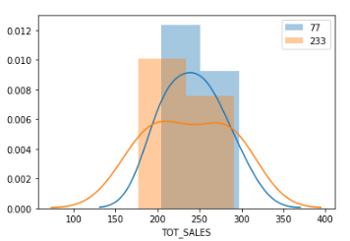
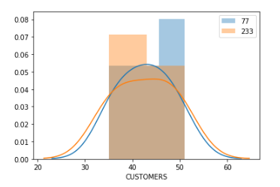
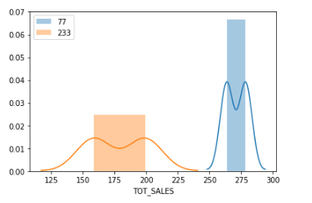
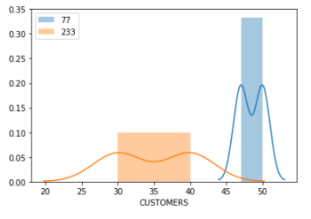
Trial store 77 vs Store 233
Distributions of total sales and customers in pretrial period
Means don’t vary and there is no significant difference between stores.
Distributions of total sales and customers in pretrial period
Means vary and there is a significant difference.

Slide 14
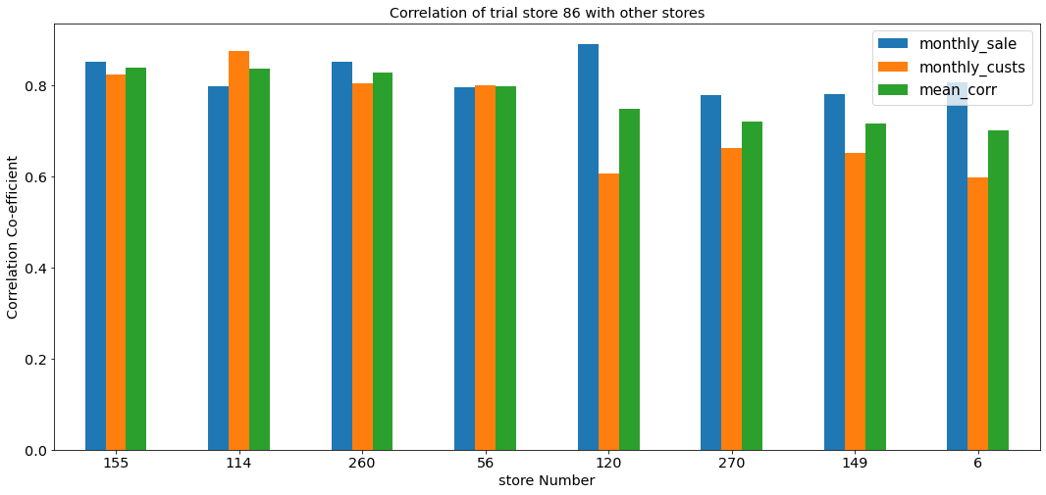
Correlation of trial store 86 with other stores

Slide 15
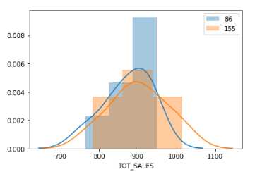
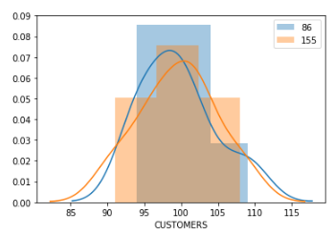
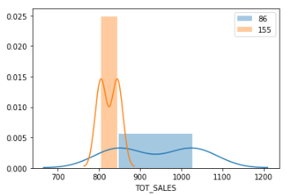
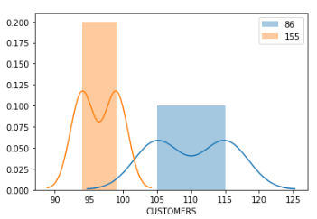
Trial store 86 vs Store 155
Distributions of total sales and customers in pretrial period
Means don’t vary and there is no significant difference
Distributions of total sales and customers in pretrial period
Means vary and there is a significant difference

Slide 16
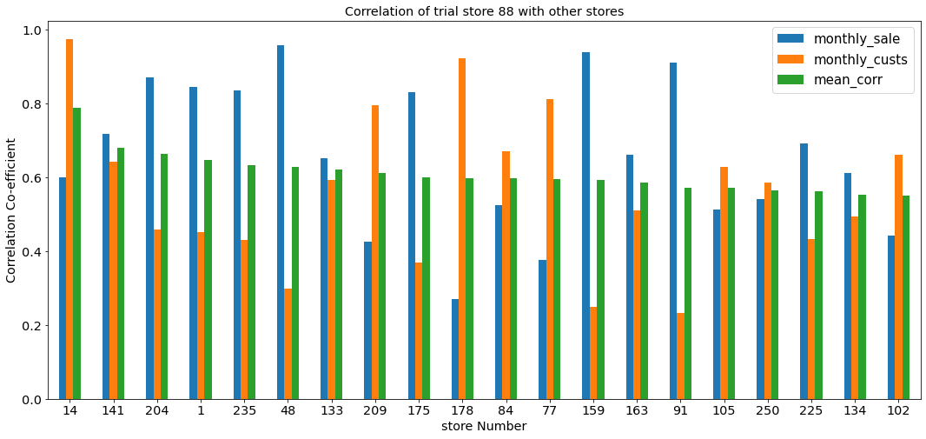
Correlation of trial store 88 with other stores

Slide 17
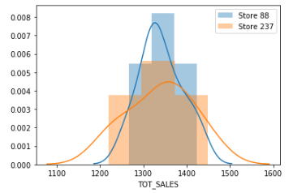
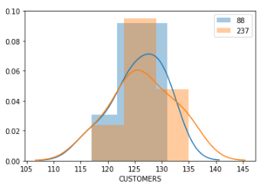
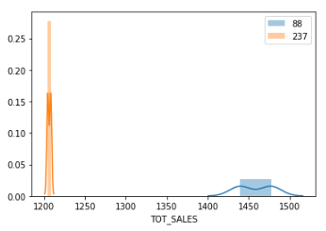
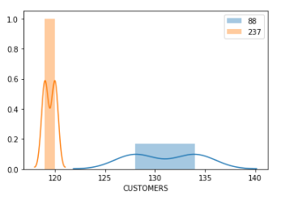
Trial store 88 vs Store 237
Distributions of total sales and customers in pretrial period
Means don’t vary and there is no significant difference
Distributions of total sales and customers in pretrial period
Means vary and there is a significant difference

Slide 18
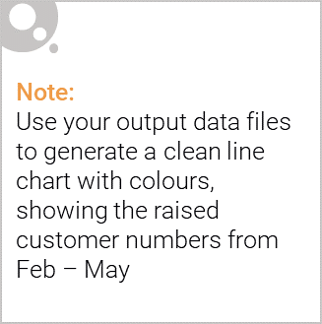
Trial Store Performance
From the above graphs we can see that every trial store out-performed its individual control store. There was hike in sales for every
trial store in the trial period. We can say that the trial stores were successful in rising the sales.

