Slide 1

Customer Shopping Behavior Analysis
Uncovering insights from transactional data to guide strategic decisions.

Slide 2
Project Overview
Data Analysis
Key Insights
Strategic Guidance
Analyzed 3,900 purchases across categories.
Spending patterns, segments, product preferences, subscriptions.
Informing business decisions with data-driven insights.

Slide 3

Dataset Summary
Key Features include customer demographics, purchase details, and shopping behavior. Missing data in Review Rating column (37 values).
Rows
3,900
Columns
18

Slide 4
Exploratory Data Analysis (Python)
01
02
Data Loading & Exploration
Missing Data Handling
Pandas for import, df.info() and .describe() for summary.
Imputed Review Rating with median by category.
03
04
Column Standardization
Feature Engineering
Renamed columns to snake_case for readability.
Created age_group and purchase_frequency_days.
05
06
Data Consistency
Database Integration
Dropped redundant promo_code_used column.
Loaded cleaned data to PostgreSQL for SQL analysis.

Slide 5

Data Analysis (SQL)
Revenue by Gender
Shipping Type Comparison
Female: $75,191
Standard: $58.46
Male: $157,890
Express: $60.48
Top 5 Products by Rating
Subscribers vs. Non-Subscribers
Gloves: 3.86
Subscribers: 1,053 customers, Avg Spend $59.49, Total Revenue $62,645
Sandals: 3.84
Non-Subscribers: 2,847 customers, Avg Spend $59.87, Total Revenue $170,436
Boots: 3.82
Hat: 3.80
Skirt: 3.78

Slide 6
SQL Insights: Customer Behavior
1
2
High-Spending Discount Users
Discount-Dependent Products
839 customers spent above average with discounts.
Hat (50%), Sneakers (49.66%), Coat (49.07%), Sweater (48.17%), Pants (47.37%).
3
4
Customer Segmentation
Repeat Buyers & Subscriptions
Loyal (3116), Returning (701), New (83).
958 repeat buyers are subscribers, 2518 are not.

Slide 7

SQL Insights: Product & Revenue
Top 3 Products per Category
Revenue by Age Group
Young Adult: $62,143
Accessories: Jewelry, Sunglasses, Belt
Middle-aged: $59,197
Clothing: Blouse, Pants, Shirt
Adult: $55,978
Footwear: Sandals, Shoes, Sneakers
Senior: $55,763
Outerwear: Jacket, Coat

Slide 8
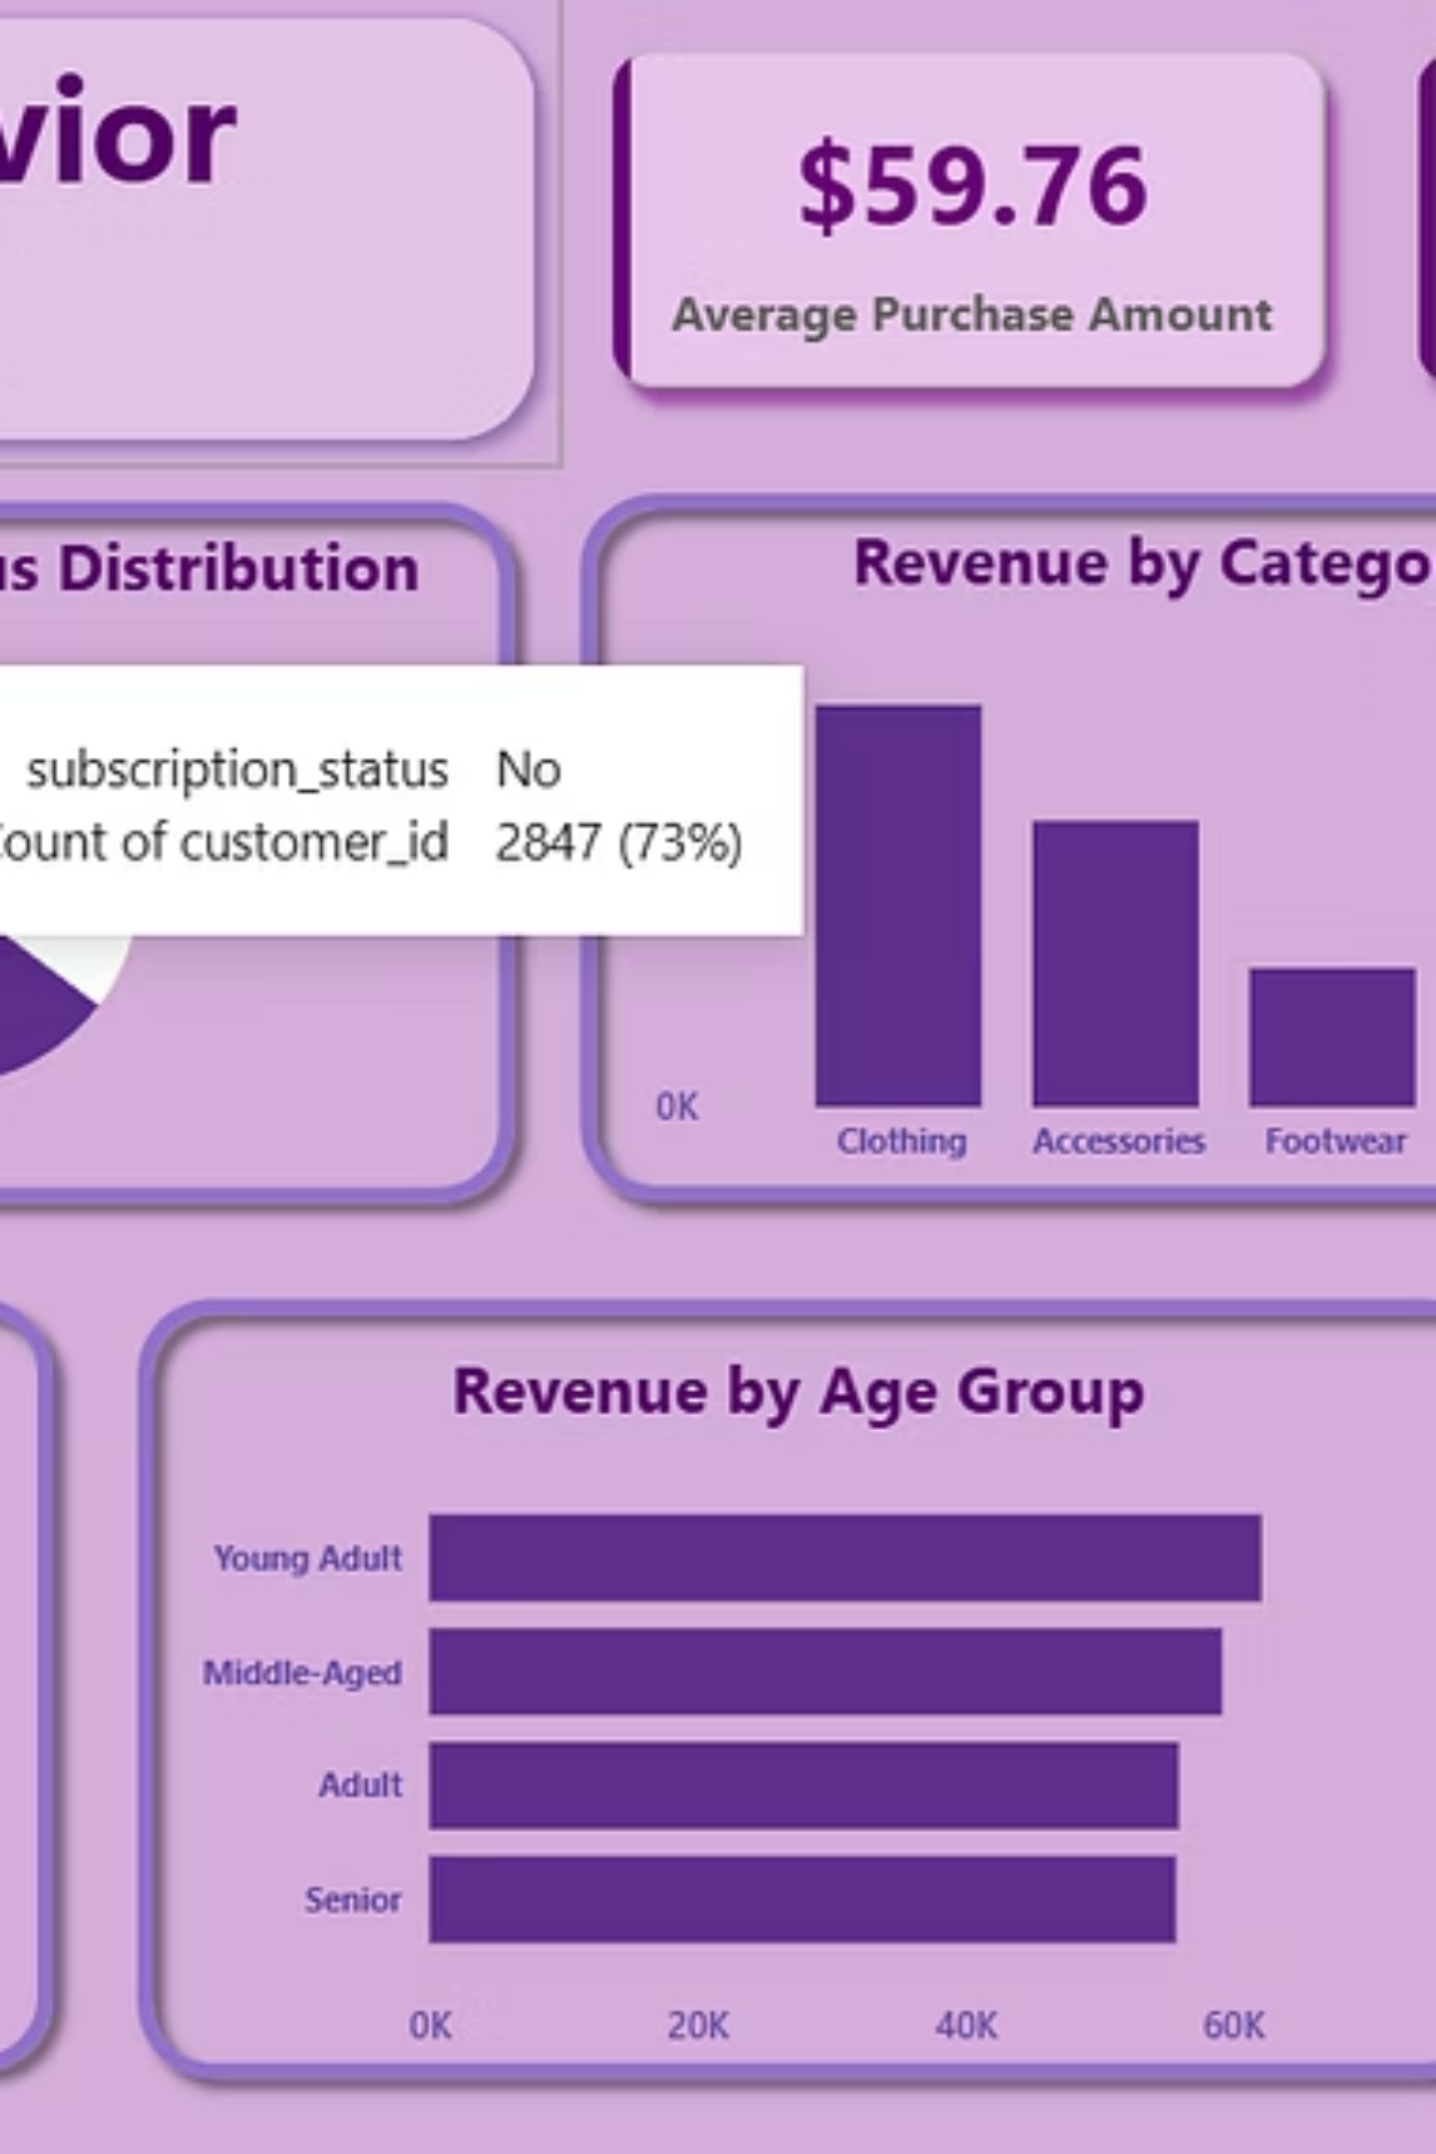
Power BI Dashboard
Interactive visualization of customer behavior insights.

Slide 9
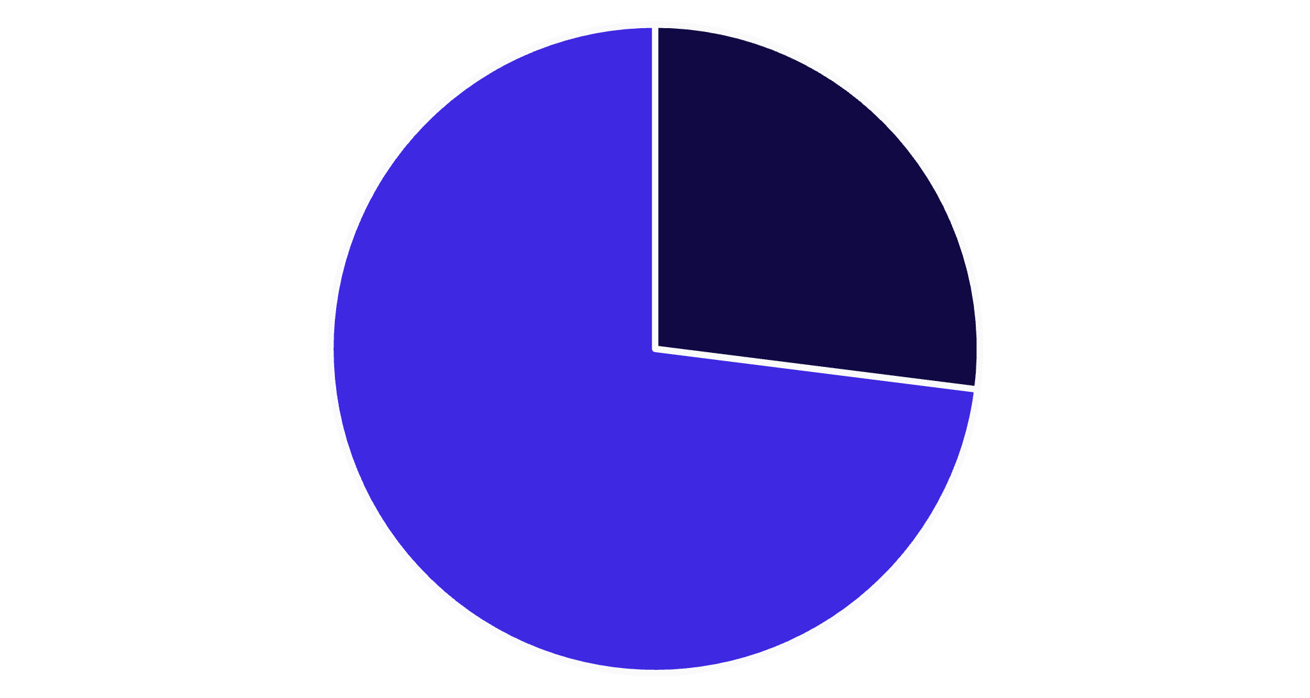
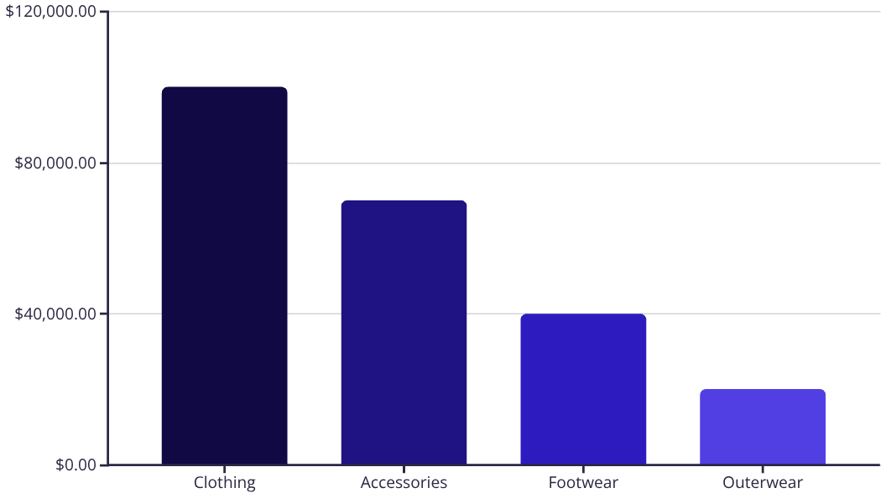
Dashboard Key Metrics
3.9K
$59.76
3.75
Customers
Avg. Purchase
Avg. Review
Clothing drives the most revenue.
Yes
No
27% of customers are subscribers.

Slide 10

Business Recommendations
Boost Subscriptions
Promote exclusive benefits for subscribers.
Customer Loyalty Programs
Reward repeat buyers to foster loyalty.
Review Discount Policy
Balance sales with margin control.
Product Positioning
Highlight top-rated and best-selling products.
Targeted Marketing
Focus on high-revenue age groups and express-shipping users.

