Slide 1
man and help command
man command in Linux is used to display the user manual of any command that we can run on the terminal.
It provides a detailed view of the command which includes NAME, SYNOPSIS, DESCRIPTION, OPTIONS, EXIT STATUS, RETURN VALUES, ERRORS, FILES, VERSIONS, EXAMPLES, AUTHORS and SEE ALSO.
Syntax :
$man [OPTION]... [COMMAND NAME]...

Slide 2
man and help command
1. No Option: It displays the whole manual of the command.
$ man [COMMAND NAME]
2. Section-num: Since a manual is divided into multiple sections so this option is used to display only a specific section of a manual.
$ man [SECTION-NUM] [COMMAND NAME]
3. -f option: One may not be able to remember the sections in which a command is present. So this option gives the section in which the given command is present.
$ man -f [COMMAND NAME]
4. -w option: This option returns the location in which the manual page of a given command is present.
$ man -w [COMMAND NAME]

Slide 3
man and help command
help: help command which as its name says help you to learn about any built-in command. help command displays information about shell built-in commands. Here’s the syntax for it:
$help [-dms] [pattern ...]
The pattern specified in the syntax above refers to the command about which you would like to know and if it is matched with any shell built-in command then help give details about it and if it is not matched then help prints the list of help topics for your convenience. And the d, m and s here are options that you can use with the help command.
-d option : It is used when you just want to get an overview about any shell built-in command i.e it only gives short description.
-m option : It displays usage in pseudo-manpage format.
-s option : It just displays only a short usage synopsis for each topic matching.

Slide 4
printf command
“printf” command in Linux is used to create formatted output. It displays the given string, number or any other format specifier on the terminal window. It works the same way as “printf” works in programming languages like C.
printf can have format specifiers, escape sequences or ordinary characters.
Syntax:
$printf [-v var] format [arguments]
Example
$printf " %s\n" "Hello, World!"
$printf "%d \n %s \n %f" 100 ghghdj 100

Slide 5
passwd command in Linux is used to change the user account passwords.
$ passwd
Passwd, who, uname command
The Linux "who" command lets you display the users currently logged in to your UNIX or Linux operating system.
$ who
uname is a command-line utility that prints basic information about the operating system name
$uname

Slide 6
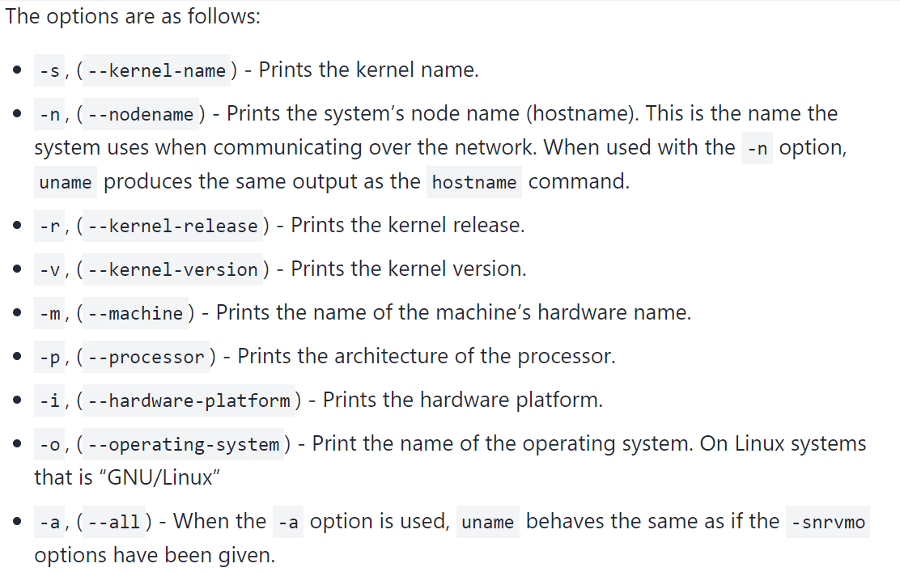
uname command

Slide 7
tty command
Linux operating system represents everything in a file system, the hardware devices that we attach are also represented as a file. The terminal is also represented as a file. There a command exists called tty which displays information related to terminal. The tty command of terminal basically prints the file name of the terminal connected to standard input.
$ tty

Slide 8
Tty, stty command
Linux operating system represents everything in a file system, the hardware devices that we attach are also represented as a file. The terminal is also represented as a file. There a command exists called tty which displays information related to terminal. The tty command of terminal basically prints the file name of the terminal connected to standard input.
$ tty
stty command in Linux is used to change and print terminal line settings. Basically, this command shows or changes terminal characteristics.
$stty

Slide 9
comm command
comm compare two sorted files line by line and write to standard output; the lines that are common and the lines that are unique.
Suppose you have two lists of people and you are asked to find out the names available in one and not in the other, or even those common to both. comm is the command that will help you to achieve this. It requires two sorted files which it compares line by line.
$comm [OPTION]... FILE1 FILE2

Slide 10
cmp command
cmp command in Linux/UNIX is used to compare the two files byte by byte and helps you to find out whether the two files are identical or not.
When cmp is used for comparison between two files, it reports the location of the first mismatch to the screen if difference is found and if no difference is found i.e the files compared are identical. cmp displays no message and simply returns the prompt if the the files compared are identical.
$cmp file1.txt file2.txt

Slide 11
diff command
diff stands for difference. This command is used to display the differences in the files by comparing the files line by line. Unlike its fellow members, cmp and comm, it tells us which lines in one file have is to be changed to make the two files identical.
The important thing to remember is that diff uses certain special symbols and instructions that are required to make two files identical. It tells you the instructions on how to change the first file to make it match the second file.
$diff file1.txt file2.txt

Slide 12
zip command
zip is a compression and file packaging utility for Linux.
Syntax :
zip [options] zipfile files_list
$zip –r myfile.zip filename.txt
unzip is a compression and file packaging utility for Linux
$unzip myfile.zip

Slide 13
tar command
The Linux ‘tar’ stands for tape archive, is used to create Archive and extract the Archive files. tar command in Linux is one of the important command which provides archiving functionality in Linux. We can use Linux tar command to create compressed or uncompressed Archive files and also maintain and modify them.
Creating an uncompressed tar Archive using option -cvf :
$ tar cvf file.tar *.txt
Extracting files from Archive using option -xvf : This command extracts files from Archives.
$ tar xvf file.tar

Slide 14
File permissions and changing the access rights.
Linux, running on shared computers use settings called permissions to determine who can access and modify the files and directories stored in their file systems. Every file in Unix has the following attributes −
Owner permissions − The owner's permissions determine what actions the owner of the file can perform on the file.
Group permissions − The group's permissions determine what actions a user, who is a member of the group that a file belongs to, can perform on the file.
Other (world) permissions − The permissions for others indicate what action all other users can perform on the file.
-rw-r--r-- 1 user1 group1 62 Jan 15 16:10 myfile.txt
drwxr-xr-x 2 user1 group1 2048 Jan 15 17:10 Example
In the output example above, the first character in each line indicates whether the listed object is a file or a directory. Directories are indicated by a (d); the absence of a d at the beginning of the first line indicates that myfile.txt is a regular file.

Slide 15
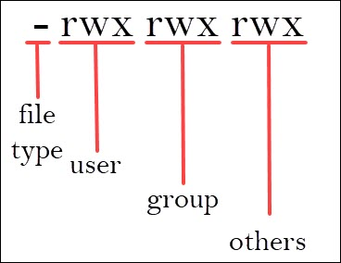
File permissions and changing the access rights.

Slide 16
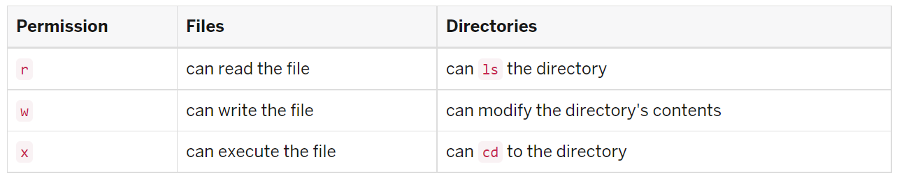
File permissions and changing the access rights.
The letters rwx represent different permission levels:
Owner or user permissions: After the directory (d) slot, the first set of three characters indicate permission settings for the owner (also known as the user).
Group permissions: The second rwx set indicates the group permissions. In the fourth column of the example above, group1 is the group name.
Other permissions: The final rwx set is for "other" (sometimes referred to as "world"). This is anyone outside the group.

Slide 17
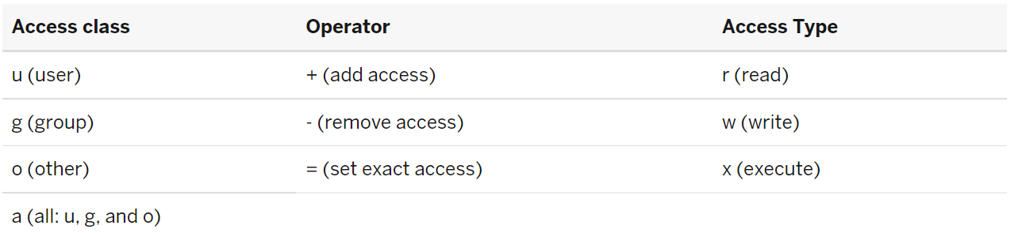
Change file permissions
To change file and directory permissions, use the command chmod (change mode). The owner of a file can change the permissions for user (u), group (g), or others (o) by adding (+) or subtracting (-) the read, write, and execute permissions. There are two basic ways of using chmod to change file permissions:
The symbolic (relative) method
The absolute method
Symbolic method:
The first and probably easiest way is the relative (or symbolic) method, which lets you specify permissions with single letter abbreviations. A chmod command using this method consists of at least three parts from the following lists: chmod o-r filea

Slide 18
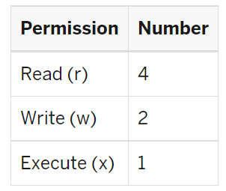
Change file permissions
Absolute form:
The other way to use the chmod command is the absolute form, in which you specify a set of three numbers that together determine all the access classes and types. Rather than being able to change only particular attributes, you must specify the entire state of the file's permissions. The three numbers are specified in the order: user (or owner), group, and other. Each number is the sum of values that specify read, write, and execute access:

Slide 19
Change file permissions
For file myfile, to grant read, write, and execute permissions to yourself (4+2+1=7), read and execute permissions to users in your group (4+0+1=5), and only execute permission to others (0+0+1=1), you would use:
chmod 751 myfile
To grant read, write, and execute permissions on the current directory to yourself only, you would use:
chmod 700

Slide 20
Change file permissions
Some other examples are:
777 | anyone can do anything (read, write, or execute)
755 | you can do anything; others can only read and execute
711 | you can do anything; others can only execute
644 | you can read and write; others can only read
Linux, running on shared high-performance computers use settings called permissions to determine who can access and modify the files and directories stored in their file systems. Each file and directory in a file system is assigned "owner" and "group" attributes.

Slide 21
Chown file permissions
Use the following procedure to change the ownership of a file.
Become superuser or assume an equivalent role.
Change the owner of a file by using the chown command.
# chown new-owner filename
new-owner | Specifies the user name or UID of the new owner of the file or directory.
filename | Specifies the file or directory.

Slide 22
find Command
The Linux find command is very powerful. It can search the entire filesystem to find files and directories according to the search criteria you specify. Besides using the find command to locate files, you can also use it to execute other Linux commands (grep, mv, rm, etc.) on the files and directories you find, which makes find extremely powerful.
find ~ -name readme.txt
find ~ -name *.txt
Locating Files by Size Another possible search is to search for files by size.
find ~ -name *.txt -size +100M
find ~ -name *.txt -size -100M
Locating Files by Access Time
find $HOME -atime +30
find $HOME -iname '*.ogg' -atime +30

Slide 23
expr – Computational and String handling
The expr command in Unix evaluates a given expression and displays its corresponding output. It is used for:
Basic operations like addition, subtraction, multiplication, division, and modulus on integers.
Evaluating regular expressions, string operations like substring, length of strings etc.
You have to provide the space between the values and the operands. Otherwise the expr command may throw error or print them as a string.
$expr expression
Using expr for basic arithmetic operations :
$expr 12 + 8
For String operations
expr length hello
Matching number of characters in two strings
$ expr hello : hell

Slide 24
expr – Computational and String handling
Finding substring of a string
$ expr substr hello 2 3
Arithmetic Operator Examples: Example: 1. Sum of numbers $ expr 5 + 3 2. Difference between two numbers $ expr 10 - 6 3. Multiplying numbers $ expr 7 \* 9 Here the * is shell builtin operator, that is why it needs to escaped with backslash. 4. Dividing numbers $ expr 6 / 4 The division operator returns only the arithmetic quotient. 5. Remainder or modulus $ expr 6 % 4

Slide 25
expr – Computational and String handling
Arithmetic Operator Examples: Example: 1. Sum of numbers $ expr 5 + 3 2. Difference between two numbers $ expr 10 - 6 3. Multiplying numbers $ expr 7 \* 9 Here the * is shell builtin operator, that is why it needs to escaped with backslash. 4. Dividing numbers $ expr 6 / 4 The division operator returns only the arithmetic quotient. 5. Remainder or modulus $ expr 6 % 4

Slide 26
expr – Computational and String handling
Comparison or Relational Operator Examples:
You can use the following comparison operators with the expr command:
Val1 < Val2 : Returns 1 if val1 is less than val2. otherwise zero.
Val1 <= Val2 : Returns 1 if val1 is less than or equal to val2. otherwise zero.
Val1 > Val2 : Returns 1 if val1 is greater than val2. otherwise zero.
Val1 >= Val2 : Returns 1 if val1 is greater than or equal to val2. otherwise zero.
Val1 = Val2 : Returns 1 if val1 is equal to val2. otherwise zero.
Val1 != Val2 : Returns 1 if val1 is equal to val2. otherwise zero.
val1 | val2 : Returns val1 if val1 is neither null nor zero. Otherwise val2.
val1 & val2 : Returns val1 if both val1 and val2 is neither null nor zero. Otherwise 0.
Note: You have to escape most of the operators with backslash as they are shell built in.

Slide 27
expr – Computational and String handling
$ expr 1 \< 2 1 $ expr 1 \<= 1 1 $ expr 2 \> 5 0 $ expr 2 \>= 5 0 $ expr 7 = 7 1 $ expr 9 != 18 1 $ expr 2 \| 5 2 $ expr 0 \| 5 5 $ expr 2 \& 5 2 $ expr 6 \& 3 6 $ expr 6 \& 0 0 $ expr 0 \& 3 0

Slide 28
expr – Computational and String handling
Length of string: The length function is used to find the number of characters in a string. $ expr length linux 5 $expr length linux\ system 12 $expr length "linux system" If you have spaces in your string escape them with backslash or quote them with double quotes.
Find Substring: You can extract a portion of the string by using the substr function. The syntax of substr function is
substr string position length
Here position is the character position in the string. length is the number of chracters to extract from the main string. $ expr substr unixserver 5 6 server

Slide 29
expr – Computational and String handling
Index of the substring: You can find the position of a string in the main string using the index function. The syntax of index function is shown below: index string chars If the chars string is found in the main string, then the index function returns the position of the chars. Otherwise it returns 0. See the following examples: $ expr index linux nux 3 $expr index linux win 0

Slide 30
expr – Computational and String handling
Matching a regexp: The match function is used to find anchored pattern match of regexp in the string. The syntax of match function is shown below: match string pattern The match function returns the number of characters in the pattern is a match is found. Otherwise, it returns 0 $ expr match linuxserver lin 3 $ expr match linuxserver server 0

