Slide 1
YouTube Viewing Habits Analysis: Understanding Digital Content Consumption
A Study of Temporal Patterns and Binge-Watching Behaviors

Slide 2
Hypothesis
YouTube viewing patterns are influenced by daily routines and external factors, such as work schedules, weekends, and seasonal changes, leading to distinct temporal trends and binge-watching behaviors.

Slide 3
Why Analyze YouTube Viewing Habits?
Understand viewing behaviors and optimize time management.
Gain insights into binge-watching tendencies.

Slide 4
Data Source and Methodology
Data obtained from Google Takeout.
Detailed watch history from 2024 onward.
Key data points: video titles, timestamps, durations.

Slide 5
Methods of Analysis
Hourly, daily, and monthly trend analysis.
Session and binge-watching identification.
Visualization techniques used.

Slide 6
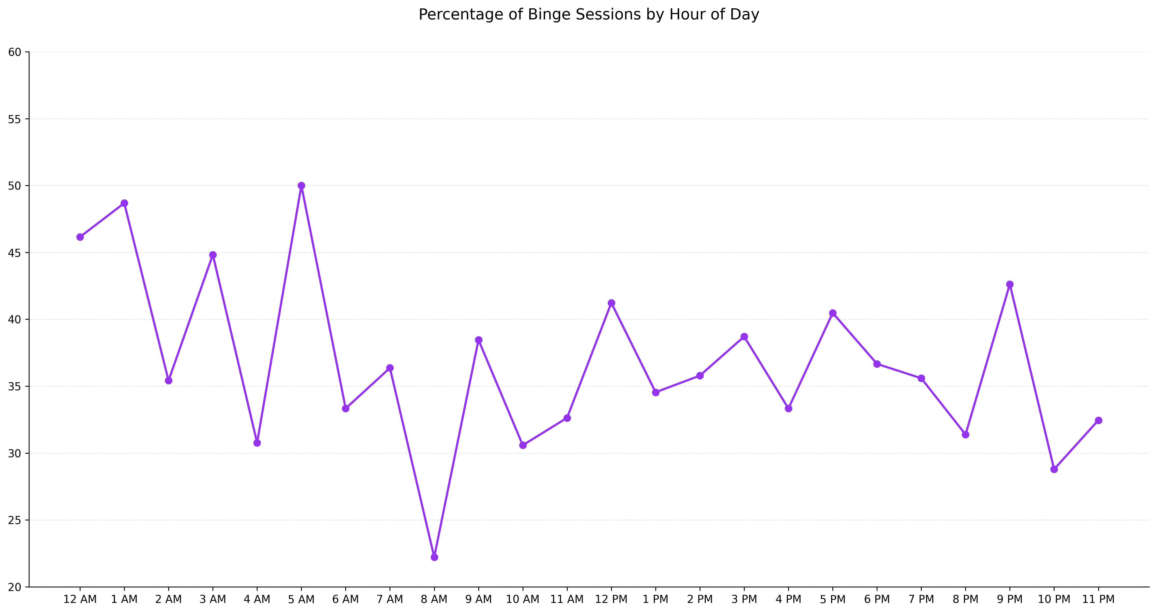
Fluctuating binge percentages, peaks during late-night hours.
Late hours offer uninterrupted time for binge watching.

Slide 7
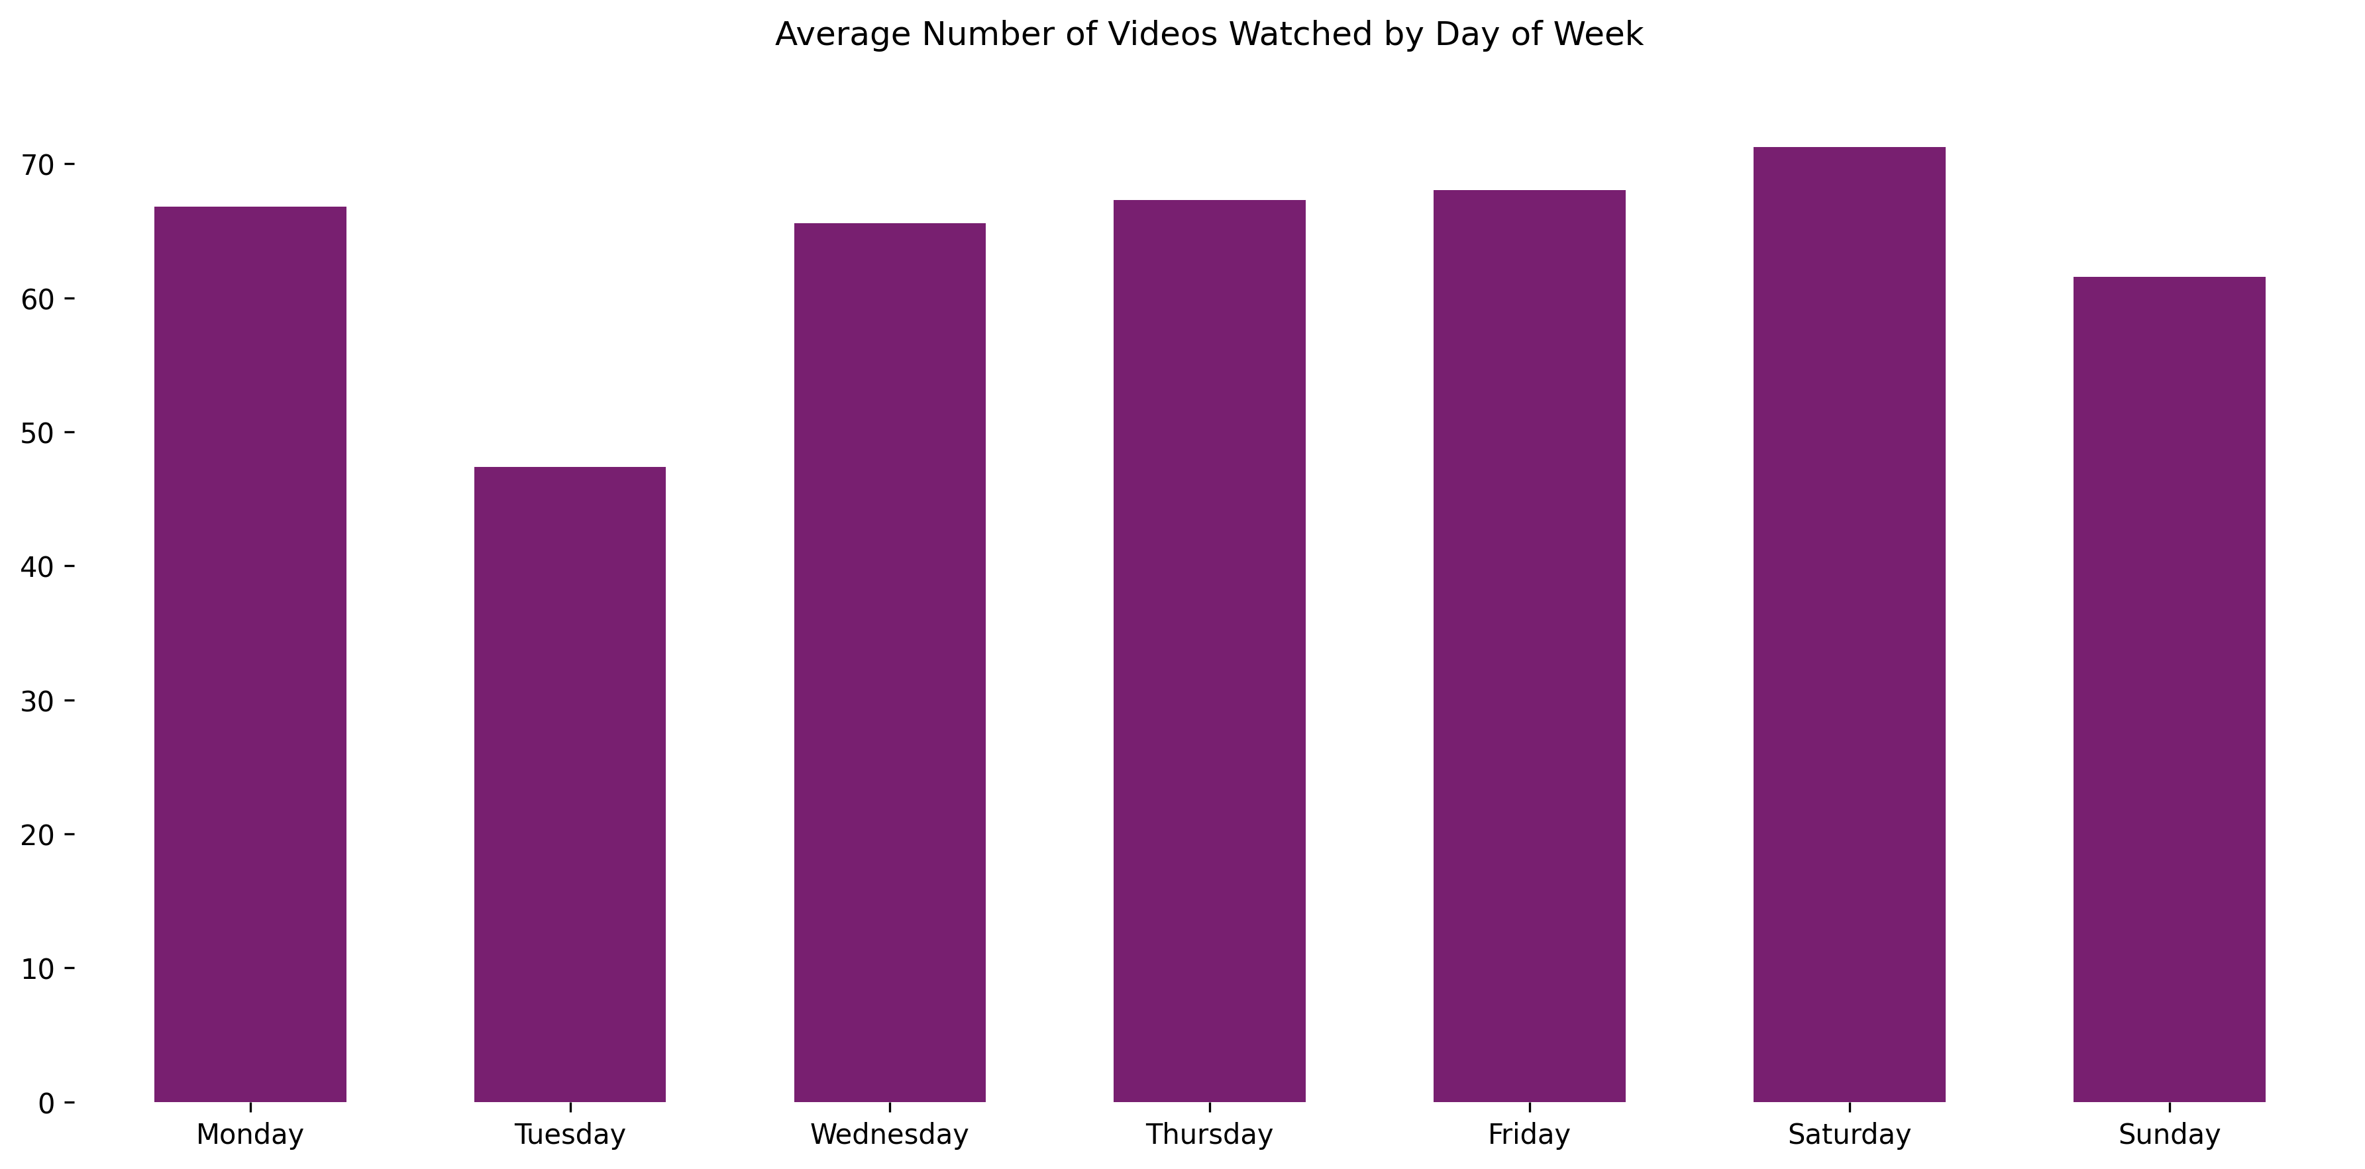
Highest engagement on Saturday and Monday; Tuesday is the lowest.
The elevated weekend activity is likely because increased leisure time, while Monday’s prominence could reflect renewed focus at the start of the week.

Slide 8
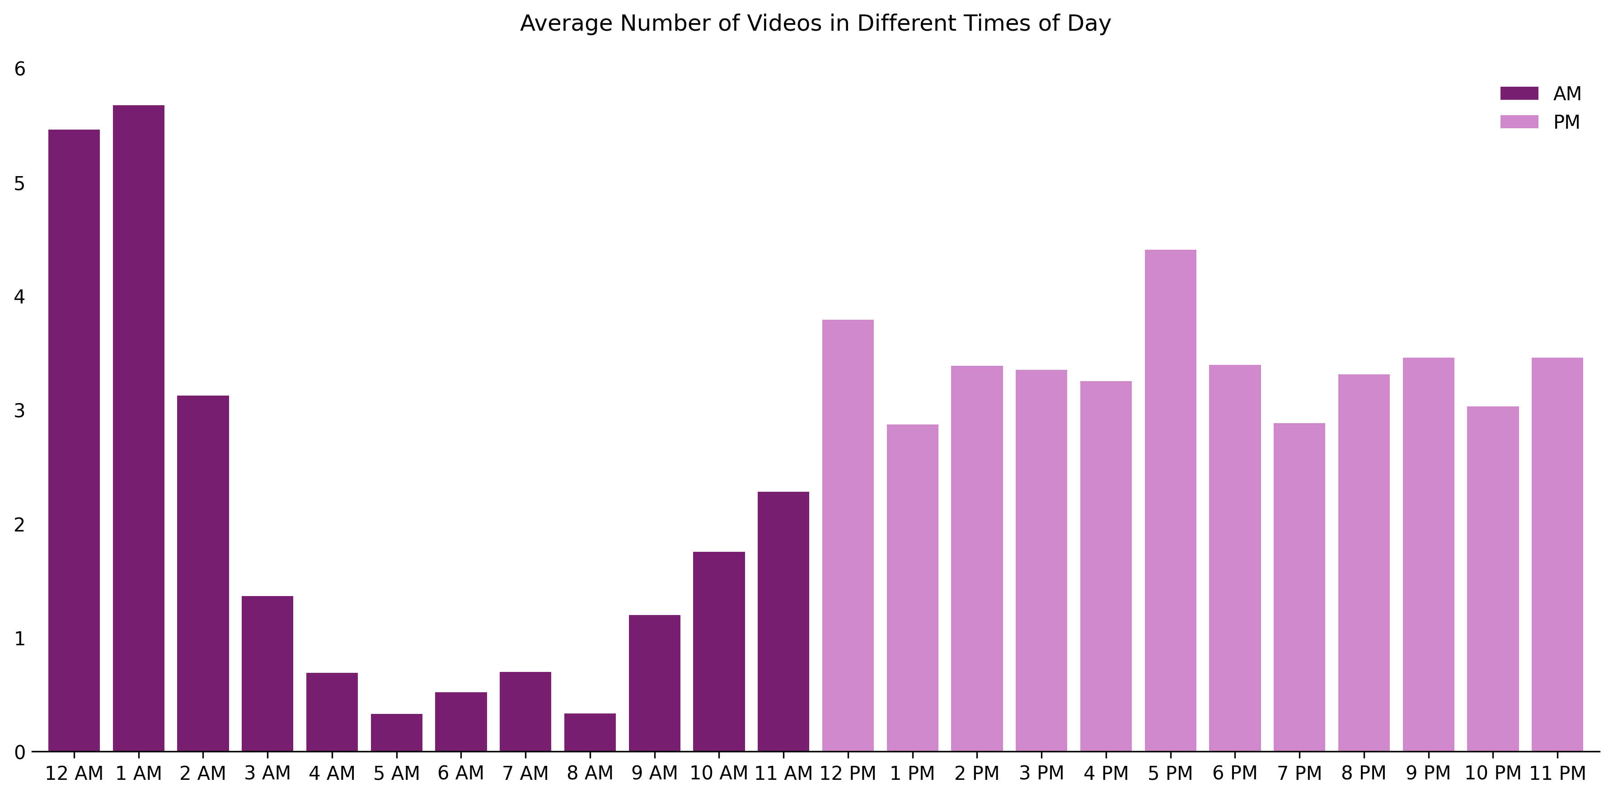
PM hours see higher engagement, with a peak around 5 PM.
Evenings are prime viewing hours, aligning with leisure time.

Slide 9
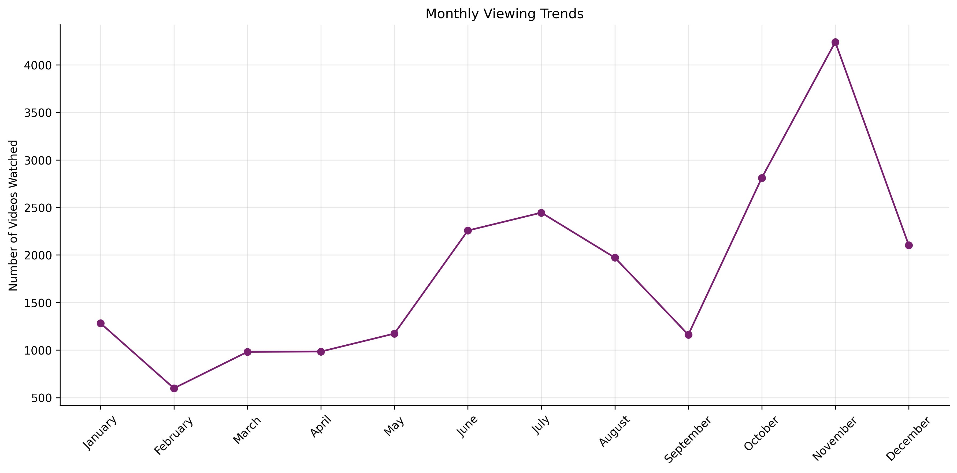
Peak activity in October and November, drop in December.
Seasonal factors, holidays, and colder weather influence trends.

Slide 10
Key Findings
Weekly patterns highlight weekends and Mondays
02
.Evening viewing dominates daily schedules.
03
Seasonal peaks in October-November.
04
Hourly binge-watching trends peak at night.
01

