Slide 1
Security in Computing, Fifth Edition
Chapter 3: Programs and Programming

Slide 2
Motivation
Some security problems result from nonmalicious oversights or blunders, but others are intentional.
A malicious attacker can exploit a nonmalicious flaw to cause real harm.
Study several common program failings to show how simple errors during programming can lead to large-scale problems during execution.
We describe real attacks that have been caused by program flaws.

Slide 3
Motivation
Flaw= faults + failures
When a human makes a mistake, called an error, in performing some software activity, the error may lead to a fault, or an incorrect step, command, process, or data definition in a computer program, design, or documentation
A failure is a departure from the system’s required behavior.

Slide 4
Motivation
Program flaws can have two kinds of security implications:
can cause integrity problems leading to harmful output or action, and (remember CIA)
Integrity involves not only correctness but also accuracy, precision, and consistency
A faulty program can also inappropriately modify previously correct data, sometimes by overwriting or deleting the original data.
offer an opportunity for exploitation by a malicious actor.
If an attacker learns of a flaw and can use it to manipulate the program’s behavior, a simple and nonmalicious flaw can become part of a malicious attack.

Slide 5
Goal
Examine several programming flaws that have security implications.
Show what activities during program design, development, and deployment can improve program security.

Slide 6
Objectives for Chapter 3
Learn about memory organization, buffer overflows, and relevant countermeasures
Common programming bugs, such as off-by-one errors, race conditions, and incomplete mediation
Survey of past malware and malware capabilities
Virus detection
Tips for programmers on writing code for security

Slide 7
Memory Allocation
Notes:
Much of this chapter requires basic knowledge of how memory is organized, and this is a nice, simple diagram to refresh students on how it works. The key takeaways: code and data separated, with the heap growing up toward high addresses and the stack growing down from the high addresses.

Slide 8
Data vs. Instructions
Notes:
The same hex value in the same spot in memory can either be a meaningful data value or a meaningful instruction depending on whether the computer treats it as code or data. This will be the basis of the attacks in the following slides.

Slide 9
Data vs. Instructions
The same hex value in the same spot in memory can
either be a meaningful data value or
a meaningful instruction
It depends on whether the computer treats it as code or data.
This will be the basis of the attacks
Usually we do not treat code as data, or vice versa;
attackers sometimes do, however, especially in memory overflow attacks.
The attacker’s trick is to cause data to spill over into executable code and then to select the data values such that they are interpreted as valid instructions to perform the attacker’s goal.
For some attackers this is a two-step goal:
First cause the overflow and then
experiment with the ensuing action to cause a desired, predictable result

Slide 10
Buffer Overflows
Occur when data is written beyond the space allocated for it, such as a 10th byte in a 9-byte array
In a typical exploitable buffer overflow, an attacker’s inputs are expected to go into regions of memory allocated for data, but those inputs are instead allowed to overwrite memory holding executable code
The trick for an attacker is finding buffer overflow opportunities that lead to overwritten memory being executed, and finding the right code to input

Slide 11
Buffer Overflows
A buffer (or array or string) is a space in which data can be held.
A buffer resides in memory.
Because memory is finite, a buffer’s capacity is finite.
For this reason, in many programming languages the programmer must declare the buffer’s maximum size so that the compiler can set aside that amount of space.
Example
char sample[10];
What if sample[10] = ‘B’;
Note some compilers do not generate the code to check for exceeding bounds.
How about pointer?

Slide 12
How Buffer Overflows Happen –detail example
char sample[10];
int i;
for (i=0; i<=9; i++)
sample[i] = ‘A’;
sample[10] = ‘B’;
Notes:
This is a very simple buffer overflow. Character B is placed in memory that wasn’t allocated by or for this procedure.

Slide 13
Memory Organization
Notes:
Similar to the earlier picture on memory organization, only this one shows where the system data/code reside vs. where the program code and its local data reside. This context is important for understanding how an attack that takes place inside a given program can affect that program vs. how it can affect the rest of the system.

Slide 14
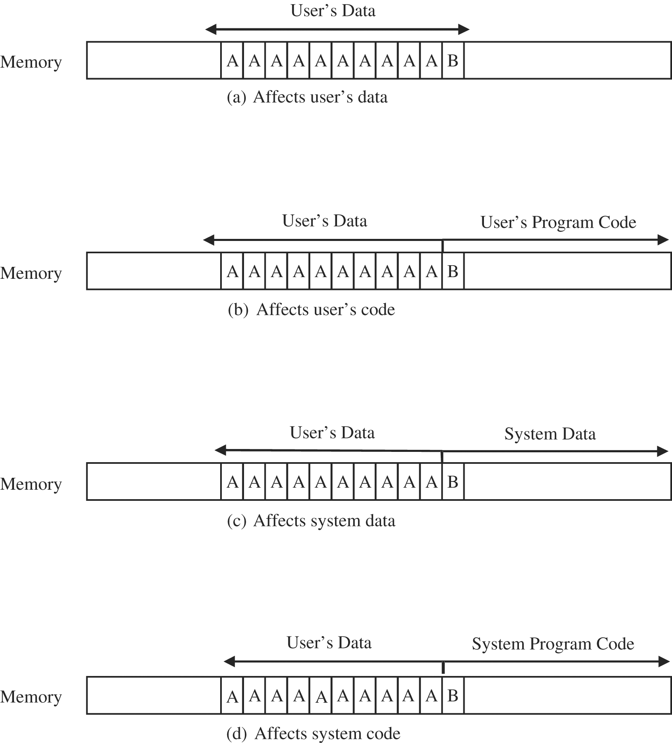
Where a Buffer Can Overflow
Notes:
Examples of buffer overflow effects in the context of the earlier AAAAAAAAAAB example. The memory that’s overwritten depends on where the buffer resides.

Slide 15
The Stack- Para and Return Addr.
When procedure A calls procedure B,
A pushes onto the stack its return address
the current value of the program counter
the address at which execution should resume when B exits,
as well as calling parameter values.

Slide 16
The Stack Frame
data group of parameters,
return address, and
stack pointer

Slide 17
The Stack after Procedure Calls
Notes:
When procedure A calls procedure B, procedure B gets added to the stack along with a pointer back to procedure A. In this way, when procedure B is finished running, it can get popped off the stack, and procedure A will just continue executing where it left off.

Slide 18
The Stack after Procedure Calls
Question? What if the attacker can
overwrite the program counter,
doing so will redirect program execution after the procedure returns, and that redirection is, in fact, a frequently seen step in exploiting a
buffer overflow.
Notes:
When procedure A calls procedure B, procedure B gets added to the stack along with a pointer back to procedure A. In this way, when procedure B is finished running, it can get popped off the stack, and procedure A will just continue executing where it left off.

Slide 19
Compromised Stack
Notes:
Instead of pointing at procedure B in this case, the program counter is pointing at code that’s been placed on the stack as a result of an overflow.

Slide 20
Overwriting Memory for Execution
Overwrite the program counter stored in the stack
Overwrite part of the code in low memory, substituting new instructions
Overwrite the program counter and data in the stack so that the program counter points to the stack

Slide 21
Harm from Buffer Overflows
Overwrite:
Another piece of your program’s data
An instruction in your program
Data or code belonging to another program
Data or code belonging to the operating system
Overwriting a program’s instructions gives attackers that program’s execution privileges
Overwriting operating system instructions gives attackers the operating system’s execution privileges

Slide 22
Overflow Countermeasures
Staying within bounds
Check lengths before writing
Confirm that array subscripts are within limits
Double-check boundary condition code for off-by-one errors
Limit input to the number of acceptable characters
Limit programs’ privileges to reduce potential harm
Many languages have overflow protections
Code analyzers can identify many overflow vulnerabilities
Canary values in stack to signal modification
wrapping each stack frame in a protective layer.
in reference to canary birds that were formerly taken into underground mines;

Slide 23
Other Programming flaws
A programming flaw that is similar to an overflow:
a failure to check and control access completely and consistently.
Incomplete Mediation Flaw
Time-of-Check to Time-of-Use Flaw
Race Conditions Flaw

Slide 24
Incomplete Mediation
Mediation: Verifying that the subject is authorized to perform the operation on an object

Slide 25
Incomplete Mediation-example
http://www.somesite.com/subpage/userinput.asp? parm1=(808)555-1212&parm2=2015Jan17
What would happen if parm2 were submitted as
1800Jan01?
Or 1800Feb30? Or 2048Min32?
Or 1Aardvark2Many?
System may crash or generate a very wrong result.

Slide 26
Preventing Incomplete Mediation
Validate all input
client side or server side
Limit users’ access to sensitive data and functions
Price, calculate the total
Complete mediation using a reference monitor
access control
reference monitor
(1) small and simple enough to give confidence of correctness
(2) unbypassable, and
(3) always invoked.

Slide 27
Time-of-Check to Time-of-Use
A person’s buying a sculpture that costs $100.
The buyer takes out five $20 bills, carefully counts them in front of the seller, and lays them on the table.
Then the seller turns around to write a receipt.
While the seller’s back is turned, the buyer takes back one $20 bill.
When the seller turns around, the buyer hands over the stack of bills, takes the receipt, and leaves with the sculpture.
Between the time the security was checked (counting the bills) and the access occurred (exchanging the sculpture for the bills), a condition changed:
What was checked is no longer valid when the object (that is, the sculpture) is accessed.

Slide 28
Time-of-Check to Time-of-Use
Mediation performed with a “bait and switch” in the middle

Slide 29
Time-of-Check to Time-of-Use
Security Implication
Checking one action and performing another is an example of ineffective access control, leading to confidentiality failure or integrity failure or both.
We must be wary whenever a time lag or loss of control occurs, making sure that there is no way to corrupt the check’s results during that interval.
Countermeasures
access control
access-checking software must own the request data until the requested action is complete.
allow no interruption (loss of control) during the validation.
the validation routine can seal the request data to detect modification.

Slide 30
Race Conditions
Notes:
Example 1 (no race condition): A booker books the last seat on the plane, and thereafter the system shows no seat available. See next slide to continue.

Slide 31
Race Conditions
Notes:
Example 2 (race condition): Before the first booker can complete the booking for the last available seat, a second booker looks for available seats. This system has a race condition, where the overlap in timing of the requests causes errant behavior.

Slide 32
Other Programming Oversights
Undocumented access points (backdoors)
The Easter Bunny!
Off-by-one errors
Integer overflows
Unterminated null-terminated string
Unsafe utility libraries
strcpy(dest, src) copies a string from src to dest, stopping on a null, with the potential to overrun allocated memory.
A safer function is strncpy(dest, src, max), which copies up to the null delimiter or max characters, whichever comes first.

Slide 33
Malware
Programs planted by an agent with malicious intent to cause unanticipated or undesired effects
Virus
A program that can replicate itself and pass on malicious code to other nonmalicious programs by modifying them
Worm
A program that spreads copies of itself through a network
Trojan horse
Code that, in addition to its stated effect, has a second, nonobvious, malicious effect

Slide 34
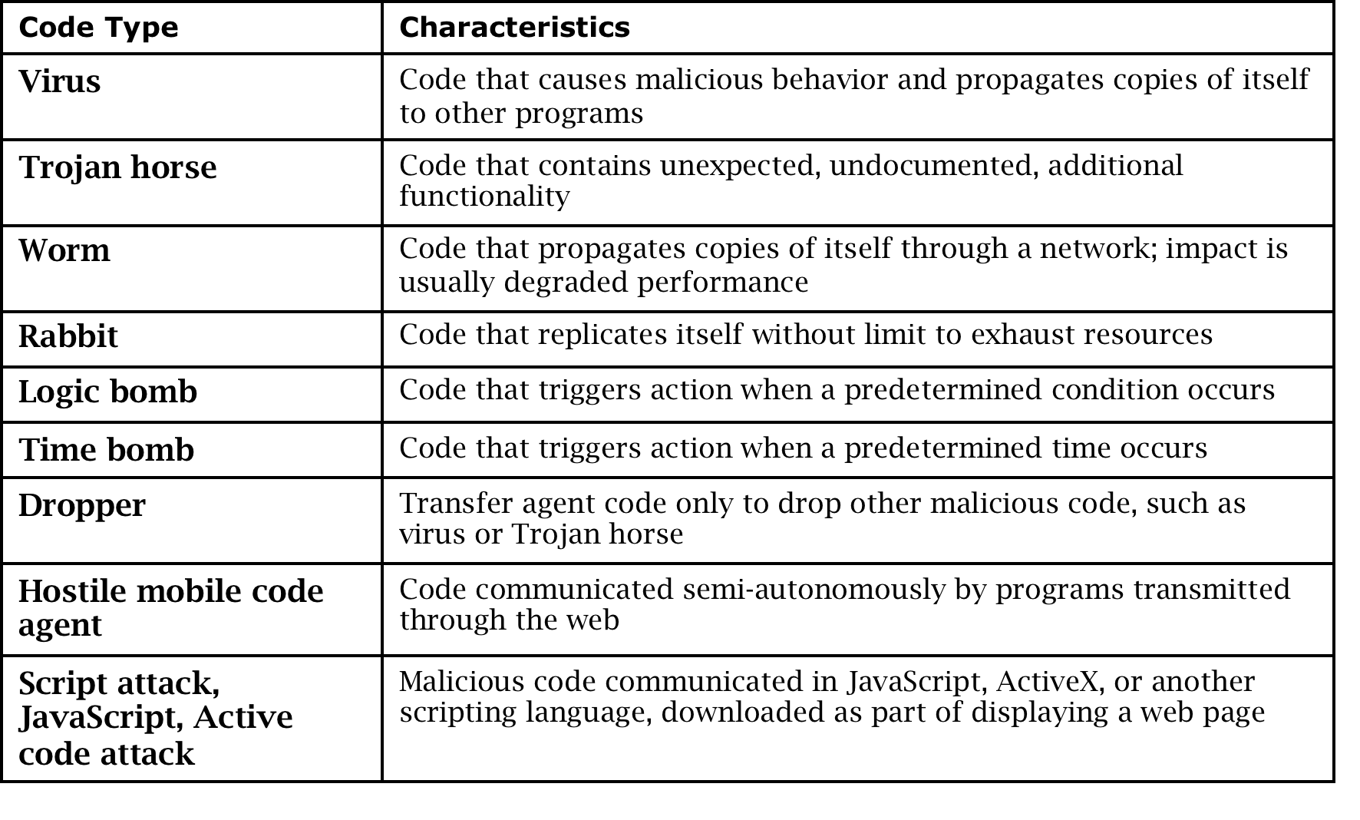
Types of Malware

Slide 35
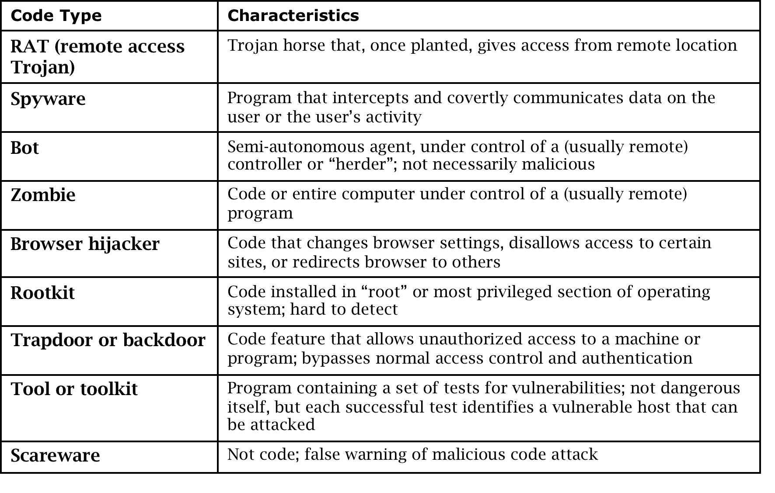
Types of Malware (cont.)

Slide 36
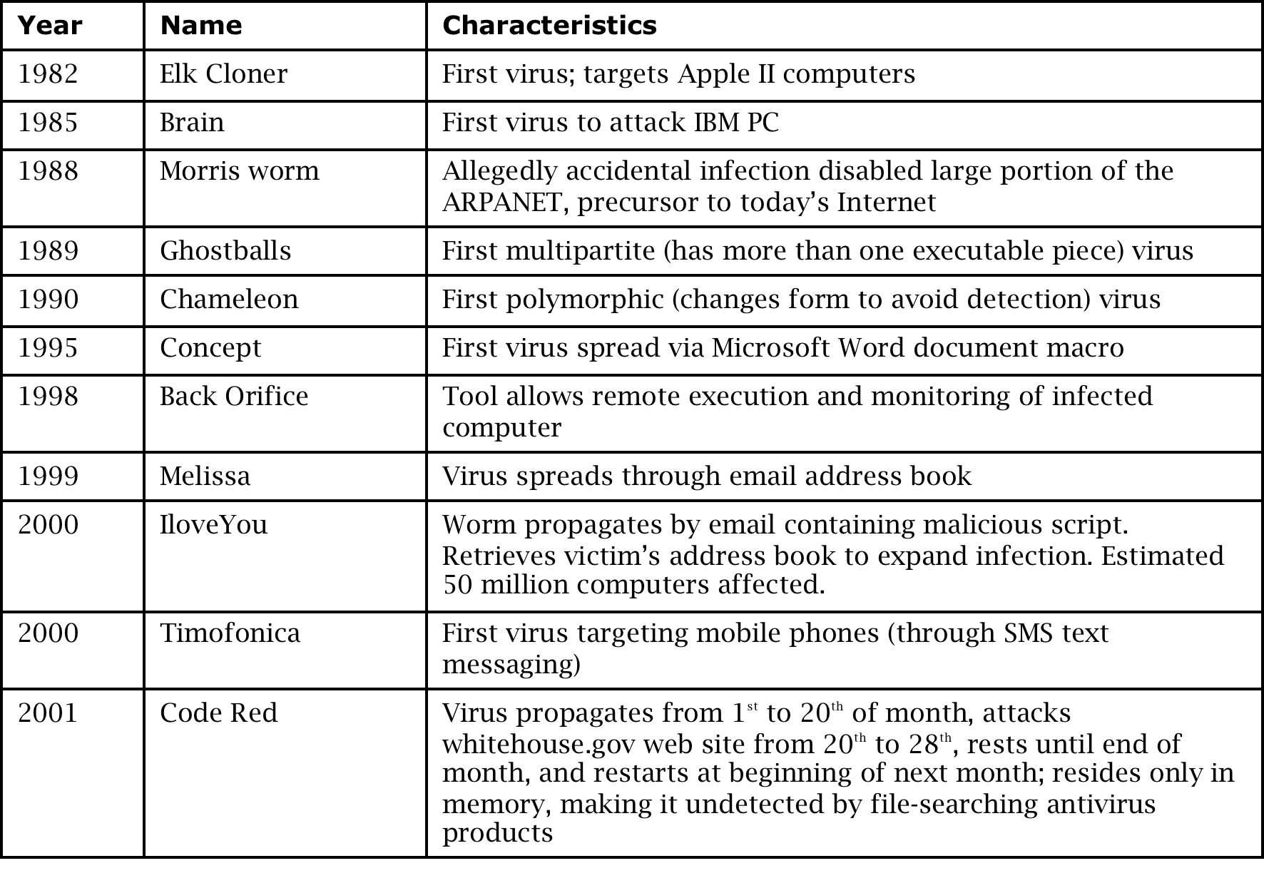
History of Malware

Slide 37
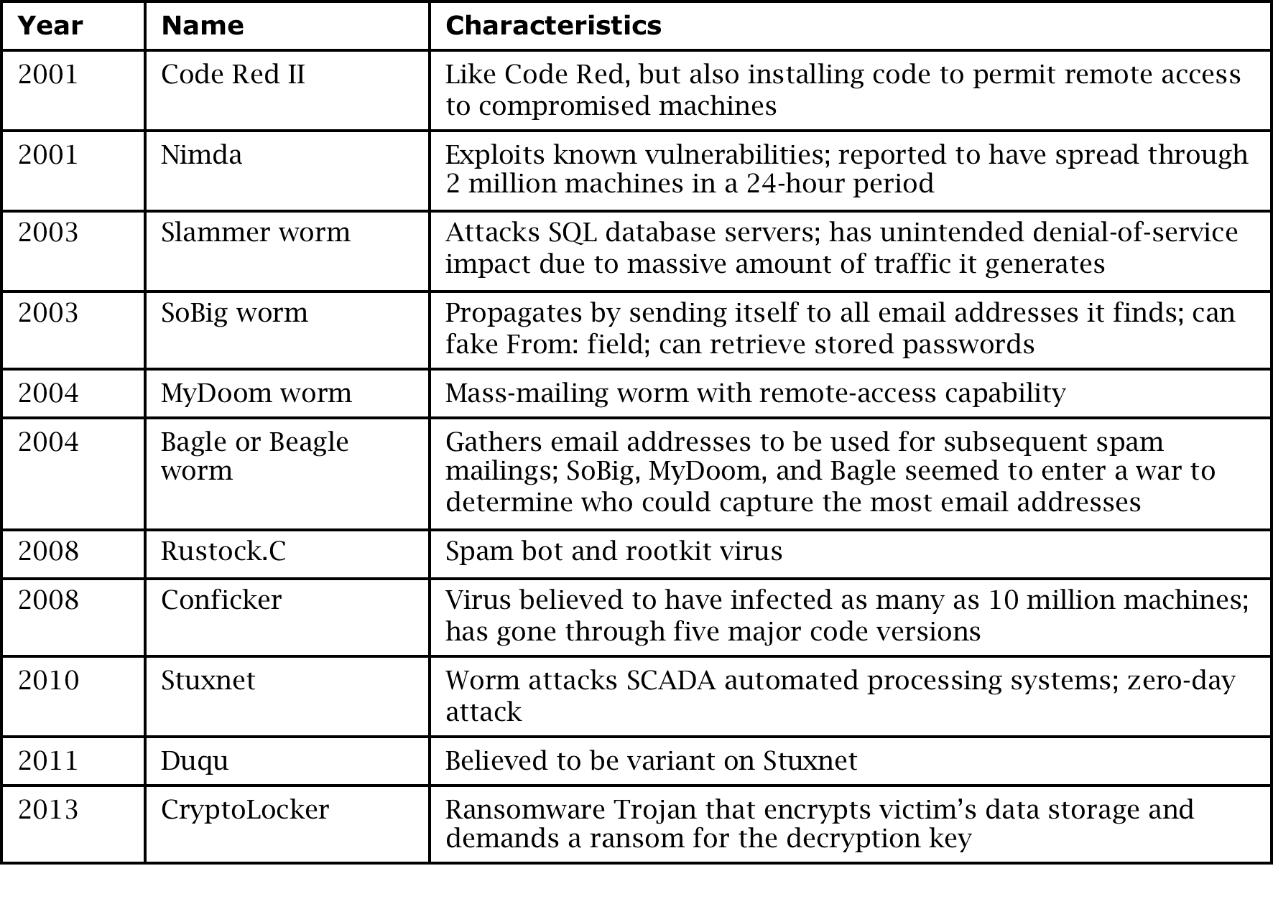
History of Malware (cont.)

Slide 38
Technical Details: Malicious Code
harm—how they affect users and systems
transmission and propagation—how they are transmitted and replicate, and how they cause further transmission
activation—how they gain control and install themselves so that they can reactivate
stealth—how they hide to avoid detection

Slide 39
Malicious Code Types
Nondestructive.
sending a funny message or flashing an image on the screen, often simply to show the author’s capability.
This category would also include virus hoaxes, messages falsely warning of a piece of malicious code, apparently to cause receivers to panic and forward the message to contacts, thus spreading the panic.
Destructive.
This type of code corrupts files, deletes files, damages software, or executes commands to cause hardware stress or breakage with no apparent motive other than to harm the recipient.
Commercial or criminal intent.
An infection of this type tries to take over the recipient’s computer, installing code to allow a remote agent to cause the computer to perform actions on the agent’s signal or to forward sensitive data to the agent.
collecting personal data, for example, login credentials to a banking web site, collecting proprietary data, such as corporate plans (as was reported for an infection of computers of five petroleum industry companies in February 2011), or serving as a compromised agent for sending spam email or mounting a denial-of-service attack,

Slide 40
Harm from Malicious Code
Harm to users and systems:
Sending email to user contacts
Deleting or encrypting files
Modifying system information, such as the Windows registry
Stealing sensitive information, such as passwords
Attaching to critical system files
Hide copies of malware in multiple complementary locations
Harm to the world:
Some malware has been known to infect millions of systems, growing at a geometric rate
Infected systems often become staging areas for new infections

Slide 41
Transmission and Propagation
Setup and installer program
Attached file
Document viruses
Autorun
Using nonmalicious programs:
Appended viruses
Viruses that surround a program
Integrated viruses and replacements

Slide 45
Malware Activation
One-time execution (implanting)
Boot sector viruses
Memory-resident viruses
Application files
Code libraries

Slide 46
One-Time Execution (Implanting)
Malicious code often executes a one-time process to transmit or receive and install the infection.
the user clicks to download a file, other times the user opens an attachment, and
the malicious code is downloaded silently as a web page is displayed.
this first step to acquire and install the code must be quick and not obvious to the user.

Slide 48
Memory-Resident Viruses
For frequently used parts of the operating system and for a few specialized user programs, it would take too long to reload the program each time it is needed.
such code remains in memory and is called “resident” code.
Examples
routine that interprets keys pressed on the keyboard,
the code that handles error conditions that arise during a program’s execution, or
a program that acts like an alarm clock, sounding a signal at a time the user determines.

Slide 49
Stealth
scanners look for identical patterns, malicious code writers try to vary the appearance of their code in several ways:
Rearrange the order of modules.
Rearrange the order of instructions (when order does not affect execution;
for example A := 1; B := 2 can be rearranged with no detrimental effect).
Insert instructions, (such as A := A), that have no impact.
Insert random strings (perhaps as constants that are never used).
Replace instructions with others of equivalent effect,
such as replacing A := B–1 with A := B + (–1) or A := B + 2 – 1.
Insert instructions that are never executed (for example, in the else part of a conditional expression that is always true).

Slide 50
Virus Effects

Slide 51
Countermeasures for Users
Use software acquired from reliable sources
Test software in an isolated environment
Only open attachments when you know them to be safe
Treat every website as potentially harmful
Create and maintain backups

Slide 52
Virus Detection
Virus scanners look for signs of malicious code infection using signatures in program files and memory
Traditional virus scanners have trouble keeping up with new malware—detect about 45% of infections
Detection mechanisms:
Known string patterns in files or memory
Execution patterns
Storage patterns

Slide 53
Code Red worm Code Pattern
/default.ida?NNNNNNNNNNNNNNNNNNNNNNNNNNNNNNN
NNNNNNNNNNNNNNNNNNNNNNNNNNNNNNNNNNNNNNN
NNNNNNNNNNNNNNNNNNNNNNNNNNNNNNNNNNNNNNN
NNNNNNNNNNNNNNNNNNNNNNNNNNNNNNNNNNNNNNN
NNNNNNNNNNNNNNNNNNNNNNNNNNNNNNNNNNNNNNN
%u9090%u6858%ucbd3
%u7801%u9090%u6858%ucdb3%u7801%u9090%u6858
%ucbd3%u7801%u9090
%u9090%u8190%u00c3%u0003%ub00%u531b%u53ff
%u0078%u0000%u00=a HTTP/1.0

Slide 54
Virus Signatures-Storage Patterns

Slide 55
Countermeasures for Developers
Modular code: Each code module should be
Single-purpose
Small
Simple
Independent
Encapsulation
Information hiding
Mutual Suspicion
Confinement
Genetic diversity

Slide 56
Code Testing
Unit testing
Integration testing
Function testing
Performance testing
Acceptance testing
Installation testing
Regression testing
Penetration testing

Slide 57
Design Principles for Security
Least privilege
Economy of mechanism
Open design
Complete mediation
Permission based
Separation of privilege
Least common mechanism
Ease of use

Slide 58
• Least privilege. Each user and each program should operate using the fewest privileges possible. In this way, damage from an inadvertent or malicious attack is minimized.
• Economy of mechanism. The design of the protection system should be small, simple, and straightforward. Such a protection system can be carefully analyzed, exhaustively tested, perhaps verified, and relied on.
• Open design. The protection mechanism must not depend on the ignorance of potential attackers; the mechanism should be public, depending on secrecy of relatively few key items, such as a password table. An open design is also available for extensive public scrutiny, thereby providing independent confirmation of the design security.

Slide 59
• Complete mediation. Every access attempt must be checked. Both direct access attempts (requests) and attempts to circumvent the access-checking mechanism should be considered, and the mechanism should be positioned so that it cannot be circumvented.
• Permission based. The default condition should be denial of access. A
conservative designer identifies the items that should be accessible, rather than those that should not.
• Separation of privilege. Ideally, access to objects should depend on more than one condition, such as user authentication plus a cryptographic key. In this way, someone who defeats one protection system will not have complete access.
• Least common mechanism. Shared objects provide potential channels for
information flow. Systems employing physical or logical separation reduce the
risk from sharing.
• Ease of use. If a protection mechanism is easy to use, it is unlikely to be
avoided.

Slide 60
Other Countermeasures
Good
Proofs of program correctness—where possible
verification involves making initial assertions about the program’s inputs and then checking to see if the desired output is generated
Defensive programming
anticipate what could go wrong,
E.g., out of range
Design by contract
Preconditions and postconditions
Bad
Penetrate-and-patch
ethical hacking,
Security by obscurity
assuming the attacker will not find a vulnerability

Slide 61
Summary
Buffer overflow attacks can take advantage of the fact that code and data are stored in the same memory in order to maliciously modify executing programs
Programs can have a number of other types of vulnerabilities, including off-by-one errors, incomplete mediation, and race conditions
Malware can have a variety of harmful effects depending on its characteristics, including resource usage, infection vector, and payload
Developers can use a variety of techniques for writing and testing code for security

